Slide 1

Contextual Text Augmentation: Enhancing NLP Performance with Paraphrasing
Team Members: Saikrishna Gudipati Mamatha Thippani Manasa Inturi

Slide 2
Contextual Text Augmentation: Enhancing NLP Performance with Paraphrasing
This presentation explores the use of contextual text augmentation, a technique to improve the performance of Natural Language Processing (NLP) models. We'll delve into the key principles of text augmentation, examine the use of Bi-Directional LSTM models for generating paraphrased text, and compare its performance against other models like Simple RNN . We'll also discuss the impact of augmented datasets on downstream tasks like sentiment analysis.

Slide 3
The Challenge of Data Scarcity in NLP
Overfitting
Poor Generalization
Data Augmentation
Limited data leads to models learning the training data too well, failing to generalize to new data.
Models fail to perform well on unseen data, hindering their real-world applications.
Enhances data diversity by creating new variations of existing data, improving generalization.

Slide 4
Traditional Text Augmentation: Limitations
Word Replacement
Unrealistic Augmentation
Replaces words with synonyms, often ignoring context and semantic relations.
Results in unnatural or irrelevant sentence variations, hindering model training.

Slide 5
Context-Aware Paraphrasing with Bi-Directional LSTM
Bi-Directional LSTMs leverage past and future contexts to understand the meaning of words and generate contextually relevant synonyms. This helps avoid the pitfalls of traditional word replacement methods.

Slide 6
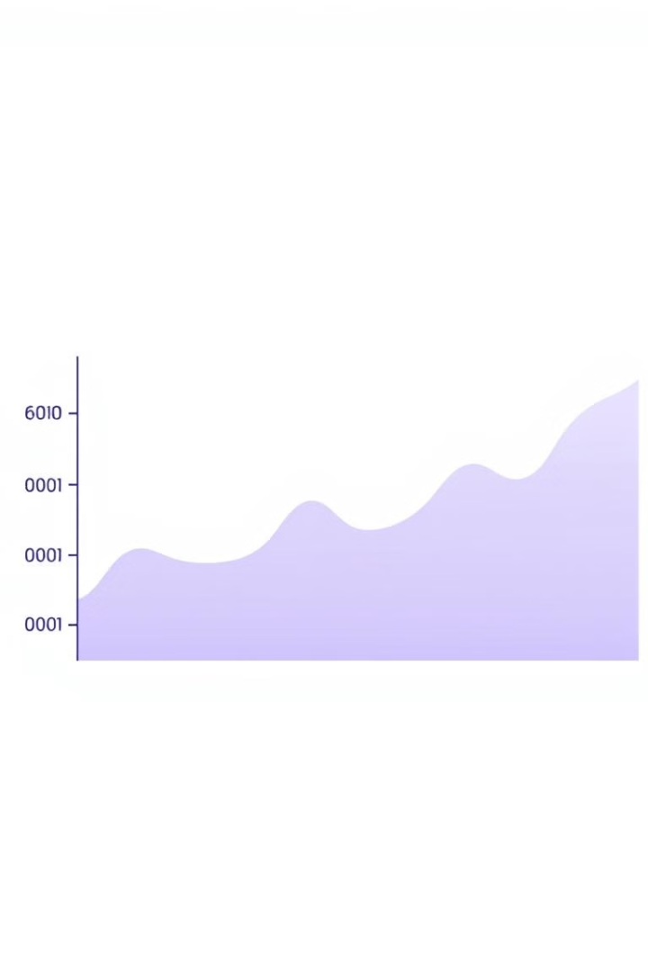
Evaluating Paraphrasing Quality: BLEU Score
BLEU score, a metric for evaluating the quality of paraphrases, measures the similarity between the original and paraphrased sentences. A higher BLEU score indicates better semantic retention and context awareness.

Slide 7
Benchmarking LSTM and RNN
0.838
0.107
LSTM
RNN
Outperforms the simple RNN, demonstrating the importance of capturing context.
Struggles to handle longer sequences due to the vanishing gradient problem, resulting in lower BLEU scores.

Slide 8
Augmented Datasets: Boosting Downstream Task Performance
Augmented datasets, generated using context-aware paraphrasing methods like LSTM, significantly enhance the performance of downstream NLP tasks, such as sentiment analysis.

Slide 9
Comparing Model Strengths and Weaknesses
LSTM
RNN
Effective for capturing context than RNN
Simplest model, but struggles with long sequences and context understanding.

Slide 10
The Importance of Context-Aware Augmentation
Context-aware augmentation provides high-quality variations of existing data, improving model generalization and reducing overfitting. This is crucial for modern NLP architectures to achieve optimal performance.

Slide 11
Conclusion:
This project highlighted the significant impact of contextual text augmentation in enhancing NLP performance. The LSTM takes the sequence of word embeddings as input and processes the words in order, updating its internal state (memory cell) as it goes through each word. After processing the entire sequence, the final hidden state or output is used to make a prediction.Future work can explore the application of text augmentation to other NLP tasks like machine translation and text summarization, utilizing advanced models like BERT, GPT and T5.

Slide 12


