Slide 1
Quantification of Resistance and Bandwidth-Correlated Noise in Linear Electronic
Components

Slide 2
Overview
Noise as fundamental material characteristic
Measurement of small signals
What correlations can we see?
Analysis & Code
[4-8]
[9-12]
[13-14]
[15-22]

Slide 3
Statistical Mechanics and Noise

Slide 4
How do we get specific about noise?
What generates noise?
What does the noise look like?
What changes the noise?

Slide 5
What generates (signal) noise
Current IS charge carrier motion (this was somewhat novel in Johnson’s time)
Electrons exhibit some brownian motion at nonzero temperature (Johnson, 1927)
Charge has discrete arrival times when traversing a gap (Shot, 1918)
Charge carrier motion depends heavily on lattice and circuit structure (Other)

Slide 6
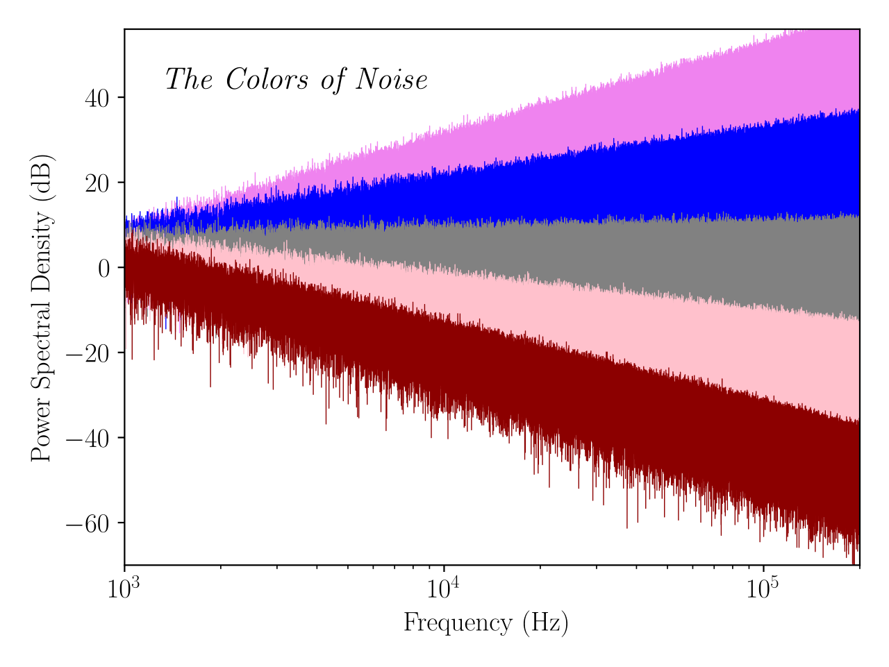
What Trends does the Noise Have?
Wikipedia contributors, "Colors of noise," Wikipedia, The Free Encyclopedia, https://en.wikipedia.org/w/index.php?title=Colors_of_noise&oldid=1284735612 (accessed April 13, 2025).

Slide 7
What Changes the Noise?
Early vacuum tube technicians realized that there was some noise in their devices
Changes with:
  Resistance
  Frequency (Nyquist)
Very, very small in magnitude...

Slide 8
Measuring Small Signals Precisely

Slide 9
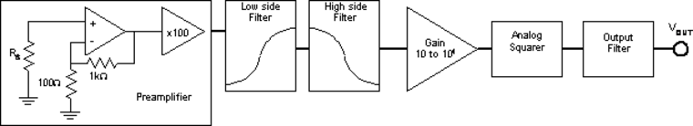
Design Goals
Huge amplification (gain of 600-100k)
Bandwidth Filtering
Separation of noise from our circuitry from the noise we want to measure
TeachSpin, Inc., Noise Fundamentals, TeachSpin, Inc., Buffalo, NY (2010).

Slide 10
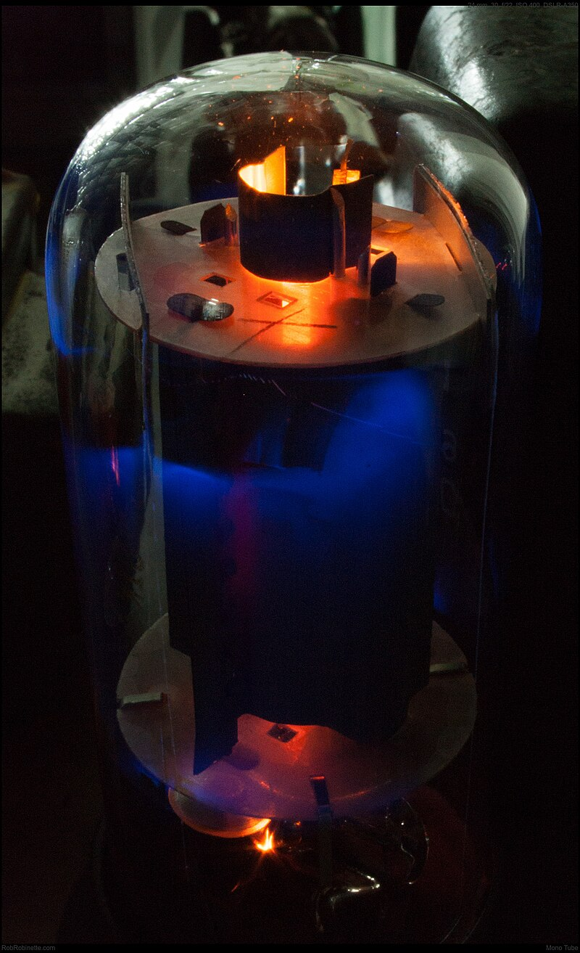
Gain
Johnson originally used vacuum tube amplifiers
We get to cheat: we have semiconductors!
Wikipedia contributors, "Valve amplifier," Wikipedia, The Free Encyclopedia, https://en.wikipedia.org/w/index.php?title=Valve_amplifier&oldid=1281498814 (accessed April 13, 2025).

Slide 11
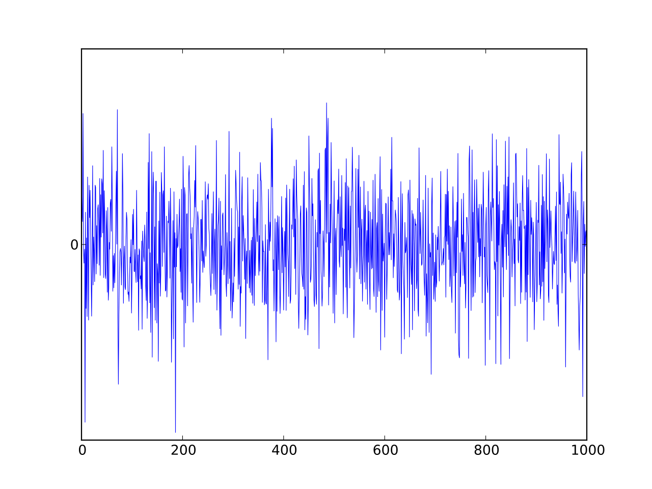
Johnson vs Amplifier Noise
We seem to be at an impasse: if Johnson noise is so small, how can we possibly measure it instead of the amplifier noise?
It’s impossible to separate the terms by default, but something interesting happens when we square our signal.
Because both amplifier and Johnson noise is white, when we time average, the cross term vanishes.
  If we suspect Johnson noise is proportional to frequency or resistance, we can extrapolate to when there is no resistance to isolate amplifier noise!
The gain itself is also a function of frequency, making computation of Johnson noise nontrivial.
Wikipedia contributors, "White noise," Wikipedia, The Free Encyclopedia, https://en.wikipedia.org/w/index.php?title=White_noise&oldid=1263396178 (accessed April 13, 2025).

Slide 12
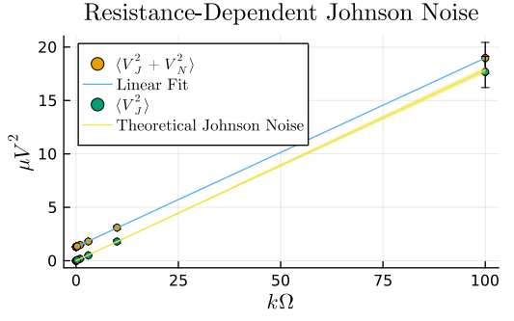
Removal of Amplifier Noise, and Resistivity Dependence
That looks pretty linear!
(On a squared axis)

Slide 13
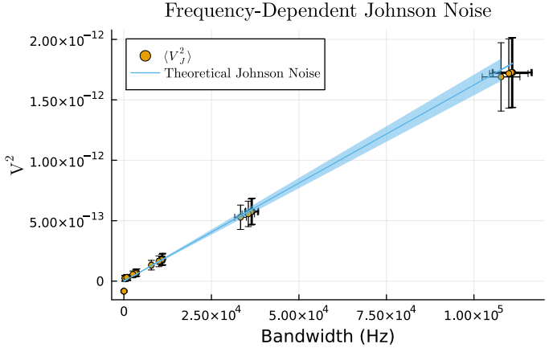
Removal of Amplifier Noise, and Resistivity Dependence
That ALSO looks pretty linear!
(on a squared axis)

Slide 14
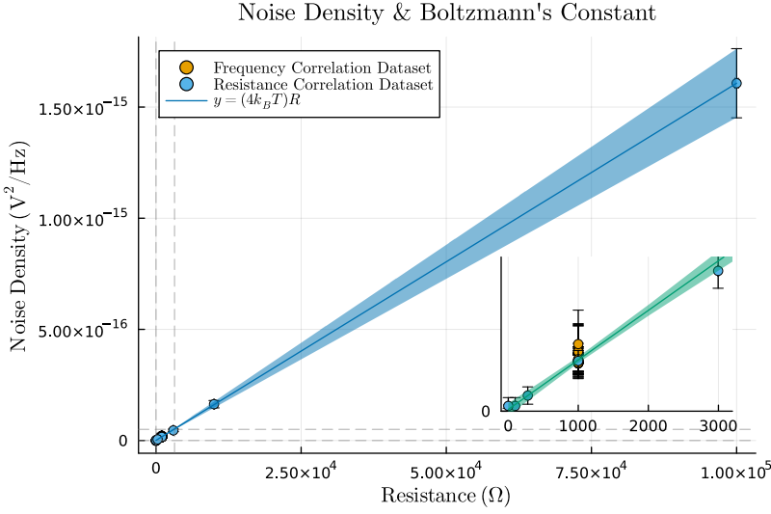
What is the Trend here?
Since we have something proportional to two values, we can plot a “density” from which we can measure kB!

Slide 15
Data Analysis Made Easy

Slide 16
What’s to talk about
Python/Julia
Thinking in terms of stability and correctness above all!
  This also saves us some time, often!
Some very useful libraries to us as researchers

Slide 17
The tools: Python and Julia
Python is by now solidified into the foundations of science anywhere. It’s a necessary skill!
Julia is a modern tool, everything you could want from python and more!
  There’s nothing wrong with liking one over the other, but there are some seriously powerful things you can do with Julia...

Slide 18
Thinking like a Programmer
Stability and assurances are desirable
  Software developers have whole languages like the Rust or Zig, need to ensure expensive machines never break down, or maximize server uptime (often >99.9%), even make sure code runs on any computer
Can we do the same as scientists?
  Yes!

Slide 19
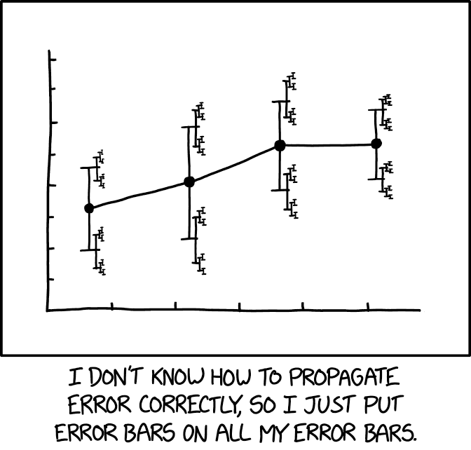
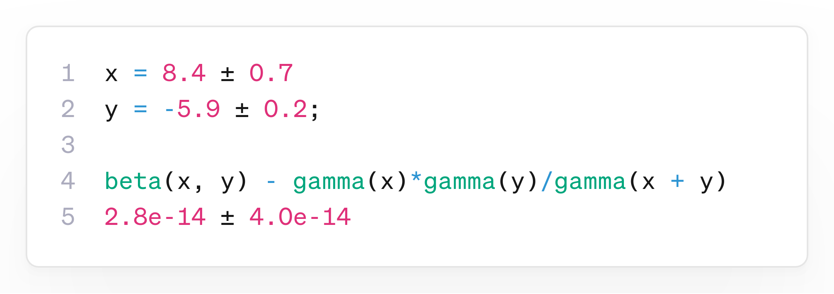
Native Uncertainty!
Automatic correlation tracking
  We don’t even do this ourselves!
It is impossible to make a mistake.
“mcerp” in Python or “Measurements.jl” in Julia!
  Works with nearly any function, even the odd ones (or in the case of Julia, even when calling code from other languages)
Image credit: "xkcd" (CC-BY-NC 2.5)

Slide 20
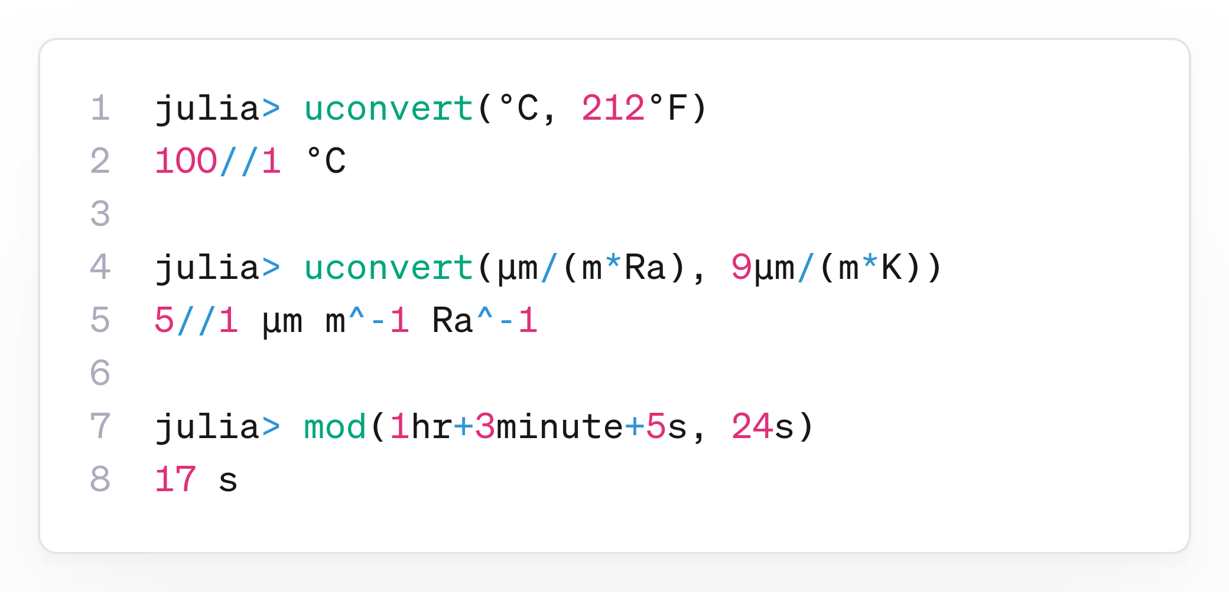
Native Units!
Science is a great big collaborative effort, and things should make sense no matter who is looking at your work.
  If I open code from months or years past, how will I know if the units are right if I can’t even know what the units are?
Checking units as you work is very good practice.
It is impossible to make a mistake.
“Pint” in Python and “Unitful.jl” in Julia.

Slide 21
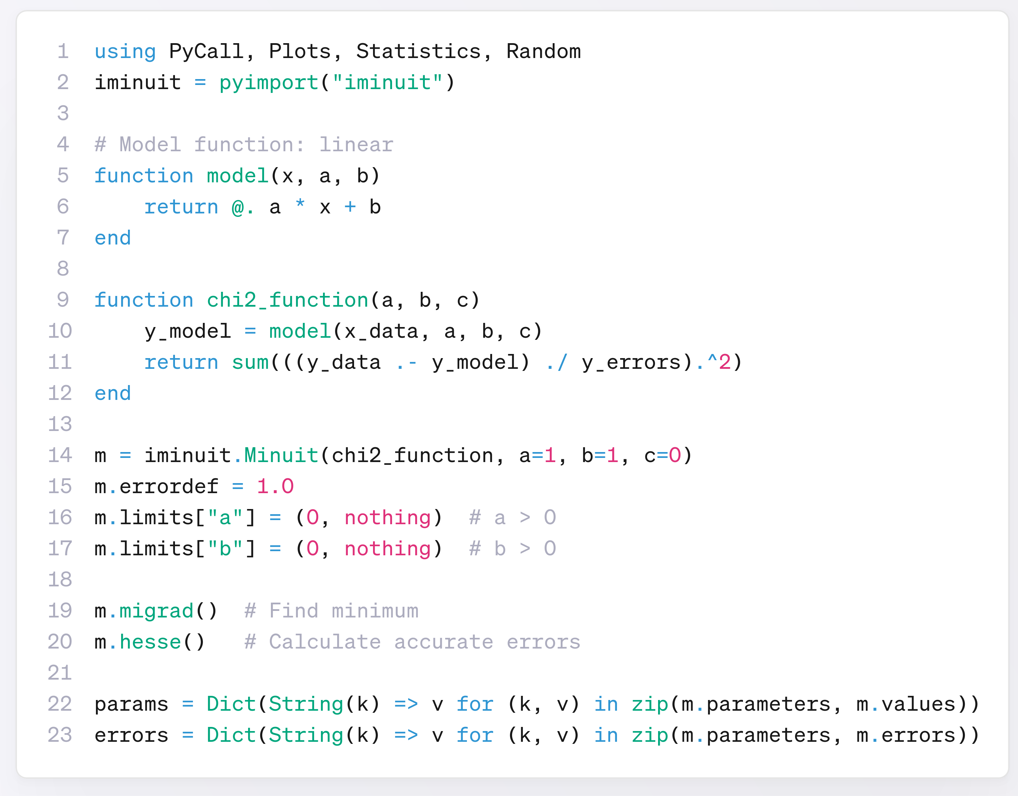
Use packages from Python, R, C/Fortran, C++, and Java
← Fitting with a python library, natively in Julia.

Slide 22
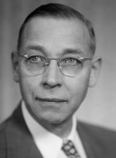


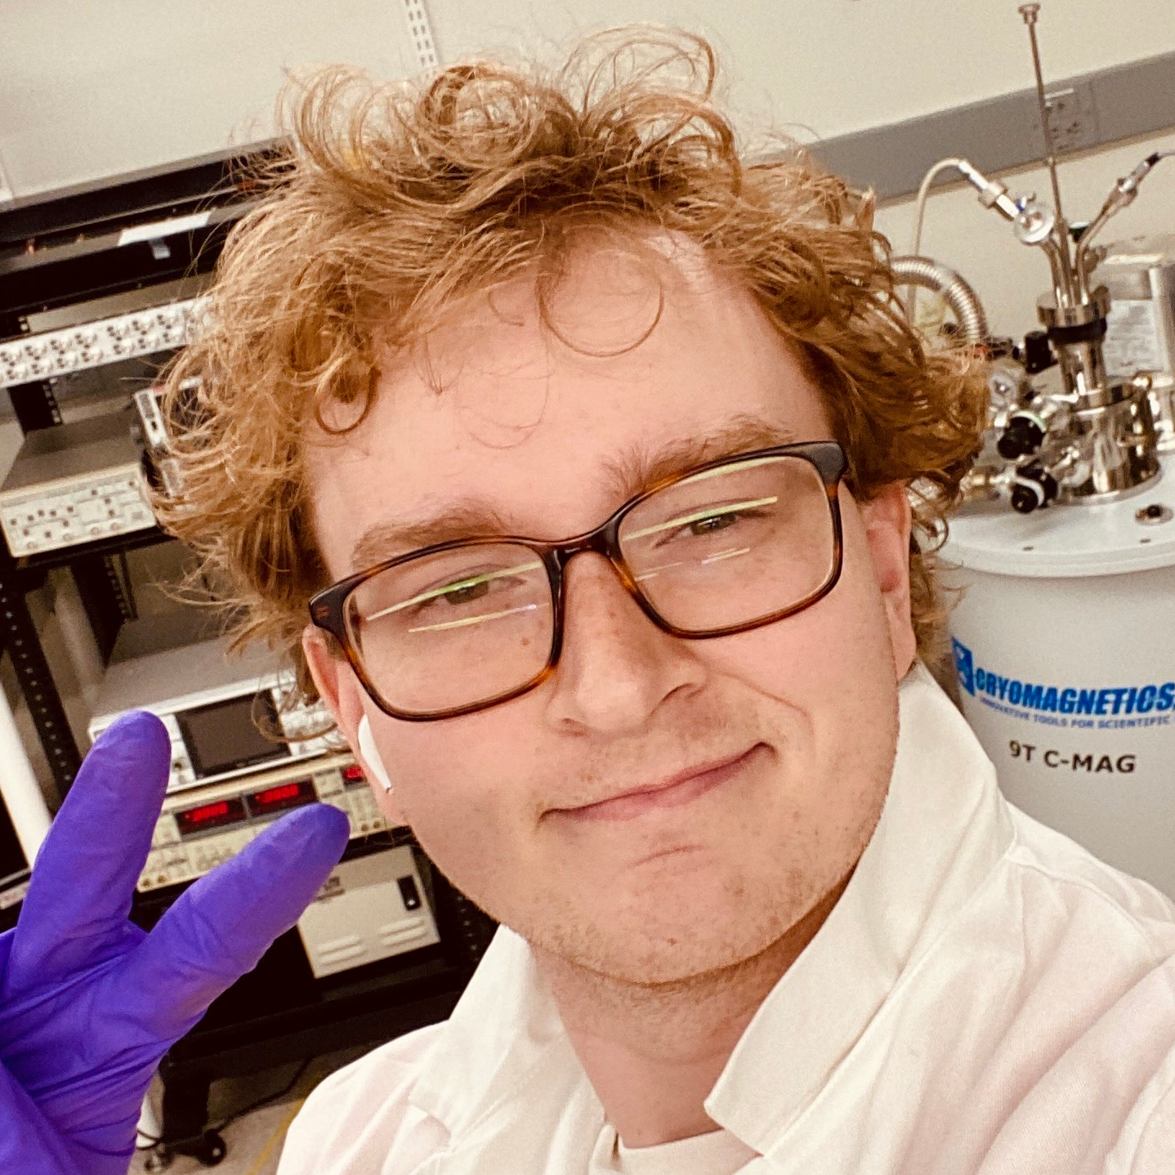
Special Thanks!
Saggars Research Group
Collaborators

