Slide 1

K-means vs DBSCAN UCI Wholesale Customers Dataset
Wholesale Customers Clustering Analysis
Group two Members.
Kato Joseph Bwanika Reg:2023-B291-11709
Kayooro P. Paul. Reg:2023-B291-13203
Ssenkaayi Vianney Reg:2023-B291-11360
Kutosi Mark Reg:2023-B291-11708
Lubangakene Jonathan Reg:2023-B291-13195

Slide 2
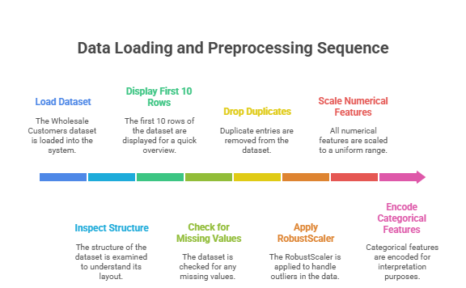
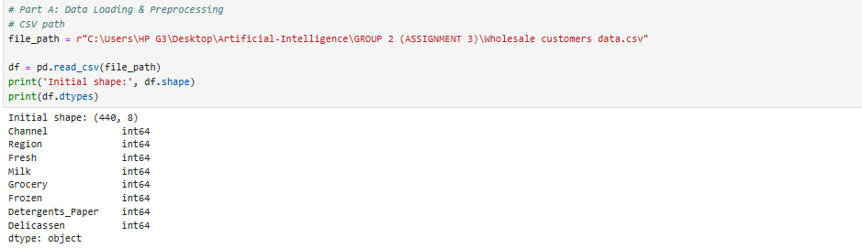
Data Loading & Preprocessing
In this section, we loaded the Wholesale Customers dataset and inspected its structure.
We displayed the first 10 rows to understand the data, checked for missing values, and dropped duplicates.
After that, we applied RobustScaler to handle outliers and scaled all numerical features.
Notes:
Channel and Region were encoded only for interpretation, not for distance calculation.
This ensured the dataset was ready for clustering analysis.

Slide 3
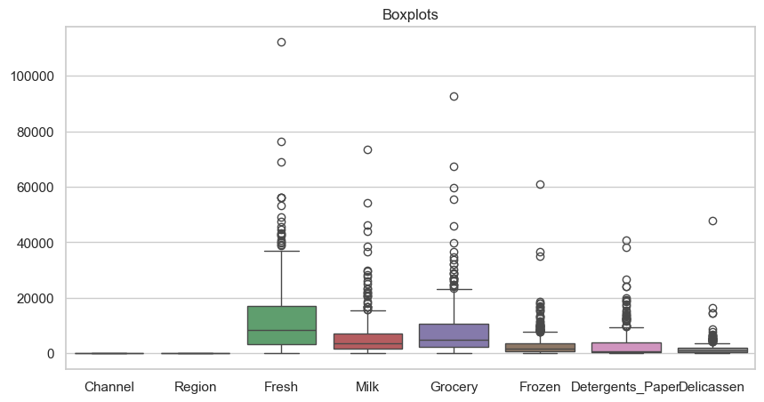
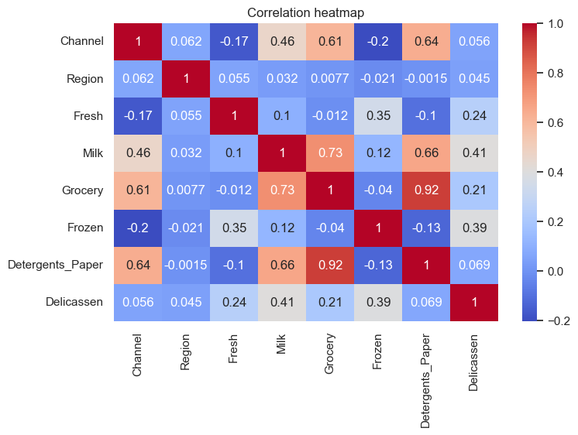
Exploratory Data Analysis (EDA)
The goal here was to explore patterns in the spending categories. We generated summary statistics, boxplots, and histograms to check for skewness and identify outliers.
Log transformation was applied to normalize highly skewed data.
We then visualized a correlation heatmap to examine relationships between variables like Milk, Grocery, and Detergents_Paper, which showed strong co-purchasing patterns per category.
The correlation heatmap highlights co-purchasing relationships among variables.
Notes:
Skewness is a measure of the asymmetry of a distribution. A distribution is asymmetrical when its left and right side are not mirror images.
A distribution can have right (or positive), left (or negative), or zero skewness.

Slide 4

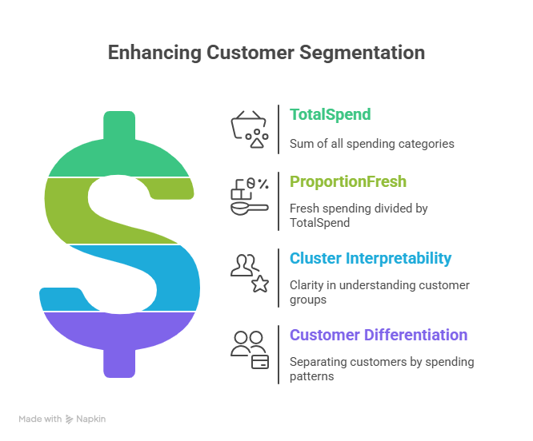
Feature Engineering & Aggregation
To improve the clustering model, we created additional features: TotalSpend (sum of all categories) and ProportionFresh (Fresh divided by TotalSpend).
These derived features capture overall and relative spending behavior, helping to distinguish heavy spenders from occasional buyers.
We justified their inclusion since they improve cluster interpretability and separate customers based on total expenditure patterns.
Notes:
Total Spend: Add up all categories to get total money spent by each customer.
Proportion Fresh: How much of their total spending goes to fresh food.
Log Total Spend: The log (smoothed version) of the total spend.
Goal: Make your dataset more useful and more meaningful for clustering.

Slide 5
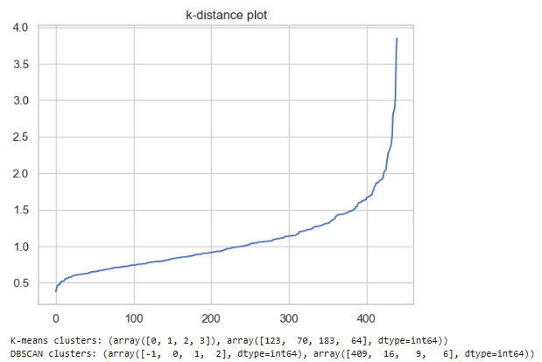
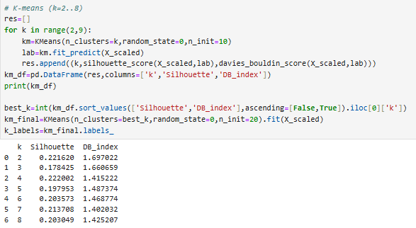
Clustering Modelling & Parameter Selection
We implemented both K-means and DBSCAN.
For K-means, values of k ranging from 2 to 8 were tested, and silhouette scores were used to find the optimal number of clusters. The elbow method supported this selection.
For DBSCAN, we used a k-distance plot to select eps (radius) and min_samples. Multiple combinations were tested to balance the number of clusters and noise points. A comparison was made between K-means and DBSCAN results.
Silhouette plot showing K-means performance and K-distance curve used to determine DBSCAN parameters.

Slide 6
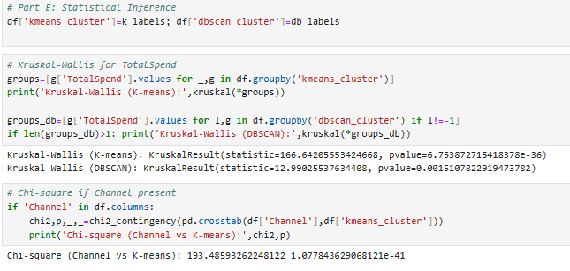
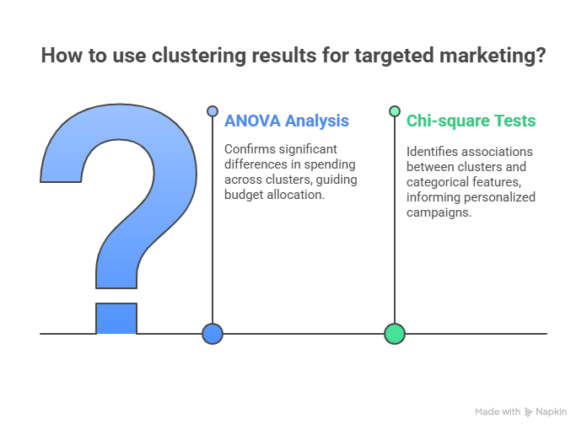
Second EDA & Statistical Inference
After clustering, we analyzed the resulting cluster centroids from K-means and DBSCAN.
We compared them using ANOVA (Kruskal–Wallis test) to test if Total Spend significantly differed across clusters.
Chi-square tests were used to check associations between clusters and categorical features like Region and Channel.
Added cluster labels from K-Means and DBSCAN to the dataset.
Applied Kruskal–Wallis test to check if Total Spend varies significantly across clusters.
Obtained low p-values (< 0.05) — showing clusters differ in spending behavior.
Used Chi-square test to examine the relationship between Channel and K-Means clusters.
Found a strong association, confirming that the clusters are statistically meaningful and distinct.

Slide 7
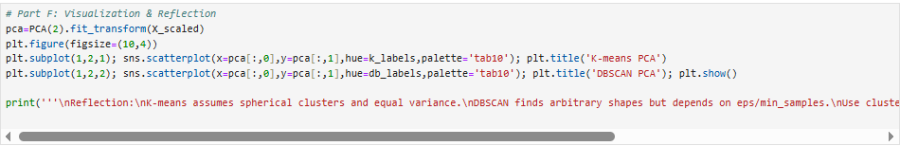
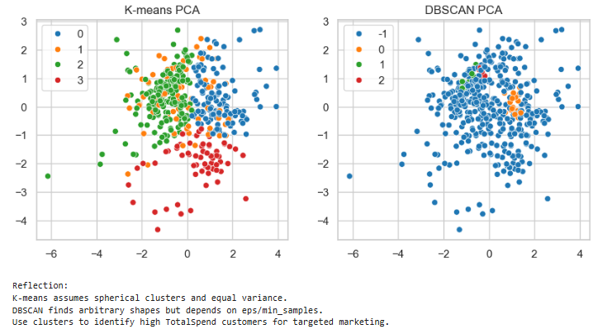
Visualization & Reflection
Using PCA (Principal Component Analysis), we reduced the dataset to two components and visualized the clusters. DBSCAN's noise points were marked distinctly.
We observed that K-means produced compact spherical clusters, while DBSCAN identified irregular clusters and outliers.
In reflection, DBSCAN was more flexible but sensitive to eps and min_samples, whereas K-means worked better for balanced, dense groups.
Insights from both algorithms can guide targeted marketing and segmentation strategies.

Slide 8
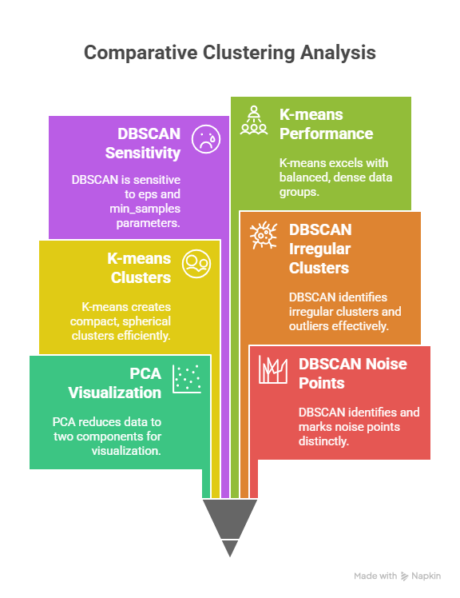
Conclusion and Recommendations
Both algorithms provided useful insights.
K-means gave clear and interpretable clusters, while DBSCAN helped uncover hidden patterns and outliers.
The analysis revealed three main customer segments based on spending behavior: bulk buyers, mixed-category spenders, and low-volume customers.
Recommendations:
1. Use K-means for general segmentation in structured datasets.
2. Apply DBSCAN when expecting irregular, noise-prone patterns.
3. Develop marketing strategies based on cluster characteristics to improve customer retention and sales.

