Slide 1

Text Sentiment Classification with RNN/LSTM (IMDB Dataset)
Group two Members.
Kato Joseph Bwanika Reg:2023-B291-11709
Mambo Emmanuel Reg:2022-B291-11357
Ssenkaayi Vihan Reg:2023-B291-11360
Kutosi Mark Reg:2023-B291-11708
Lubangakene Jonathan Reg:2023-B291-13195

Slide 2
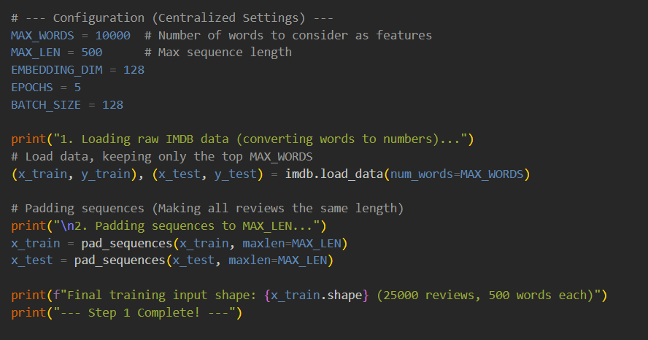
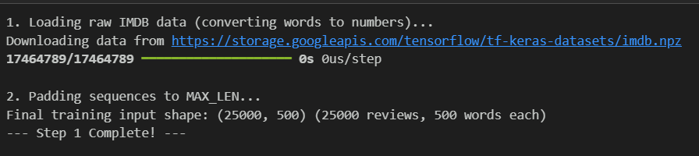
Loading and preprocessing IMDB dataset
Data Loading and Preprocessing
The IMDB dataset has 50,000 movie reviews (25,000 for training and 25,000 for testing).
Each review is already turned into a list of numbers representing words.
The model learns to decide if a review is positive (1) or negative (0).
Since RNNs need inputs of the same length, short reviews are padded with zeros and long ones are cut (truncated) to match the required size.

Slide 3
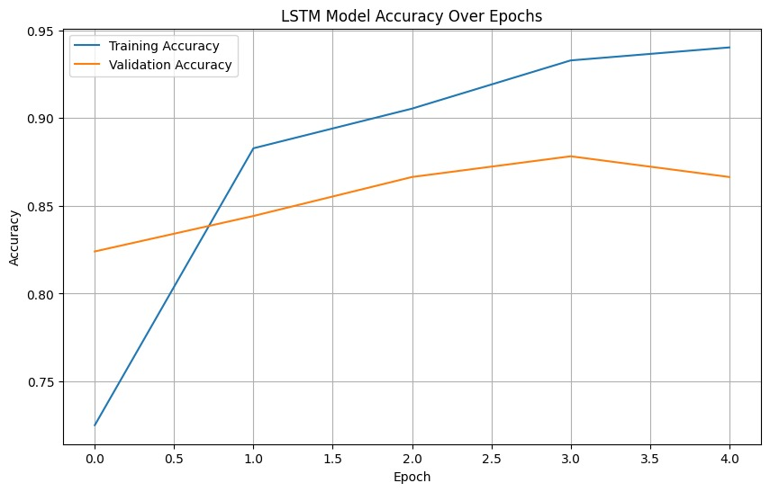
LSTM model for binary sentiment
Embedding Layer:
This first layer converts each word-number into a dense vector of 128 numbers. Think of this as turning a simple code like 5 into a richer, detailed profile that captures the word's meaning.
LSTM Layer: (Long Short-Term Memory)
Is a special kind of sequence processor. It is good at remembering context over long pieces of text. It reads the 500-word review and summarizes the overall sentiment.
Dense Layer (Output):
This takes the summary and outputs a number between 0 and 1. 1 means it's positive, and 0 means its negative.

Slide 4
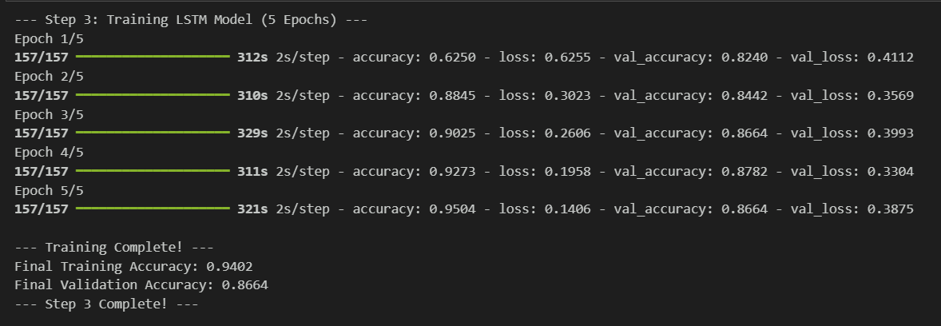
Plot training/validation accuracy
Training (The Learning Process):
This is where the model reads the reviews and tries to guess the sentiment 0 or 1. If it guesses wrong, it adjusts its internal settings (its weights/parameters) to improve its next guess.
Epochs: We set the model to train for 5 epochs. One epoch means the model reads and learns from the entire training dataset once.
Validation Split: We use 20% of our 25,000 training reviews as a validation set. The model doesn't learn from this 20%; it just guesses on them after each epoch. This helps us monitor if the model is overfitting

Slide 5
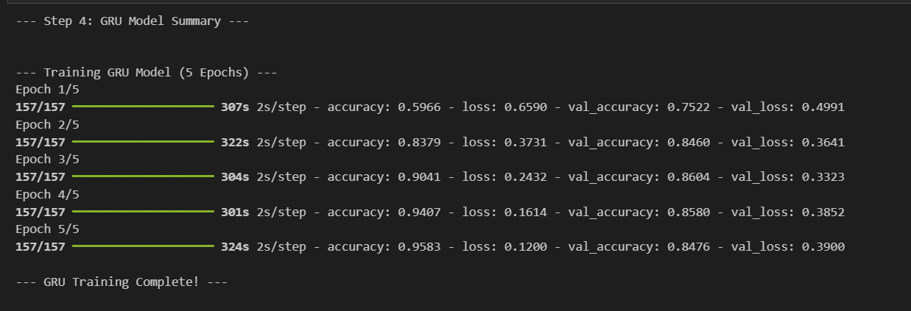
Comparison with a GRU-based model
Comparison: We are comparing the performance of the LSTM model with a GRU model. Both are types of advanced Recurrent Neural Networks (RNNs).
GRU (Gated Recurrent Unit): This is a simpler version of the LSTM. It has fewer parameters because it uses only two internal gates instead of three.
GRU is marginally higher on the data it trained on, but this doesn't translate to better performance on unseen data.
Minimal difference. In practice, the expected speed advantage of GRU is not significant for this dataset size and model architecture.
The GRU model overfits slightly more (larger gap between training and validation accuracy).

Slide 6
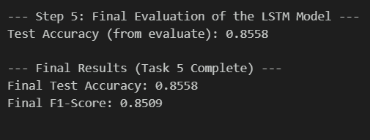
Evaluation on test set
Accuracy:
The LSTM model performed slightly better on the unseen validation data, suggesting its more complex architecture (with the additional gate) was better at generalizing the long-term dependencies in the reviews.
Model Complexity (Parameters):
The GRU model is less complex (fewer trainable parameters) than the LSTM model. This is the main theoretical difference, as the GRU uses 2 gates while the LSTM uses 3.
Training Speed:
Both models took approximately the same time but GRU proved to be faster
The high F1-score shows a strong balance between the model's Precision (avoiding false positives) and Recall (finding all true positives).

Slide 7
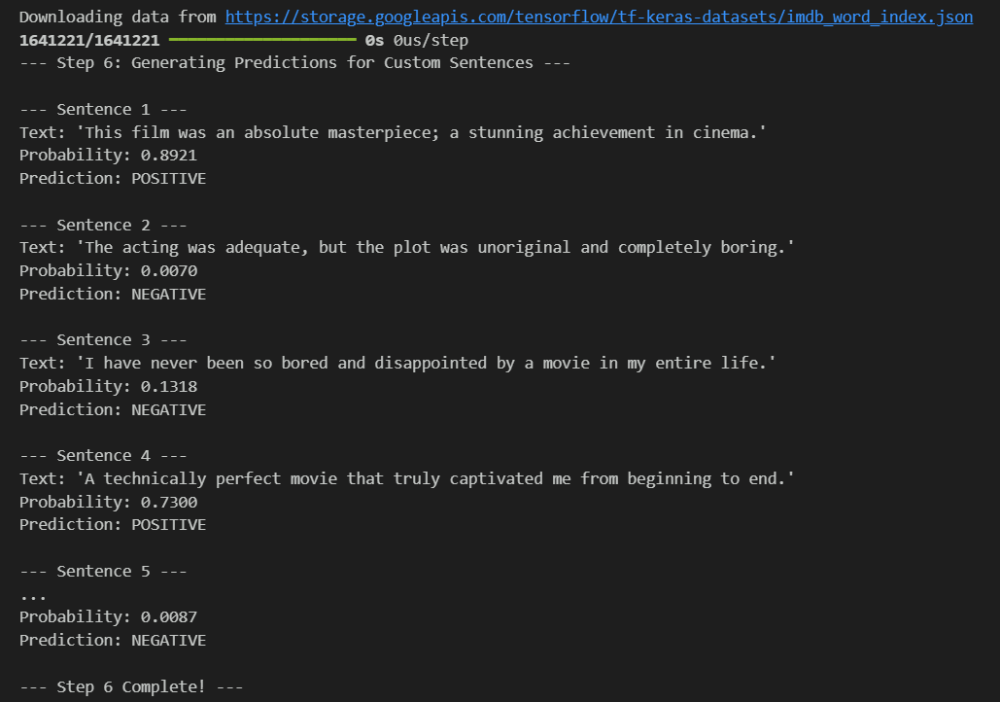
Predictions for custom sentences and output
if prediction_proba > 0.5:
sentiment = "POSITIVE"
else:
sentiment = "NEGATIVE"
The final evaluation on the test set showed that the LSTM model slightly outperformed the GRU in capturing long-term dependencies in movie reviews.
It achieved a high F1-score, reflecting a good balance between Precision and Recall.
Sentiment classification is determined from the output probability of the final Dense layer, with reviews labeled "POSITIVE" if the probability exceeds 0.5, and "NEGATIVE" otherwise.

Slide 8
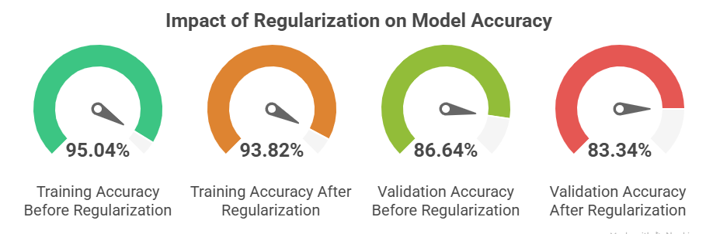
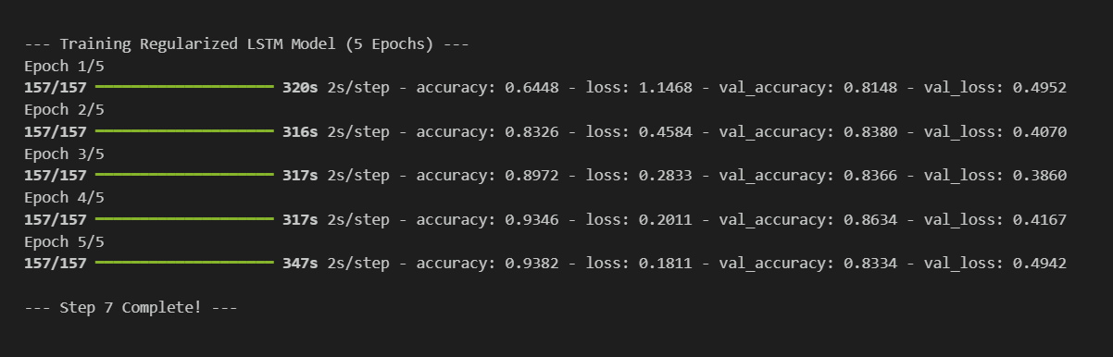
Dropout and regularization
Dropout: Randomly turns off some neurons during training to stop the model from relying too much on specific features and reduce overfitting.
Recurrent Regularization (L2): Adds a small penalty to large weights inside the LSTM/GRU to make the model learn simpler, more general patterns.
Training Accuracy: Dropped slightly from 95.04% to 93.82%, which is expected since regularization slows learning to prevent memorization.
Validation Accuracy: Fell from 86.64% to 83.34%, meaning the regularization was too strong and caused underfitting. The model struggled to generalize well to new data.

Slide 9
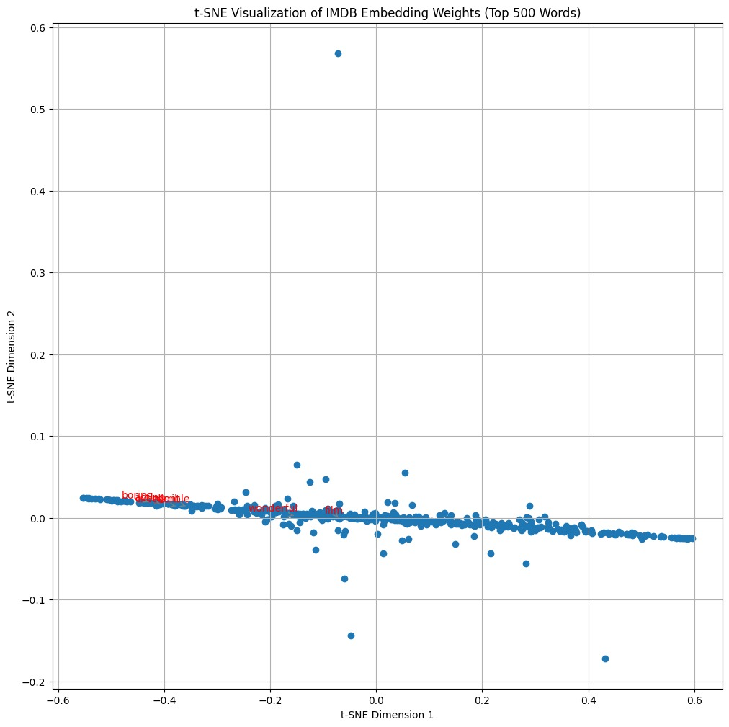
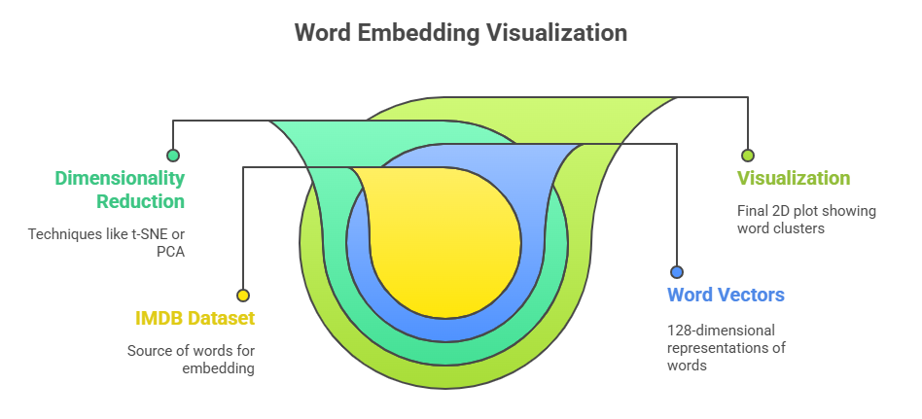
Embedding weights using t-SNE or PCA
Word Embedding Visualization (t-SNE)
We used t-SNE to reduce 500 common word vectors from 128 dimensions to 2 for easy viewing.
The plot shows that similar words are grouped together.
Words with the same feeling, like “terrible” and “boring”, appear close to each other.
This means the model understands word meanings and emotions, which helps it predict sentiment correctly.

Slide 10
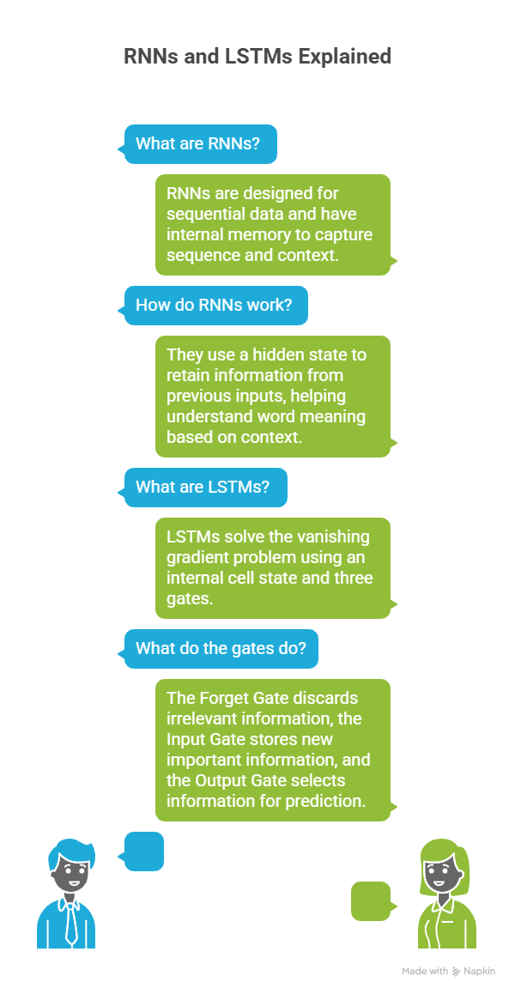
Final report
Recurrent Neural Networks (RNNs) and LSTMs
RNNs are designed for sequential data (e.g., movie reviews) because they have internal memory that captures sequence and context.
They use a hidden state to retain information from previous inputs, helping the model understand word meaning based on context.
LSTMs (Long Short-Term Memory networks) solve the vanishing gradient problem using an internal cell state and three gates:
  Forget Gate – discards irrelevant information
  Input Gate – stores new important information
  Output Gate – selects information for prediction
These gates allow LSTMs to maintain key information across long sequences, making them effective for tasks like sentiment analysis and understanding long-term dependencies.

Slide 11
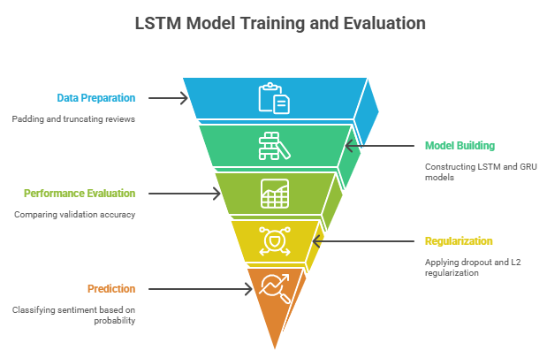
Conclusion
This project trained LSTM and GRU models to classify IMDB movie reviews as positive or negative.
The LSTM model performed slightly better because it captures long-term context. t-SNE visualization showed that similar emotional words clustered together, proving the model learned meaningful patterns.
Dropout and L2 regularization reduced overfitting but slightly lowered validation accuracy. Reviews with a prediction above 0.5 were classified as positive.

