Slide 1
VIDEO GAMES
SALES

Slide 2
AGENDA
Dataset
source
Fields include
Data problems and how they were solved
Analyze data and answer questions
Who are the top five publishers with overall sales of copies?
What are the top five games that got the most copies sales overall?
What are the top five genres that have garnered copy sales in general?
preprocessing for modeling
which data will drop
change text to numbers
Modeling
linear regression
Random Forest Regression
Decision Tree Regression

Slide 3


Dataset
source
Fields include
Data problems and how they were solved

Slide 4
source
Video games sales from Kaggle
link: https://www.kaggle.com/gregorut/videogamesales

Slide 5
Fields include
• Rank - Ranking of overall sales
• Name - The games name
• Platform - Platform of the games release (i.e. PC,PS4, etc.)
• Year - Year of the game's release
• Genre - Genre of the game
• Publisher - Publisher of the game
• NA_Sales - Sales in North America (in millions)
• EU_Sales - Sales in Europe (in millions)
• JP_Sales - Sales in Japan (in millions)
• Other_Sales - Sales in the rest of the world (in millions)
• Global_Sales - Total worldwide sales.

Slide 6
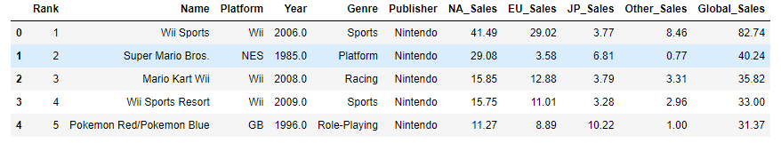
Fields include

Slide 7
Data problems and how they were solved
Fill in the blanks in the Publisher column with the word No Publisher
Fill in the blanks in the Year column using the mean

Slide 8
02
Analyze data and answer questions

Slide 9
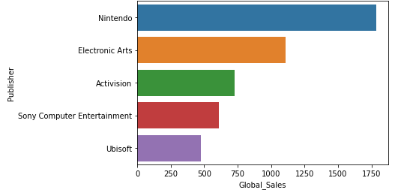
Which best five Publishers had received the copies sales overall?

Slide 10
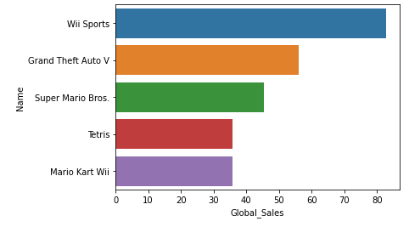
Which best five games had received the most copies sales overall?

Slide 11
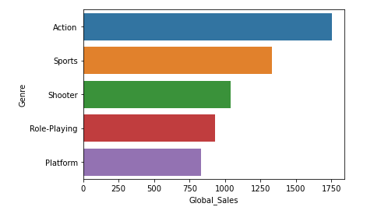
Which best five genres had received the copies sales overall?

Slide 12
03
preprocessing for modeling

Slide 13
which data will drop
Platform → 31 unique number
Name → Name = Rank
Publisher → 579 unique number

Slide 14
change text to numbers
Change Genre column to 12 different columns
Ever new column has name one of genre in Genre column

Slide 15
04
Modeling

Slide 16
linear regression
r2 socre is 0.9624691048355563
mean_sqrd_error is== 0.07807327488654686
root_mean_squared error of is== 0.2794159531711582

Slide 17
Random Forest Regression
Mean Absolute Error: 0.0034668674698795166
Mean Squared Error: 0.00468840361445783
Root Mean Squared Error: 0.06847191843710697

Slide 18
Decision Tree Regression
Mean Absolute Error: 0.004216867469879518
Mean Squared Error: 0.013855421686746987
Root Mean Squared Error: 0.11770905524532506

Slide 19
END
Any Question

