Slide 1

IMPLEMENTATION AND ANALYSIS
OF COAP-BASED
IOT COMMUNICATION SYSTEM

Slide 2
CONTENT
INTRODUCTION
PROBLEM STATEMENT
METHODOLOGY OVERVIEW
IMPLEMENTATION SETUP
RESULT
DISCUSSION
CONCLUSION

Slide 3
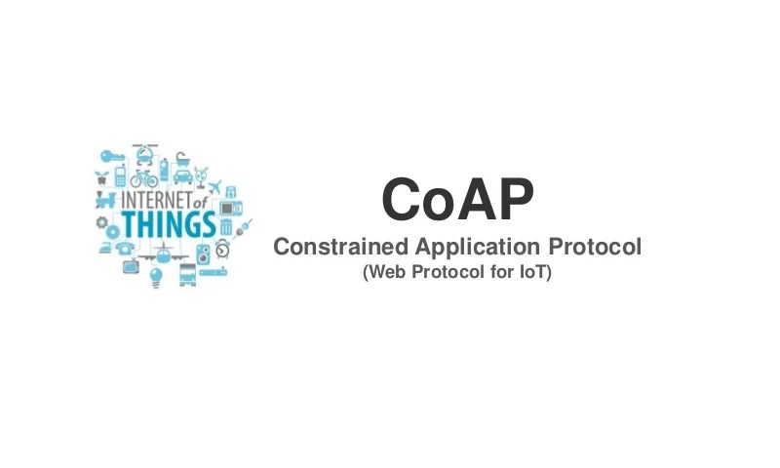
INTRODUCTION
The swift growth of the Internet of Things (IoT) has created a demand for communication protocols that are efficient, lightweight, and dependable for devices with limited resources. Conventional protocols such as HTTP and FTP are not suitable for IoT because of their excessive overhead and resource requirements.
CoAP (Constrained Application Protocol) was specifically developed to overcome these challenges, providing a low-power, UDP-based approach for IoT communication. Nevertheless, there are few practical studies that implement and evaluate CoAP beyond simulation environments.

Slide 4
PROBLEM STATEMENT
IoT devices typically function under limited network and hardware capabilities. Conventional client-server protocols fail to satisfy the requirements for low latency and minimal overhead in these devices.
The goal of this project is to assess how well CoAP performs in a realistic environment using Linux VM within a virtual framework. We intend to analyze CoAP's performance under various scenarios and evaluate the reliability and observability of the communication.

Slide 5
METHODOLOGY OVERVIEW
Employed virtual machines running Raspberry Pi OS.
Installed required libraries including txThings and Twisted.
Developed a Python-based CoAP server and client
Simulated communication and logged traffic using Wireshark.
Conducted observations and GET request evaluations.

Slide 6
IMPLEMENTATION SETUP
Software: Linux virtual system, AICOAP, WIRESHARK, TXTHINGS, TWISTED
Hardware: Minimum 2 CPU cores, 4GB RAM, 40GB disk space.
Steps:cg
CoAP server script created to handle requests on standard port 5683.
Deploy Mirai Botnet to simulate attacks.
Client configured to observe and retrieve resources (/.well-known/core, /time).
Localhost environment used to validate packet exchange
Wireshark utilized to trace message types (e.g., CON, ACK) and payloads.

Slide 7
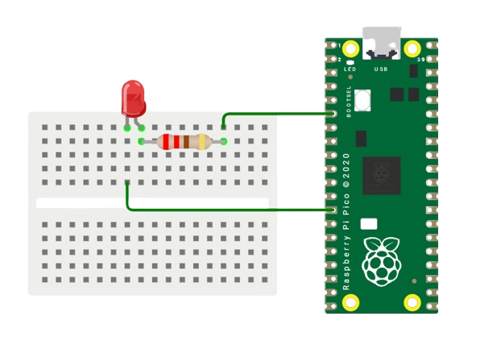
A SIMPLE RASPBERRY IOT SETUP

Slide 8
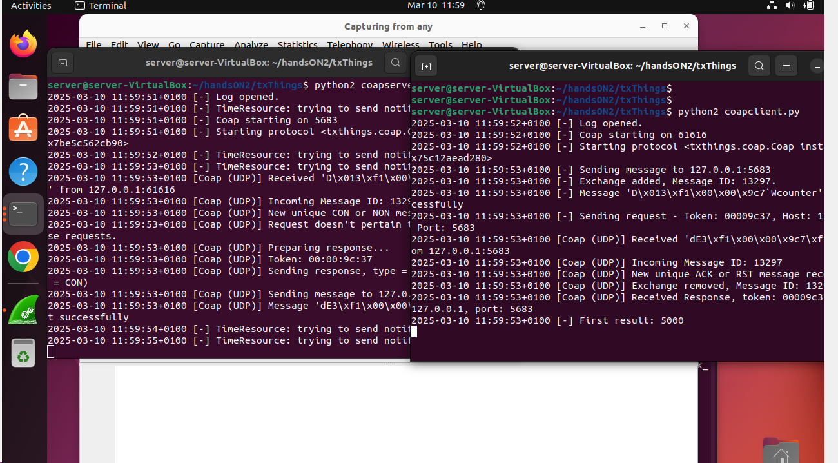
RESULTS (RUNNING SERVER AND CLIENT)

Slide 9
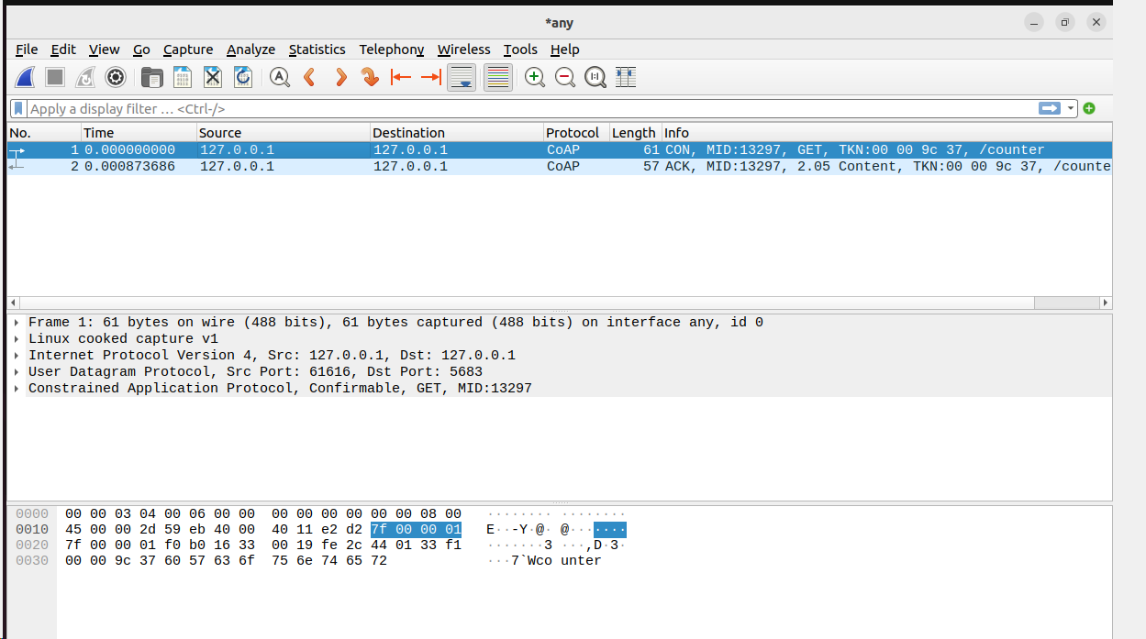
RESULT WIRESHARK ANALYSIS

Slide 10
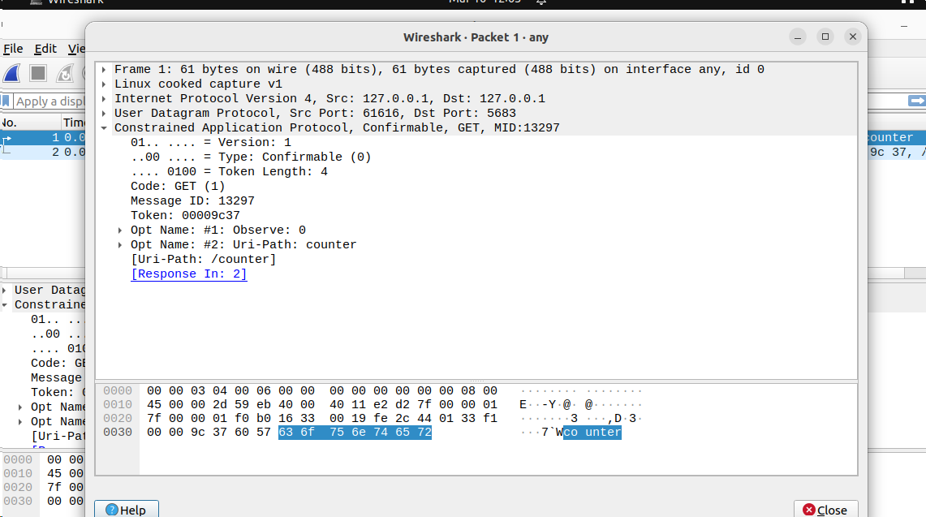
RESULT WIRESHARK ANALYSIS

Slide 11
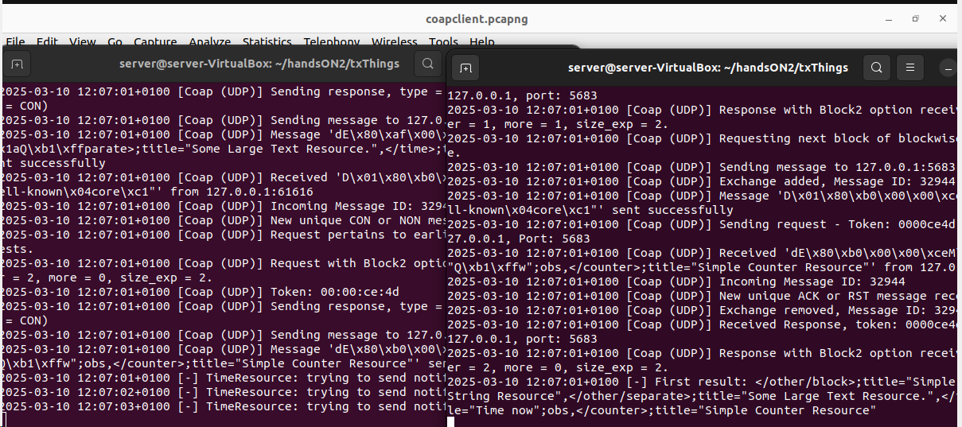
RESULTS (.well-known, core)

Slide 12
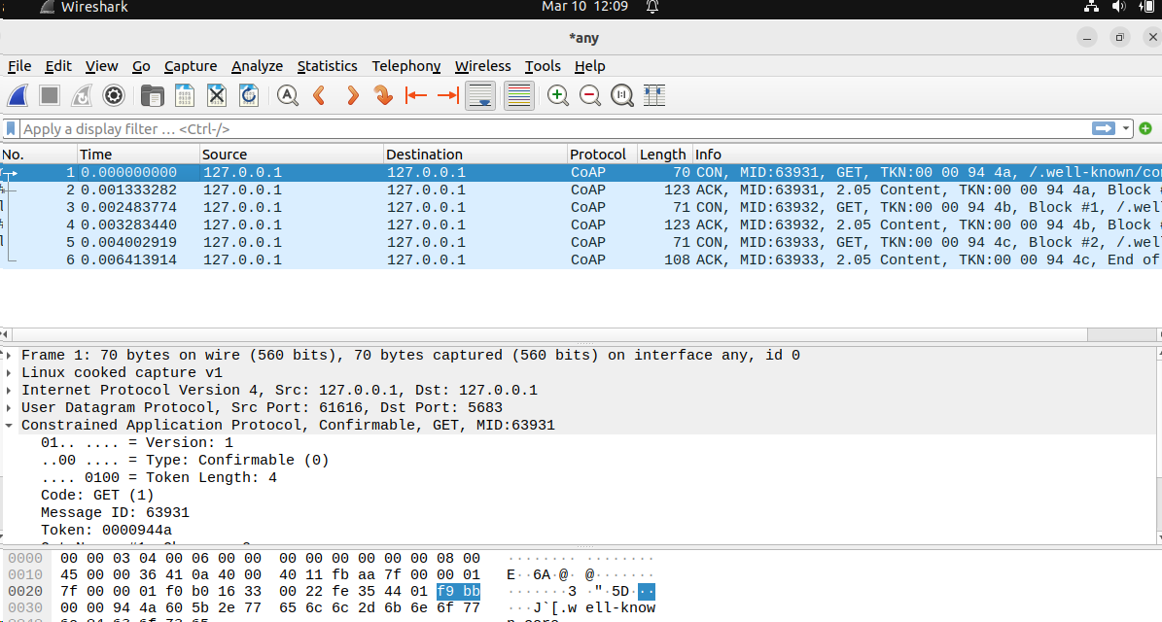
RESULTS (.well-known, core) wireshark Analysis

Slide 13
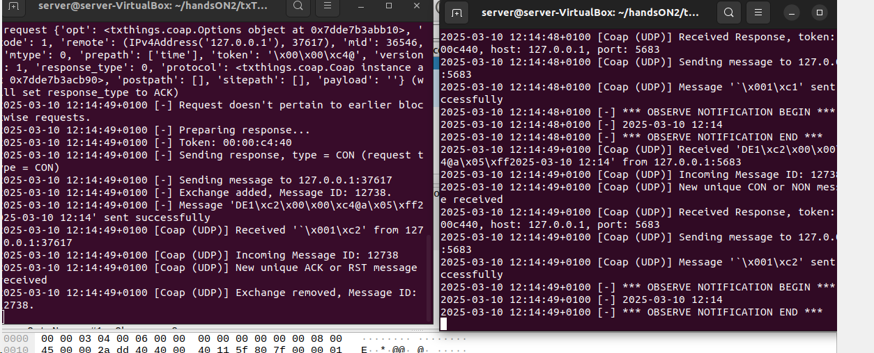

RESULTS – Analyze CoAP GET request/response for the counter resource in Wireshark
The captured traffic shows a CoAP (Constrained Application Protocol) exchange over localhost (127.0.0.1). A client sends a Confirmable (CON) GET request (MID: 36546) to retrieve the "/time" resource. The server acknowledges with an ACK and responds with 2.05 Content, returning the requested data. Some responses contain the text "time", suggesting a time-related payload. Additional empty ACK messages confirm successful receptions. The interaction indicates a working local CoAP setup, likely for IoT or application testing.

Slide 14
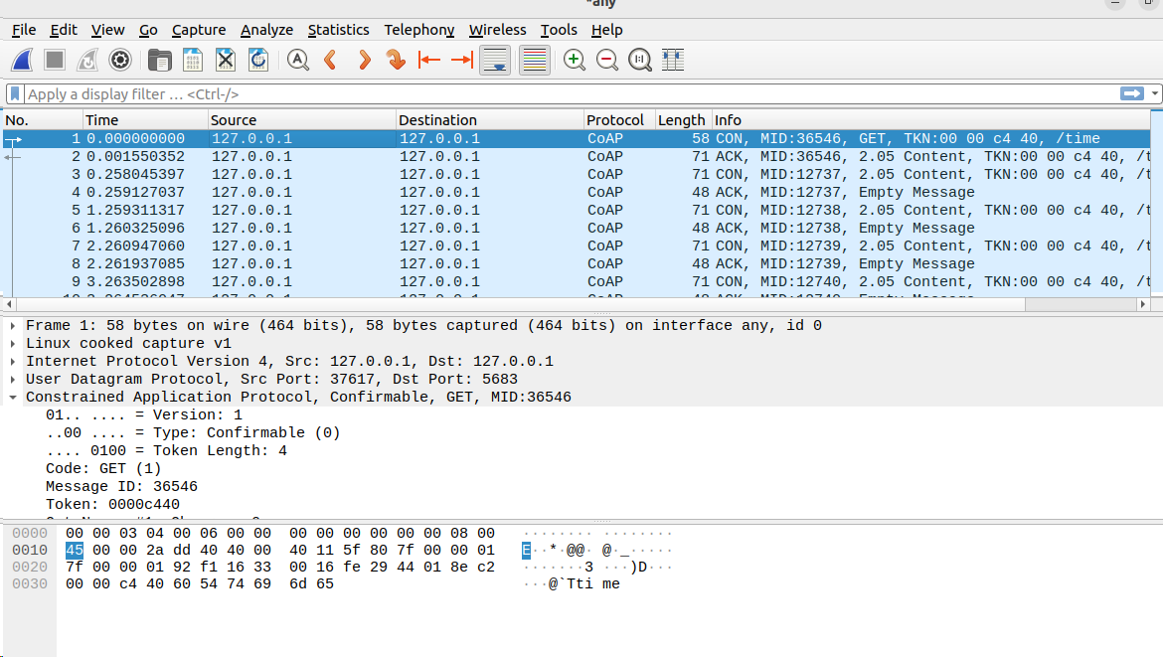
RESULTS – Analyze CoAP GET request/response for the counter resource in Wireshark

Slide 15
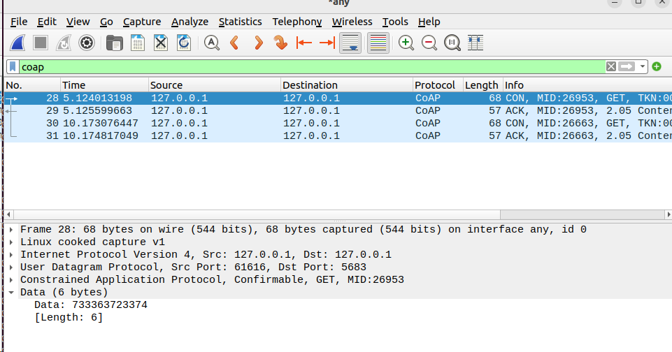
RESULTS Security Analysis Results
The implementation was validated through multiple test scenarios:
• Authorized Request: When the client sends the correct token (s3cr3t), the server responds with the current counter value, e.g., 5000.

Slide 16
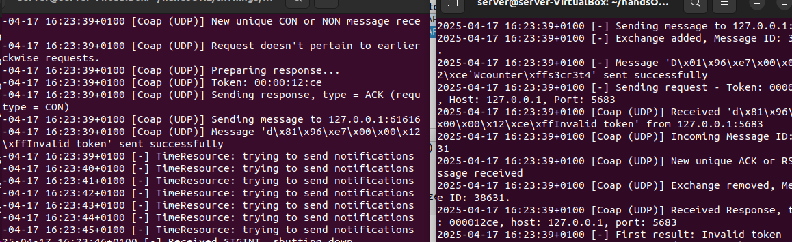
RESULTS Security Analysis Results
Unauthorized Request: If the token is missing or incorrect, the server replies with an error message indicating invalid token

Slide 17
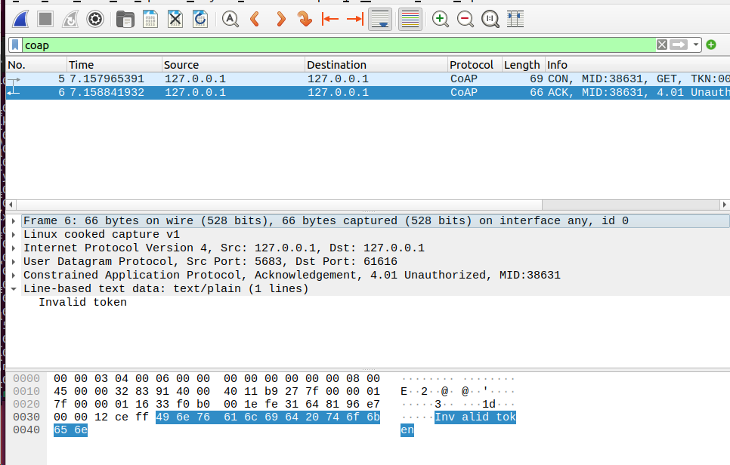
RESULTS Security Analysis Results
Traffic analysis using Wireshark confirmed that:
• The payload was transmitted in plaintext, visible within the UDP datagram.
• Message integrity was maintained, and the response codes matched the expected behavior.
• Unauthorized messages did not trigger state changes or processing on the server beyond token verification.

Slide 18
CONCLUSION
This project successfully implemented and evaluated a CoAP-based communication system optimized for IoT environments. The system demonstrated efficient resource observation, low-overhead message exchange, and reliable performance across both virtual and physical devices.
Network analysis confirmed proper CoAP behavior, including Confirmable requests and Acknowledgements. To enhance security, a lightweight token-based mechanism was integrated, allowing basic access control without compromising protocol efficiency.
Overall, the project reaffirmed CoAP’s suitability for constrained IoT applications, combining simplicity, responsiveness, and adaptable security in a practical deployment.

Slide 19
THANK
YOU

