Slide 1

IMPLEMENTATION AND ANALYSIS
OF COAP-BASED
IOT COMMUNICATION SYSTEM

Slide 2
CONTENT
INTRODUCTION
PROBLEM STATEMENT
METHODOLOGY OVERVIEW
IMPLEMENTATION SETUP
RESULT
DISCUSSION
CONCLUSION

Slide 3
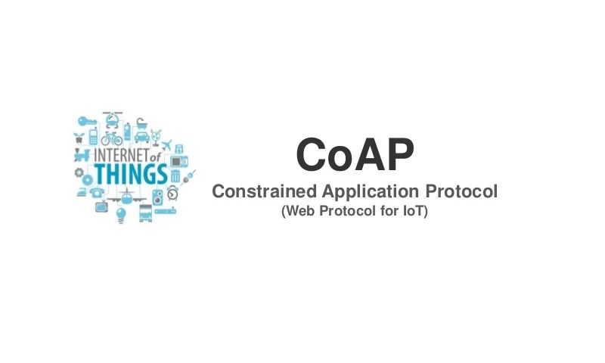
INTRODUCTION
The swift growth of the Internet of Things (IoT) has created a demand for communication protocols that are efficient, lightweight, and dependable for devices with limited resources. Conventional protocols such as HTTP and FTP are not suitable for IoT because of their excessive overhead and resource requirements.
CoAP (Constrained Application Protocol) was specifically developed to overcome these challenges, providing a low-power, UDP-based approach for IoT communication. Nevertheless, there are few practical studies that implement and evaluate CoAP beyond simulation environments.

Slide 4
PROBLEM STATEMENT
IoT devices typically function under limited network and hardware capabilities. Conventional client-server protocols fail to satisfy the requirements for low latency and minimal overhead in these devices.
The goal of this project is to assess how well CoAP performs in a realistic environment using Linux VM within a virtual framework. We intend to analyze CoAP's performance under various scenarios and evaluate the reliability and observability of the communication.

Slide 5
METHODOLOGY OVERVIEW
Employed virtual machines Linux OS.
Installed required libraries including txThings and Twisted.
Developed a Python-based CoAP server and client
Security Implementation
Simulated communication and logged traffic using Wireshark.
Conducted observations and GET request evaluations.

Slide 6
IMPLEMENTATION SETUP
Software Environment
Operating System: Linux (Virtual Machine)
Protocols & Libraries:
AI-CoAP – Lightweight CoAP implementation
txThings – CoAP library for Twisted (Python)
Twisted Framework – Asynchronous networking engine
Network Analysis Tool: Wireshark (for traffic inspection and protocol validation)

Slide 7
IMPLEMENTATION SETUP
Implementation Steps:
Server Deployment:
CoAP server script created to handle GET requests.
Runs on UDP port 5683 (standard CoAP port).
Supports multiple resources:
/counter, /.well-known/core, /time.
Client Configuration:
Python-based CoAP client configured to:
Send GET requests
Observe resources for real-time updates
Authenticate using token and AES-encrypted payload
Testing Environment:
Localhost used for initial validation (127.0.0.1).
Client-server communication verified in controlled VM setup.

Slide 8
IMPLEMENTATION SETUP
Traffic Monitoring with Wireshark:
Captured CoAP message flows:
CON (Confirmable), ACK (Acknowledgment), 2.05 Content
Verified payload integrity and encryption.
Observed token-based authentication and rejection of invalid tokens.
Security Features Added:
Token-based Access Control (pre-shared secret)
AES Encryption of payloads (CBC mode with static IV for demonstration)

Slide 9
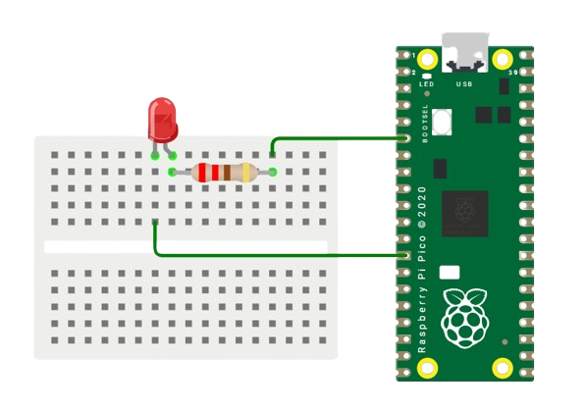
A SIMPLE RASPBERRY IOT SETUP
Virtual Componenets
Rapberry Pico
Breadboard
Led
Resistor

Slide 10
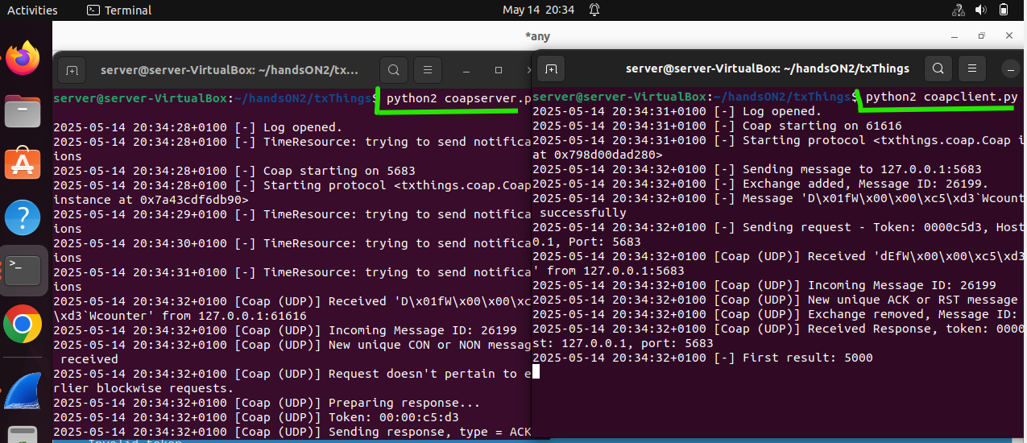
RESULTS (RUNNING SERVER AND CLIENT)
Running the server
python2 coapserver.py
Running the client
python2 coapclient.py

Slide 11
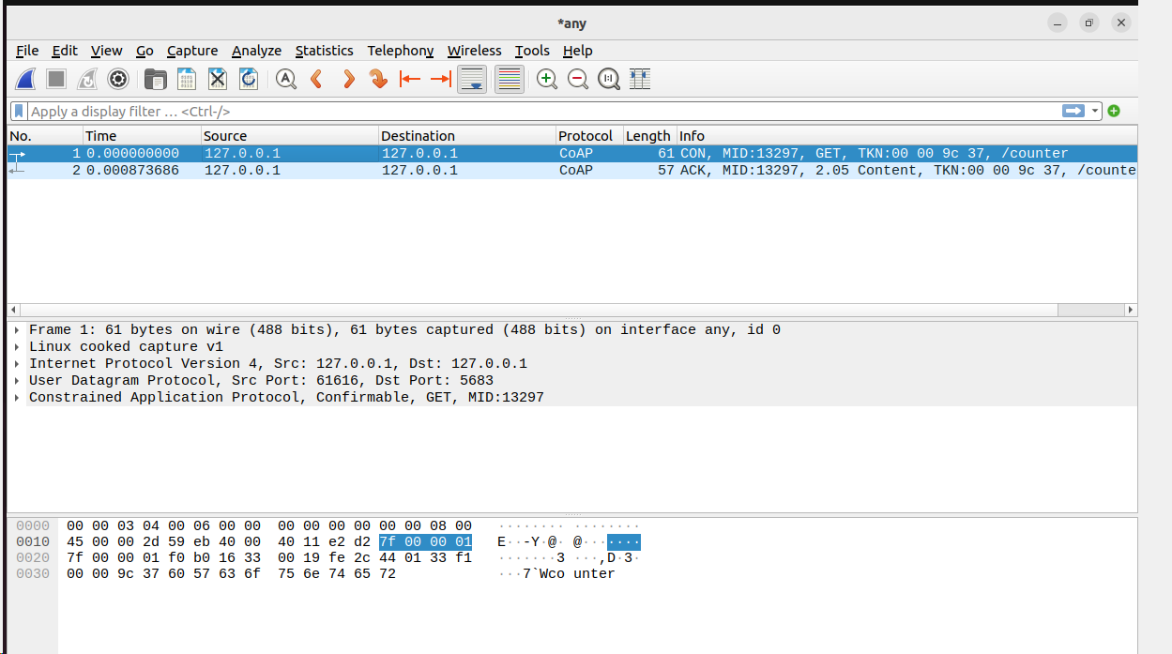
RESULT WIRESHARK ANALYSIS

Slide 12
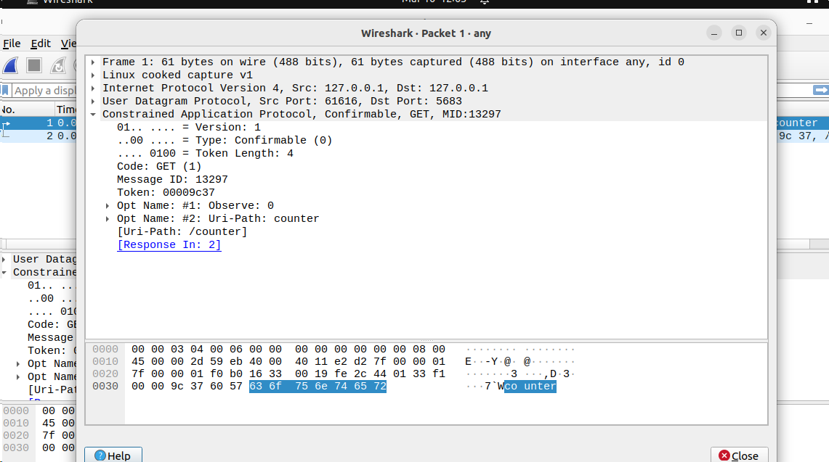
RESULT WIRESHARK ANALYSIS

Slide 13
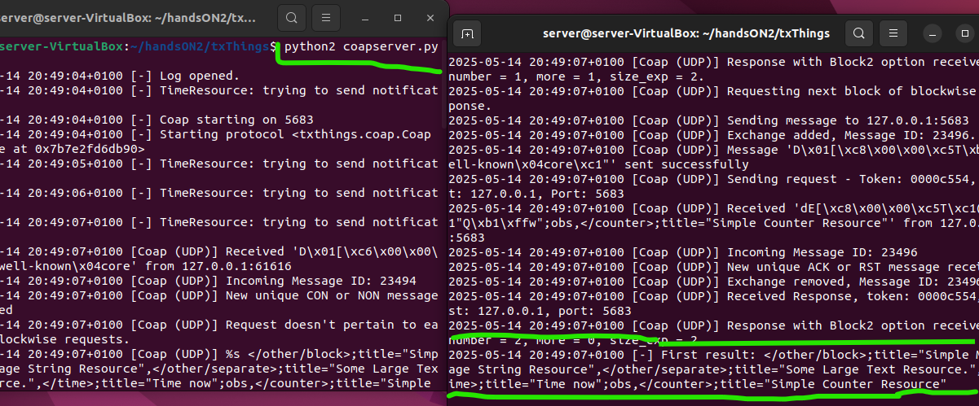
RESULTS (.well-known, core)
Running the server
Python2 coapserver.py
Running the client
Python2 coapclient-well.py

Slide 14
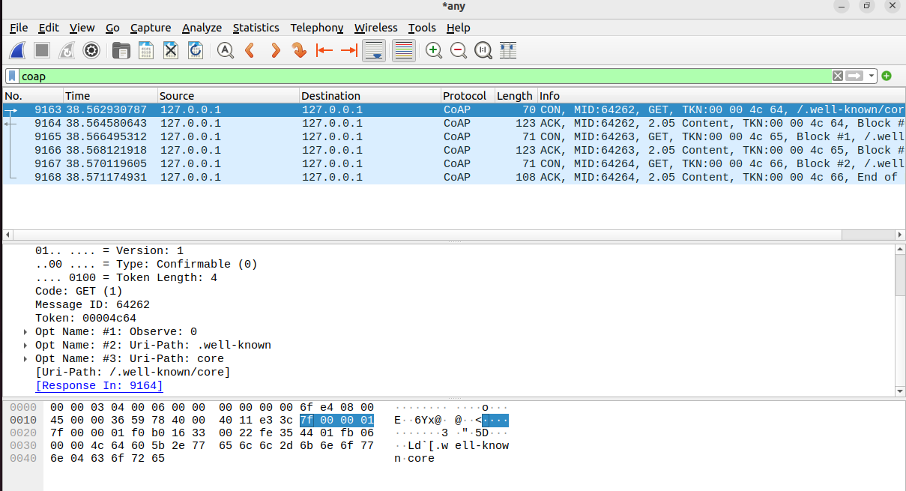
RESULTS (.well-known, core) wireshark Analysis

Slide 15

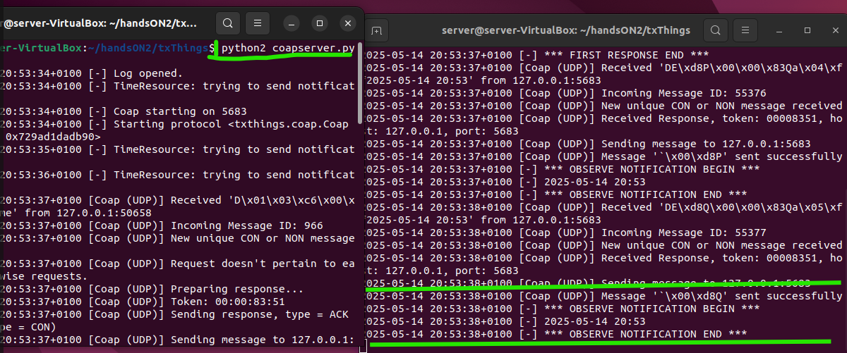
RESULTS – Analyze CoAP GET request/response for the Time resource in Wireshark
The captured traffic shows a CoAP (Constrained Application Protocol) exchange over localhost (127.0.0.1). A client sends a Confirmable (CON) GET request (MID: 36546) to retrieve the "/time" resource. The server acknowledges with an ACK and responds with 2.05 Content, returning the requested data. Some responses contain the text "time", suggesting a time-related payload. Additional empty ACK messages confirm successful receptions. The interaction indicates a working local CoAP setup, likely for IoT or application testing.
Running Server
python2 coapserver.py
Running Client
python2 coapclient_observer.py

Slide 16
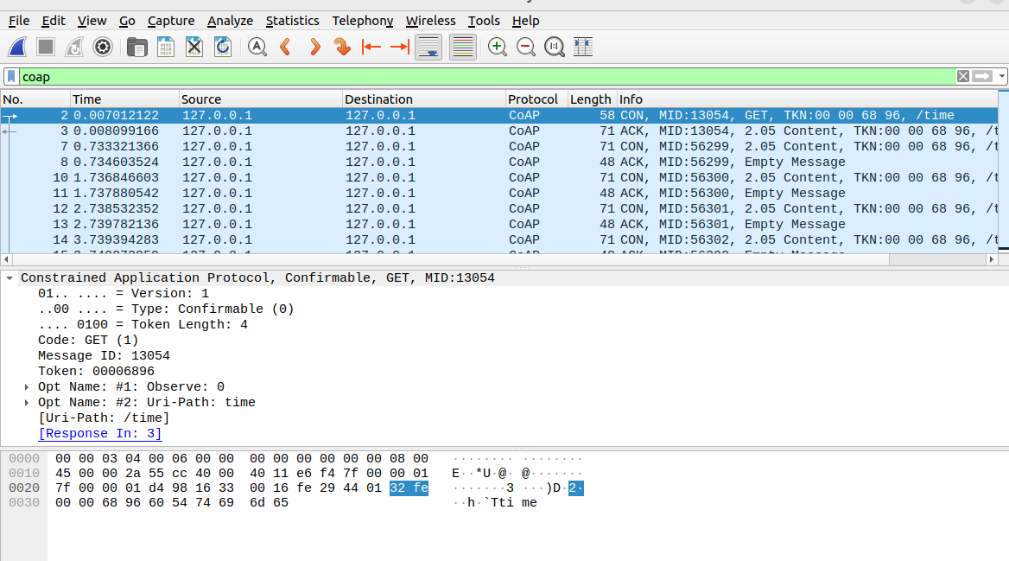
RESULTS – Analyze CoAP GET request/response for the counter resource in Wireshark

Slide 17
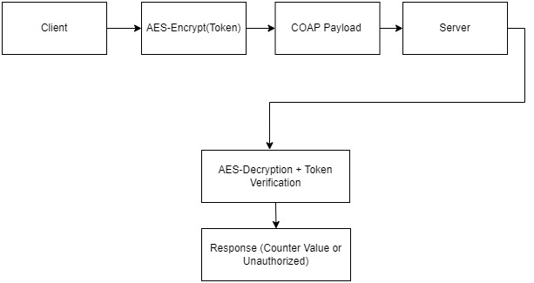
Security Architecture
To enhance access control and confidentiality in CoAP communication, two lightweight security measures were implemented: a pre-shared authentication token and AES-based payload encryption. The token enables the server to authenticate incoming requests, while AES encryption (in CBC mode) ensures that the payload remains confidential during transmission. This layered approach strengthens security against unauthorized access and eavesdropping without altering the core CoAP proto

Slide 18
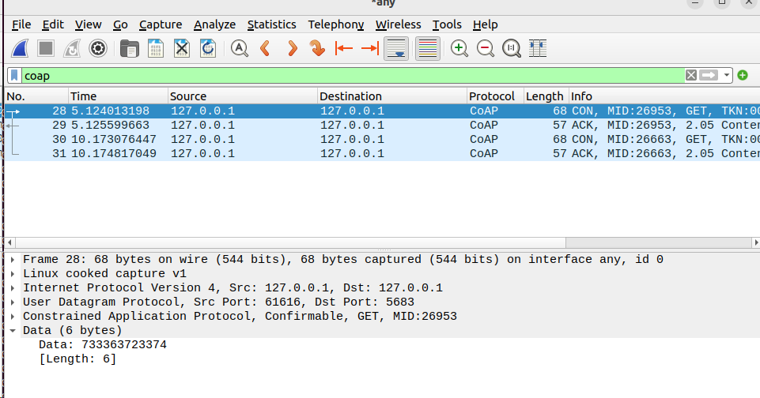
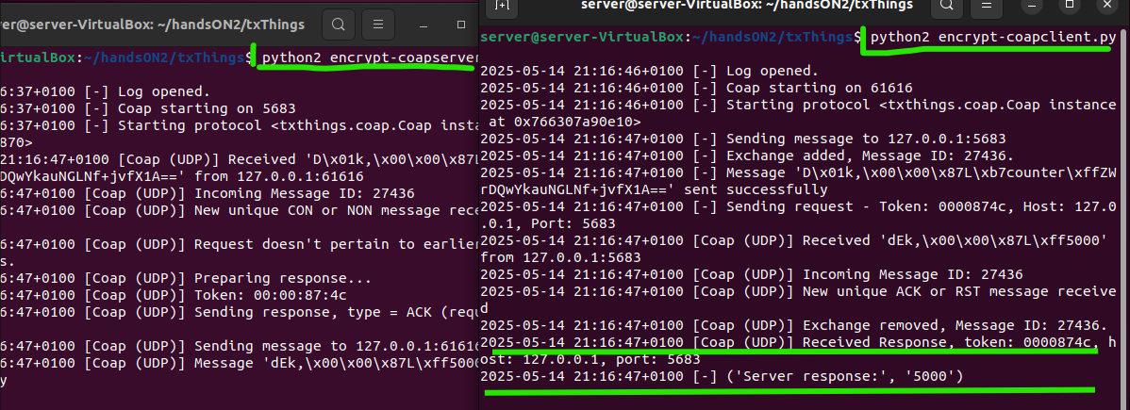
RESULTS Security Analysis Results
The implementation was validated through multiple test scenarios:
• Authorized Request: : When a client transmitted a request containing the correct authentication token (s3cr3t), encrypted using the agreed-upon AES key and IV, the server successfully decrypted the payload and authenticated the request. The server then responded with the current value of the counter resource e.g., 5000, demonstrating that the secure communication channel was functioning as intended
Running Server
python2 encrypt-coapserver.py
Running Client
python2 encrypt-coapclient.py

Slide 19
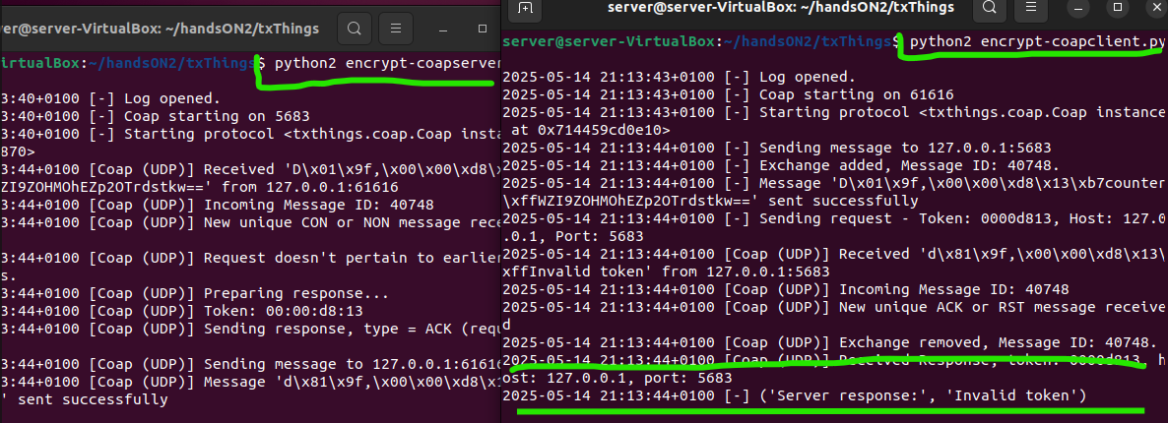
RESULTS Security Analysis Results
Unauthorized Request: If a client sent a request with an invalid token or tampered encrypted payload, the server responded with a 4.01 UNAUTHORIZED CoAP response code, accompanied by an appropriate error message. This confirms that the server correctly rejected unauthenticated or corrupted requests without processing them further.
Running Server
python2 encrypt-coapserver.py
Running Client
python2 encrypt-coapclient.py

Slide 20
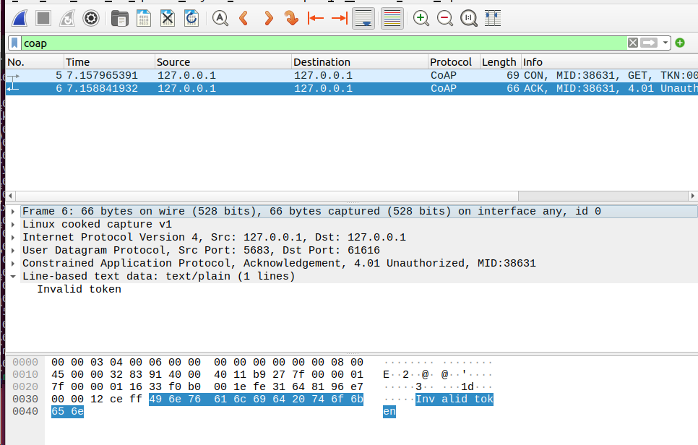
RESULTS Security Analysis Results
Traffic analysis using Wireshark confirmed that:
• The payload was transmitted in plaintext, visible within the UDP datagram.
• Message integrity was maintained, and the response codes matched the expected behavior.
• Unauthorized messages did not trigger state changes or processing on the server beyond token verification.

Slide 21
CONCLUSION
This project successfully implemented and evaluated a CoAP-based communication system optimized for IoT environments. The system demonstrated efficient resource observation, low-overhead message exchange, and reliable performance across both virtual and physical devices.
Network-level analysis using Wireshark confirmed correct protocol behavior, including the exchange of Confirmable requests, Acknowledgements, and Content responses. To enhance system security, a lightweight token-based authentication mechanism was introduced, later strengthened with AES payload encryption. This dual-layered security approach ensured basic access control and data confidentiality without affecting protocol efficiency or increasing computational demands.
Overall, the project reaffirmed the practicality and effectiveness of CoAP in constrained IoT scenarios, showcasing its lightweight nature, real-time responsiveness, and adaptability to simple yet meaningful security enhancements.

Slide 22
THANK
YOU

