Slide 1






Project Team
Mamdouh Koritam
Yousef Yacoub
Arwa Sameh salah
Amany Mhran
211001948
221000838
21101158
211001892
Salma Essam mahdy
211001778

Slide 2
Project Abstract
Purpose
Facilitate bi-directional synchronization between two directories on a Linux-based system
Language
C programming language
Key Features
Directory traversal, file comparison, synchronization of additions, modifications, and deletions
Error Handling
Robust error handling mechanisms to manage issues during file operations
Customization
Ability to customize and expand the tool based on specific requirements

Slide 3
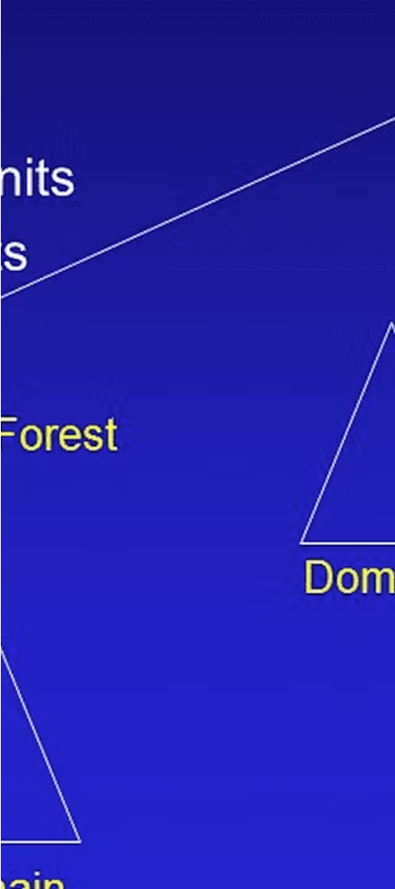
Synchronization Process
1
Directory Traversal
The tool recursively traverses both directories, comparing files in corresponding paths to identify changes.
2
File Comparison
The project compares file attributes, such as size and modification time, to determine if synchronization is required.
3
AI-Directional Sync
The Directory Synchronizer ensures that both directories remain identical by transferring additions, modifications, and deletions as needed.

Slide 4
Leveraging System APIs
Directory Operations
File I/O
Error Handling
The project utilizes system APIs like opendir(), readdir(), and closedir() to access and navigate directories.
Functions such as open(), read(), write(), and close() are used to perform file input/output operations.
The tool incorporates robust error handling mechanisms, using functions like perror() to manage potential issues during file operations.

Slide 5
Advantages of the one-way Synchronizer
1
Automated Synchronization
2
Data Consistency
Saves time and minimizes the risk of manual errors.
Ensures that files with identical names are kept up-to-date across directories.
3
Preserves Directory Structure
4
Efficient Handling of Large Datasets
Maintains the entire directory tree during the synchronization process.
Utilizes buffered I/O and recursive traversal to handle large amounts of data effectively.

Slide 6
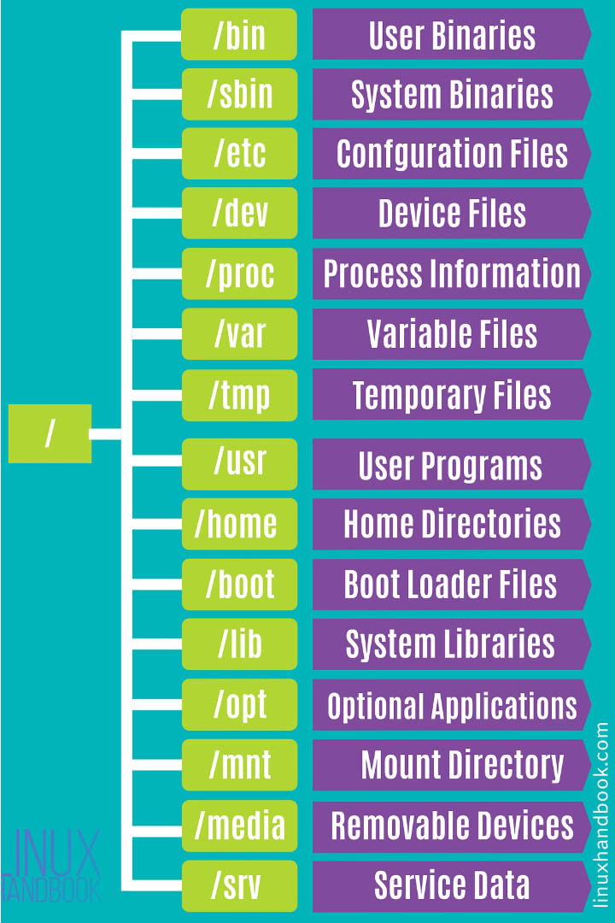

The one-way Synchronizer
One-way sync typically refers to a synchronization process where data is mirrored or transferred in one direction only, from a source to a destination, without any changes being made in the opposite direction.

Slide 7
Customization and Extensibility
Customizable Features
Platform Compatibility
The tool can be tailored to meet specific requirements, such as adding file deletion synchronization or conflict resolution strategies.
The C-based implementation allows the Directory Synchronizer to be compiled and executed on different platforms without modifications.
Robust Error Handling
Versatile Applications
The integrated error handling mechanisms enhance the tool's reliability in managing various scenarios, such as file permission issues or disk full errors.
The Directory Synchronizer can be utilized in a wide range of applications where maintaining data consistency across directories is crucial.

Slide 8
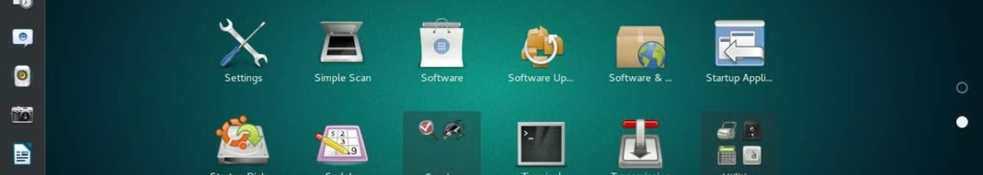



Operating System
Linux-based
Compatibility
Release Date
The Directory Synchronizer is designed to run on Linux-based operating systems, leveraging their file system and system APIs.
The C-based implementation allows the tool to be compiled and executed on different Linux distributions without any modifications.
The project is scheduled for release in May 2024, under the supervision of Dr. Mohamed ElGazzar.

Slide 9

Thank you

