Slide 1
Information Systems Project Management (course code: INSY4101)
By
Temtim Assefa, PhD
September 2023

Slide 2
Course objectives
Up on successful completion of the course students will be able to:
Understand and value the essence of Project management within the context of organizational information systems
Describe the project management phases and the various processes of project management
Develop project proposal/ project plan
Understand the concepts, experiences and practices of managing IT related projects

Slide 3
Teaching Methods
Lectures,
Student presentations,
Group discussions,
individual and group project work
Browsing online materials

Slide 4
Course Assessment
Assessment %
Tests 20
Individual assignments 10
Group Work (on project plan) 20
Presentation 10
Final examination 40
Total 100%

Slide 5
Reference Materials
Information Technology Project Management (9th Ed). Kathy Schwalbe. 2019. Cengage Learning.
Information Technology Project Management (5th Ed). Jack T. Marchewka. 2016. Wiley.
Project Management: A Strategic Managerial Approach (10th Ed). Jack R. Meredith, Scott M. Shafer, Samuel J, Mantel, Jr. 2017. John Wiley & Sons.
A Guide to the Project Management Body of Knowledge (6th Ed). Project Management Institute. 2017. PMI.
Lecture slides
Internet resources

Slide 6
Unit one – Project management introduction

Slide 7
Unit objective
At the end of the unit, you will able to
Explain the concept of the project.
Benefits of project management
Characteristics of a project
Identify the difference between project and program
Identify constraints of project management
The impact of project constraints on project management

Slide 8
Introduction
The world as a whole spends nearly $10 trillion of its $40.7 trillion gross product on projects of all kinds
More than 16 million people regard project management as their profession
The overall information and communications technology market grew by 6 percent to almost $3 trillion in 2010

Slide 9
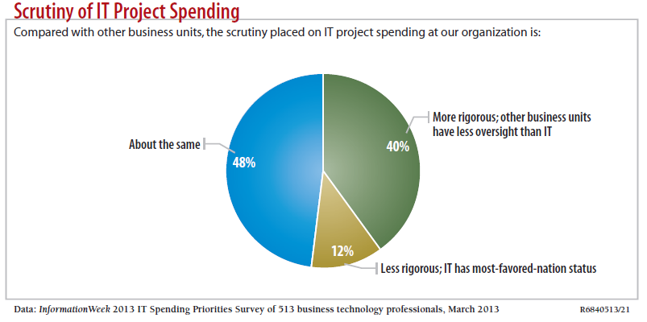
Motivation for Studying Information Technology (IT) Project Management
IT Projects have a terrible track record, as described in the “What Went Wrong?”

Slide 10
Advantages of Using Formal Project Management
Better control of financial, physical, and human resources
Improved customer relations
Shorter development times
Lower costs
Higher quality and increased reliability
Higher profit margins
Improved productivity
Better internal coordination
Higher worker morale

Slide 11
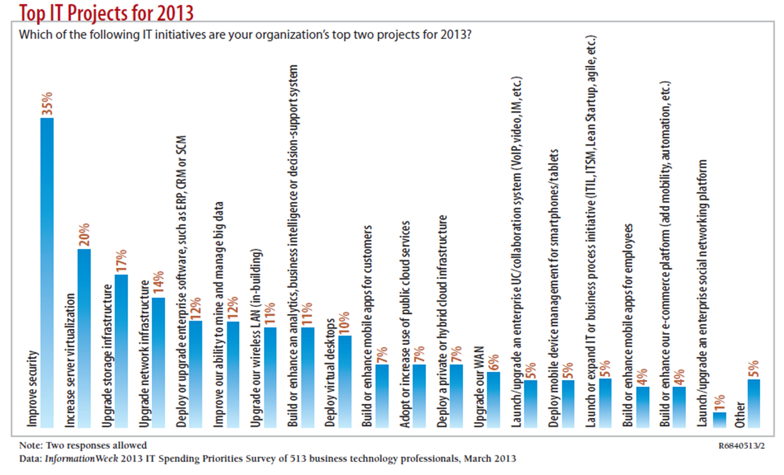
What Is a Project?
A project is “a temporary endeavor undertaken to create a unique product, service, or result” (PMBOK® Guide, Fifth Edition, 2012)

Slide 12
Project Attributes
A project
has a unique purpose
is temporary
is developed using progressive elaboration
requires resources, often from various areas
should have a primary customer or sponsor
The project sponsor usually provides the direction and funding for the project
involves uncertainty

Slide 13
Project and Program Managers
Project managers work with project sponsors, project team, and other people involved in a project to meet project goals
Program: group of related projects managed in a coordinated way to obtain benefits and control not available from managing them individually (PMBOK® Guide, Fifth Edition, 2012)

Slide 14
Program and Project Portfolio Management
A program is “a group of related projects managed in a coordinated way to obtain benefits and control not available from managing them individually” (PMBOK® Guide, Fifth Edition, 2012)
A program manager provides leadership and direction for the project managers heading the projects within the program

Slide 15
A Portfolio
A portfolio is a collection of projects and/or programs used to structure and manage investments at an organizational or functional level
They can be managed at an organizational or functional level.

Slide 16
Portfolio Management
Portfolio management is the selection, prioritization, and control of an organization’s programs and projects, in line with its strategic objectives and capacity to deliver.
The goal is to balance the implementation of change initiatives and the maintenance of routine business activities
The purpose is to maximize return on investment.

Slide 17
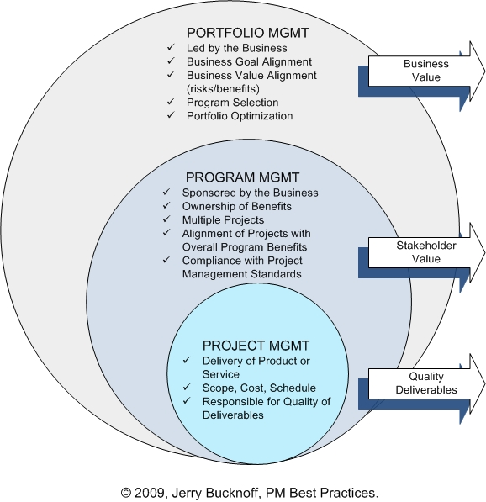
Project Portfolio Management
Organizations group and manage projects and programs as a portfolio of investments that contribute to the entire enterprise’s success

Slide 18
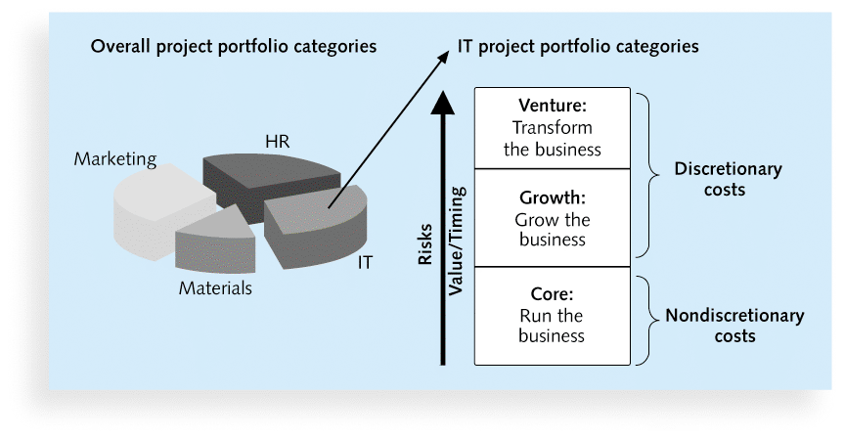
Sample Project Portfolio Approach

Slide 19
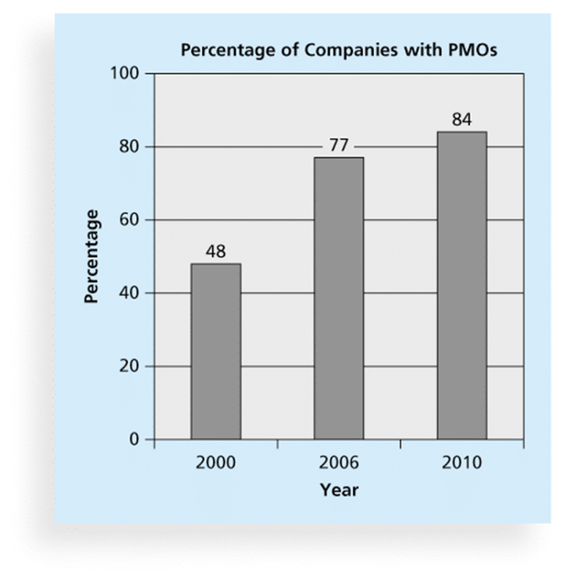
Project Management Offices
A Project Management Office (PMO) is an organizational group responsible for coordinating the project management function throughout an organization

Slide 20
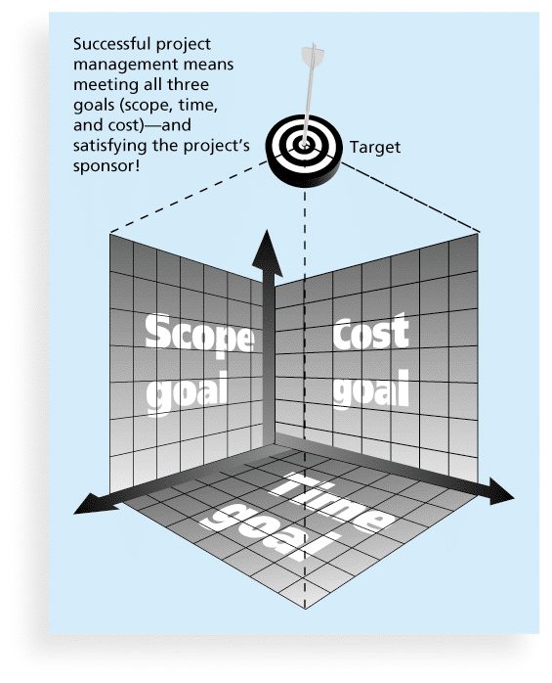
The Triple Constraint of Project Management

Slide 21
Additional reading

Slide 22
Assessment questions
What is project?
How it project differs from other projects like bridge projects?
What is the characteristics of a project?
What is the impact of different project constraints on your project management?
Why do you initiate a project in the organization?

Slide 23
Individual activity
Browse the Internet and pick one IT project, write a short note about the project:
Its purpose
Its success or benefits to the organization
Challenges encounter while executing the project

Slide 24
Unit two – Project Management process

Slide 25
Project Management Processes
Project Management encompasses five processes
Initiating
Planning
Executing
Controlling, and
Closing
Nine knowledge areas

Slide 26
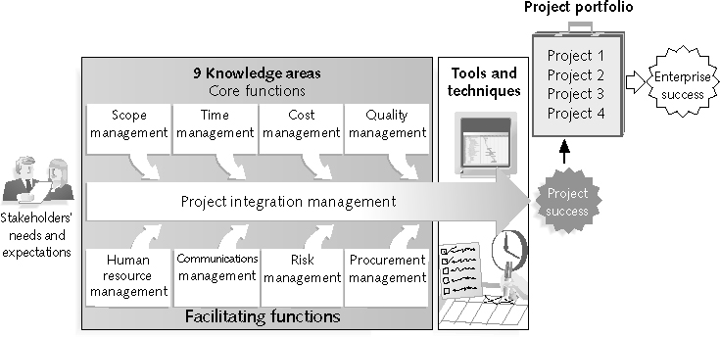
What is Project Management?
“the application of knowledge, skills, tools and techniques to project activities to meet project requirements” (PMBOK® Guide, Fourth Edition, 2012)
Stakeholders
Core Functions
Facilitating
Functions

Slide 27
Project Management Knowledge Areas
Knowledge areas describe the key competencies that project managers must develop
Core Functions
Facilitating Functions
Integration Function

Slide 28
Project Management Tools
Can be software tools like Microsoft Project Management
Used to create the project baseline plan
Record project progress to register completed tasks, used costs, etc.
Generates reports when required
Generate also variance reports
Has also embedded tools like Gantt Chart and Network diagram for visual representation

Slide 29
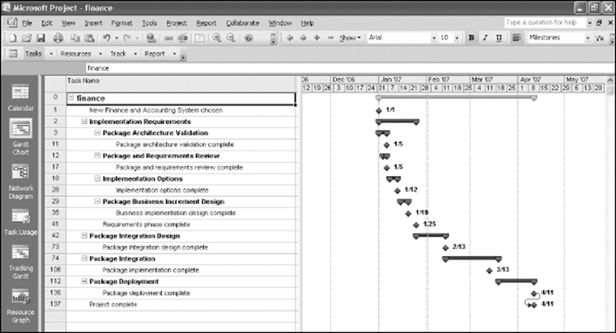
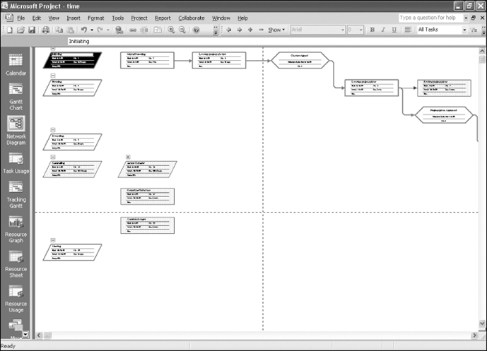
Project Management Tools and Techniques
Project management tools and techniques assist project managers and their teams in various aspects of project management
network diagram
Gantt chart

Slide 30
Why the Improvements?
What Went Right? Improved Project Performance

Slide 31
Project Success
There are several ways to define project success:
Triple Constraint
Customer/Sponsor Satisfaction
The results of the project met its main objective

Slide 32
What Helps Projects Succeed?*
1. User involvement
2. Executive support
3. Clear business objectives
4. Emotional maturity
5. Optimizing scope
6. Agile process
7. Project management expertise
8. Skilled resources
9. Execution
10. Tools and infrastructure
*The Standish Group, “CHAOS Activity News” (August 2011).

Slide 33
The Role of the Project Manager
Job descriptions vary, but most include responsibilities like planning, scheduling, coordinating, and working with people to achieve project goals
Remember that 97% of successful projects were led by experienced project managers, who can often help influence success factors

Slide 34
Suggested Skills for Project Managers
The Project Management Body of Knowledge
Application area knowledge, standards, and regulations
Project environment knowledge
General management knowledge and skills
Soft skills or human relations skills

Slide 35
Ten Most Important Skills and Competencies for Project Managers
1. People skills
2. Leadership
3. Listening
4. Integrity, ethical behavior, consistent
5. Strong at building trust
6. Verbal communication
7. Strong at building teams
8. Conflict resolution, conflict management
9. Critical thinking, problem solving
10. Understands, balances priorities

Slide 36
Careers for IT Project Managers
In a 2012 survey, IT executives listed the “nine hottest skills” they planned to hire for in 2013
Project management was second only to programming and application development
Job Categories | Total Current Employees Rank | Growth Rank
Big Data / Analyst | 6 | 1
Business/Systems Analyst | 3 | 3 (tie)
Database Admin / Analyst | 7 | 3 (tie)
Networks / Security | 5 | 5
Project Management | 4 | 2
Software Development | 2 | 6
Other IT Skills( Primarily Help Desk) | 1 | 7

Slide 37
The Project Management Profession
The profession of project management is growing at a very rapid pace
It is helpful to understand the history of the field, the role of professional societies like the Project Management Institute, and the growth in project management software

Slide 38
Project Management Certification
The Project Management Institute (PMI) is an international professional society for project managers with 380,000 members worldwide in 2012
Project Management Professional (PMP) has documented sufficient project experience, agreed to follow a code of ethics, and passed the PMP exam
Certified Associate in PM (CAPM) is achievable with less experience
CompTIA offers another certification option
CompTIA Project+ has less requirements but is not as well recognized as PMP

Slide 39
Project Management Software
There are hundreds of different products to assist in performing project management
Three main categories of tools:
Low-end tools
Midrange tools
High-end tools

Slide 40
Project Management Software
Various software includes:
Microsoft Project Management
BaseCamp
Clarizen
Collabtive (open source)
dotProject (open source)
OneDesk
Genius Inside
PlanBox

