Slide 1
School of Information Science
BSc in Information Systems
Undergraduate Program
INSY3093: Knowledge Management
Addis Ababa University

Slide 2
Chapter 1:
Introduction to Knowledge Management
Knowledge Management Definition?
Alternative views of knowledge
Different types of knowledge
Location of knowledge
Forces driving knowledge management
Knowledge management systems

Slide 3
Knowledge
Knowledge has always been valuable to people.
The key to wealth creation is the creation of knowledge.
Highly profitable companies like Microsoft, Google, Facebook, Cisco Systems, Oracle, and Sun—all of which were started from scratch by college kids with nothing but knowledge, passion, and vision.
Most executives often state that their greatest asset is the knowledge held by the employees.
    They are successful because of the skills and experience of their employees, not because of some physical asset they control.

Slide 4
Introduction to KM
Knowledge management (KM) is a process that helps organizations identify, select, organize, disseminate, and transfer important information and expertise that are part of the organization’s memory and that typically reside within the organization in an unstructured manner.
It is a process through which organizations generate value from their intellectual property and knowledge-based assets

Slide 5
KM?
KM involves the creation, dissemination, and utilization of knowledge
It is also viewed as the intersection between People, Processes and Technology
The information technologies that together make knowledge management available throughout an organization are referred to as a knowledge management system (KMS).

Slide 6
Why Manage Knowledge? ..cont’d
Any organization needs knowledge to perform its functions. – OM, OL
    We need
      formalized knowledge,
      Rules and regulations,
      policies, laws, programs and procedures,
      know-how, skills, and experience of people.
  Knowledge includes the way that organizations function, communicate, analyze situations, develop new solutions to problems, and develop new ways of doing business.
    Knowledge involves issues of culture, custom, and values as well as relationships

Slide 7
Why Manage Knowledge? ..cont’d
Knowledge is lost from an organization through retirement, turnover, death
  knowledge assets need to be handled.
  Knowledge needs to be gathered, stored, transmitted, applied, updated, or generated.
Organizations that are aware of their knowledge resources possess a valuable unique resource

Slide 8
Why manage knowledge? …cont’d
The ability to manage knowledge is becoming increasingly more crucial
  Managing knowledge is a necessity due to changes in the environment such as increasing competition.
  Management of Knowledge is a controversially discussed concept
There is still a debate on the meaning, definitions and dimensions of KM
  All however agree that knowledge is more than just mere data and information

Slide 9
Data, Information, Knowledge
Data is
  row fact
  a set of discrete objective facts about events
  represented by characters and can be produced, codified, and distributed without a reference to the context or person
  considered as the basis for creating information and knowledge
  content that is directly observable or verifiable,

Slide 10
Data, Information, Knowledge …cont’d
Information
  Processed data
  Refers to context
  Can be considered as messages or news created by the interpretation of data
  Can be understood by the recipient and has meaning to the recipient
  Content that represents analyzed data
  Used for decision making

Slide 11
Data, Information, Knowledge… cont’d
Knowledge:
  stored for future use
  Emerges from the processing of the perceived information and contextualization of a person
  A mix of framed experience, values, contextual information
  expert insight that provides a framework for evaluating and incorporating new experiences and information
  Can also be defined as the ability of persons to evaluate information and act effectively

Slide 12
Examples
    Data
    Listings of the times and locations of all movies being shown today (can be downloaded)
    Information
    I can not leave before 3, so I will go to the 7:00 PM show
    Knowledge:
    At that time of day, it will be impossible to find parking. I remember the last time I took the car, I was so frustrated and stressed because I thought I would miss the opening credits. I will therefore take a taxi.
    But first I will have to check with …. I usually love all the movies he hates so I want to make sure it is worth seeing.

Slide 13
Examples …cont’d
    Data
    List of applicants for entrance examination
    Information
      There are a lot of applicants for Information Science, only 30 students will be accepted.
      I only have a small chance of passing the entrance examination
    Knowledge
      Last time, I saw the exam, the English exam is mostly taken from standardized tests. I better concentrate on that
      I may not be able to finish the mathematics anyway, so I have to concentrate on English and IT

Slide 14
Concepts of Knowledge
Difference among data, information and knowledge
Data is a raw facts on any thing
  Example - Addis Ababa, 1000, 1.8cm
Information is
  a processed data meaningful to the user
  A relationship between data sets
  Example
        Addis Ababa has 15⁰c daily temperature
        Gambela has 30⁰c daily temperature
        The Programmer salary is 10,000 birr

Slide 15
Alternative views …
Information can have different meanings in different contexts
  40 degrees can have different meanings in the context of Medicine, Geography or Engineering?
Example
  40 deg Celsius (is a sign of fever in Medicine);
  40 deg Angle (has a shape like V in Geometry)

Slide 16
Knowledge
Knowledge is information combined with experience, interpretation and reflection of an individual
Knowledge is a justified personal belief.
  Knowledge is relative to the knower
  More structured information in the human mind
A capability to apply information
Example
  The programmer salary is small, I will not be a programmer
Actionable information

Slide 17
Wisdom
It is Knowledge that is combined with Learning, Insight, Intuition and Judgmental abilities.
Almost exclusive to our own minds.
An Ability to make wise decisions and judgment using one’s knowledge
Example – King Solomon’s decision for two mothers

Slide 18
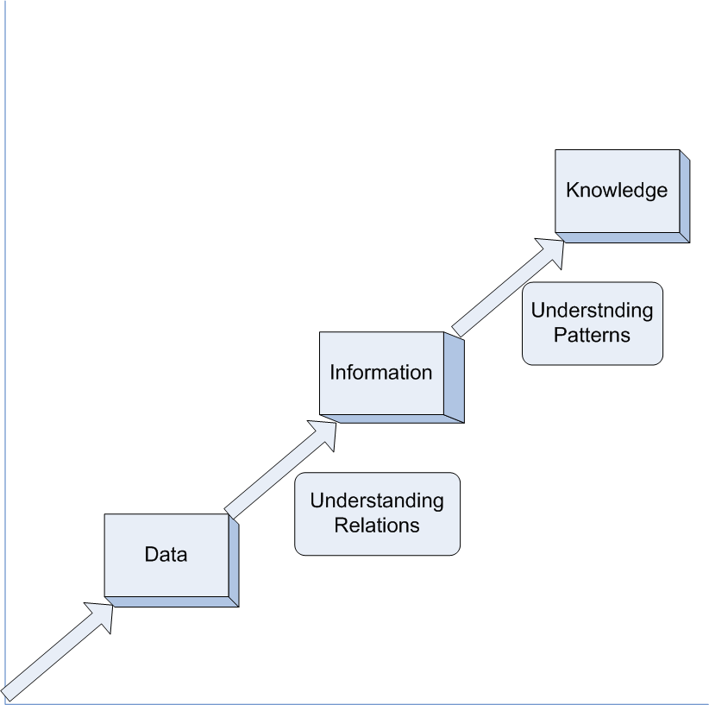
Data →Information →Knowledge
knowledge involves the recognition or the understanding of patterns

Slide 19

Data to Knowledge Hierarchy
Wisdom
Knowledge
Information
Data

Slide 20
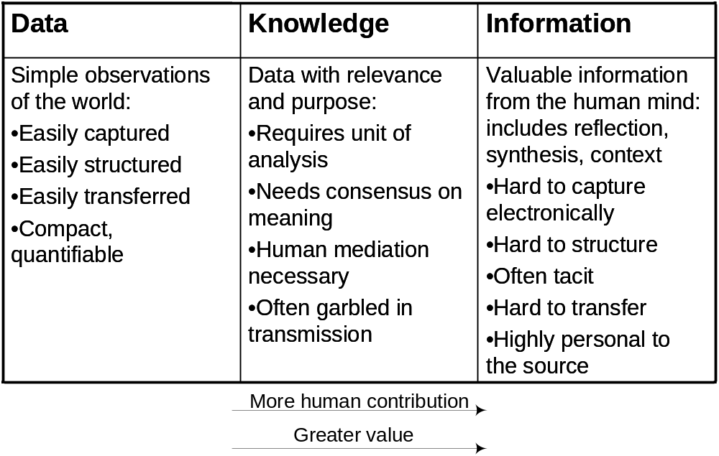
Information
Knowledge
The relationships between data, information, and knowledge.

Slide 21
Characteristics of Knowledge
Knowledge is based on values, perceptions and experience
Use of knowledge does not consume it
Transferal of Knowledge does not result in losing it
Knowledge is abundant, but the ability to use it is scarce
Much of an organization’s valuable knowledge walks out the door at the end of the day

Slide 22
Different types of knoweldge
Knowledge is classified into different categories in the existing literature
Procedural or Declarative Knowledge
  Declarative knowledge (facts) focuses on beliefs about relationships among variables
  Procedural knowledge (how to ride a cycle) focuses on beliefs relating sequences of steps or actions to desired (or undesired) outcomes.

Slide 23
Different types of knowledge
Tacit and Explicit Knowledge
Another important classification of knowledge views it as tacit or explicit (Nonaka 1994; Polanyi 1966).
Tacit knowledge includes insights, intuitions, and hunches.
Explicit knowledge typically refers to knowledge that has been expressed into words and numbers.

Slide 24
Tacit Knowledge
A knowledge that is embedded with the knower
Highly contextual knowledge
Unstructured as compared to explicit knowledge
Difficult to verbalize and codify on knowledge repositories and also to share it
It contains the largest part of our knowledge
As Polanyi Said “We know more than we can say”

Slide 25
Explicit knowledge
Knowledge that can be verbalized and codified
Knowledge that we can find in books, databases
Structured compared to tacit knowledge
Easy to store in databases and documents
It is easily accessible to every one as it is detached from the Knower
Some Researcher label it as Information
The Issue is not resolved among philosophers and scholars
The smaller part of our knowledge

Slide 26
Tacit versus Explicit knowledge
Tacit knowledge
Explicit knowledge

Slide 27
Different types of knowledge …
General or Specific Knowledge
Focuses on whether the knowledge is possessed widely or narrowly (Sabherwal and Becerra-Fernandez 2005).
General knowledge is possessed by a large number of individuals and can be transferred easily across individuals.
  For example, knowledge about the rules of football
Specific knowledge, is possessed by a very limited number of individuals, and is expensive to transfer

Slide 28
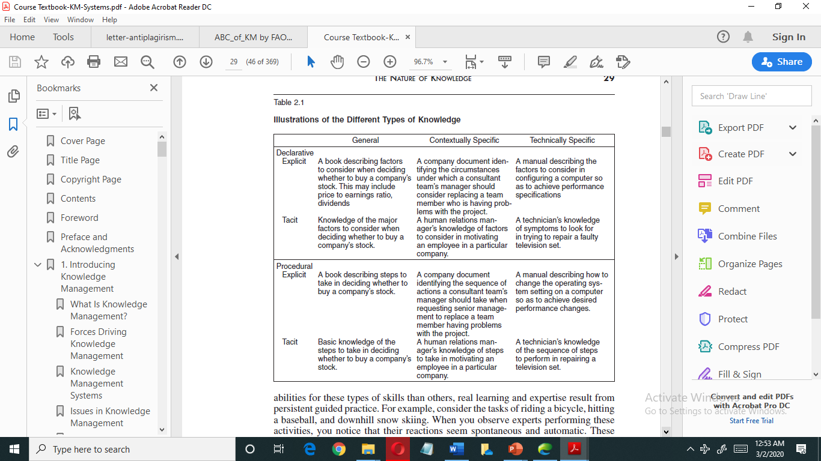

Slide 29
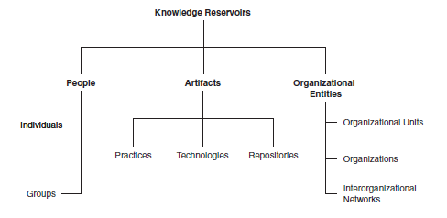
Location of Knowledge

Slide 30
Locations of Knowledge
Individual Knowledge
  Individual knowledge is knowledge created and possessed by individuals
  It is the base for other categories of knowledge
  It is more of personal belief which may or may not be accepted by the group and the organization
  Emanates from experience by doing tasks
  The knowledge stored in individuals is the reason for several KM initiatives by companies

Slide 31
Locations of Knowledge …
Group knowledge
  Considerable knowledge resides within groups because of the relationships among the members of the group (Felin and Hesterly 2007).
  When people work together for a long time, they know each other’s strengths and weaknesses, understand the other’s approach, and recognize aspects that need to be communicated and those that could be taken for granted).
  Groups form beliefs about what works well and what does not,
  Collective knowledge is synergistic—greater than the sum of their individual knowledge.
  Communities of practice possess a typical group knowledge

Slide 32
Locations of Knowledge …
Knowledge in Artifacts
  knowledge is stored in organizational artifacts
  Knowledge is embedded in procedures, rules, and norms that are developed through experience over time and guide future behavior
  For example, software developers often store knowledge about how to produce high-quality software in routines

Slide 33
Location of knoweldge …
Knowledge in Organizational Entities
  Knowledge is also stored within organizational entities.
  These entities can be considered at three levels:
      organizational units (parts of the organization or departments),
      an entire organization, and
      in interorganizational relationships (such as the relationship between an organization and its customers).

Slide 34
Organizational knowledge
An organization stores certain knowledge, especially contextually specific knowledge such as Hospital and Banks.
The norms, values, practices, and culture within the organization, and across its organizational units, contain knowledge that is not stored within the mind of any one individual.
Organizations respond to environmental events not only upon the knowledge stored in individuals and organizational units but also in the overall organizational knowledge

Slide 35
Inter-organizational relationships
As organizations establish and consolidate relationships with customers and suppliers, they draw upon knowledge embedded in those relationships.
Organizations often learn from their customers’ experience with products about how these can be improved.
They can also learn about new products that might be appealing to customers.

Slide 36
Forces that drive Knowledge Management
Information and knowledge have become the fields in which businesses compete
Several important factors include:
  Increasing Domain Complexity
  Accelerating Market Volatility
  Employee turnover
  Managing Information and Communication Overload
  Knowledge Embedded in Products
  Sustainable Competitive Advantage

Slide 37
Increasing Domain Complexity
The complexity of the underlying knowledge domains is increasing.
The complexity of the knowledge required to complete a specific business task has also increased.
Sophistication of internal and external processes, increased competition, and the rapid advancement of technology all contribute to increasing domain complexity.
For example, new product development requires the partnership of inter-organizational teams representing various functional subunits—from finance to marketing to engineering.

Slide 38
Accelerating Market Volatility
The pace of change, or volatility, within each market domain has increased rapidly in the past decade.
For example, market and environmental influences can result in overnight changes in an organization.
New products technologies are invented every month

Slide 39
Employee Turnover
Organizations continue to face employee turnover
Employee turnover inevitably leads to the organization losing some of the knowledge possessed by the departing individuals.
Leaving individuals might have knowledge that would be valuable to competitors.

Slide 40
Sustainable Competitive Advantage
Knowledge has become a strategic resource of an organization
KM provides you to quickly integrate your knowledge resources and convert into products and services
Knowledge is unique to every organizations.
Once you innovate new products using your knowledge, it is not easily imitated
Knowledge also increases your innovation capability and able to create new products with short product life cycle
All these feature gives you sustainable competitive advantage

Slide 41
Forces that drive KM …
Managing Info Overload:
  data must be categorized in some manner if it is to be useful rather than overwhelming
  Use of data mining tools help to overcome problem
Knowledge Embedded in Products:
  the intangibles that add the most value to goods and services are becoming increasingly knowledge-based
  Products like mobile banking, software products, etc

Slide 42
Issues in knowledge management
Many attempts have been made to launch KM initiatives, but not all KM implementations have been successful.
  knowledge workers do not share as they are expected.
KM is not acquiring a state of the art technologies
Effective KM uses all the options available to motivate employees in order to put knowledge to work.

Slide 43
Issues in KMS …
Employees play active role building the content of KMS unlike traditional information system.
The successful implementation of KM systems requires users not only effectively “use” such systems, but also contribute to the knowledge repository
Managers understand the factors that lead to the successful implementation of KM systems
Effective KM is 80 percent related to organizational culture and human factors and 20 percent related to technology

Slide 44
Summary
Knowledge management is a process that deal with knowledge creation, storage, dissemination and application
Knowledge management system is an integration of organizational social and structural mechanisms and information technologies
Knowledge management implementation can be successful when we motivate employees to use knowledge and donate knowledge to the knowledge repository

Slide 45
Review questions
What is knowledge?
What is knowledge management?
Why is knowledge management important?
Explain the difference between KM and KMS?
What is the driving force for adopting KM solutions
What are key factors for successful implementation of knowledge management system

Slide 46
Thank You

