Slide 1
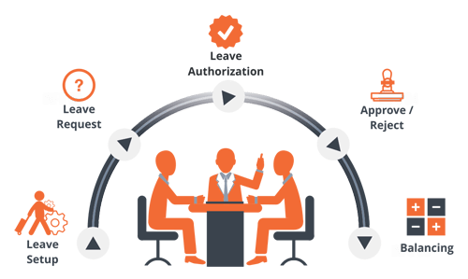
Data Base Management System Lab Project
Faculty Leave Management System
Team:
17071A05I1
17071A05J6
17071A05L1
17071A05M6
17071A0537

Slide 2
Need for DBMS in Faculty Leave Management System
Before DBMS was developed, administration used to be done with the help of registers. In these registers, records were entered manually. This had lots of disadvantages, which are as follows:
Human errors while entering data(Mismatch).
Difficut in evaluating no. Of absentees at the end of moth by maually counting.
Non centrailzed
Difficult to retireve data, as searching takes time.

Slide 3
E. Difficult to store registers(books) and chances of loosing data are high.
F. Inefficient leave processing ,as the registers have to be checked for the no. of absents and also substitute teacher availability need to be checked.
G. Lack of prioritizing of leaves as different faculty may have different level of urgency.

Slide 4
Objectives:
To reduce processing work load and paperwork.
To help in easier mainteanance of records.
To cnetralize the records.
To automate the system.
To overcome dat loss.
To avoid errors while entering data(by providing error message while entering invalid data).
To make it user friendly.
To prioritize the leaves.
To make the data reliable and properly organized

Slide 5
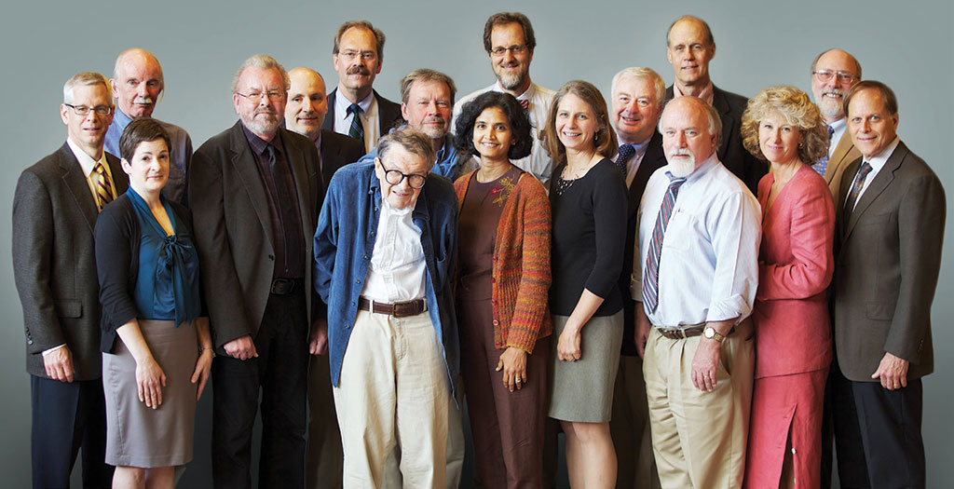
Users:
HOD
Clerk
Faculty(Teaching and Non-teaching)
Centrail and state certification authorities(like JTUH,JTUK,AICTE etc.)
Supervisors

Slide 6
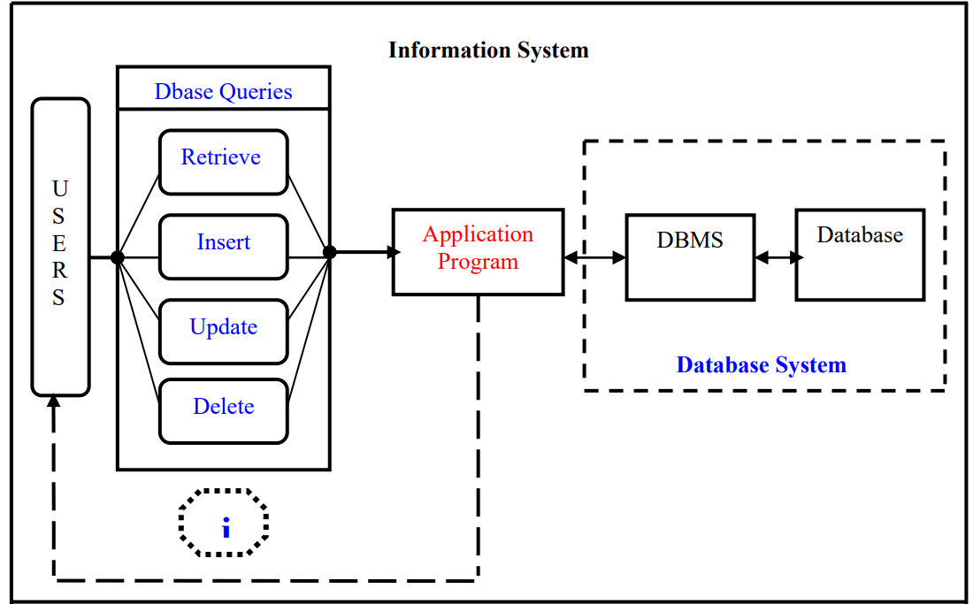
Background

Slide 7
Basic ER diagram:
No_of_days_worked
Status
Dept
Faculty Id
Faculty Name
Urgent leave
Maternity leave
Checked By
Role_id
Leaves
Appiled for
Faculty
Teaches
Paternity leave
Casual leave
Decided By
Subject
Leaves available
Availabiltity of substitute teachers
SubId
Subame
Student count

Slide 8
lid
fid
reason
Date_of_leave
No_of_days
Urgent leave
lid
fid
reason
Date_of_leave
No_of_days
Maternity leave

Slide 9
lid
fid
reason
Date_of_leave
No_of_days
Paternity leave
lid
fid
reason
Date_of_leave
No_of_days
Casual leave

Slide 10
Role_id,Dept_no
Count
Roles
Dept_no
Dept_name
Department
Faculty
Participates
Count

Slide 11
Modules
No. Of tables:7
Table1:
Department(dept_no, dept_name, faculty_count)
Description:
Faculty_count-Total no. of faculty in that respective deaprtment
Constraints:
Primary key: dept_no

Slide 12
Table2:
Roles(role_id,dept_no,count)
Description:
Role_id:Id of role(1-Professor,2-Asscociate professor,3-Assistant professor)
Count:No. Of lecturers of that particular role in that particular department
Constraints:
Primary key:role_id,dept_no
Foreign key:dept_no references(department(dept_no))

Slide 13
Table3:
Faculty(fid,fname,mname,lname,dept_no,phone_no,gender,role_id)
Description:
Fid-Faculty id
Fname-First name
Mname-Middle name
Lname-Last name
Role_id-Id of role(1-Professor,2-Asscociate professor,3-Assistant professor)
Constraints:
Primary key:fid
Foreign key:role_id,dept_no references roles(role_id,dept_no)

Slide 14
Leave tables
Description:
Lid- leave id
Fid-faculty id
Date_of_leave-Starting date of leave
No_of_days-No. of days of leave from starting date
Table4:
Urgent_leave(lid,fid,reason,date_of_leave,no_of_days)
Constraints:
Primary key:lid
Foreign key:fid references(faculty(fid))

Slide 15
Table5:
Maternity_leave(lid,fid,reason,date_of_leave,no_of_days)
Constraints:
Primary key:lid
Foreign key:fid references(faculty(fid))
Table6:
Paternity_leave(lid,fid,reason,date_of_leave,no_of_days)
Constraints:
Primary key:lid
Foreign key:fid references(faculty(fid))

Slide 16
Table7:
Casual_leave(lid,fid,reason,date_of_leave,no_of_days)
Constraints:
Primary key:lid
Foreign key:fid references(faculty(fid))

Slide 17
Triggers
As maternity leave is only applicable for female faculty, the below trigger raises an error if the faculty applying for maternity leave is not female. Also, minimum no. Of working days must be 80 .otherwise, error will be raised. Along with this, a maternity leave cannot exceed 90 days. So, when a female faculty tries to apply maternity leave for more than 90 days then also an error will be raised.
1 create or replace trigger m_st2
2 before insert or update
3 on maternity_leave
4 for each row
5 declare
6 g varchar2(1);
7 d number(30,2);
8 begin
9 select gender into g from faculty where fid=:new.fid;

Slide 18
10 select no_of_days_worked into d from faculty where fid=:new.fid;
11 if(g='M') then
12 raise_Application_error(-2002,'Male not applicable for maternity leave');
13 elsif(d<80) then
14 raise_Application_error(-2002,'Atleast 80 worked days required to apply for maternity_leave');
15 elsif(:new.no_of_days>90) then
16 raise_Application_error(-2002,'Only 90 days of maternity leave applicable');
17 end if;
18* end;
19 /

Slide 19
As paternity leave is only applicable for male faculty, the below trigger raises an error if the faculty applying for maternity leave is not male. Also, minimum no. Of working days must be 80 .Along with this, paternity leave cannot exceed 6 weeks. So, when a male faculty tries to apply for paternity leave for more than 6 weeks an error will be raised.
SQL> ed
Wrote file afiedt.buf
1 create or replace trigger p_st2
2 before insert or update
3 on paternity_leave
4 for each row
5 declare
6 g varchar2(1);
7 d number(30,2);
8 begin
9 select gender into g from faculty where fid=:new.fid;

Slide 20
10 select no_of_days_worked into d from faculty where fid=:new.fid;
11 if(g='F') then
12 raise_Application_error(-2002,'Female not applicable for paternity leave');
13 elsif(d<80) then
14 raise_Application_error(-2002,'Atleast 80 worked days required to apply for paternity_leave');
15 elsif(:new.no_of_days>42) then
16 raise_Application_error(-2002,'Only 42 days of paternity leave applicable');
17 end if;
18* end;
SQL> /

Slide 21
In order to avoid misuse and manevolent manipulation of data, the data opeartions must be performed only within the working hours. Below is a trigger which raises error if the if its not working hours.
1 create or replace trigger sys_st3
2 before insert or update or delete
3 on faculty
4 for each row
5 declare
6 begin
7 if(to_char(sysdate,'hh24') not between 9 and 16) then
8 raise_Application_error(-2002,'Not working hours');
9 end if;
10* end;

Slide 22
Functions &Procedures
Function that takes faculty id as argument and returns no. Of days of leave taken by that respective faculty.
For urgent leave u2(a number):
create or replace function u2(a number)
return number is
c number:=0;
begin
select count(*) into c from urgent_leave where fid=a;
if c<>0 then
select sum(no_of_days) into c from urgent_leave where fid=a;
end if;
return(c);
end;

Slide 23
For maternity leave m2(a number).
For paternity leave p2(a number).
For casual leave c2(a number).

Slide 24
Content in table
SQL> select * from department;
DEPT_NO DEPT_NAME FACULTY_COUNT
---------- -------------------------------------------------- -------------
1 Aeronautical engineering 60
2 Computer science and engineering 60
3 Electrical and communications engineering 60
4 Information technology 60
5 Mechanical engineering 60

Slide 25
SQL> select * from roles;
ROLE_ID DEPT_NO COUNT ROLE_NAME
---------- ---------- ---------- --------------------------------------------------
1 2 30 Professor
2 2 15 Associate Professor
3 2 15 Assistant Professor
2 1 15 Associate Professor
3 1 15 Assistant Professor
2 3 15 Associate Professor
3 3 15 Assistant Professor
1 1 30 Professor
1 3 30 Professor

Slide 26
SQL> select * from faculty;
FID FNAME MNAME LNAME DEPT_NO PHONE_NO G ROLE_ID
---------- ---------- ---------- ---------- ---------- -------------------- - ----------
1 a a a 2 9999999999 F 1
2 ab ab ab 2 9999999999 F 1
3 abc abc abc 2 9999999999 F 1
4 abcd abcd abcd 2 9999999999 F 1
5 abcde abcde abcde 2 9999999999 F 1
6 a a a 2 9999999999 F 2
7 a a a 2 9999999999 F 3

Slide 27


