Slide 1
Acceptance of application form and target advertising and chatbot
By: M.Eshwar 17071A05L1
M.Meghana 17071A05L2
V.Sohan 17071A05N4
U.Bindu 17071A05N2

Slide 2
What is Machine Learning?
Machine Learning-"Machine "+"Learning"Learning-The process of improving behavior or performance onexperience.In together, machine learning means developing algorithms,techniques and data models for machines, thereby empowering to
learn from data without explicitly programming it.Machine learning is a subset of artificial intelligence in the field of computer science based on the idea that systems can learn from data, identify patterns and make decisions based on their experience.

Slide 3
Datasets used
For polynomial regression,knn clustering we used the dataset “American University Data” IPEDS dataset | Kaggle
For naive baiyes we used https://www.kaggle.com/rakeshrau/social-network-ads
For NLP we have used Restaurant reviews | Kaggle

Slide 4
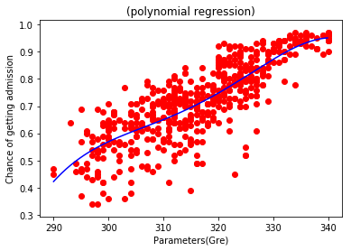
Polynomial regression
In polynomial regression by using the dataset university acceptance we are predicting the acceptance rate of a given application based on gre score,toefl score,university rating,statement of purpose.￼

Slide 5
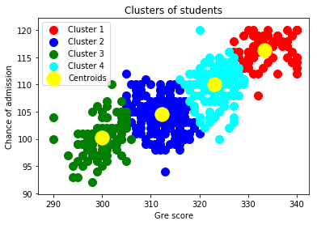
KNN clustering
In this based upon given parameters we are grouping input data into four clusters,which are :
Low acceptance
Average acceptance
High acceptance
Very High acceptance

Slide 6

Chatbot
In this chatbot we used inbuilt mathematical operator and time adaptor to give the machine to answer mathematical and time related questions
Eg: ⅔?

Slide 7
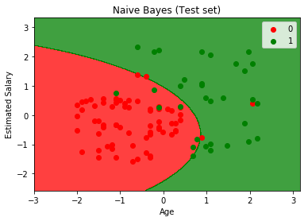
Naive bayes
Bayes’ Theorem finds the probability of an event occurring given the probability of another event that has already occurred. Bayes’ theorem is stated mathematically as the following equation:
Based upon the salary,age,family size,previous purchase history we are predicting the rate of acceptance of a given product i.e, an SUV or a sedan.

Slide 8
Natural language processing
Using NLTK library we are differentiating a restaurant review based on whether it is a positive review of a negative review. Firstly removal of words which do not help in determining the result and cleared and for the remaining words ,with the help of stopwords and corpus we have created a confusion matrix.

Slide 9
Thank You

