Slide 1
Ray Tracing Results
Mamona Awan
20141006

Slide 2
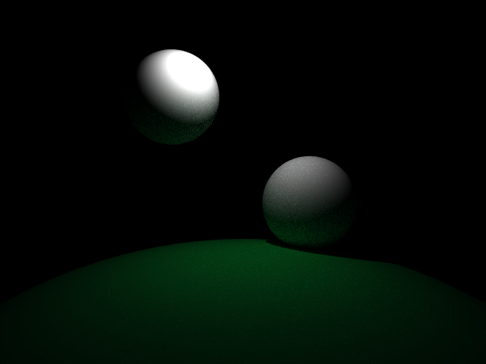
Results

Slide 3
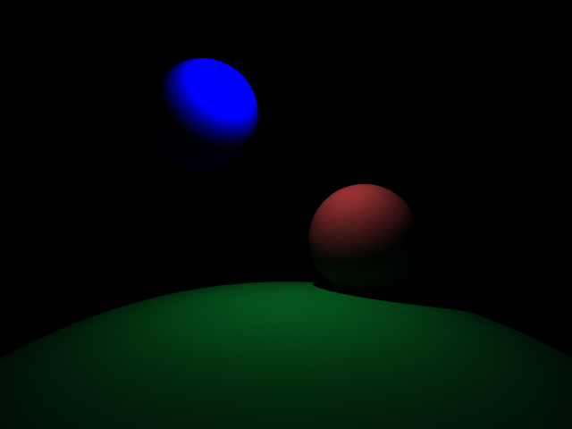
Results

Slide 4
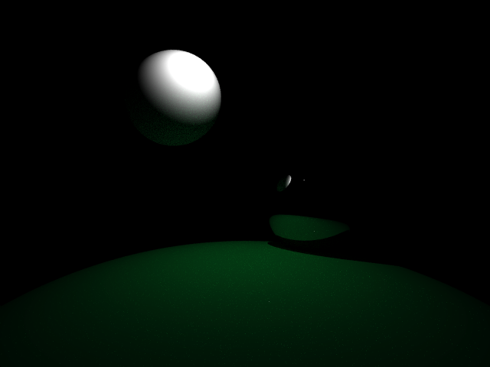
Results

Slide 5
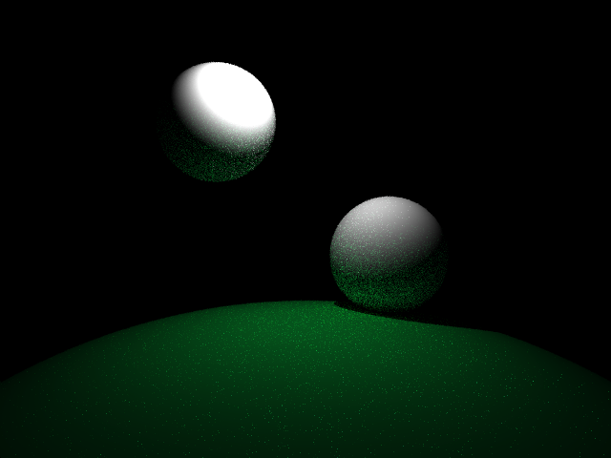
Results

Slide 6

Results

Slide 7

Results

