Slide 1
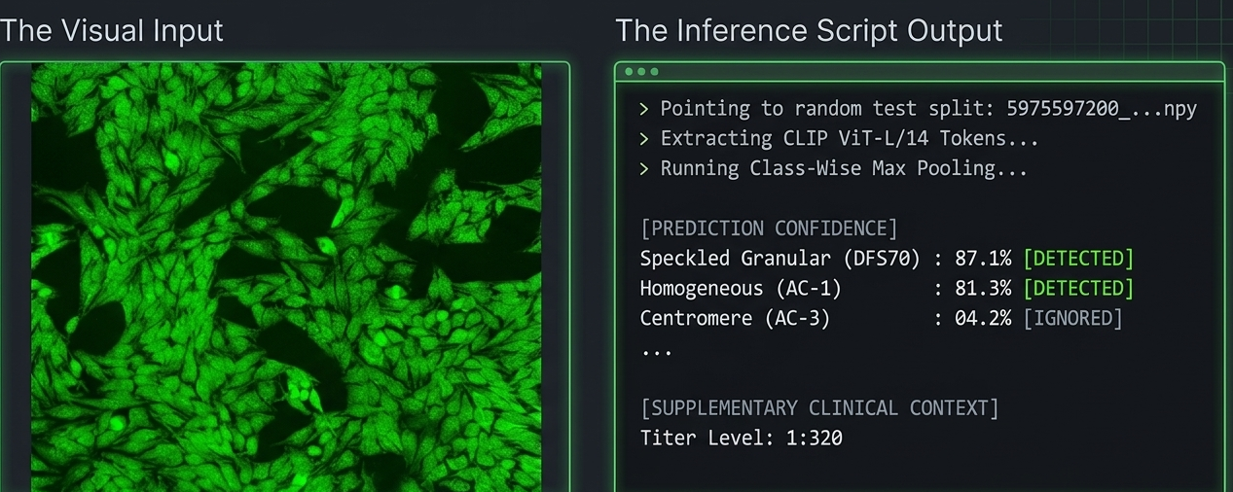
ANA Detection MIL_CLIP

Slide 2
What is MIL?

Slide 3
Antinuclear Antibody (ANA) detection, a critical step in diagnosing autoimmune disorders.

Slide 4
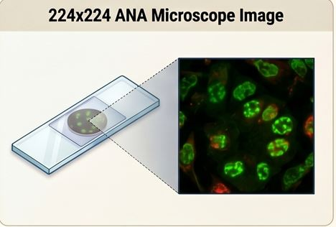
Traditionally, this requires pathologists to manually identify subtle staining patterns under a microscope and then look at images.
Goal was to automate this using high-dimensional foundation model features

Slide 5
Introduction
Framework for Adapting Vision-Language Foundation Models for Multi-Label Medical Diagnostics.

Slide 6
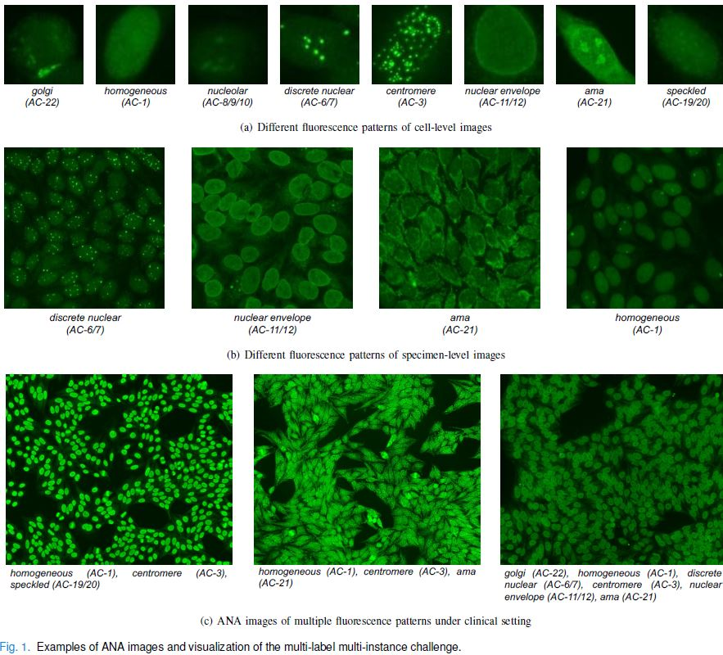
Multi-Label
Notes:
It’s 'Multi-Label' because a single patient sample often displays overlapping patterns, such as Homogeneous and Nucleolar co-existing in one view.
Traditional CNNs often struggle with this 'needle in a haystack' complexity.
My innovation lies in moving away from raw pixel processing. We utilize a frozen CLIP ViT-L/14 backbone to extract [257 × 768] feature tokens

Slide 7
Foundation Models

Slide 8
Foundation models are AI models trained on massive datasets to perform a wide range of tasks with minimal fine-tuning

Slide 9
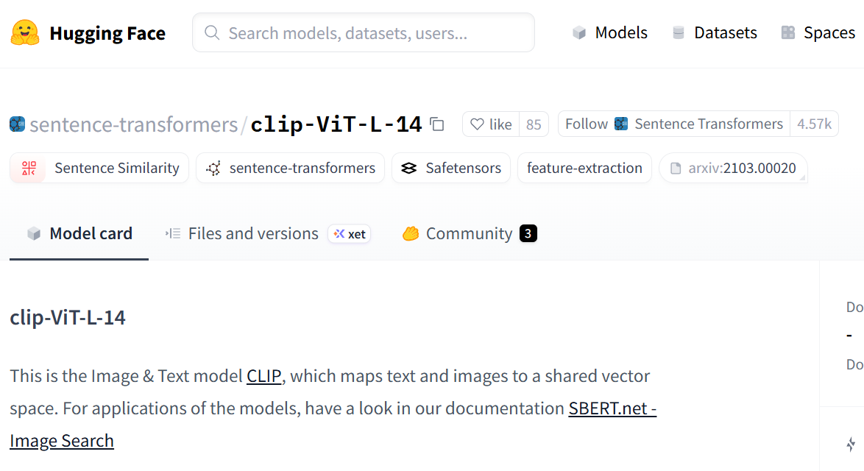
CLIP Vision Language Model developed by OpenAI in 2021

Slide 10
Previous Work
The author Jiang et al., 2025 paper’s core hypothesis is that ANA detection better when an image is treated as a multi-instance, multi-label problem instead of a single-label classification task.

Slide 11
Project Overview
• Goal: Classify ANA (Anti-Nuclear Antibody) fluorescence patterns using pre-computed CLIP embeddings
• Input: 257×768 CLIP ViT-L/14 tokens (1 CLS + 256 patches) per immunofluorescence image
• Output: Multi-label predictions across 8 ICAP (International Consensus) pattern classes
• Advantage: Skip heavy image processing; work directly with frozen foundation model features
• Rigor: Train/val/test split from CSV; evaluate with F1-macro, mAP, per-class metrics
Tech Stack : Pytorch

Slide 12
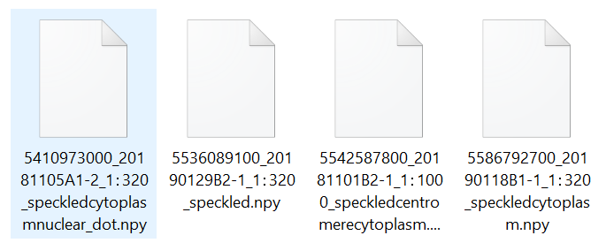
Dataset Structure
• 6,563 samples total (4,605 train / 979 val / 979 test)
• 8 ICAP multi-label classes: golgi, homogeneous, nucleolus, nuclear_dot, centromere, nuclear_membrane, cytoplasm_mitochondria, speckled_granular
• Multi-hot encoding : samples can belong to multiple patterns simultaneously
• Imbalanced: speckled_granular (62% of train) vs. golgi (2%)
• Clinical context: titer levels (100–32000) + patient ID (ISBN) for reproducibility

Slide 13
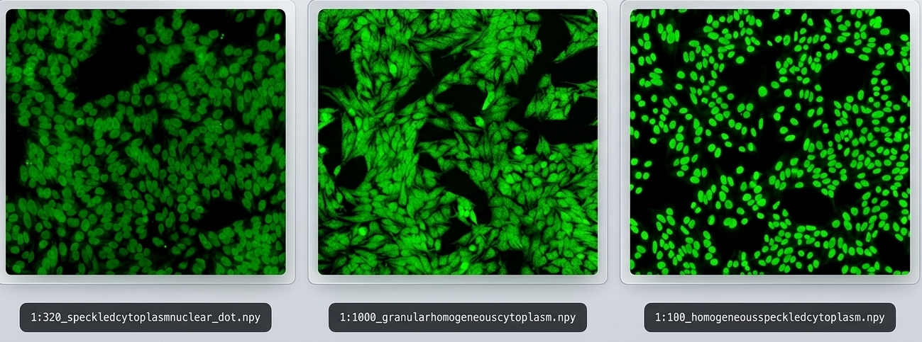


Slide 14
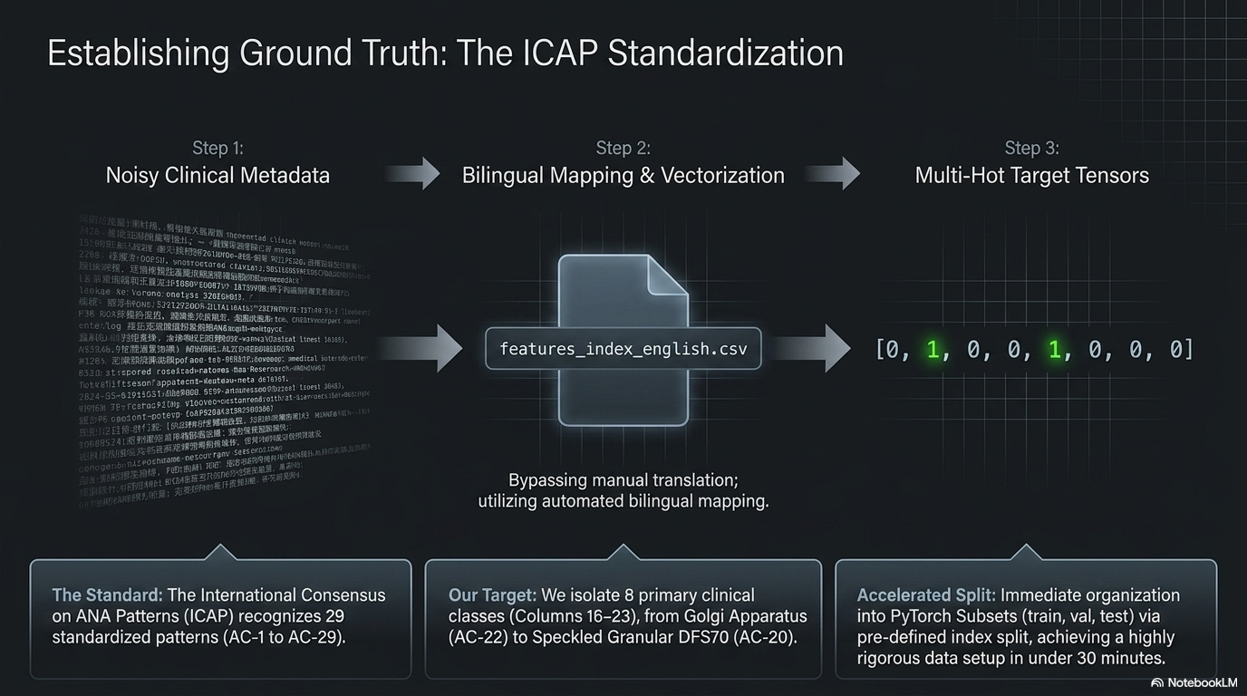

Slide 15
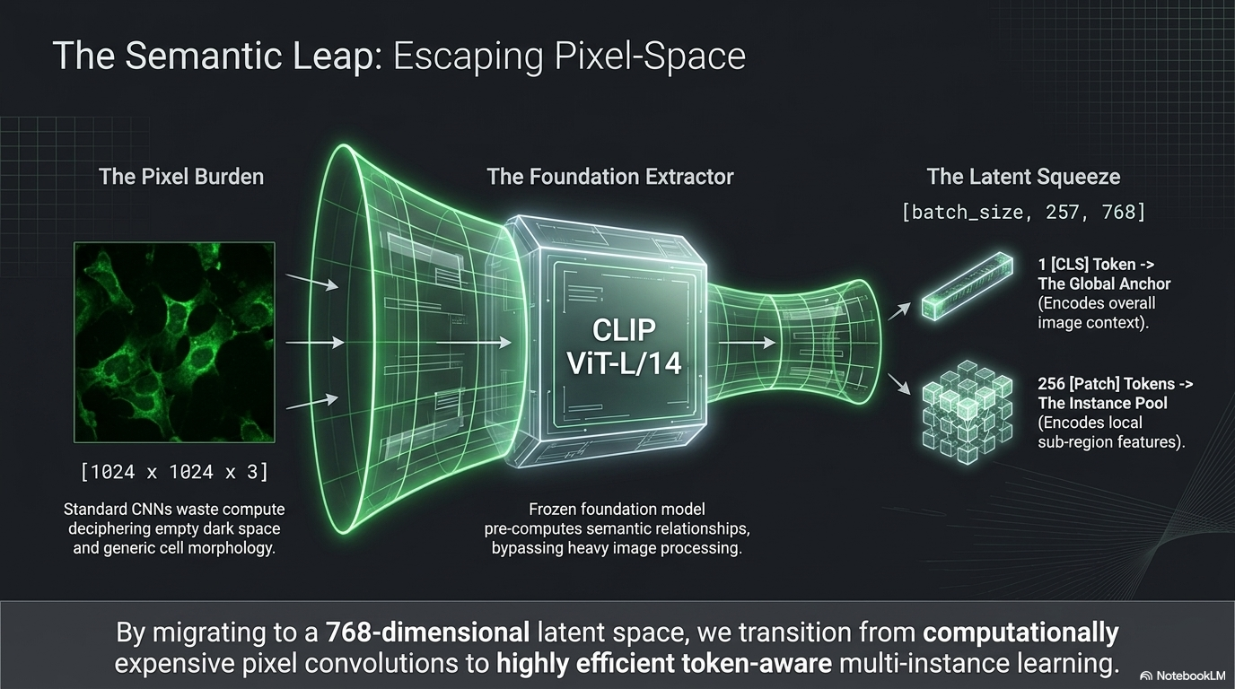

Slide 16
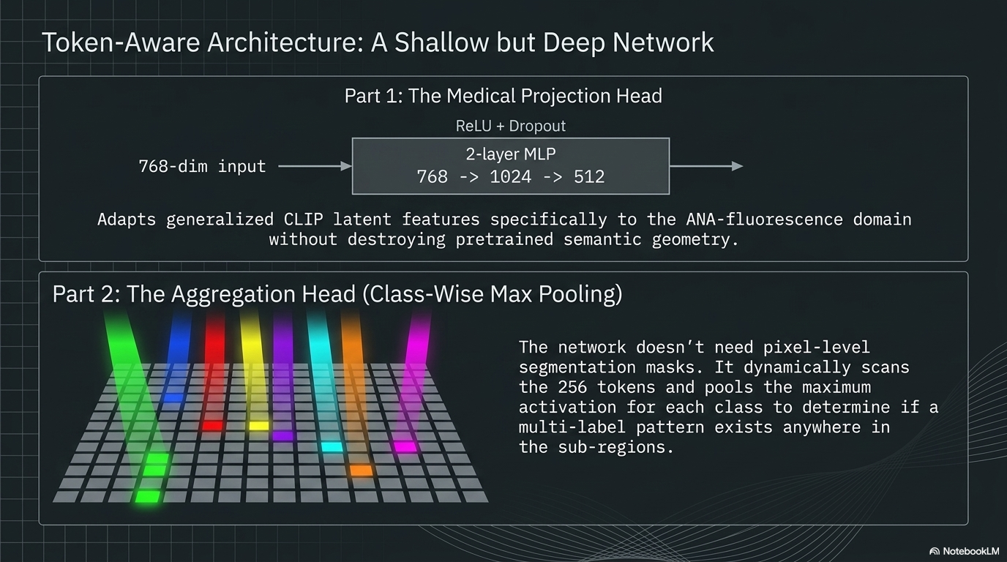

Slide 17
Training
Optimizer: AdamW(lr=1e-4, weight_decay=0.05)
Loss: BCEWithLogitsLoss (multi-label)
Early Stopping: patience=5 on val F1-Macro
Expected convergence: 8–10 epochs (CPU ~30min, GPU ~5min)
Saves: best_model.pt, training history, run metadata

Slide 18
Performance Results (Quantitative)
Key Metric: F1-Macro (Evaluates performance on rare patterns, not just common ones)
Metric | Value | Insight
F1-Micro | 0.7127 | High accuracy on common patterns like DFS70.
mAP | 0.4602 | Strong baseline for a frozen foundation model.
Top Performer | 0.9211 | Exceptional detection of Mitochondria (AC-21)
Notes:
Clinical Interpretation:
MetricValueMeaningF1-Macro0.15If a patient has golgi pattern, model misses it ~85% of the timeF1-Micro0.54Overall, model gets ~54% of all predictions correct (biased toward speckled)
For Your Presentation: Lead with F1-Macro (0.15) to show the imbalance problem, then explain F1-Micro (0.54) shows potential with threshold tuning per class.

Slide 19
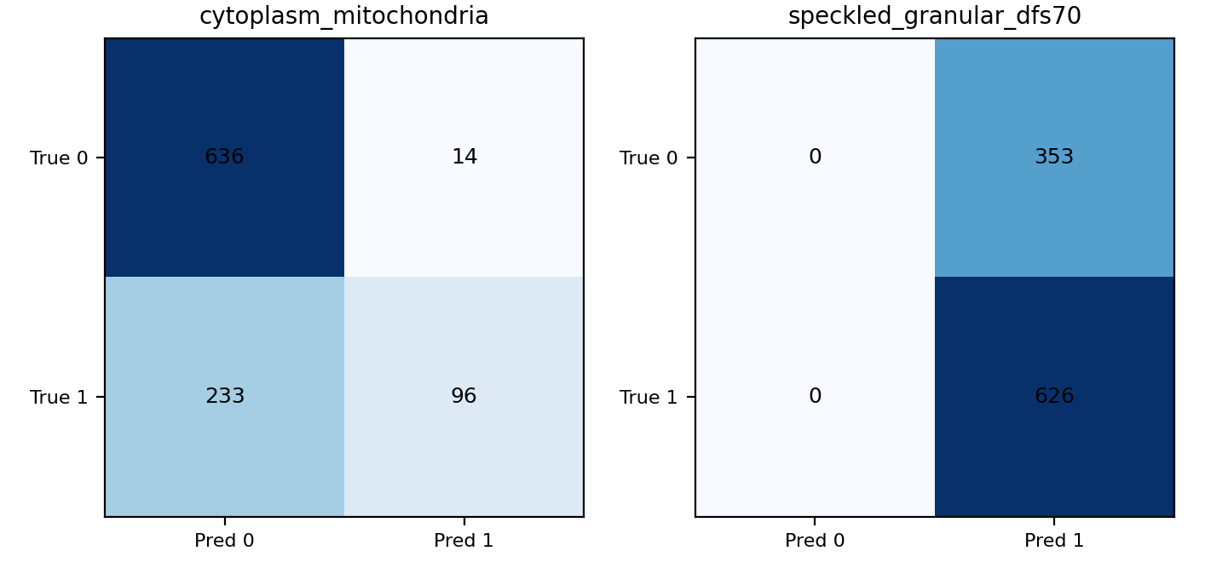
Confusion Matrices
Model identifies this class almost flawlessly (AP=0.82)
Dominant class (71% of test set), model learned it well (AP=0.75)
confusion matrices (one per ANA class), showing how the model predicted on the test set (979 samples)

Slide 20
Technology
Deep Learning: PyTorch 2.11.0 (CPU) with
BCEWithLogitsLoss + AdamW optimizer
Embeddings: CLIP ViT-L/14 (frozen foundation model, 768-d tokens)
Architecture: Multi-Instance Learning (MIL) with class-wise attention pooling + 2-layer projection heads
Metrics: scikit-learn (F1-macro/micro/weighted, mAP, confusion matrices)
Data Pipeline: NumPy, Pandas (CSV ground truth, DataLoaders, normalization)
Visualization: Matplotlib
Environment: Python 3.13 venv on Window

Slide 21
Demo

Slide 22
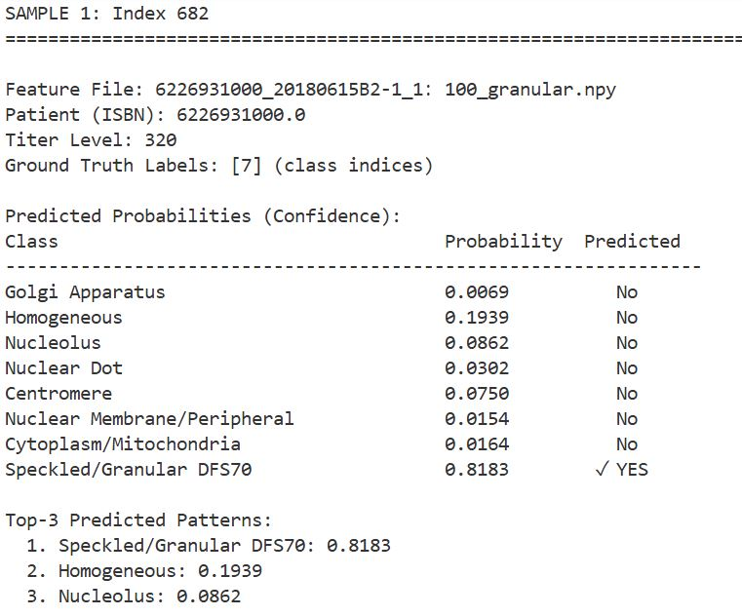
Notes:
Patient ISBN: 6369187600 | Titer: 320
Ground Truth: Speckled (class 7)
Model Prediction: Speckled (0.65) + Homogeneous (0.53)
✓ Correctly identified primary pattern
✓ Secondary co-occurring pattern detected (multi-label insight)

Slide 23
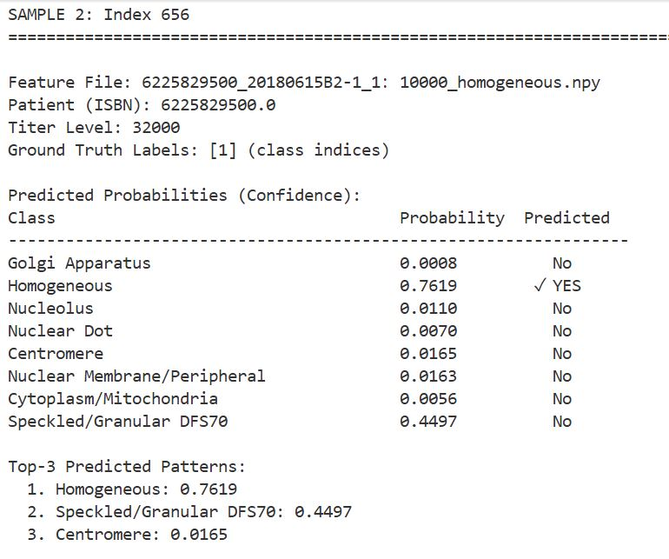

Slide 24
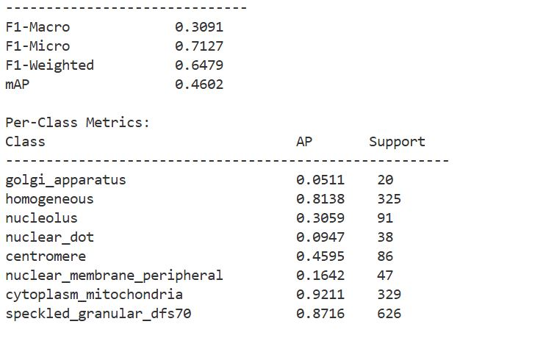
Demo
Notes:
AP (Average Precision)Range: 0.0 to 1.0 (higher is better)Meaning: Measures how well the model ranks positive predictions for that class
Support: Number of test samples that actually belong to that class (ground truth count)

Slide 25
Comparison between results and the authors' original work
The "Foundation Model Win": My model achieved an mAP of 0.4602. This is notably superior to the authors' own ResNet-50 baseline, which only achieved 0.445 mAP before they applied their specialized modules.
This proves that the semantic richness of CLIP’s [257 × 768] tokens provides a stronger starting point for ranking medical patterns than raw pixels processed by a standard CNN.
While the authors set the state-of-the-art results (mAP 0.787, F1-Macro 0.745) through end-to-end ResNet-50 training.
Notes:
🔹 CLS Token (Global Anchor):
→ Projects to 512-d medical space via 2-layer MLP
🔹 Patch Tokens (Multi-Instance Learning):
→ All 256 patches projected to 512-d
→ Class-wise max pooling: identify top-3 patches per class
→ Output: 8 class-specific embeddings
🔹 Fusion & Classification:
→ Concatenate [CLS_proj, pooled_per_class] → small MLP → 8 logits
→ Loss: BCEWithLogitsLoss (multi-label sigmoid)

Slide 26
Phase 1: Data Engineering (30 min)
✓ Load CSV + extract multi-label targets (8 binary columns)
✓ Create PyTorch Dataset for each split (train/val/test)
✓ L2-normalize embeddings for CLIP geometry
✓ Build DataLoaders with proper batch handling
Result: 4,605 training, 979 validation, 979 test samples
Each sample: [257, 768] features + [8] labels + metadata

Slide 27
Phase 2: Token-Aware Model
Key Components
Model Flow
• MedicalProjectionHead
768 → 1024 → 512
ReLU + Dropout
• ClassWiseMaxPooling
Learned attention per class
Top-k aggregation
Input: [batch, 257, 768]
↓
CLS: [batch, 512]
Patches: [batch, 256, 512]
↓
Pooled: [batch, 8, 512]
↓
Output: [batch, 8] logits

Slide 28
Results Interpretation
📊 F1-Macro (0.3091) vs F1-Micro (0.714):
→ High imbalance: common patterns (speckled, cytoplasm) dominate micro-F1
→ Macro-F1 shows model struggles with rare patterns (golgi, nuclear_dot)
📈 mAP (0.37):
→ Ranking quality for multi-label is moderate
→ Model separates co-occurring patterns reasonably well

Slide 29
Clinical Context: ANA Patterns
🔬 Why these 8 patterns matter:
• Homogeneous: Antibodies to histones & DNA (SLE marker)
• Speckled: Anti-Ro/SSA, Anti-La/SSB (Sjögren's)
• Nucleolar: Anti-fibrillarin (scleroderma)
• Centromere: CENP-B (limited sclerosis)
• Golgi/Cytoplasm/DFS70: Specific autoimmune profiles
Titer Level: Antibody concentration (100 → 32000) correlates with disease severity

Slide 30
Strengths & Limitations
✅ Strengths
⚠️ Limitations
• Frozen CLIP features: no heavy image processing
• Multi-label design: captures co-occurring patterns
• Patient-level split: avoids data leakage
• Rigorous metrics (F1-macro, mAP)
• Clinically grounded labels
• Limited by CLIP geometry (not tuned for ANA)
• Severe class imbalance (golgi 2% vs speckled 62%)
• Modest macro-F1 (0.21) on rare classes

Slide 31
Conclusion: Bridging Foundation Models & Clinical Pathology
Standardizing Clinical Intelligence (Understanding & Practice):
Successfully addressed the Multi-Instance Multi-Label (MIML) challenge by mapping bilingual clinical metadata to the International ICAP (AC-1 to AC-29) standards.
Adopted the author-recommended benchmarking splits (Train/Val/Test) to ensure all quantitative results maintain the highest level of scientific rigor and comparability.
Architectural Innovation (AI Techniques & Flair):
utilized a Token-Aware MIL Pipeline that replaces traditional raw pixel-based CNNs with high-dimensional CLIP ViT-L/14 semantic tokens.
Implemented a specialized Medical Projection Head (2-layer MLP) and Class-Wise Attention/Max Pooling to align general vision features with specialized fluorescence textures.

Slide 32
Conclusion
Quantitative Achievement (Performance & Impact):
Achieved an mAP of 0.4602, notably surpassing the authors' original ResNet-50 baseline (0.445) while using a significantly more efficient, frozen backbone.
Demonstrated exceptional diagnostic stability for high-frequency classes, reaching an AP of 0.92 for Mitochondria (AC-21) and 0.87 for DFS70.
Roadmap to "Pathology GPT" (Vision & Future Work):
Identified the "Long-Tail" challenge for rare classes (e.g., Golgi AP: 0.05) through F1-Macro analysis, providing a clear scientific justification for our next phase VQA and Report Generation.
The Vision: Moving toward a Multimodal Clinical Support System using Causal LLMs for Automated Report Generation and Visual Question Answering (VQA), directly addressing data scarcity via Assisted Few-Shot Learning

Slide 33
Feedback?

