Slide 1
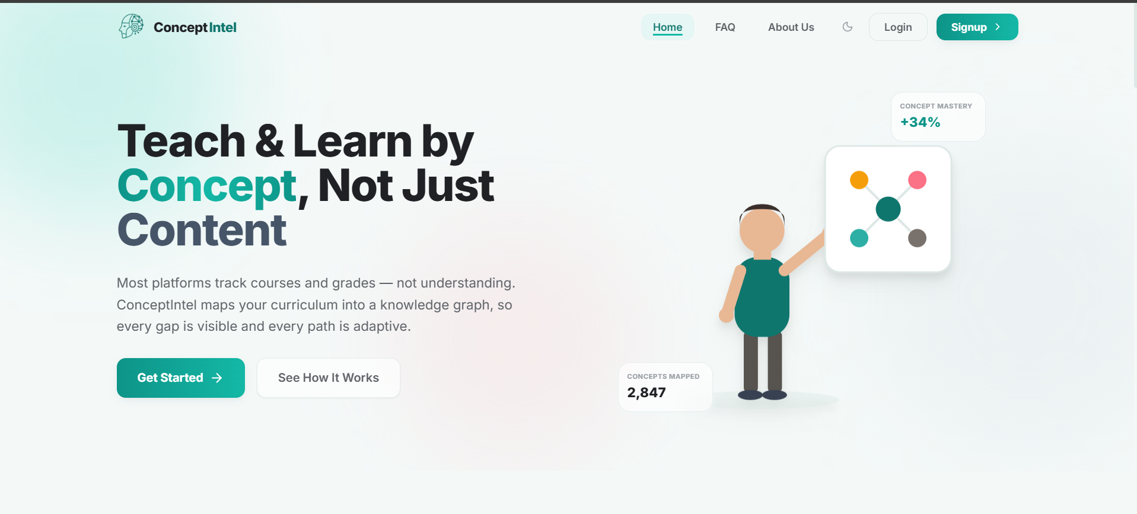
C
FINAL YEAR ROJECT - EDTECH
ConceptIntel
A Knowledge Graph–Based Concept Intelligence Platform for Adaptive Higher Education
Group Members:
Mamoona
Laiba
Muhammad Kashif
Supervisor: Dr. Sumaira Farid
Live at ConceptIntel — real product, not a mockup
Air University, Islamabad | Faculty of Computing & AI

Slide 2
INTRODUCTION
Rethinking Digital Learning
Universities run on LMS platforms that manage courses and record grades but never measure understanding.
Knowledge is hierarchical: you cannot grasp acceleration without first understanding velocity and time.
ConceptIntel maps every course into a knowledge graph, so gaps are visible before a final score ever hides them.
“Today's systems measure performance, but they do not measure understanding.”
3
5
12
1
Pilot Subjects
User Roles
Planned Modules
Unified Platform
ConceptIntel
2

Slide 3
THE PROBLEM
The Challenge in Higher Education
Traditional platforms are administrative tools, not intelligent learning systems.
  Student-side problems:
  Progression without mastering prerequisites lead to fragmented knowledge
  No concept-level tracking of learning
  Lack of insight into which concepts are weak
  Feedback on assignments is generic, manual, or static
  Teacher-side problems:
  Cannot identify struggling concepts easily
  Manual content creation and assignment review is time-consuming
  Limited ability to provide adaptive, personalized guidance
  AI tools are disconnected from course content
ConceptIntel
3

Slide 4
MARKET LANDSCAPE
Existing Solutions vs. ConceptIntel
Application | Limitation | Proposed System (Nodle)
Google Classroom | Supports assignments but lacks adaptive learning insights. | Tracks concept mastery and generates quizzes.
Coursera | Static learning paths with limited course customization. | Creates dynamic knowledge graphs and adaptive paths.
Khan Academy | Uses predefined content; teachers cannot create concept graphs. | Extracts concepts from uploaded materials automatically.
Duolingo | Mainly for language learning with fixed skill tree. | Supports any subject using flexible concept graphs.
Socratic | Gives quick answers but does not track progress. | Tracks concept-level progress and recommendations.
ChatGPT | Explains topics but not linked to course progress. | Connects AI with course content and analytics.
Edkasa | Provides recorded lecs, prep but limited concept-level AI analysis. | Uses knowledge graphs and adaptive learning to analyze conceptual understanding.
ConceptIntel is the only platform in this comparison that checks every single box.
ConceptIntel
4

Slide 5
MARKET LANDSCAPE
Existing Solutions vs. ConceptIntel
Application
Course
Mgmt
AI
Assist
Know.
Graph
Adaptive
Learning
Teacher
Review
Concept
Analytics
Google Classroom
✓
–
–
–
✓
–
Moodle
✓
–
–
–
✓
–
Coursera
✓
–
–
~
–
–
Khan Academy
–
–
–
~
–
–
ChatGPT
–
✓
–
–
–
–
ConceptIntel
✓
✓
✓
✓
✓
✓
ConceptIntel is the only platform in this comparison that checks every single box.
ConceptIntel
4

Slide 6



OUR SOLUTION
Introducing ConceptIntel
AI-Powered Academic Intelligence
One platform for students and teachers, built around concepts — not just courses.
Knowledge-Graph-Driven Learning
Course material becomes an interconnected map of concepts and prerequisites.
Retrieval-Augmented Generation
Concept extraction is grounded directly in each course's own uploaded material — not guesswork.
ConceptIntel
5

Slide 7



OUR SOLUTION
Introducing ConceptIntel
Adaptive Learning Engine
Personalized paths that reinforce exactly the concepts each student is weak on.
Teacher-in-the-Loop
Every AI-generated concept and knowledge graph is reviewed and approved before students see it.
Curriculum Intelligence
Knowledge graphs are shared and reused across every instructor teaching the same course.
ConceptIntel
6

Slide 8
GOALS
Objectives
Develop a web-based AI platform supporting both students and teachers.
Extract key concepts from course materials into a knowledge graph.
Track concept-level mastery for every student, continuously.
Generate adaptive learning materials — with explainable feedback.
ConceptIntel
7

Slide 9
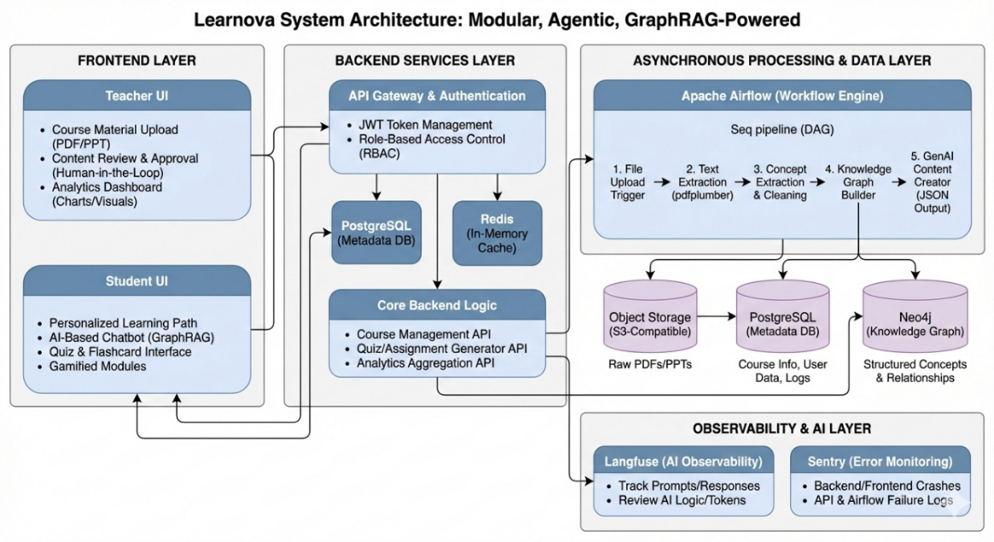
SYSTEM ARCHITECTURE
ConceptIntel
8

Slide 10


PROJECT SCOPE
Prototype Scope
Three real subjects, chosen to prove prerequisite-based concept relationships actually work end to end:
Applied Physics
Digital Logic Design
Calculus & Analytical Geometry
Foundational prerequisite subject
Builds directly on Applied Physics
Independent third pilot subject
Teachers upload slides, PDFs, textbooks, CLOs, PLOs, and HEC outlines.
Graphs are shared across every teacher on the same course — and reused by future instructors.
ConceptIntel
9

Slide 11
HOW IT WORKS
End-to-End Workflow
1
2
3
4
Teacher Uploads Material
→
AI Processing (RAG)
→
Knowledge Graph Built
→
Coordinator Approval
5
6
7
8
AI Content Generated
→
Student Learns
→
Adaptive Feedback
→
Analytics Dashboard
ConceptIntel
10

Slide 12



PLATFORM CAPABILITIES
Core Features — Live Today
Knowledge Graph Builder
Content Upload + RAG
AI Concept Extraction
LIVE
LIVE
LIVE
5-Tier Role-Based Access
Coordinator Approval
AI Assistant Chat
LIVE
LIVE
LIVE
ConceptIntel
11

Slide 13




PLATFORM CAPABILITIES
Core Features — Live & Upcoming
Class Stream
Assignments
Notification Center
LIVE
LIVE
LIVE
Adaptive Learning Engine
Analytics Dashboard
Gamification
UPCOMING
UPCOMING
UPCOMING
ConceptIntel
12

Slide 14
MODULES 7.1 – 7.6
System Modules
7.1
User Authentication
Sign-up, login, role-based access for 5 roles.
LIVE
7.2
Course Management
Create/edit/delete courses with scheduling & status.
LIVE
7.3
Enrollment
Enrollment codes, join links, prerequisite checks.
LIVE
7.4
Content Upload
AI + RAG pipeline extracts concepts & objectives.
LIVE
7.5
Knowledge Graph
Build, edit, and share concept dependencies.
LIVE
7.6
Content Generation
Generate quizzes and study guides from concepts.
UPCOMING
ConceptIntel
13

Slide 15
MODULES 7.7 – 7.12
System Modules
7.7
Teacher Supervision
Review and approve AI-generated content.
LIVE
7.8
Assignment Evaluation
Concept-level grading with explainable feedback.
IN PROGRESS
7.9
Adaptive Engine
Personalizes each student's learning path.
UPCOMING
7.10
Analytics Dashboard
Concept-mastery heatmaps for teachers.
UPCOMING
7.11
Gamification
Mini-games tied to concept mastery.
UPCOMING
7.12
Notification Module
Real-time alerts for content and feedback.
LIVE
ConceptIntel
14

Slide 16




TECHNICAL ARCHITECTURE
System Architecture
Users
Students · Teachers · Coordinators · Admins
▼
React Frontend
React 19 · TypeScript · React Flow · Tailwind
▼
FastAPI Backend
REST API · JWT/OAuth · Role-Based Access Control
▼
AI & RAG Layer
OpenAI GPT · fastembed · OCR · Langfuse Tracing
▼
Data Layer
Neo4j Knowledge Graph + PostgreSQL Vector Store
▼
Storage & Services
AWS S3 / Supabase Storage · Email · Notifications
ConceptIntel
15

Slide 17
TECHNOLOGY
Technology Stack
Tool / Technology | Keywords / Use
React | Frontend, UI, responsive, components
FastAPI | Backend, API, REST, Python
PostgreSQL / Supabase | Auth, PostgreSQL, object storage, online ,Relational DB, structured data
Neo4j | Graph DB, knowledge graph, concepts
OpenAI Models (Kimi) | AI content generation, assignment feedback, adaptive learning
Langfuse | LLM tracing, prompt management, model management
Sentry | Error monitoring, bug tracking
Apache Airflow | Job scheduling, batch tasks, pipelines
ConceptIntel
16

Slide 18
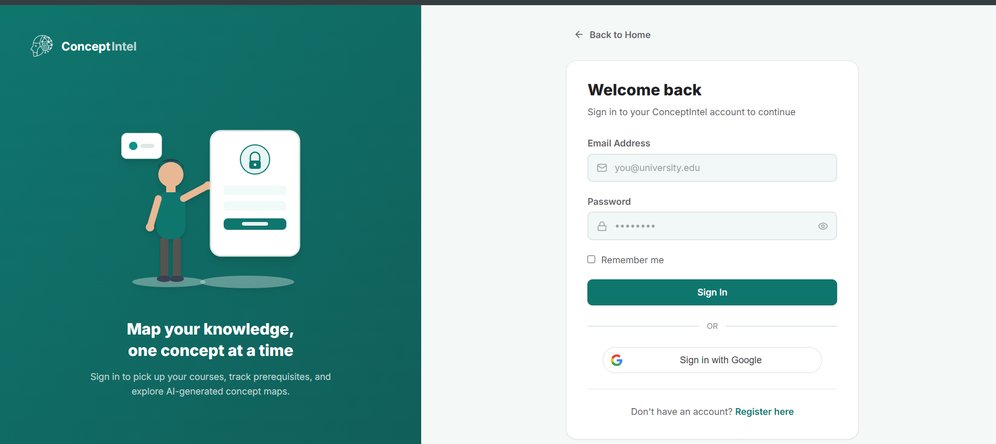
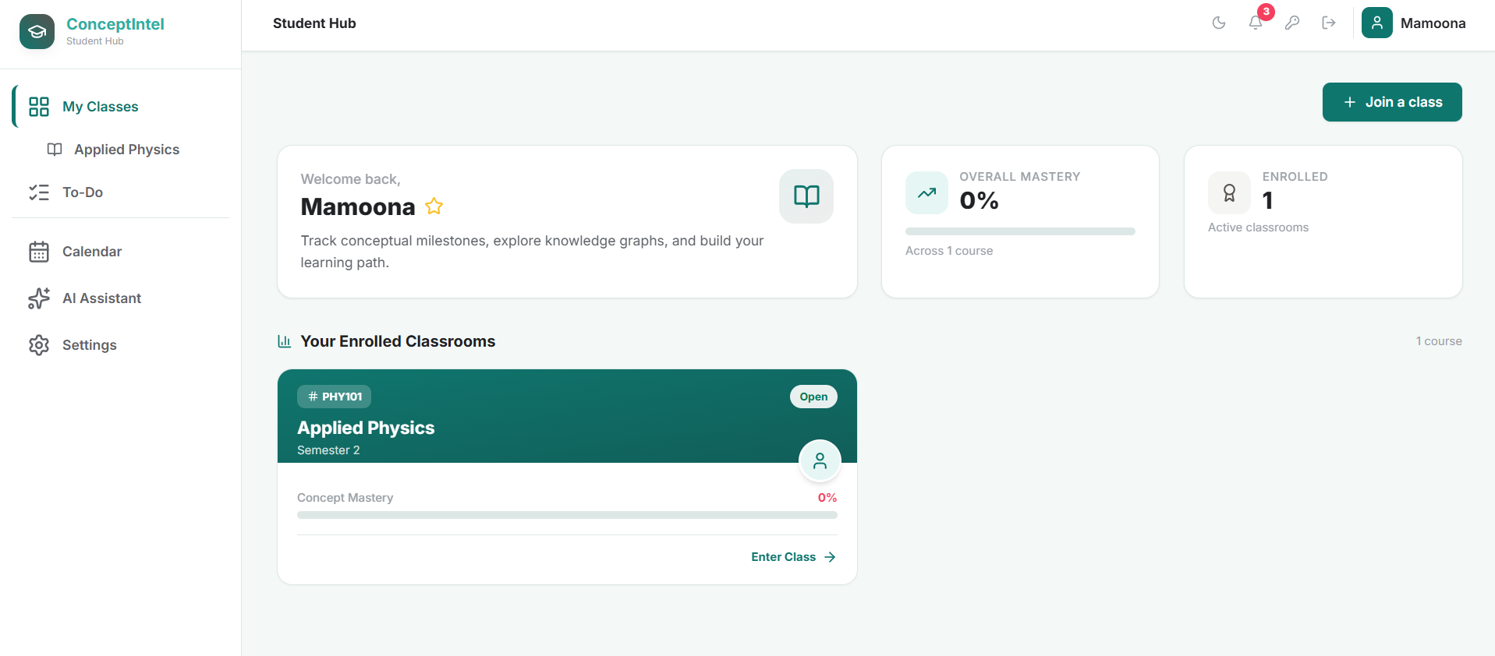
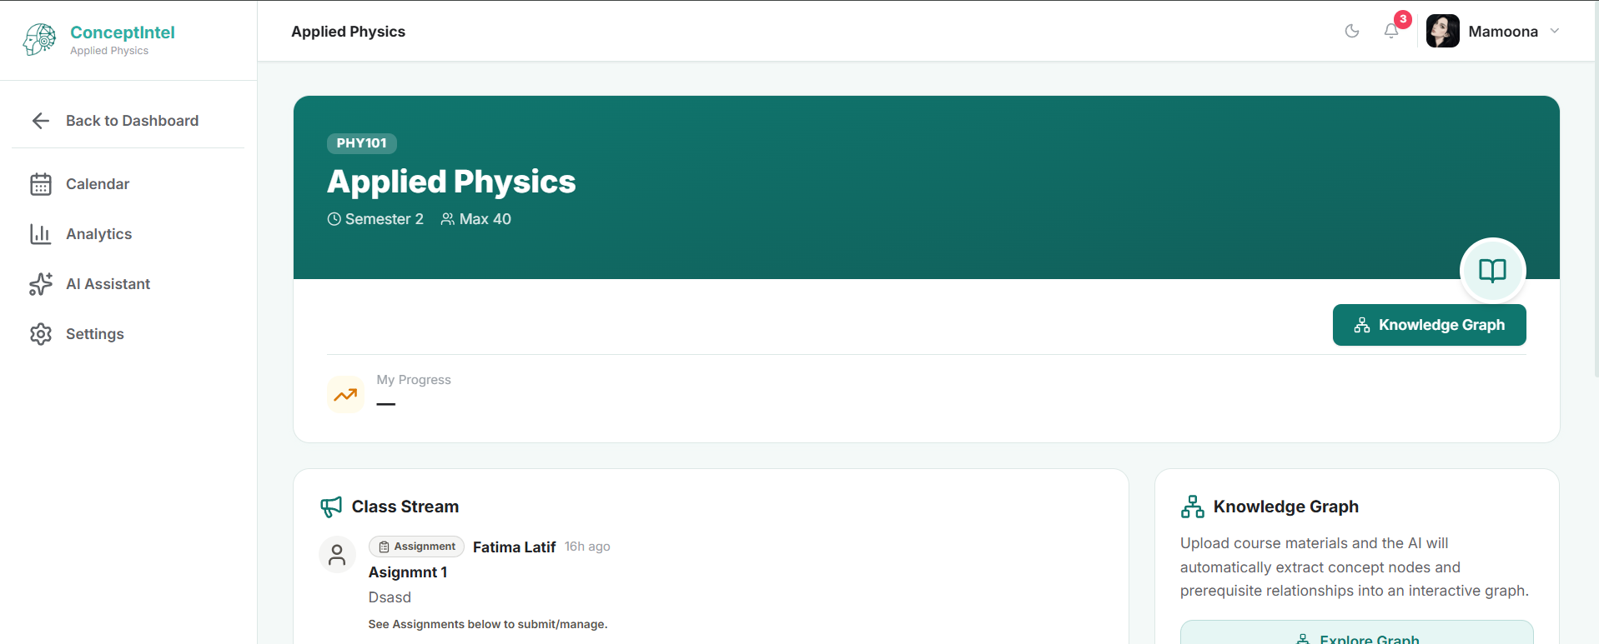
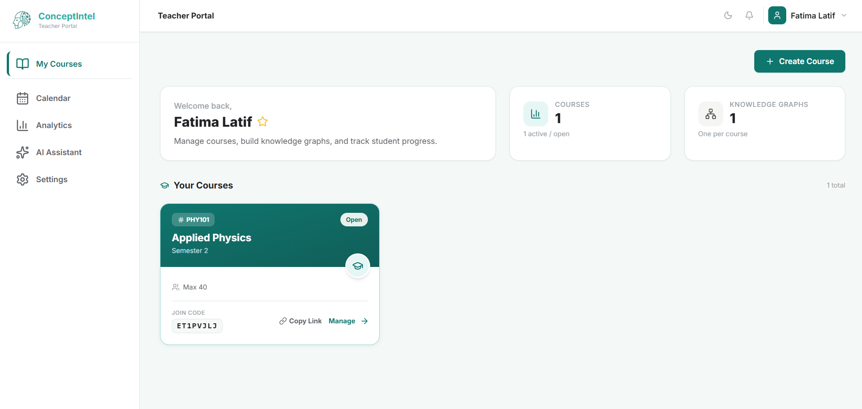
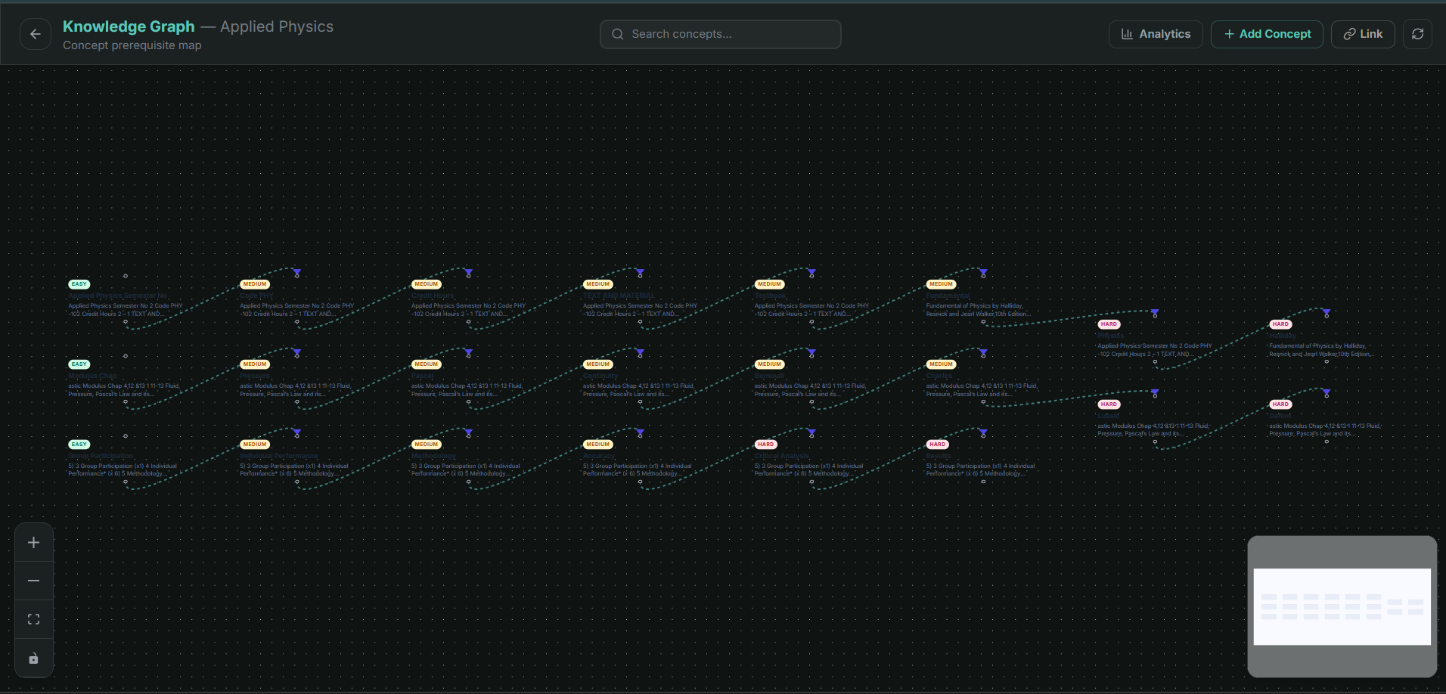
PROTOTYPE PREVIEW
Product Demonstration (1 of 2)
Landing Page
Login & Google Sign-In
Student Dashboard
Student — Course & Knowledge Graph
Teacher Portal Dashboard
Knowledge Graph Editor
Live screenshots from the running prototype — every screen shown is real.
ConceptIntel
17

Slide 19
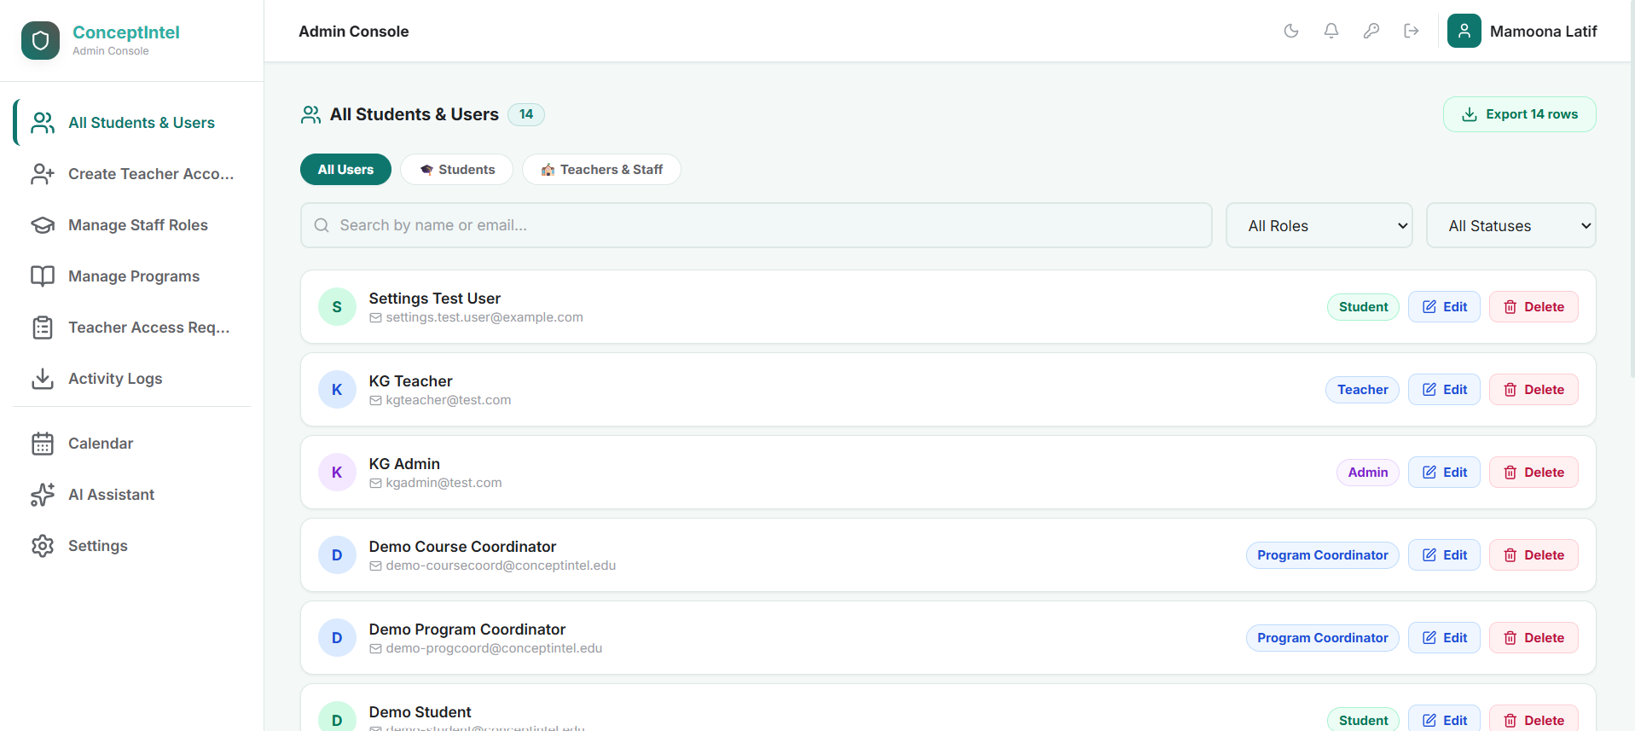
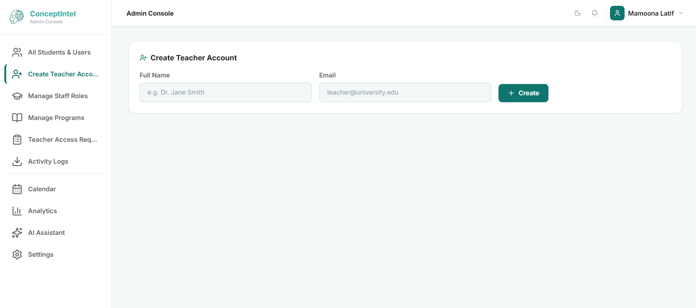
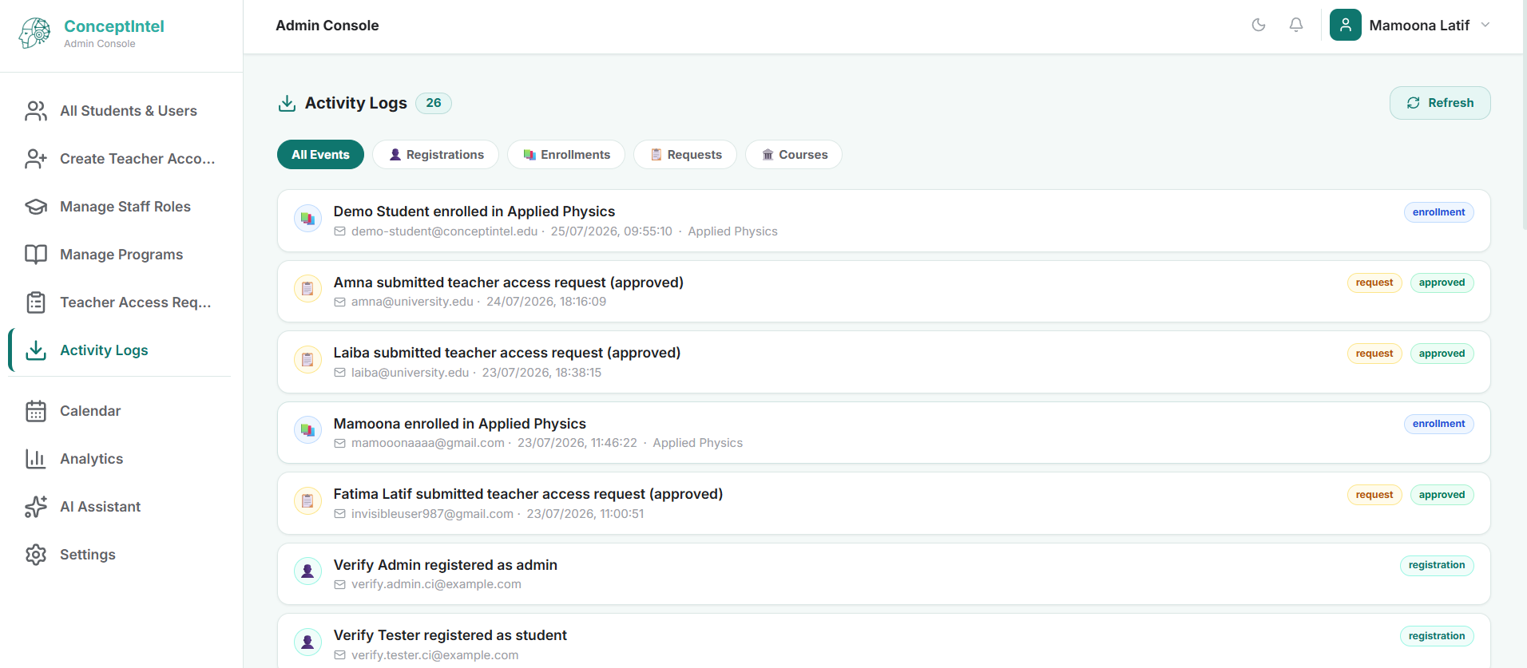
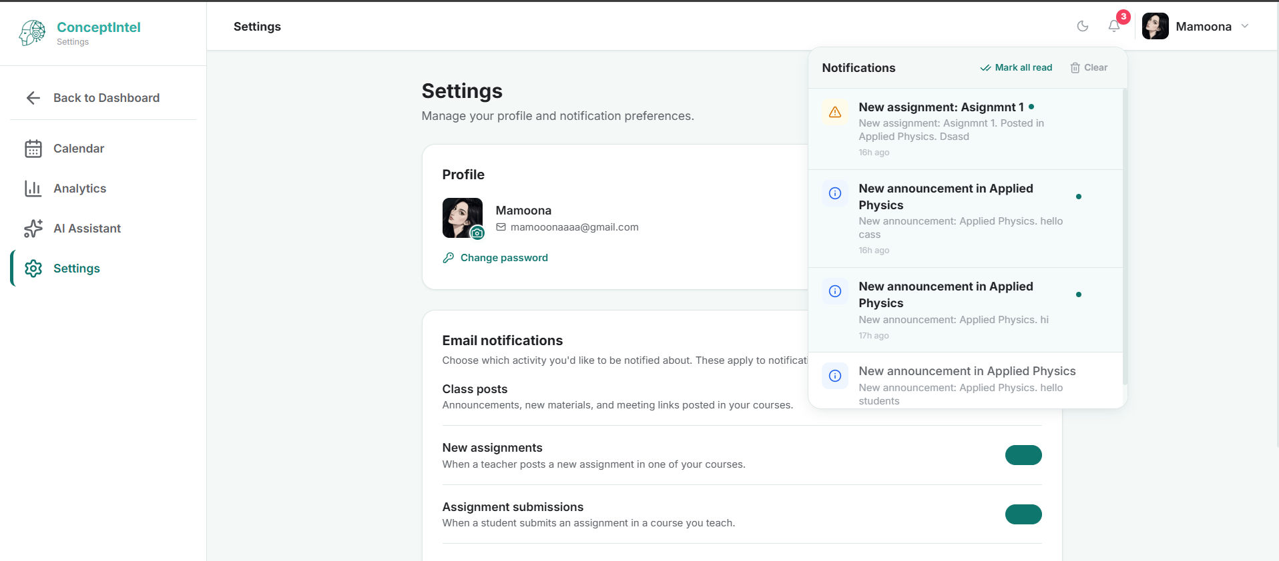
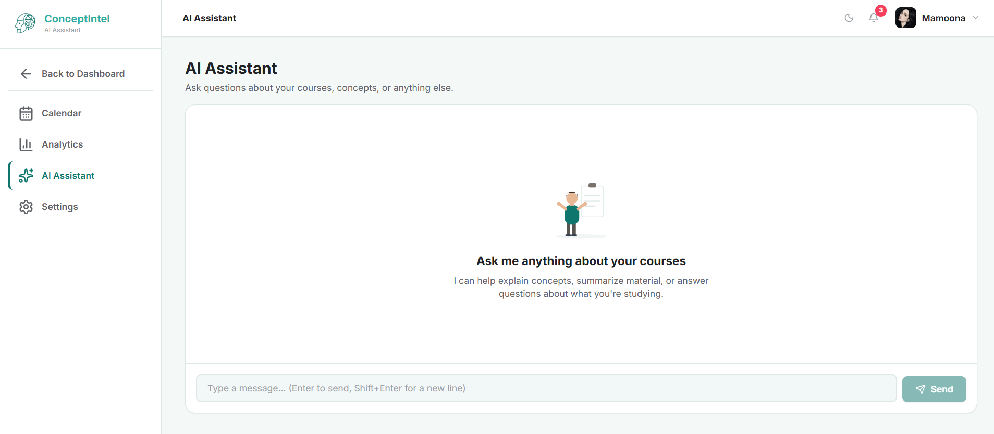
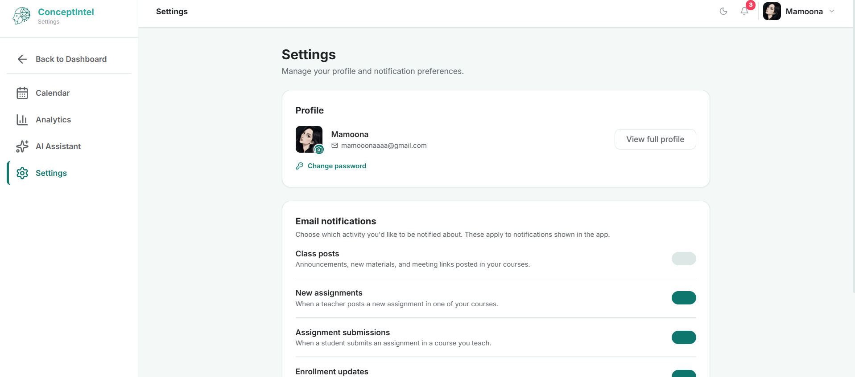
PROTOTYPE PREVIEW
Product Demonstration (2 of 2)
Admin Console — All Users
Create Teacher Account
Activity Logs (Full Audit Trail)
Notification Center
AI Assistant Chat
Account Settings
Every user role — Student, Teacher, Admin — has a fully working, distinct experience.
ConceptIntel
18

Slide 20
DIFFERENTIATION
Why ConceptIntel Is Different
AI + Knowledge Graph Fusion — concept extraction is grounded in a real graph database, never a flat AI response.
Curriculum-Aware RAG — every answer is retrieved from the course's own uploaded material.
Teacher-Approved AI — a dedicated Course Coordinator role reviews and approves every knowledge graph.
Shared Institutional Knowledge — graphs are reused across instructors teaching the same course, term after term.
Multi-Tier Academic Governance — five distinct roles mirror how real universities actually run.
Concept-Level Analytics — insight into exactly which prerequisite concepts a cohort is weak on, not just grades.
ConceptIntel
19

Slide 21
HONEST CONSTRAINTS
System Limitations & Constraints
AI Extraction Isn't Perfect
Prototype-Focused
Automated concept extraction can require teacher adjustment.
Targets 3 pilot subjects, not full-scale deployment yet.
Compute at Scale
Depends on Material Quality
Real-time adaptation for many concurrent students needs more compute.
Extraction quality depends on the uploaded materials themselves.
ConceptIntel
22

Slide 22
METHODOLOGY
Data Gathering Approach
Educational Materials
User Interaction Data
Slides, textbooks, and course outlines are processed with AI to extract concepts.
Quiz responses and learning progress are tracked over time.
Supervisor Guidance
Existing System Analysis
Academic supervisors shape system design decisions continuously.
Analysis of existing digital learning platforms informs every workflow.
ConceptIntel
23

Slide 23

WHO'S INVOLVED
Project Stakeholders & Roles
Project Sponsor: Air University, Islamabad
Students
Teachers
Coordinators
Supervisor
FYP Committee
Following adaptive learning paths
Course creators and KG supervisors
Curriculum oversight and approval
Dr. Sumaira Farid — guidance
Final project assessment
ConceptIntel
24

Slide 24
PROJECT TIMELINE
Development Gantt Chart
W0
W3
W6
W9
W12
W15
W18
Research & System Design
Auth + Course Management
Enrollment + Coordinator Roles
Content Upload + RAG Pipeline
Knowledge Graph Refinement
Content Generation + Adaptive Engine
Assignment Evaluation + Analytics
Testing, Deployment & Pilot
Completed
In Progress
Upcoming
ConceptIntel
26

Slide 25

VISION
Impact, Scalability & Roadmap
Students
Teachers
Universities
Administrators
Personalized, concept-level learning
AI-assisted teaching, full oversight
Reusable curriculum intelligence
Data-driven academic decisions
2026
2027
2028
Future
Prototype Completion & AU Pilot
University Pilot Expansion
Multi-University Deployment
SaaS · LMS Integrations
ConceptIntel
27

Slide 26
CITATIONS
References
1.
Q. Wang, Z. Mao, B. Wang and L. Guo, “Knowledge Graph Embedding: A Survey of Approaches and Applications,” IEEE TKDE, vol. 29, no. 12, 2017.
2.
B. P. Woolf, Building Intelligent Interactive Tutors. Morgan Kaufmann, 2009.
3.
F. Doshi-Velez and B. Kim, “Towards A Rigorous Science of Interpretable Machine Learning,” arXiv:1702.08608, 2017.
4.
Kavitha Ganesan and L. Raj, “Educational Data Mining and Learning Analytics,” arXiv, June 2017.
ConceptIntel
28

Slide 27
WRAPPING UP
Conclusion
ConceptIntel's workflow shows how users, AI modules, and course management work together seamlessly.
Content, AI-generated guidance, and teacher supervision are fully integrated — not bolted together.
The result: adaptive, concept-driven learning with a personalized path for every single student.
From knowledge graphs to adaptive feedback — this is intelligence built into the platform, not bolted on top of it.
ConceptIntel
29

Slide 28
THE TEAM
Meet the Team
ML
L
MK
Mamoona Latif
Laiba
Muhammad Kashif
Reg# 231662
Reg# 231627
Reg# 231568
Auth · Content Upload · AI Content Generation · Notifications
Course Mgmt · Knowledge Graph · Analytics · Gamification
Enrollment · Supervision · Assignment Evaluation · Adaptive Engine
Supervisor: Dr. Sumaira Farid | Air University, Islamabad
Reimagining Higher Education through Knowledge Graphs and Artificial Intelligence

