Slide 1

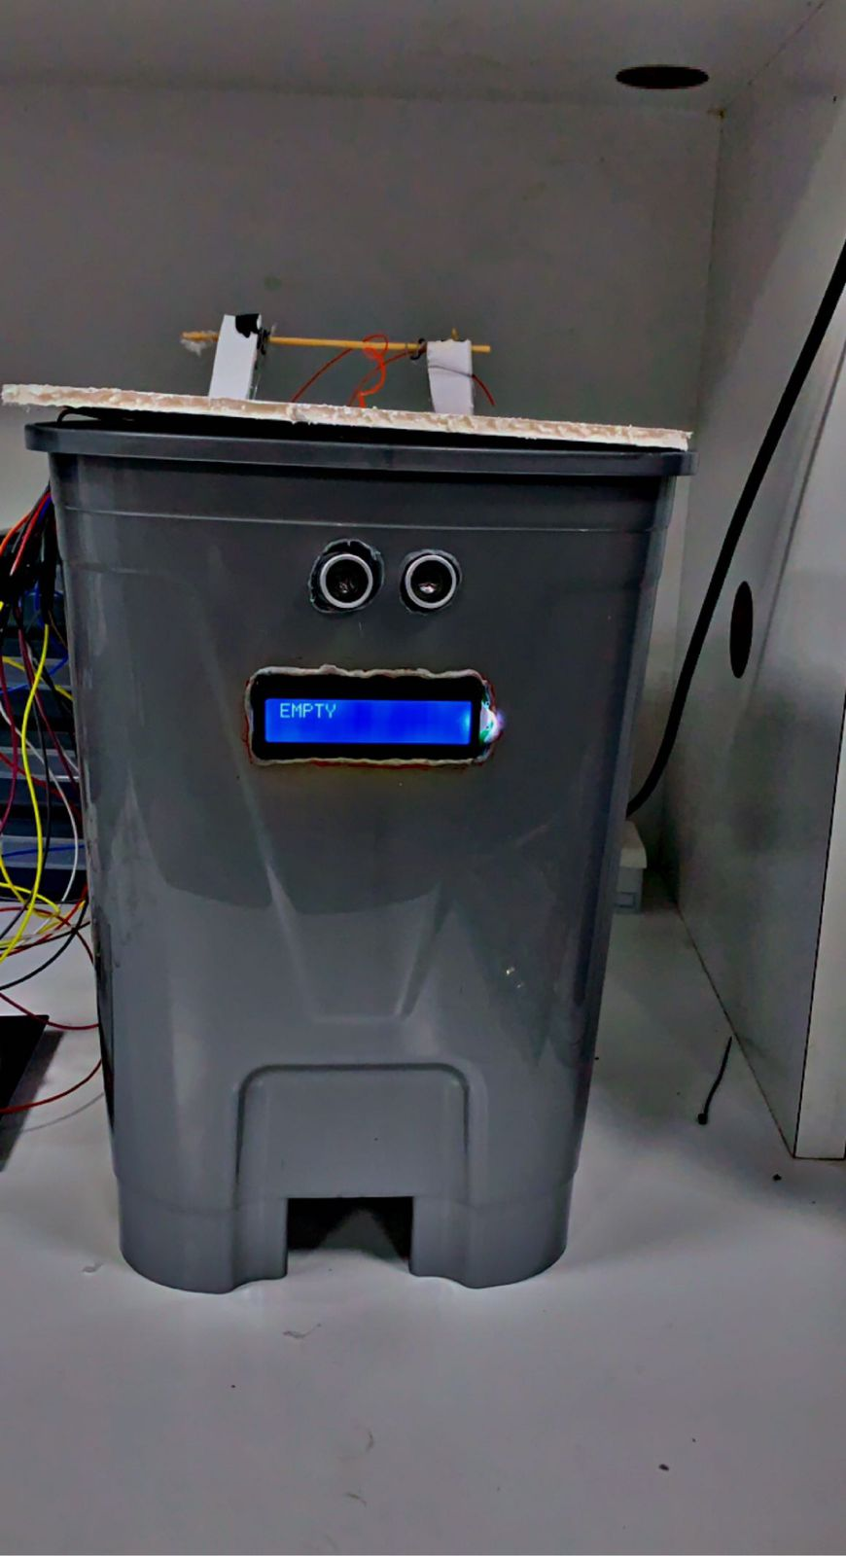
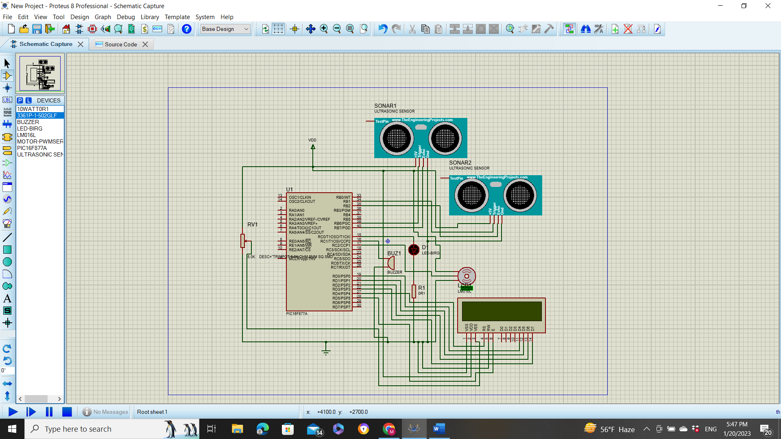
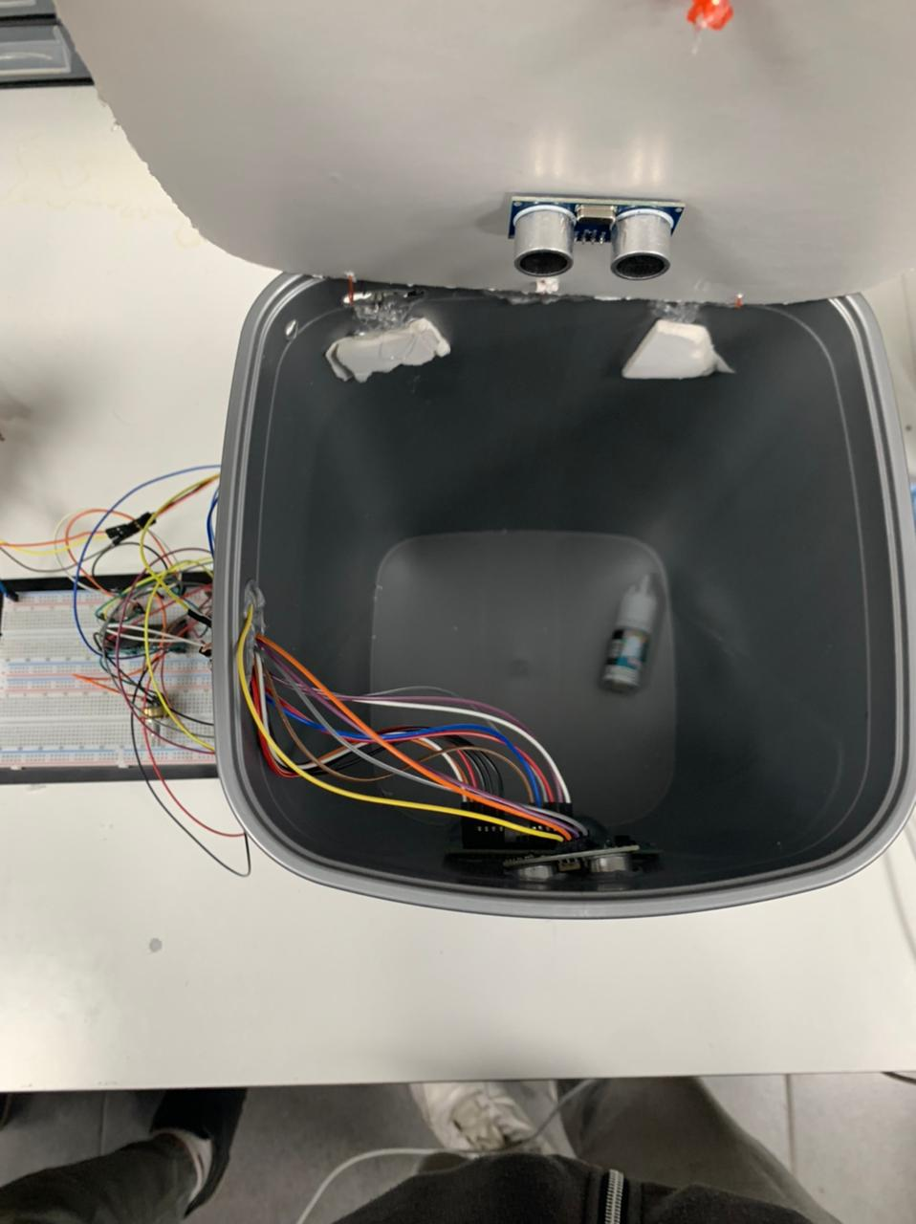
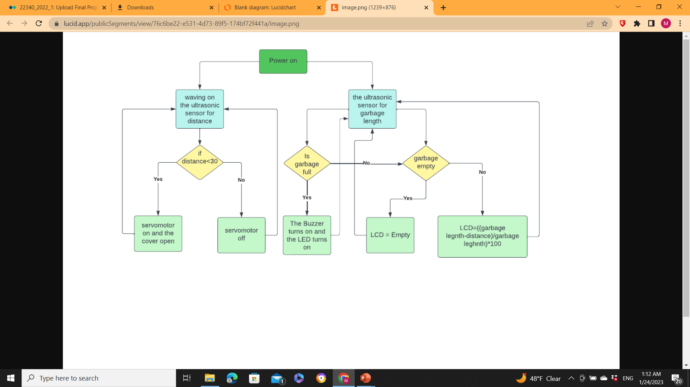
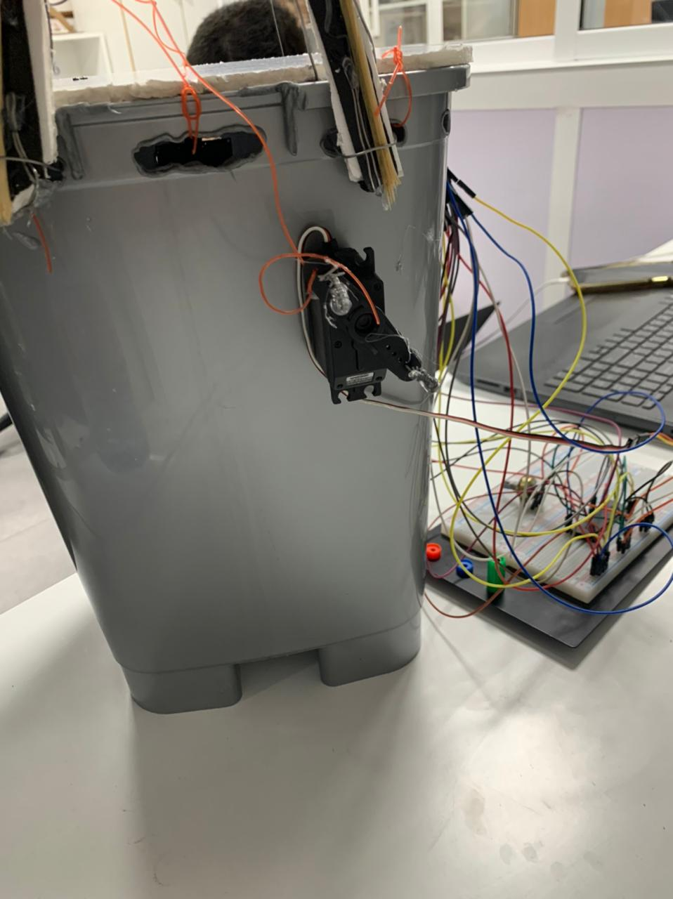
Smart Dustbin
M. Joudeh, M. Soudani
Supervisor: Dr. Belal Sababha
Embedded Systems Final Design Project, Fall 2022
King Abdullah II School of Engineering
Princess Sumaya University for Technology
Introduction
Waste management is a critical issue that affects the health and well-being of communities around the world. The increasing population and consumption patterns have led to a significant increase in the amount of waste generated, which has put a strain on existing waste management systems. One of the most critical challenges in waste management is ensuring that waste is properly collected and disposed of in a timely manner. This is where the concept of smart dustbins comes in.
Results
The smart dustbin indicate that the system is able to effectively measure the distance using ultrasonic sensors, and open the lid of the bin using a servo motor when the distance is less than 30cm. The system is also able to measure the level of garbage and display it on an LCD display. Overall, our smart dustbin has the potential to greatly improve the efficiency and sustainability of waste management systems
Figure 4
Figure 5
Figure 6
Design
.
Figure 1: Electrical Circuit Diagram.
Figure 2: Flow Chart Diagram.
Conclusion
In conclusion, the smart dustbin is a functional and efficient solution for waste management. The use of ultrasonic sensors to detect hand gestures and control the servo motor, allows for easy and hands-free opening and closing of the dustbin cover. Additionally, the use of an ultrasonic sensor to measure the depth of the trash inside the dustbin, and the integration of an LCD display, a buzzer, and an LED, enables the user to easily monitor the fill level of the dustbin and be alerted when it is full. The smart dustbin is an innovative solution that improves the convenience and hygiene of waste management, and it can be implemented in various settings such as homes, offices, and public spaces.

