Slide 1

Jawaharlal nehru university school of computer and systems sciences
MINI PROJECT
ANALOG CLOCK
Submitted to: Mr. Piyush Pratap Singh
Submitted by: Mamta Singh
Enrollment no:22/10/JC/005

Slide 2
Libraries used in project:
1.stdio.h
2.stdlib.h
3.time.h
4.graphics.h
6.conio.h

Slide 3
Functions used in project
Initgraph():
getmaxx() and getmaxy()
setcolor()
circle()
Time()
Outtext()
Strftime()
Sscanf()
Line()
Localtime()
Delay()
Closegraph()

Slide 4
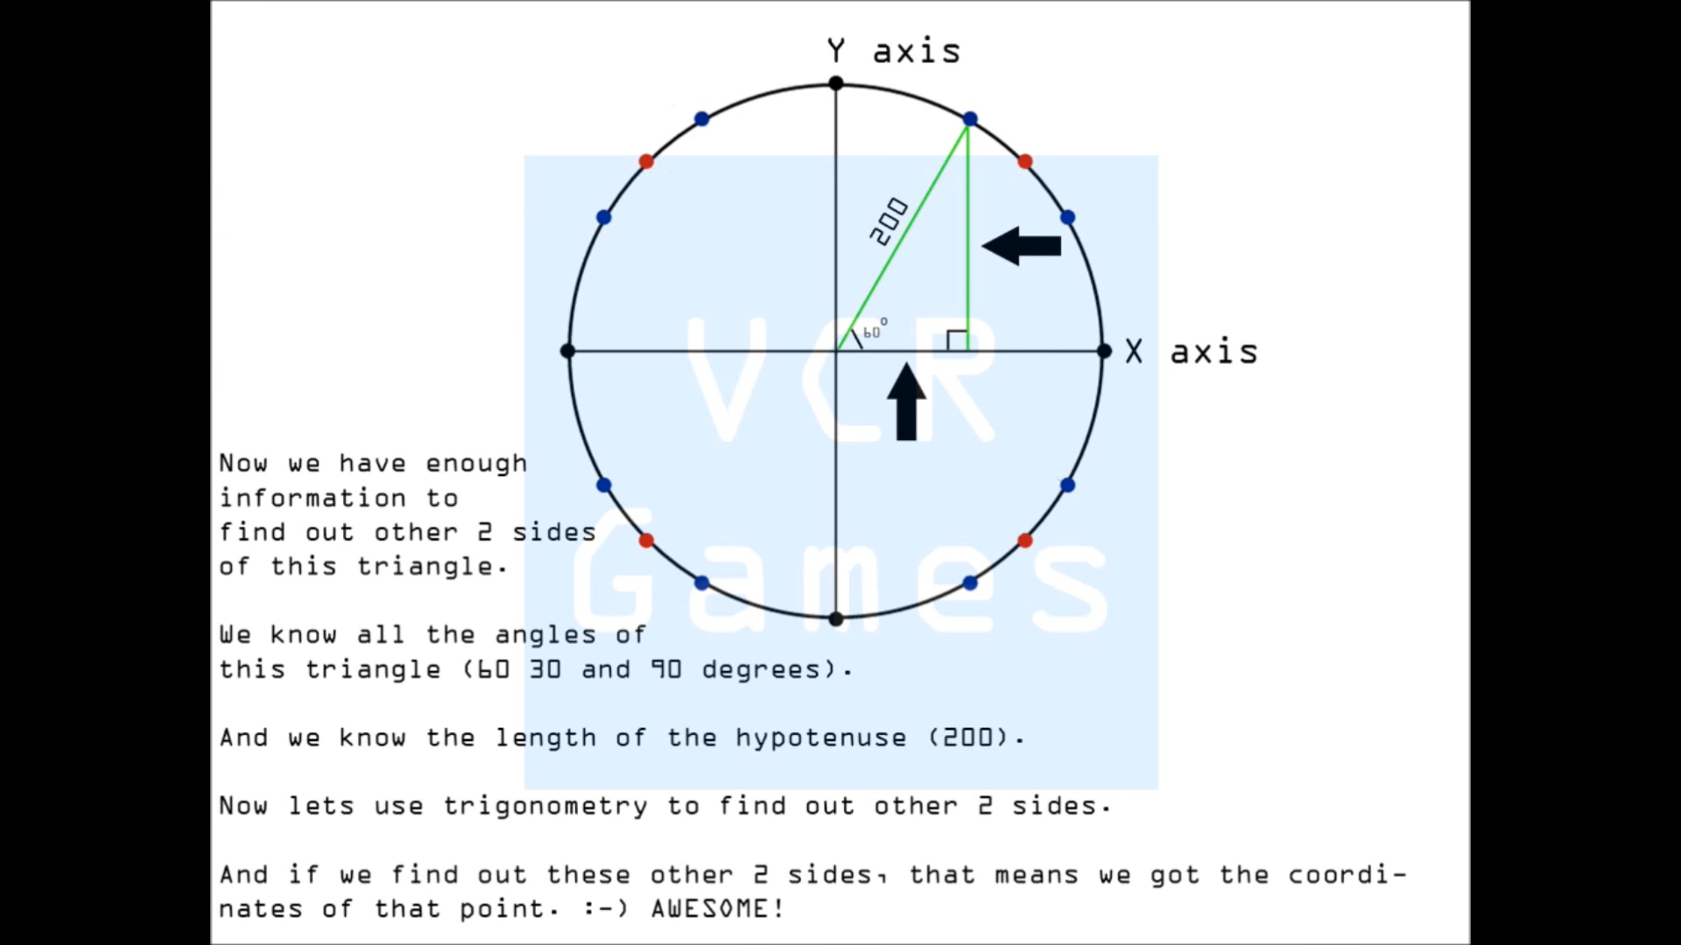
Lets take an example how we get the coordinates :for the number on a clock

Slide 5
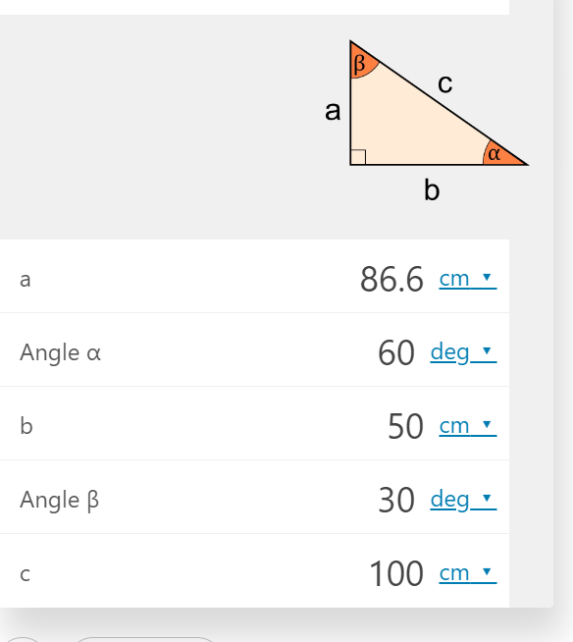
used calculator for finding the coordinates

Slide 6
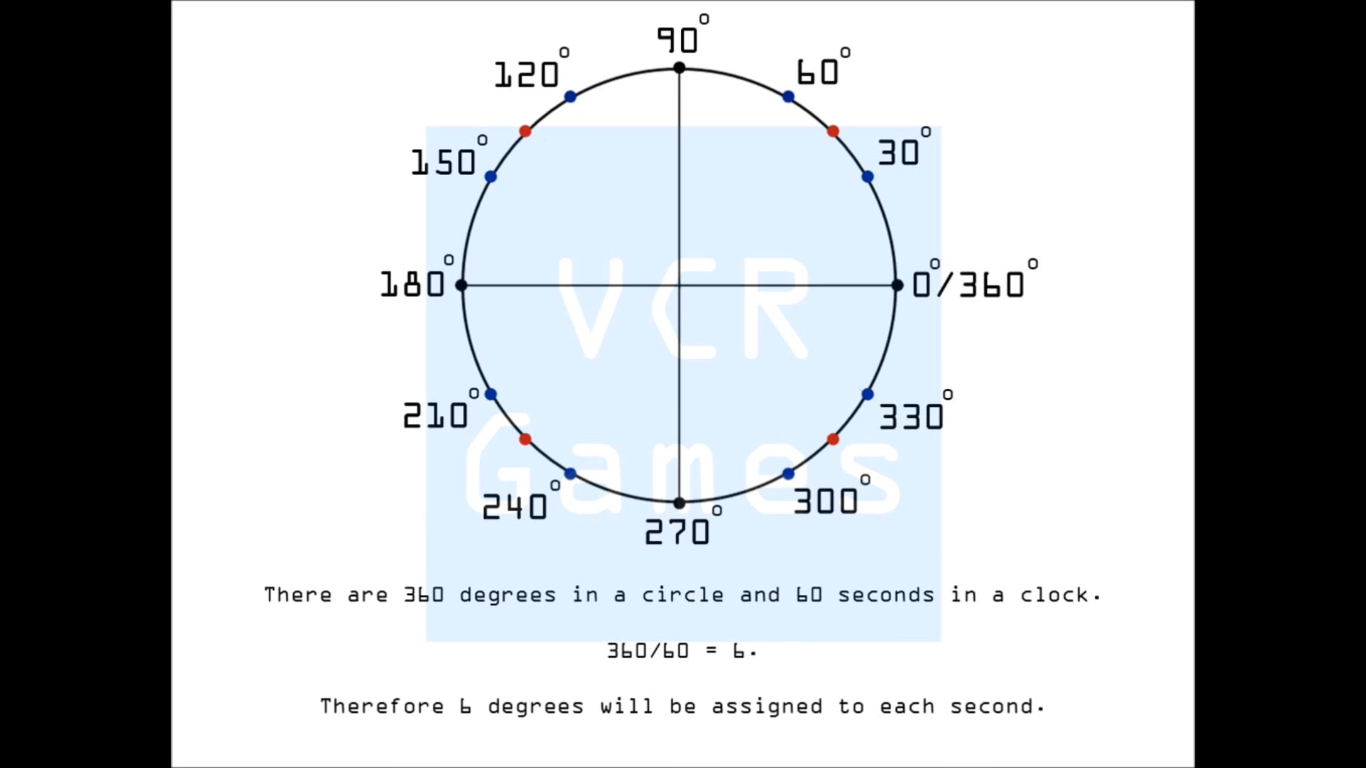

Slide 7
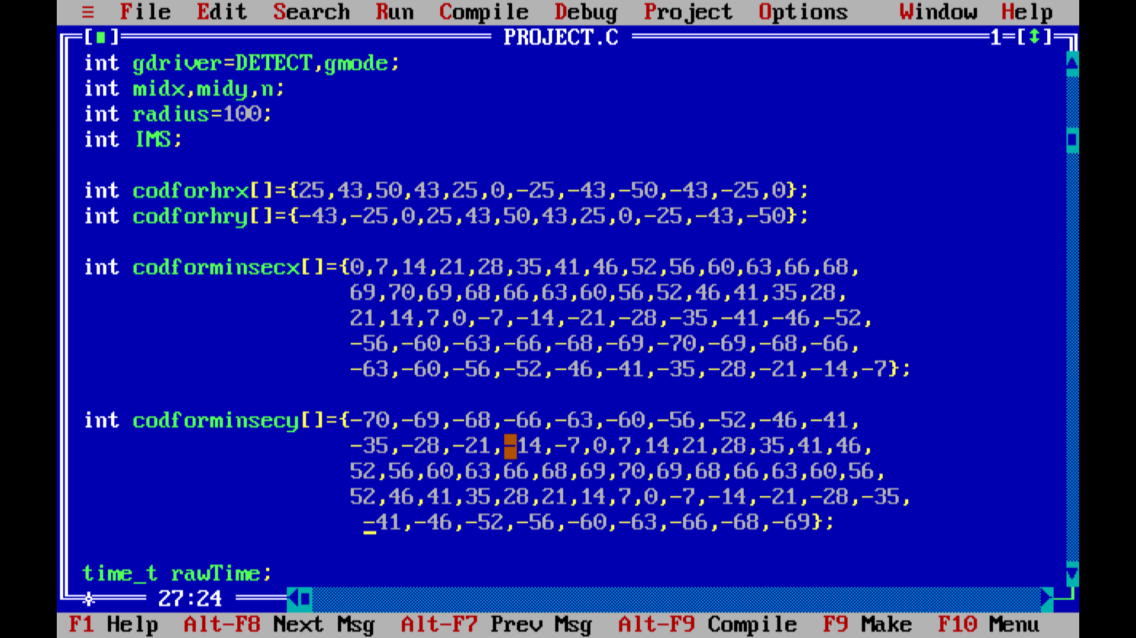

Slide 8
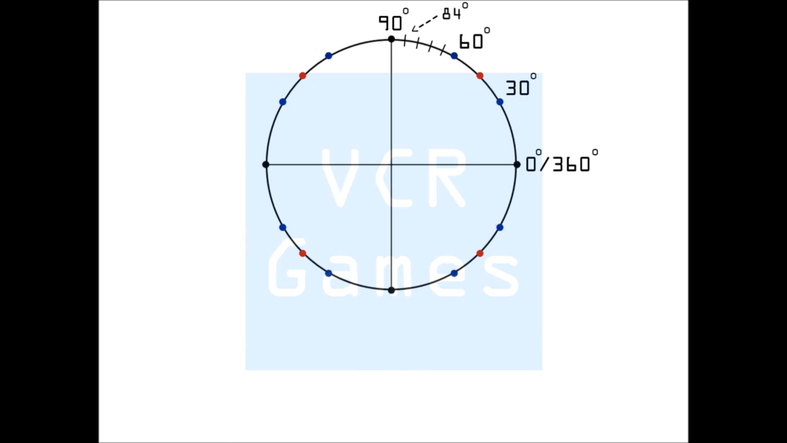

Slide 9
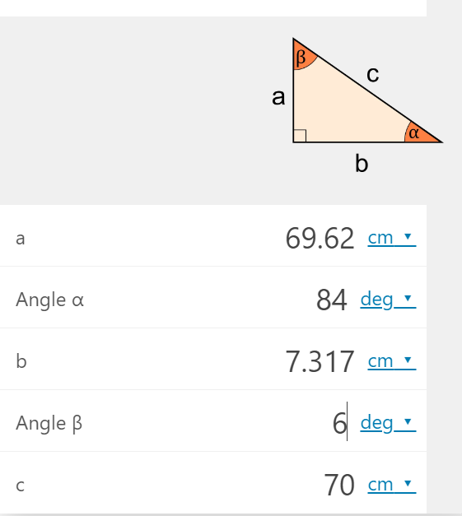

Slide 10
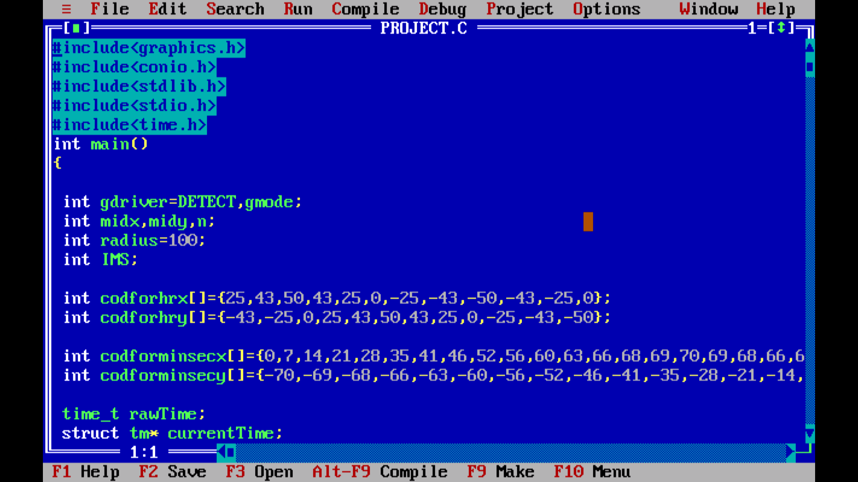
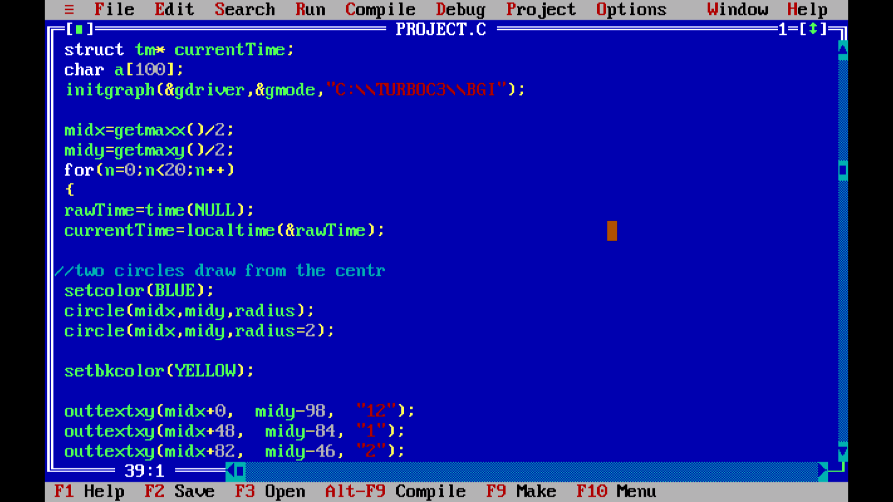

Slide 11
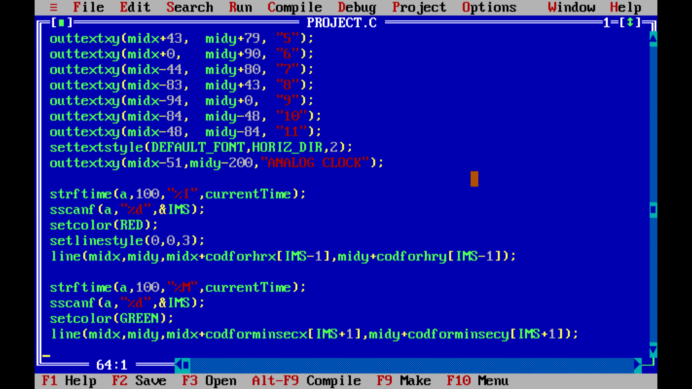
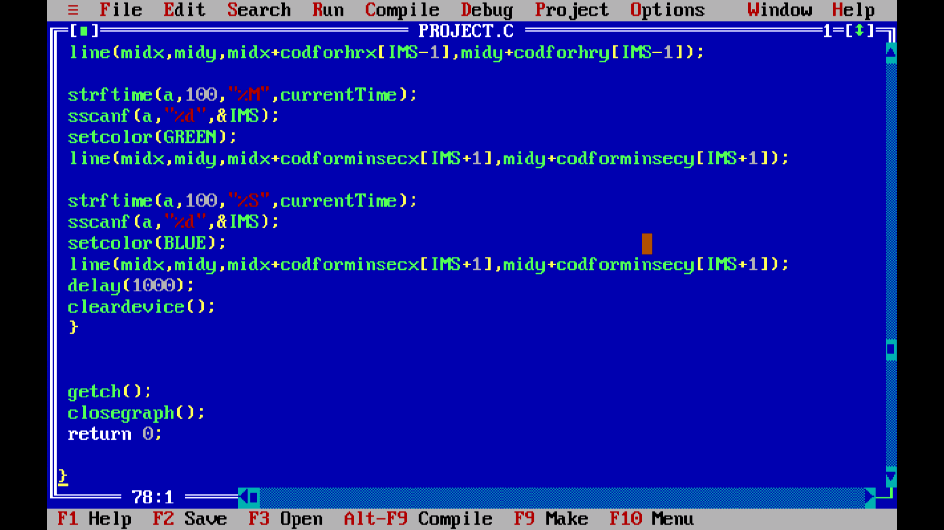

Slide 12
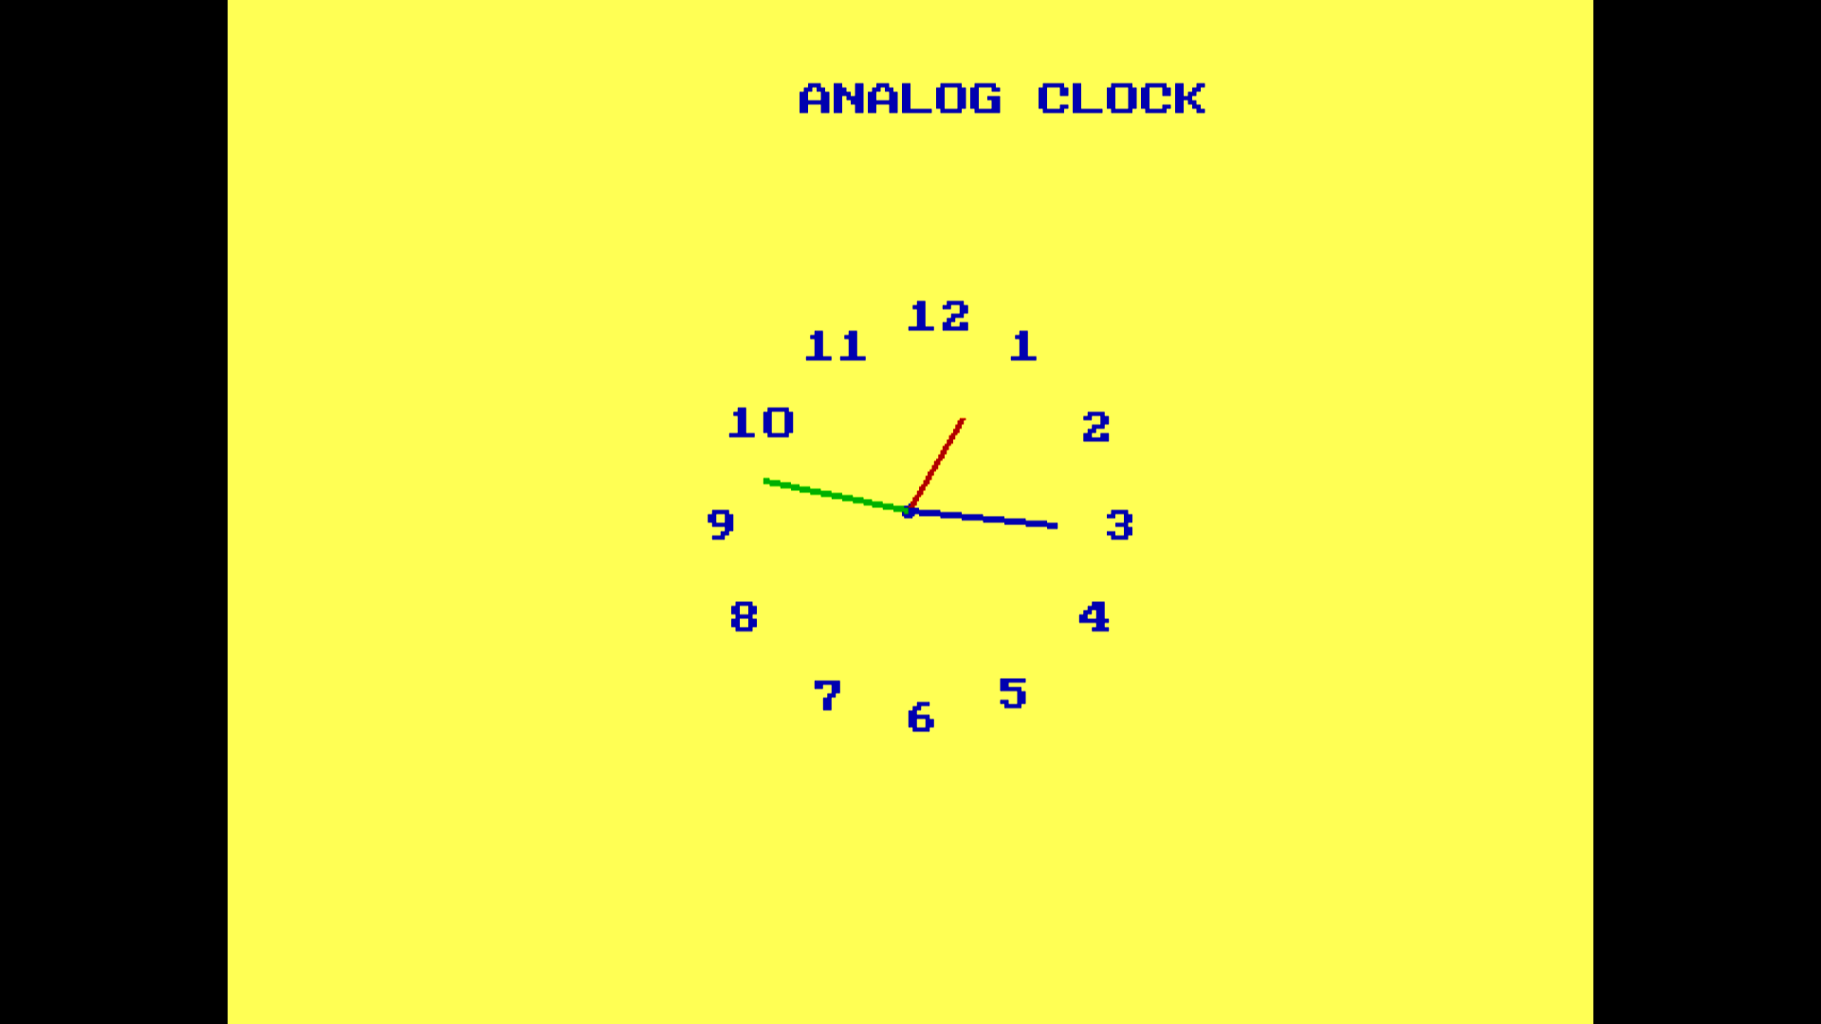
OUTPUT: shows the current time

