Slide 1

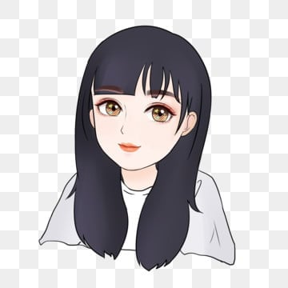





Neha, 27 yrs old, IT Professional in Bangalore
Neha faces the challenge of finding a compatible flatmate to share expenses and living space with. This process is both time-consuming and stressful, as she does not get time after her work to invest and hence struggles to identify individuals who share similar lifestyles and values. The lack of a supportive living environment hinders Neha's overall well-being and adds financial strain due to the high cost of living in the city. She is currently living in PG (Paying guest)
The Flatmate Finder product streamlines Neha's search for a suitable flatmate by providing a convenient platform to connect with potential candidates who match her preferences and lifestyle. Through advanced filters and personalized recommendations, Neha can quickly identify compatible individuals, saving her time and effort in the process. By facilitating the creation of a harmonious living environment, the product reduces Neha's stress and financial burden, ultimately enhancing her overall quality of life.
Motivations [rank 1 for high, 5 for low] Financial incentive: Rank 1
Career Advancement : Rank: 2 Personal Growth: Rank: 3
Mental peace: Rank 4 Social power: Rank 5
“Live and let others live”
Goals Short-term: To find a flatmate and shift. It is causing her stress.
Long-term Goal: To become financially independent
Life-goals
Achieve a balance between her passion for technology and creativity
Explore the world through travel and document experiences through photography
Make meaningful connections
Demography and Geography Age: 27 yrs Education: B. Tech Work: Software Developer Marital status: Unmarried
Gender: Female Location: Bangalore
Workplace area: Whitefield Minimum duration to stay: 10 months
Food Preference: Vegetarian
Psychographic details
Personality: Chilled out, Extrovert, Techie Interests: Coding, Travel, photography, driving Lifestyle: likes weekend house party, explorer
Entertainment Preferences: mostly OTTs
Smoker: No
Frustrations: Difficulty finding reliable and compatible flatmates in a new city, frustrated with brokers who have looted a lot of money on the name of giving her good flatmates.
Needs: Affordable housing options in convenient locations with basic amenities
Technology: Vey comfortable with technology usage
Influencers and brands - Follows Indian Travel Bloggers on Instagram: Tanya Khanijow
Follows Youtuber Technical Guruji
Brands she follows- Zudio, Zara, H&M, Apple Inc.
IPL team she supports is RCB (Royal challengers Bangalore)
Marketing channels Channel 1: Social Media channels like Instagram and LinkedIn. She is highly active on Instagram and loves to post her professional achievements on LinkedIn and has good Engagement.
Channel 2: ads on Coding websites like leetcode, geeksforgeeks, she keeps visiting there for learning
Channel 3: Offline/online Photography forums

