Slide 1
Employee Data Analysis using Excel
STUDENT NAME:N.Mamtha
REGISTER NO:312200865
DEPARTMENT:B.com(General)
COLLEGE:Pachaiyappa’s college for women, kanchipuram.

Slide 2
PROJECT TITLE
Employee Turnover Analysis

Slide 3


AGENDA
Problem Statement
Project Overview
End Users
Our Solution and Proposition
Dataset Description
Modelling Approach
Results and Discussion
Conclusion
3/21/2024 Annual Review

Slide 4
PROBLEM STATEMENT
Employee Turnover is the rate at which employee leave and are replaced by new employees.It can be described as how long employees tend to stay.
Organization is experiencing high employees turn over rates resulting in significant costs, disruption to operations, and potential impacts on customer satisfaction and reputation.
Despite efforts to improve retention,the organization struggles to identify the underlying causes of turnover and develop effective strategies to mitigate it.

Slide 5
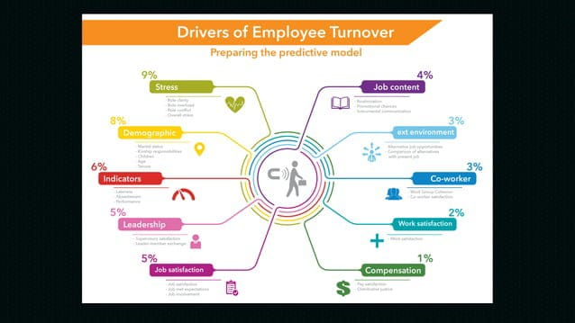
PROJECT OVERVIEW
.

Slide 6

WHO ARE THE END USERS?
HR MANAGERS: To inform recruitment, retention and talent management strategies.
SENIOR MANAGEMENT: To make data-driven decisions on employee engagement and retention.
DEPARTMENT HEADS: To identify turnover trends and develop targeted retention strategies.
TALENT ACQUISITION: To optimize recruitment processes and reduce turnover.
ORGANIZATIONAL DEVELOPMENT TEAM: To improve overall Organizational effectiveness.
INVESTORS: To assess company performance and potential risks.
REGULATORY BODIES: To ensure compliance with labour laws and regulations.
CONSULTANTS: To provide expertise on retention strategies and implementation.

Slide 7
OUR SOLUTION AND ITS VALUE PROPOSITION
Here are some things you can do to improve employee retention and reduce turnover: Develop an employee value proposition (EVP) A strong EVP can attract and retain talent, and reduce turnover. To create an EVP, you can: Understand your organization: Learn about your company’s mission, culture, and values. Research your competitors: See what other companies offer in terms of compensation, benefits, and work-life balance. Interview employees: Learn what your current and past employees value most about working for your organization.

Slide 8
Dataset Description
About Dataset It periodically evaluates employees’ work details including the number of projects they worked upon, average monthly working hours, time spent in the company, promotions in the last 5 years, and salary level.
Employee turnover refers to the total number of workers who leave a company over a certain time period. It includes those who exit voluntarily as well as employees who are fired or laid off—that is, involuntary turnover. Turnover is different from attrition.

Slide 9
THE "WOW" IN OUR SOLUTION
Average Monthly Employment -348.0833
Total separations -54
Employee Turnover -15.51%
3/21/2024 Annual Review
9

Slide 10
MODELLING
Modeling for employee turnover analysis can help identify employees who are at risk of leaving and can help organizations prioritize retention strategies: Identify key data points Consider factors like job tenure, job performance, job satisfaction, compensation, and previous instances of turnover. Develop a predictive model Use machine learning techniques like logistic regression, decision trees, random forests, and gradient boosting classifiers to build a model that can calculate a turnover risk score for each employee. Refine the model Evaluate the model’s performance using metrics like accuracy, precision, recall, and F1-score. Identify at-risk employees The model can help identify employees who share similar characteristics with those who have previously left.
10

Slide 11
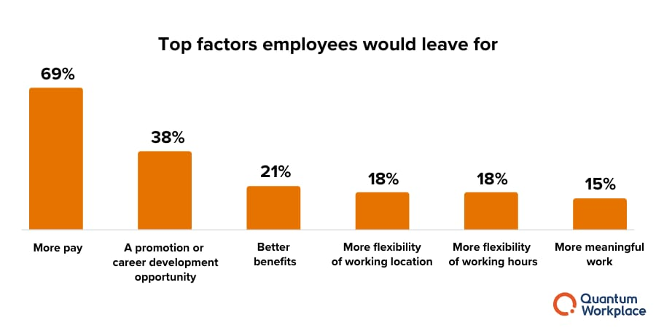
RESULTS
11

Slide 12
conclusion
The employee turnover rate is a way to measure how often employees leave a company and are replaced by new ones. It is calculated by dividing the number of employees who leave during a specific period by the average number of employees in the company during that same time.
Understanding employee turnover is important HR professionals can use data to understand their workforce and develop strategies to improve HR processes, reduce turnover, and create a thriving organizational culture. Employee turnover can have a significant impact High employee turnover can lead to decreased productivity, morale, and trust in leadership. It can also disrupt workflow, increase recruitment costs, and negatively impact customer satisfaction.

