Slide 1


Defensible Space in Urban Planning
Manansinh Narendrasinh Chudasama
Naraniya Mamtha Nagpuria
Sai Teja Reddy Mekala
Sangeeta Harish Rijhwani
Shaily Modi
Rohith Konduru
ISOL-634-M40: Physical Security
Group Project - Group C
March 16, 2025

Slide 2
Introduction
Defensible Space is an important for people residing in urban area of city.
This situation accurse in the situation of rapid relocation of people living in those areas.
Based on the Five Oaks case study in Dayton, Ohio, this report explores effective urban design elements for safer neighborhoods.

Slide 3
Thesis Statement
Defensible space is a critical urban design theory that significantly reduces crime and enhances social cohesion through strategic design elements.

Slide 4
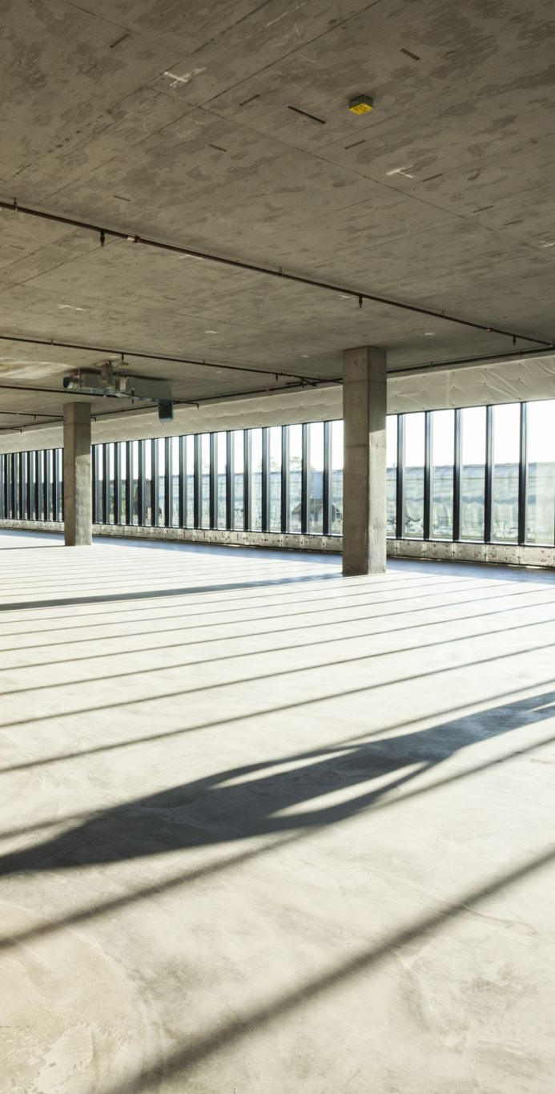
Overview
Explores defensible space principles using the Five Oaks project as a case study.
Key design aspects:
- Building design
- Security systems
- Parking
- Waste disposal
- Lighting improvements

Slide 5
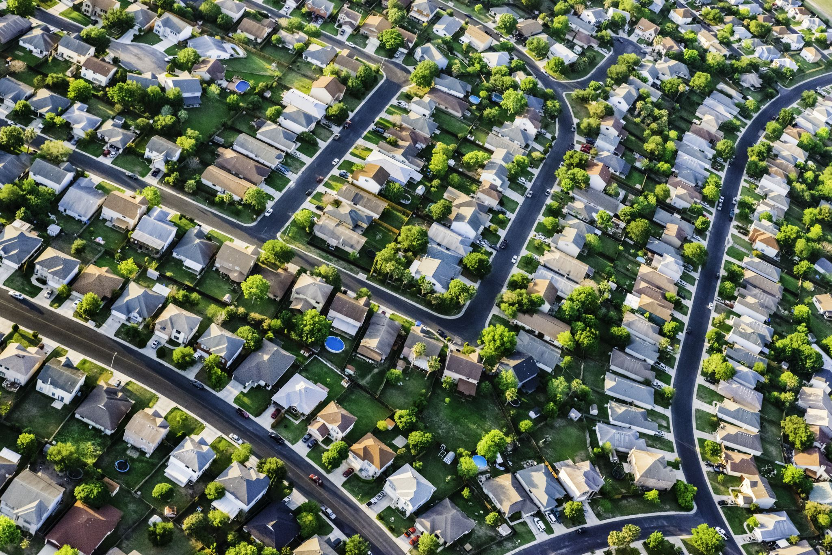
Purpose
To provide a defensible space model for public housing to improve safety and community engagement.
Guidelines for policymakers, urban planners, and housing authorities.

Slide 6
Background
Developed in the 1970s by Oscar Newman.
Key principles:
- Territoriality
- Natural Surveillance
- Image & Milieu
- Access Control
Implemented successfully in urban renewal projects like Five Oaks.

Slide 7
Five Oaks Case Study
Issues before redesign:
- High crime rates (50% increase in 5 years)
- Vandalism and property abandonment
Implemented strategies:
- Limited street access
- Property boundary marking
- Enhanced lighting
- Community policing
Result: 25% reduction in crime rates.

Slide 8
Obstacles in Implementation
Budget Constraints
Community Resistance
Maintenance Issues
Design Limitations
High Resident Turnover

Slide 9
Innovations in Design
Smart Security Systems
Solar Lighting Solutions
Community Watch Programs
Modular Design for Easy Upgrades
Interactive Public Spaces

Slide 10

Key Benefits of Defensible Space
Crime Reduction
Community Cohesion
Increased Property Values
Sustainable Urban Growth
Improved Livability

Slide 11
Lessons Learned
• Defensible space can drastically improve safety.
• Community involvement is essential.
• Urban design plays a significant role in crime prevention.
• Proper planning ensures long-term benefits.

Slide 12
Recommendations
• Expand defensible space principles in urban planning.
• Implement smart surveillance and lighting.
• Encourage active resident participation.
• Secure funding for long-term maintenance.

Slide 13
Conclusion
Applying defensible space principles enhances security, fosters social bonds, and improves urban environments.
The Five Oaks project serves as a model for future implementations in urban renewal.

Slide 14
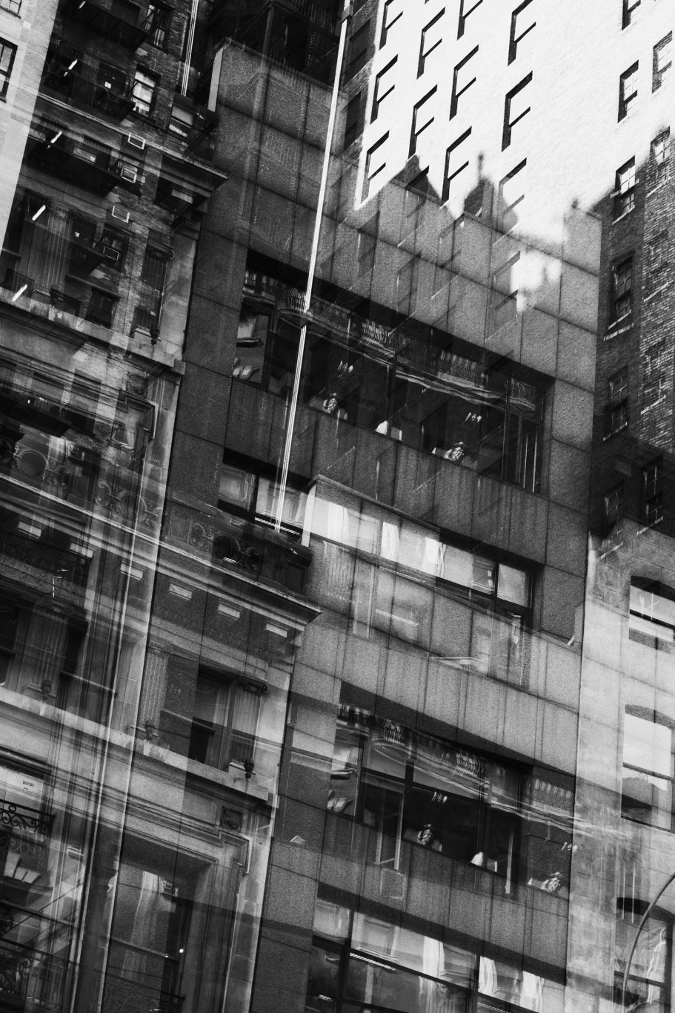
References
• Newman, O. (1972). Defensible Space: Crime Prevention through Urban Design.
• Cozens, P., & Love, T. (2015). Crime Prevention Through Environmental Design.
• National Institute of Justice (1996). Five Oaks Case Study.
• Armitage, R. (2013). Crime Prevention through Housing Design.

