Slide 1
Forecasting Weekly Sales to Drive Business Decisions

Slide 2
Why Forecast?
Forecasting reduces uncertainty so operations can act early instead of reacting late
Inventory Management: Avoid stockouts before peak weeks and reduce holding costs in slow periods
Staffing & Operations: Align warehouse and customer-service capacity with predicted demand
Capital Planning: Budget purchasing spend ahead of seasonal spikes
Risk Quantification: Move from single-number guesses to probabilistic ranges

Slide 3
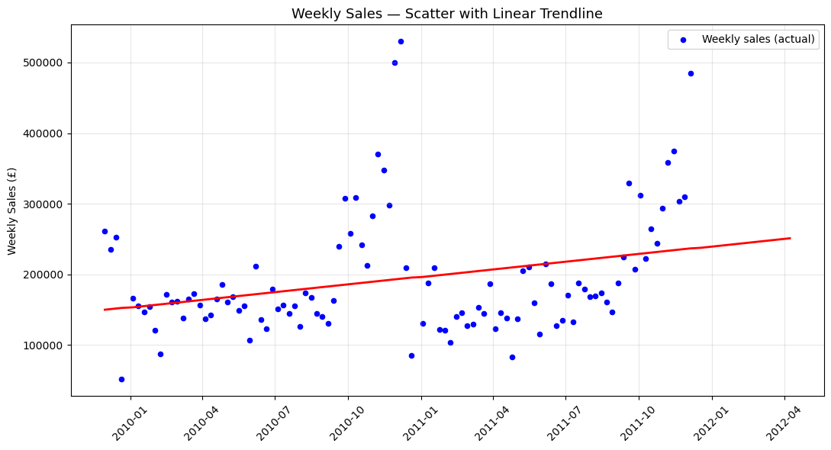
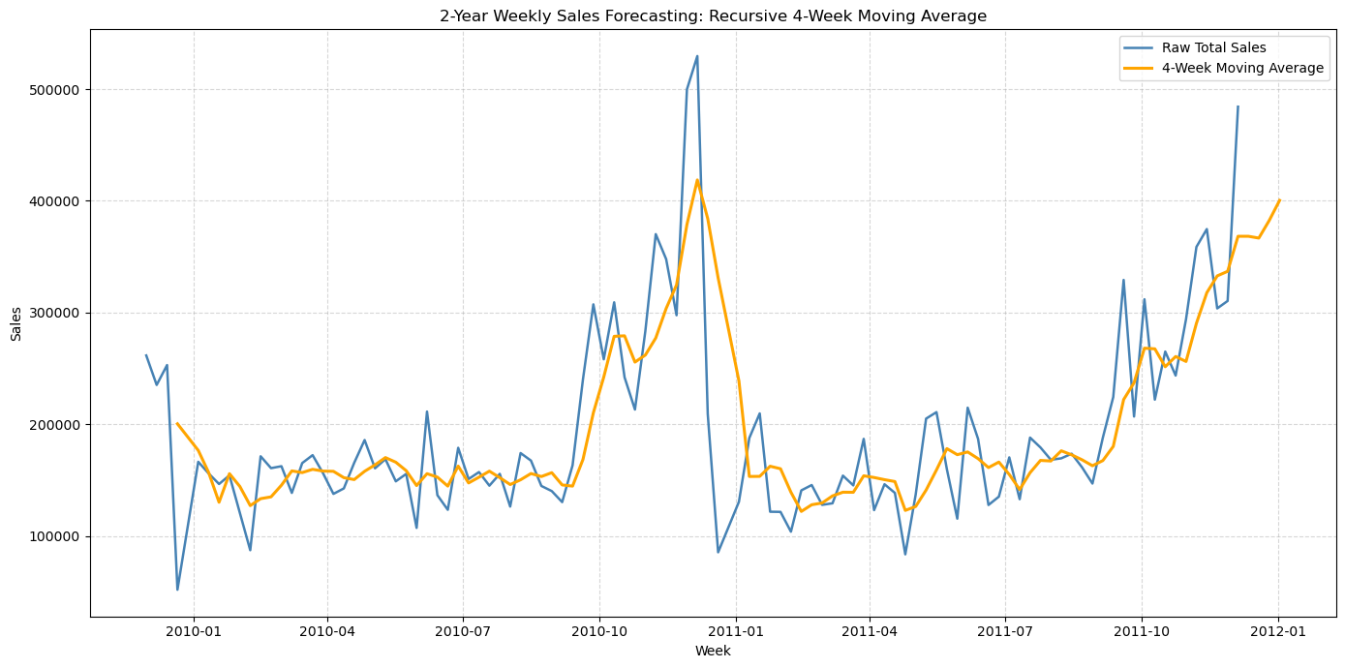
Simple Tools: Trendlines & Moving Averages
Linear Trendline: Captures long-term direction (£1,600/week growth) but assumes constant growth forever
4-Week Moving Average: Smooths noise and tracks recent momentum, but flat-lines after the last window

Slide 4
The Limitation of Simple Methods
Simple methods give direction, but fail when the business behaves like a real business
No Seasonality: Both methods treat Christmas week the same as March — missing the core business cycle
No Confidence Interval: We get one number, not a range of plausible outcomes for risk planning
No Trend Adaptation: If growth suddenly accelerates, a fixed slope lags behind reality
Rigid Extrapolation: Moving averages flat-line; trendlines run off forever without bound
Test Window Bias: Trendline and MA posted lower error on a linear 12-week slice, but completely miss structural volatility

Slide 5
Why Prophet Is Better for Business
Prophet is built for business time-series: it decomposes signal into trend, seasonality, and events
Seasonal Awareness: Automatically detects yearly cycles (e.g., holiday peaks in Nov/Dec)
Automatic Trend Shifts: Identifies changepoints where growth speeds up or slows down
Built-in Uncertainty: Produces prediction intervals via Monte Carlo simulation, not just point estimates
Event Modeling: Lets us inject known business events (promotions, holidays, warehouse closures)
Granularity: Works just as well on one SKU as on total sales — scales from CFO to warehouse manager

Slide 6
How Prophet Works:
A. Trend Component
• Piecewise linear model with automatic changepoint detection
• 25 potential changepoints placed uniformly; L1 regularization keeps only the most significant breaks
• Business meaning: If growth shifted after a market expansion, Prophet notices and splits the trend
B. Seasonality Component
• Fourier series model — smooth seasonal waves, not rigid monthly dummies
• Yearly: Captures Nov/Dec peak and summer lull automatically
• Weekly: Models intra-week patterns (disabled here since data is already weekly)
• Custom: Add your own cycles (e.g., 4-week promotional rhythms)
C. Holidays & Special Events
• Feed in a custom table of dates (Black Friday, Christmas, closures)
• Each holiday gets its own effect estimate — some boost, some depress
• Additive vs. Multiplicative: Seasonality scales with trend or stays fixed
D. Uncertainty Intervals
• Monte Carlo simulation generates many possible futures
• The shaded band is a statistical confidence interval, not a guess
• Plan for the 95th percentile (worst-case stock) or 5th (cash-flow minimum)

Slide 7
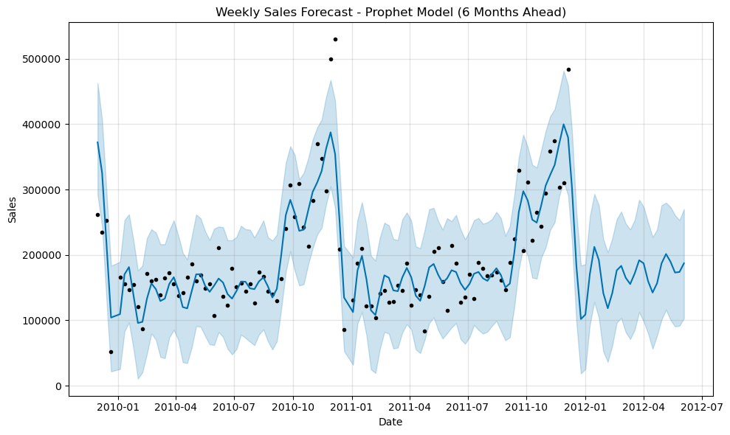
Reading the Prophet Graph
Graph Anatomy
• Black dots = Actual weekly sales
• Blue line = Point forecast (trend + seasonality + holidays)
• Light-blue band = 95% prediction interval
What to notice:
• Nov–Dec spikes: Model lifts because yearly seasonality detected the holiday pattern
• Post-Dec drop: Forecast correctly dips after seasonal peak
• A trendline would cut straight through the middle, missing both peak and trough

Slide 8
From Aggregate to Individual Products
The weekly total keeps the CFO happy; SKU-level forecasts keep the warehouse manager productive
Aggregate Forecast: Tells us how big the business will be overall (CFO view)
Product-Level Prophet: Tells us what to buy, when, and how much (Operations view)
Business decisions enabled by SKU-level forecasting:
• Purchasing: Order more units of products with rising Prophet trends
• Marketing: Promote products where forecast underperforms current inventory
• Cash Flow: Tie individual product forecasts to supplier payment schedules
• Discontinuation: Flag top products with flat/negative trend components for review
Example: Run the same Prophet pipeline on each of the Top 15 SKUs

Slide 9
Conclusion
• Simple methods give direction; Prophet gives structure
• Seasonality, changepoints, and holidays mirror how the business actually behaves
• Uncertainty intervals turn forecasts into risk-adjusted decisions
• Scaling from total sales to individual products closes the loop between analytics and operations

