Slide 1
Rapid prototyping in legacy system with dadysql, clojure.spec and reagent/re-frame

Slide 2
Introduction
Legacy system
Why clojure?
Dadysql

Slide 3
About Me
Working for Commerz Finanz- BNP Paribas/Commerz Bank
CORBA/C++/J2EE/Java
Clojure
Love to solve small problem
Love to build prototype

Slide 4
Legacy system
No API End point.
Multiple copy of data model.
Business logics are spread all the place.
Almost no test case or does not maintain since long time.
Cobol/C++/CORBA is not for agile
Database is playing main role for verifying data and business logic

Slide 5
Why Clojure?

Slide 6
Safe zoo
There are groups of animal in zoo, all groups are infected by some kind of virus. Take a sample from every group and build new group for symptom.
Sample input: x, y1 y2, z1 z2 z3
Sample output: x y1 z1, x y2 z1, x y1 z2, x y2 z2, x y1 z3, x y2 z3

Slide 7
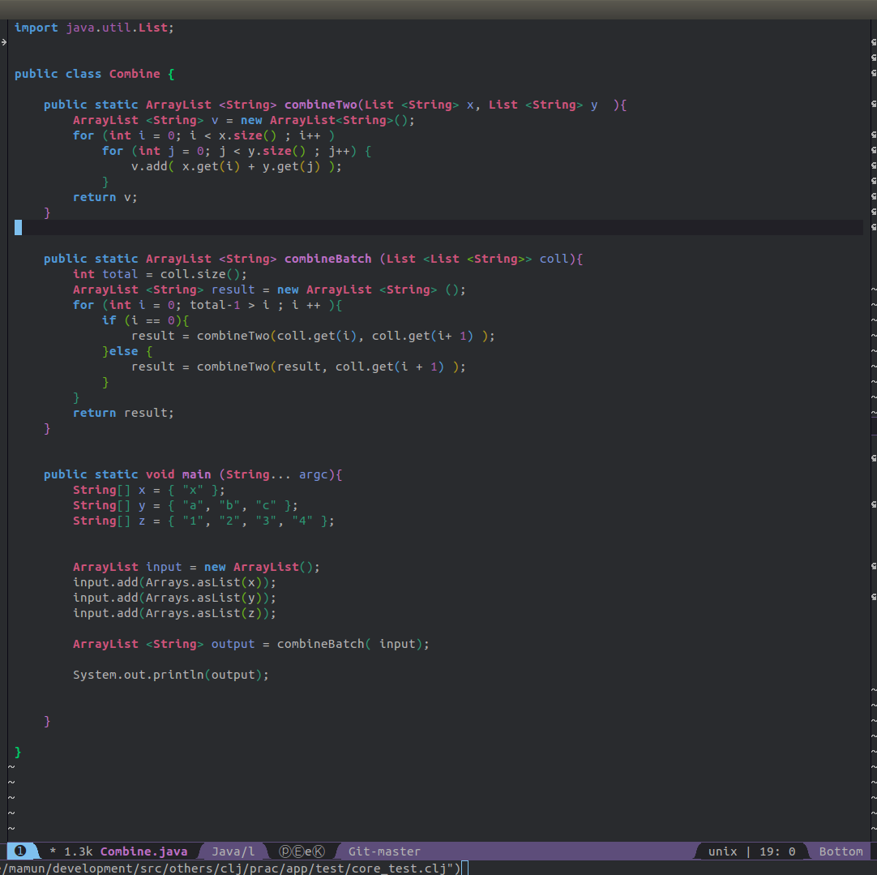
Using Java

Slide 8
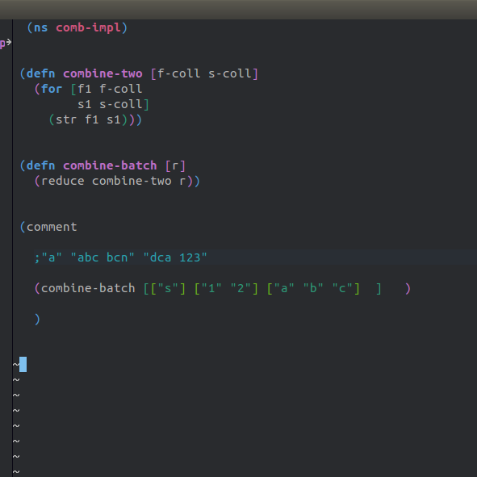
Using Clojure

Slide 9

Using Java

Slide 10
Live code demo

Slide 11
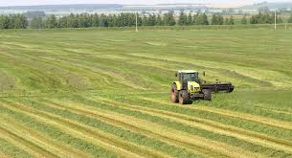

Tool to do fast

Slide 12
More in clojure!!
Working with abstract (Seq & Data structure)
Lot of Seq function like map, reduce, select etc
Abstract structural binding - destructing
Immutable and persistence data structure
REPL (Feel like lufthansa nonstop you)
ClojureScirpt, figwheel, devcard and more

Slide 13
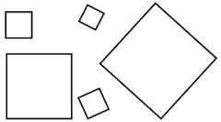
What about data shape?

Slide 14
Data shape
Format
Web as string {:credit-amount “3,000.00”}
API end point {:credit-id 1213 :customer {:c-name “Max”}}
Messaging with type {:credit {:credit-id 1234}}
Batch precessing [{:credit {:credit-id 1234}}]
Messaging
Constraint
Credit-amount > 0 with decimal format
Interest rate > 0.01
C-name not empty
Email with correct format

Slide 15
Clojure Spec
Unify specification
Parsing and conformation for string value and others
Test data generation
Error reporting

Slide 16
DadySQL
Make sql data available as fast as possible as service or lib
Write sql with metadata in sql file, inspired from yesql
Param validate using spec
Default param for primary key
Versioning using namespace (com.app, v2.app or app.v2)
Only two API pull and push(for transaction )
Three level of metadata grouping (SQL, group of sql, database level)
Don’t need to compile or load just run sql and continue

Slide 17
Live code demo

Slide 18
Thanks
Github url- https://github.com/Mamun/dadysql
Follow me https://twitter.com/mamuninfo2

