Slide 1
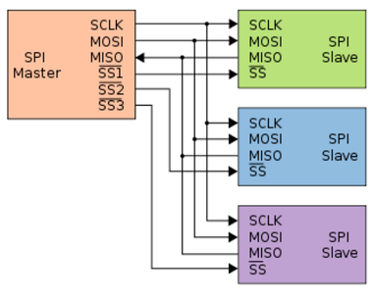
SPI(Serial Peripheral Interface)
SPI communication need 4 wires
SS (Slave Select) − The pin on each device that the master can use to enable and disable specific devices.
SCK(Serial Clock) − The clock pulses which synchronize data transmission generated by the master
MOSI (Master Out Slave In) − The Master line for sending data to the peripherals.
MISO (Master In Slave Out) − The Slave line for sending data to the master.

Slide 2
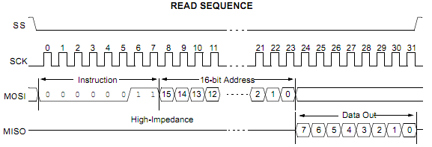
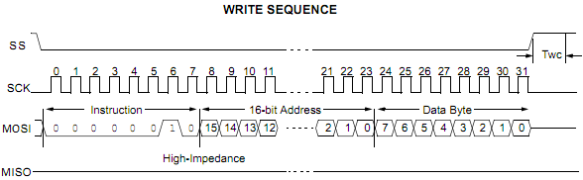
SPI Communication

Slide 3
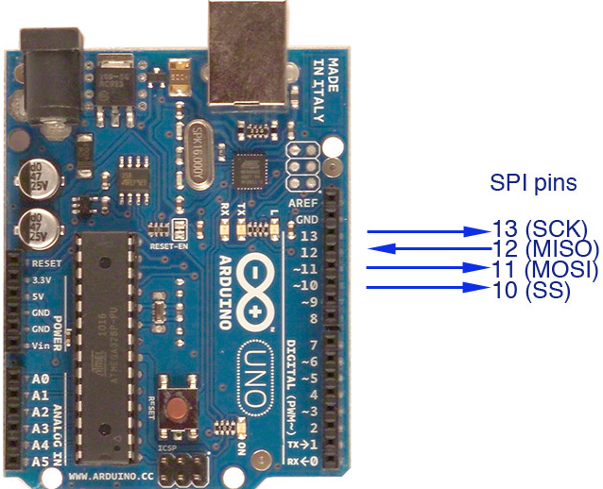
Arduino Uno SPI Pins
Arduino IDE has a built-in library for enabling SPI communication. The name of the library is “SPI.h” .

Slide 4
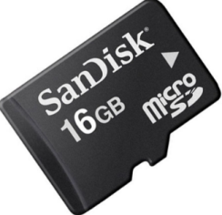
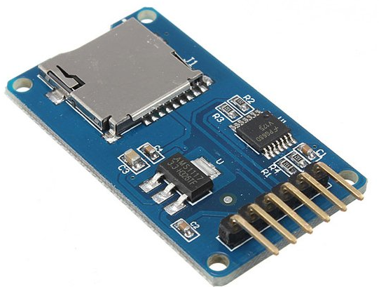
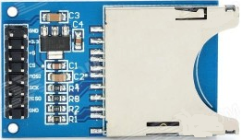
SD Card Adapter

Slide 5
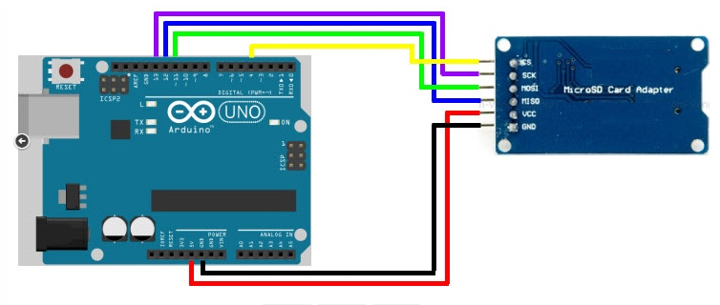
SPI Example Circuit Diagram

Slide 6
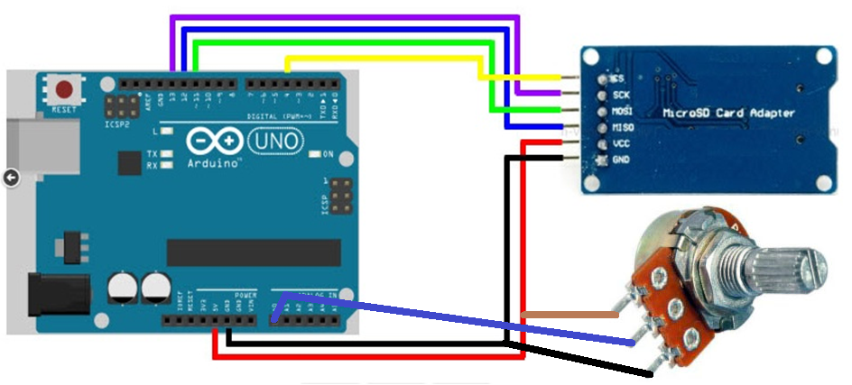
Save Sensor Data Into SD Card

