Slide 1

Real-time Customer Emotion Detection System
Course Title : Data Science Lab
Course Code : IoT 4314
Presented By
Jul Jalal Al-Mamur Sayor(1901029)
Nishat Tasnim Shishir(1901030)
Date of Presentation : 7th November 2023

Slide 2
Abstract
In the age of digital communication and customer-centric business models, understanding the emotions of our customers is crucial. This is an innovative machine learning project that leverages Flask to create a web-based platform for real-time customer emotion detection. This project aims to provide businesses with a powerful tool to gauge customer sentiment and enhance the overall customer experience. This project utilizes state-of-the-art machine learning techniques to accurately detect and categorize a wide range of emotions, from satisfaction to frustration. It processes visual customer interactions with valuable insights to improve their products and services.

Slide 3
Objective
Emotion Detection System: Develop a robust system for recognizing and interpreting human emotions.
Real-Time Processing: Real-time capabilities to process and respond to customer emotions immediately.
Human-Robot Interaction: Integrate the system with robots to enhance empathetic interactions in retail and hospitality.
Versatile Integration: Create a versatile emotion detection model that seamlessly integrates with existing robots and online platforms.
User-Friendly Interface: Develop an intuitive interface for businesses to easily implement the system across various applications.
Continuous Improvement: Establish a framework for ongoing adaptation to evolving customer preferences and emotional expressions.

Slide 4





Technologies

Slide 5






Development and Deployment Workflow
Data Set
Save Model in Drive
Model training
.h5
Download and use
.h5 format
Visual Input
.h5

Slide 6
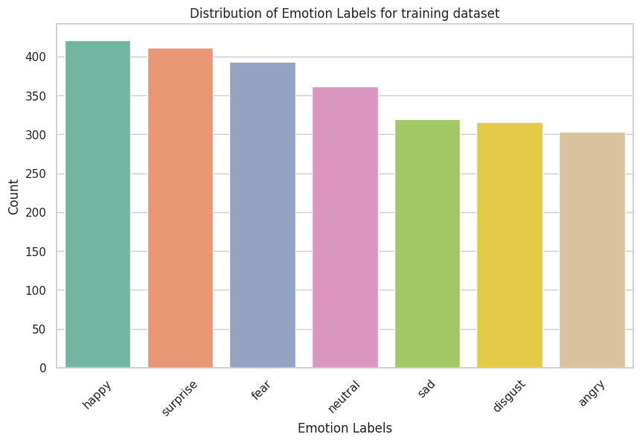
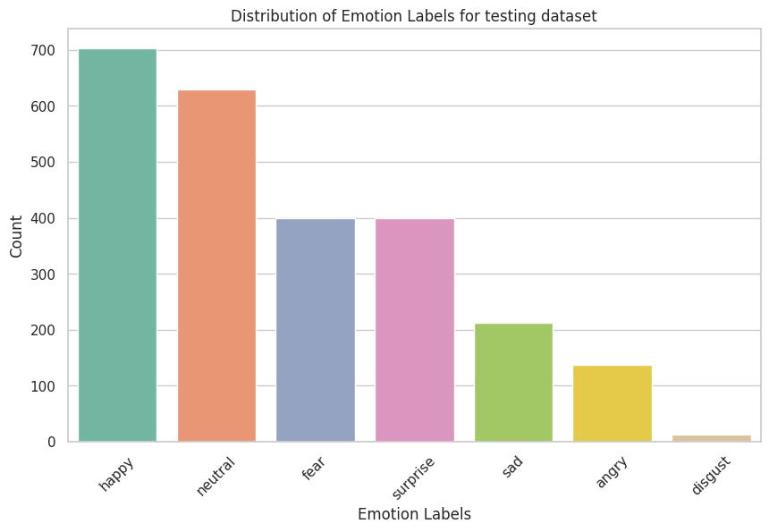
Implementation
1.Exploratory Data Analysis, Visualization

Slide 7
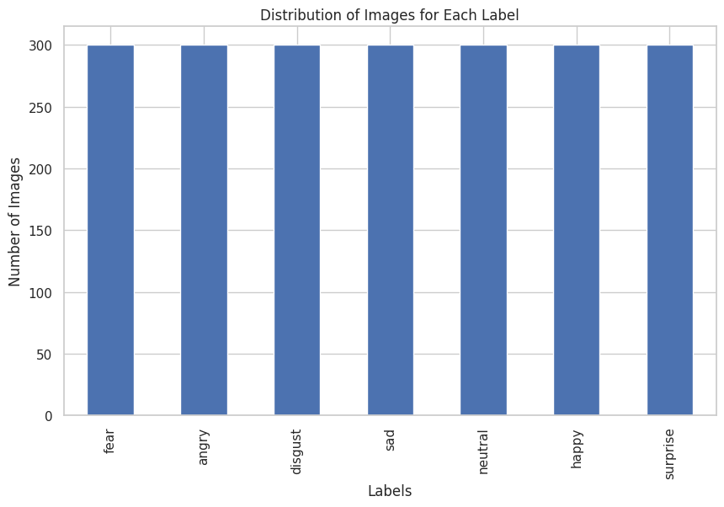
2. Preprocessing, Feature Engineering ( Balancing & Normalization )

Slide 8
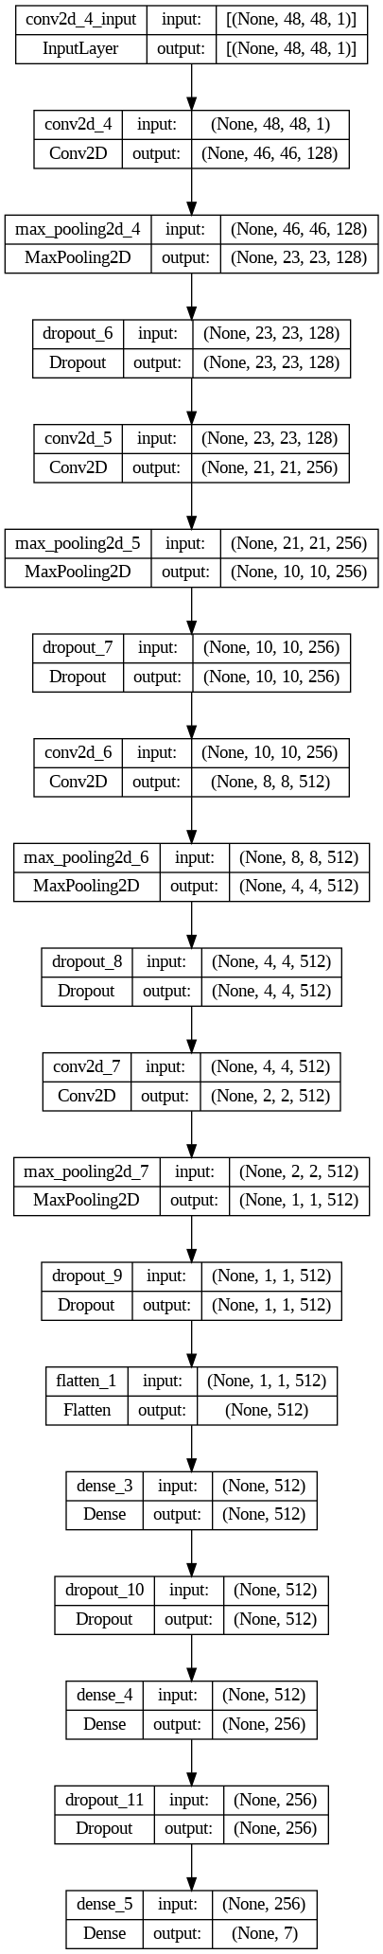
3. Feature Extraction & Model Building (CNN)

Slide 9
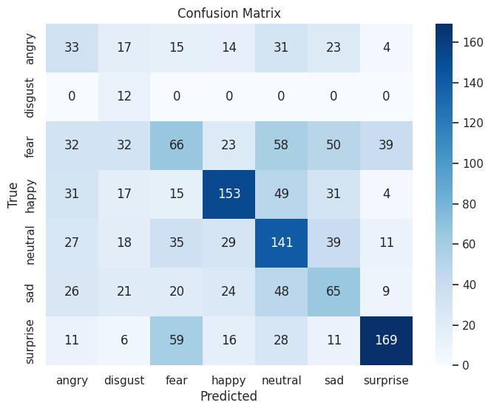
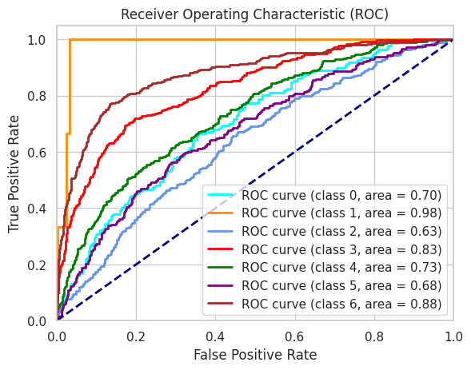
4. Performance Measure

Slide 10
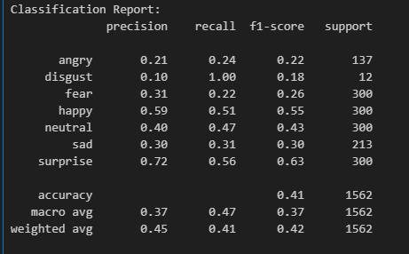

4. Performance Measure

Slide 11
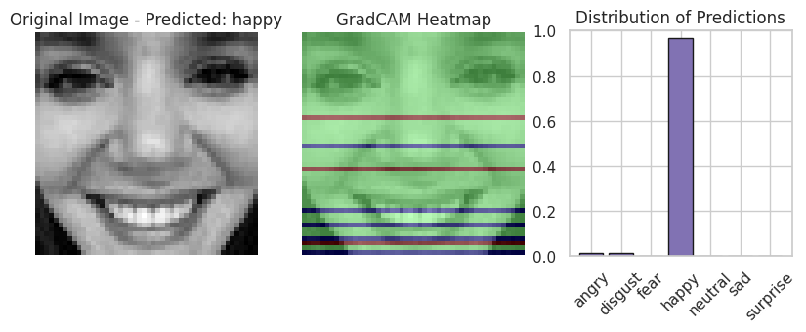
5. Model Interpretability

Slide 12
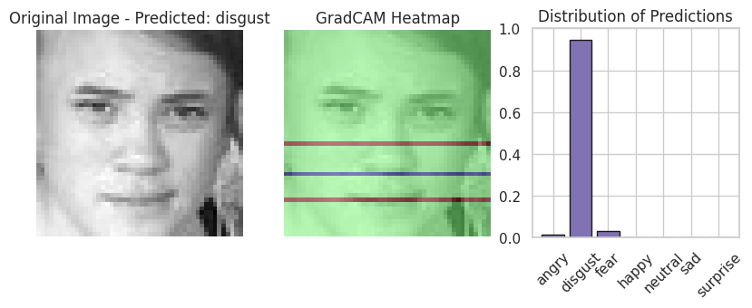
5. Model Interpretability

Slide 13
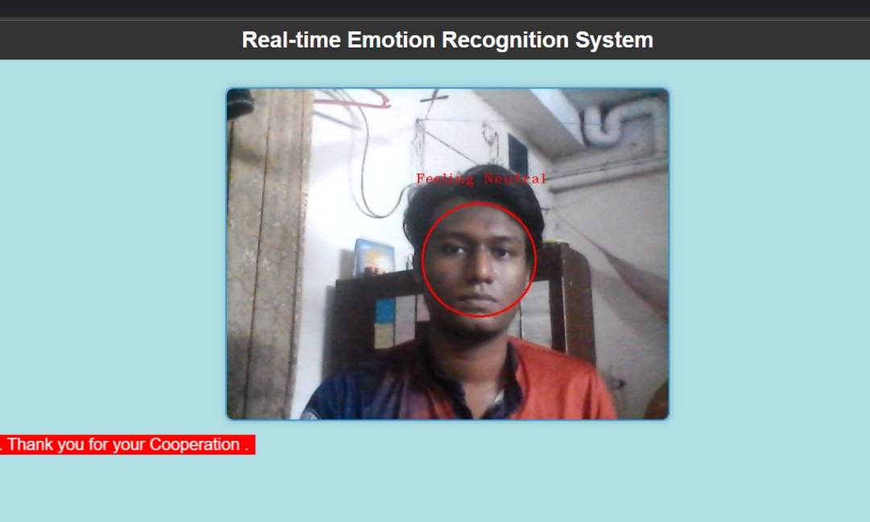
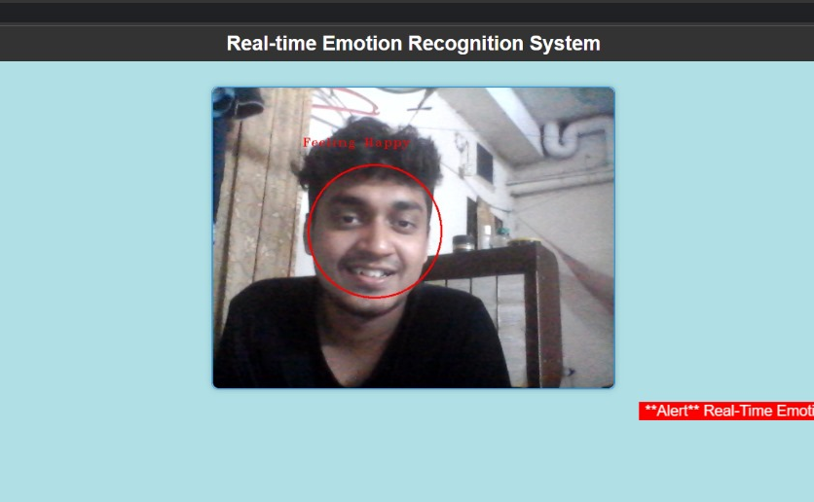
6. Model Deployment ( Flask )

Slide 14
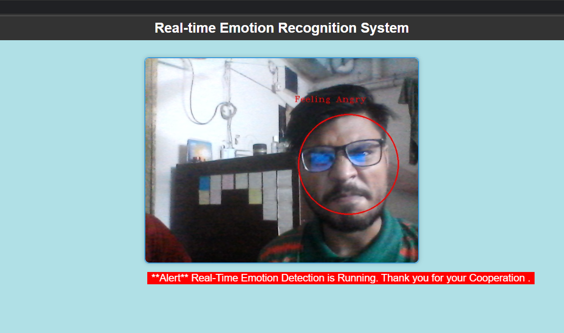
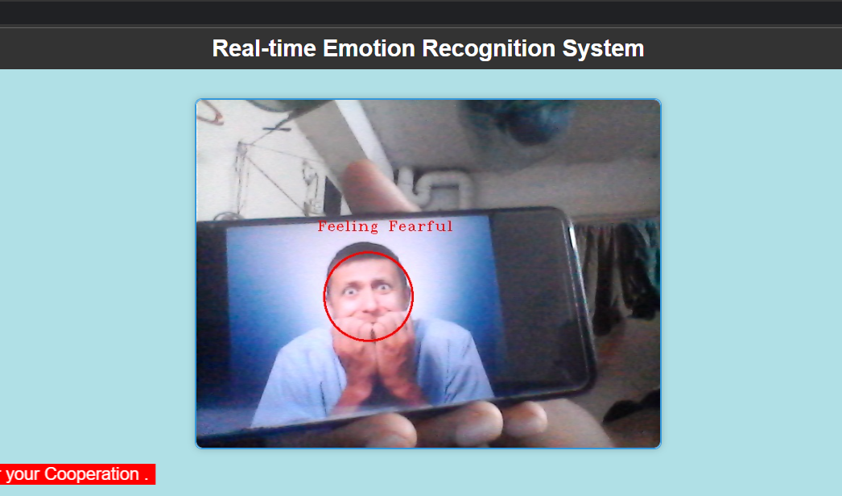
6. Model Deployment

Slide 15
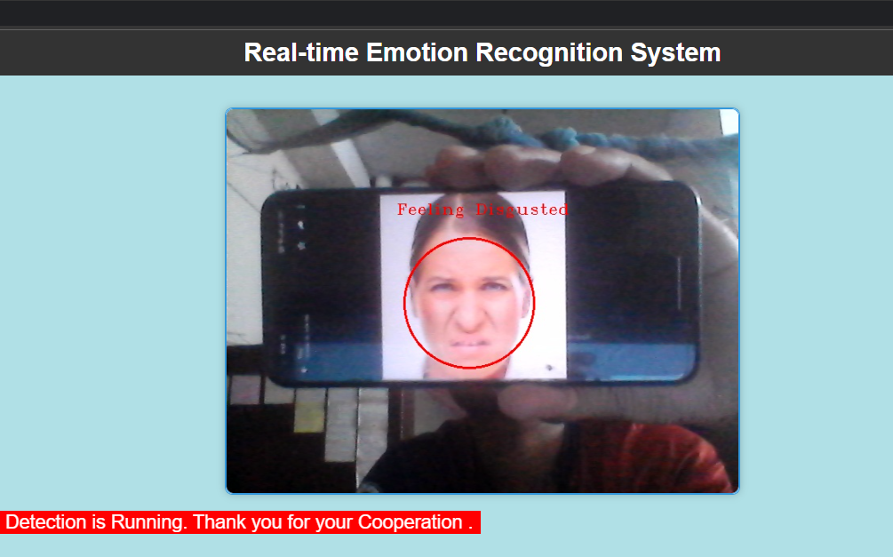
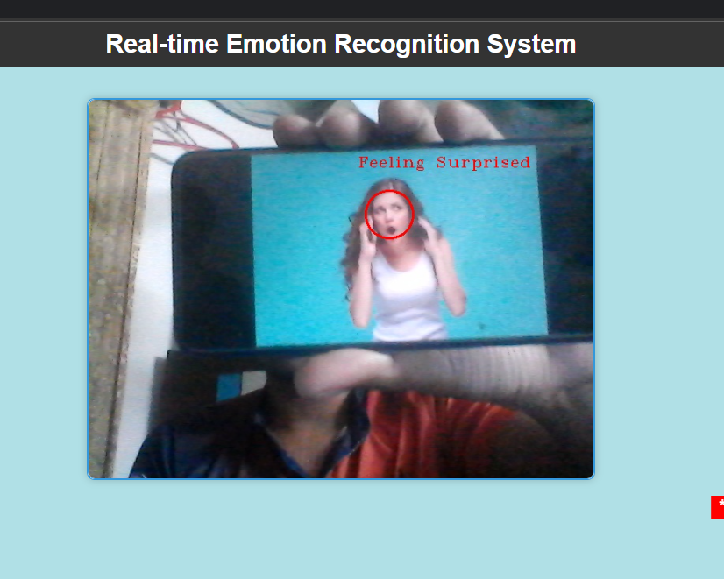
6. Model Deployment

Slide 16
Limitations
Accuracy: The achieved test accuracy of 40.9 % is below the average for the Face expression recognition dataset, indicating room for improvement.
Data Quality: The model's performance may be affected by variations in data quality, such as viewing angles and image rotations.
Dataset Size: The Face expression recognition dataset's size and diversity may limit the model's ability to generalize to a broader range of facial expressions.
Real-time Recognition: The system's real-time facial expression recognition may have latency issues that need to be addressed for practical applications.
Limited Emotions: The model predicts 7 basic emotions, and its applicability to more nuanced emotional states may be limited.

Slide 17
Reference
[1] Jin et al.“Image restoration method based on GAN and multi-scale feature fusion”, 978-1-7281-5855-6/20/$31.00 c 2020 IEEE
[2] Cao et al. “An Improved GAN-Based Image Restoration Method for Imaging Logging Images”, Appl. Sci. 2023, 13(16), 9249.
[3] Kishore et al. “Enhanced Image Restoration by GANs using Game Theory”, International Conference on Smart Sustainable Intelligent Computing and Applications under ICITETM 2020.
[4] Yu et al. “A practical generative adversarial network architecture for restoring damaged character photographs”, Volume 423, 29 January 2021, Pages 590-600.
[5] S. Li et al .”A two-channel convolutional neural network for image super-resolution”
Neurocomputing(2018).
[6] link : https://machinelearningmastery.com/how-to-accelerate-learning-of-deep-neural-networks-with-batch-normalization

Slide 18
Thank You
Do you have any question?

