Slide 1
Image Restoration using GAN
Presented By
Jul Jalal Al-Mamur Sayor(1901029)
Nishat Tasnim Shishir(1901030)
Fahim Shahriar Prottoy(1901041)

Slide 2
Introduction
In image restoration, especially in cases of extensive damage or pixelation, traditional methods often fall short in such scenarios, prompting the exploration of Deep Neural Networks (DNNs) for improved results. We introduce a novel approach that leverages a Generative Adversarial Network (GAN) for image restoration. Our system consists of an image generation network responsible for restoring damaged images and a discriminator network that assesses the authenticity of the restorations. Additionally, we provide a user-friendly web interface for real-time image restoration.

Slide 3
Objective
1. Image Restoration Network: Develop a high-precision image generation network to restore damaged images effectively.
2. Authenticity Evaluator (Discriminator): Create a discriminator network to assess the authenticity and quality of generated image restorations.
3. GAN Model Training Optimization : Optimize GAN training with a curated dataset of damaged and undamaged images to prioritize high-quality restorations and minimize flaws.
4. Creating a User-Friendly Web Interface with Flask.
5. Performance Assessment: Evaluate the effectiveness of the image restoration system by assessing its performance on a diverse range of damaged images, including those with extensive and intricate damage

Slide 4
Method
Model Formation : A standard Convolutional Neural Network (CNN) architecture is used for both the generator and discriminator models. The CNN architecture consists of convolutional layers, batch normalization layers, and activation functions (LeakyReLU) to process and transform the input data. These layers are organized into downsample and upsample blocks in the generator and downsample blocks in the discriminator.
Dataset : humanface8000 [from Kaggle]
While developing the model we have used Down sampling and up sampling.
Batch Normalization : It contributes to the stability, faster training, and improved performance of the generator when learning to colorize grayscale images. These two figures show how batch normalization can minimize the number of epoch to get better accuracy from random sample.

Slide 5
Coding Algorithm
Step 1: Import necessary libraries
Step 2: Set image size, variables, and file paths
Step 3: Define a function for sorting image files
Step 4: Load and preprocess color and grayscale images
Step 5: Create TensorFlow datasets for training and testing data
Step 6: Define and initialize Generator and Discriminator models
Step 7: Set up loss functions and optimizers
Step 8: Create a training loop
for epoch in range(epochs):
Step 9: Inside the training loop for batch in training_dataset:
a. Forward and backward passes through Generator and Discriminator
b. Calculate and update gradients
c. Apply gradients to optimize Generator and Discriminator
Step 10: After training, save Generator and Discriminator models
Step 11: End

Slide 6

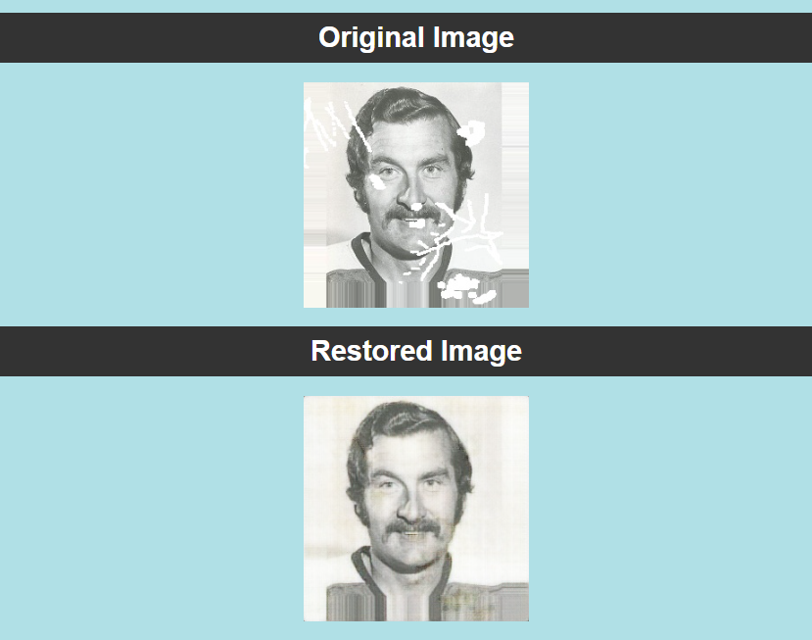
Outcome
Webpage
Result

Slide 7
Structural Similarity Index (SSIM)
Peak Signal-to-Noise Ratio (PSNR)

Slide 8
Model Plot
Generator Plot
Discriminator Model Plot

Slide 9
Limitations
Future Plan
The accuracy of the generator model in excellent.
Slight color deviations
Challenges with complex image content
Performs better in Gray shaded image.
Refine model architecture
Explore alternative loss functions
Investigate conditional variations
Augment the dataset and adapt to specific domains.

Slide 10
Resources
[1] Jin et al.“Image restoration method based on GAN and multi-scale feature fusion”, 978-1-7281-5855-6/20/$31.00 c 2020 IEEE
[2] Cao et al. “An Improved GAN-Based Image Restoration Method for Imaging Logging Images”, Appl. Sci. 2023, 13(16), 9249.
[3] Kishore et al. “Enhanced Image Restoration by GANs using Game Theory”, International Conference on Smart Sustainable Intelligent Computing and Applications under ICITETM 2020.
[4] Yu et al. “A practical generative adversarial network architecture for restoring damaged character photographs”, Volume 423, 29 January 2021, Pages 590-600.
[5] S. Li et al .”A two-channel convolutional neural network for image super-resolution”
Neurocomputing(2018).
[6] link : https://machinelearningmastery.com/how-to-accelerate-learning-of-deep-neural-networks-with-batch-normalization

Slide 11
Thank You
Do you have any question?

