Slide 1

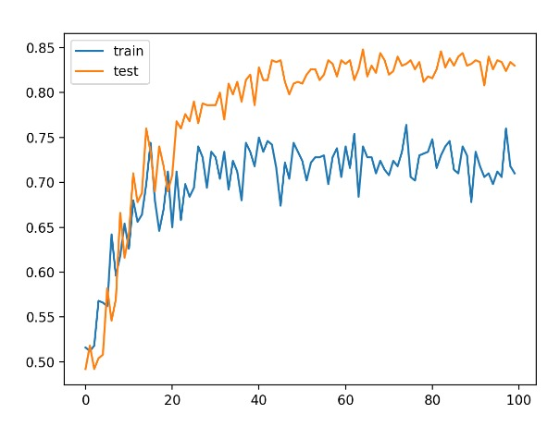
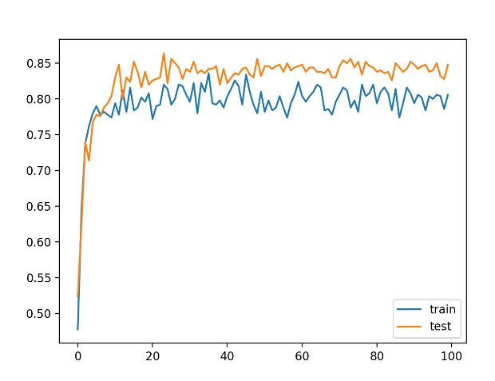
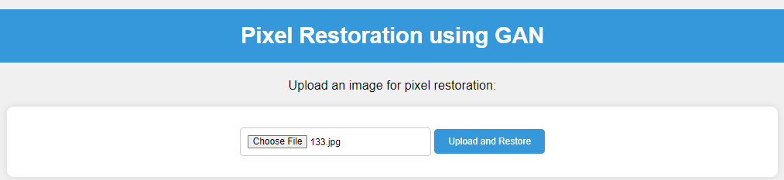
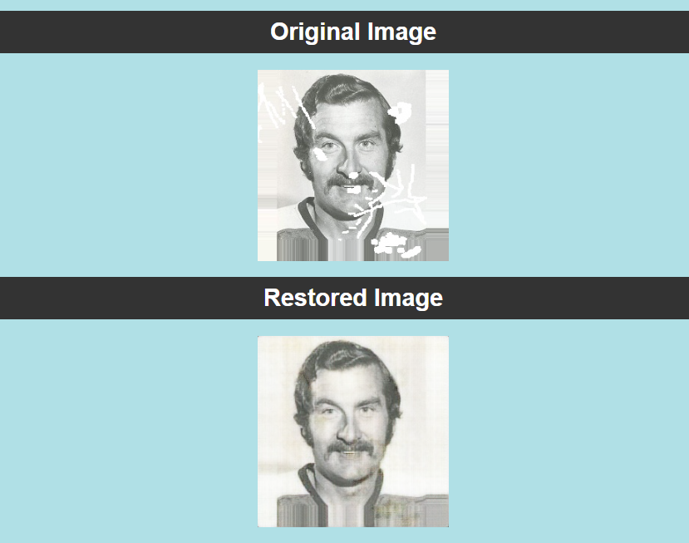
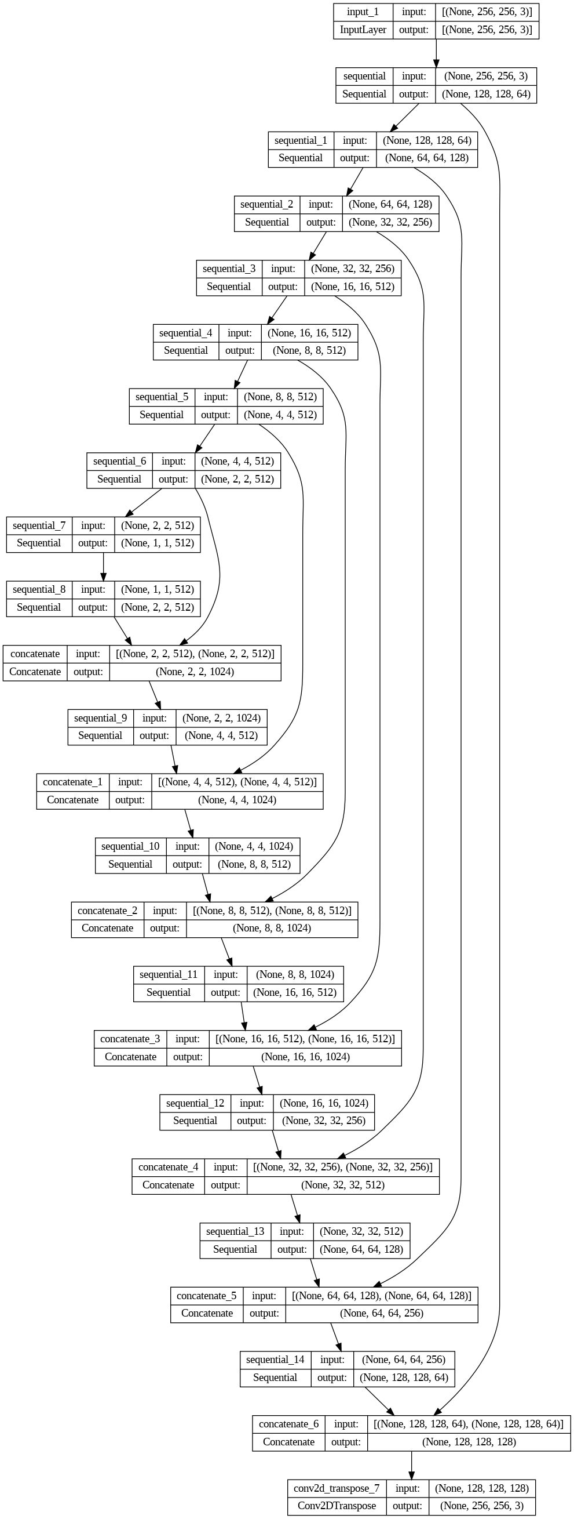
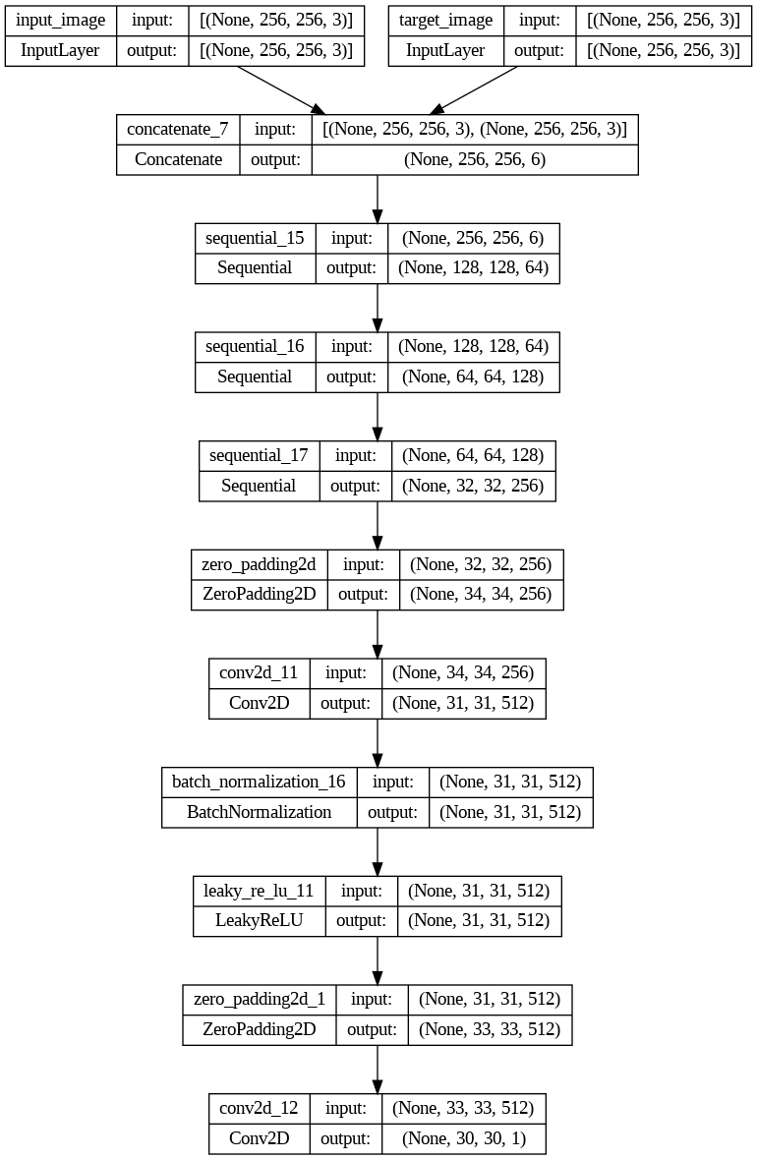
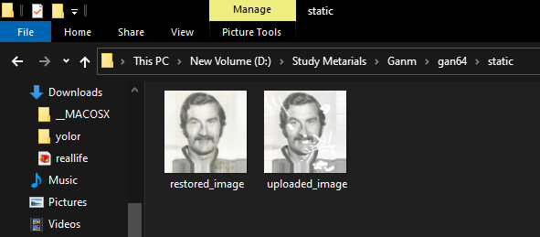
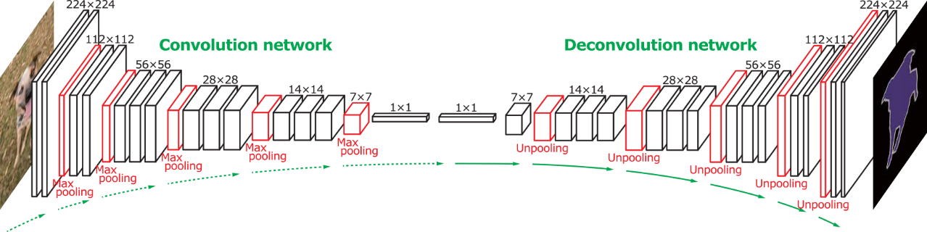
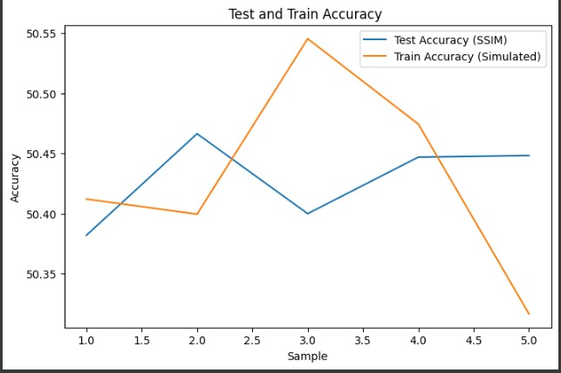
GAN Based Pixel Restoration System
Jul Jalal Al-Mamur Sayor, Nishat Tasnim Shishir, Fahim Shahriar Prottoy
Department of IoT and Robotic Engineering , BDU
ABSTRACT
RESULTS
CONCULSION
In this paper, we address the challenge of image restoration, especially in cases of extensive damage or pixelation. Traditional methods often fall short in such scenarios, prompting the exploration of Deep Neural Networks (DNNs) for improved results. We introduce a novel approach that leverages a Generative Adversarial Network (GAN) for image restoration. Our system consists of an image generation network responsible for restoring damaged images and a discriminator network that assesses the authenticity of the restorations. Additionally, we provide a user-friendly web interface for real-time image restoration. This project primarily highlights the effectiveness of our image restoration network, emphasizing its prowess in scenarios involving pixelation and widespread damage.
Keywords: Deep Neural Networks (DNNs), Image Restoration, Generative Adversarial Network (GAN),Image Generation Network, Damage Reconstruction
After training The model we saved that and develop a web interface and access it through Flask . After running the app.py that we have developed then the main web page is loaded in http://127.0.0.1:5000 development server . Then in the next step need to select a scratched or pixelated image from desktop
Our cGAN model demonstrates promise for grayscale-to-color image translation. Leveraging a diverse dataset, our model demonstrated promising results, providing a viable solution for colorization tasks While some limitations exist, including occasional color artifacts and deviations, future work will focus on refining the model and exploring alternative approaches. This research lays the foundation for improved colorization applications.
So here mentioning some Limitations and future work of this project
The designed webpage looks like this, Here we submitted 133.jpg for correction then click to the ‘Upload and Restore’ Button .
Figure-2 [without Batch Norm.]
Figure-3 [with Batch Norm]
Limitations:
The accuracy of the generator model in excellent.
Slight color deviations
Challenges with complex image content
Performs better in Gray shaded image.
Future Work:
Refine model architecture
Explore alternative loss functions
Investigate conditional variations
Augment the dataset and adapt to specific domains.
The project’s coding algorithm is given below:
Step 1: Import necessary libraries
Step 2: Set image size, variables, and file paths
Step 3: Define a function for sorting image files
Step 4: Load and preprocess color and grayscale images
Step 5: Create TensorFlow datasets for training and testing data
Step 6: Define and initialize Generator and Discriminator models
Step 7: Set up loss functions and optimizers
Step 8: Create a training loop
for epoch in range(epochs):
Step 9: Inside the training loop for batch in training_dataset:
a. Forward and backward passes through Generator and Discriminator
b. Calculate and update gradients
c. Apply gradients to optimize Generator and Discriminator
Step 10: After training, save Generator and Discriminator models
Step 11: End
OBJECTIVES
After Successfully uploading the image our saved model in the background will fix the image and will show both input and output image .
Image Restoration Network: Develop a high-precision image generation network to restore damaged images effectively.
Authenticity Evaluator (Discriminator): Create a discriminator network to assess the authenticity and quality of generated image restorations.
GAN Model Training Optimization : Optimize GAN training with a curated dataset of damaged and undamaged images to prioritize high-quality restorations and minimize flaws.
Creating a User-Friendly Web Interface with Flask.
Performance Assessment: Evaluate the effectiveness of the image restoration system by assessing its performance on a diverse range of damaged images, including those with extensive and intricate damage
REFERENCE
[1] Jin et al.“Image restoration method based on GAN and multi-scale feature fusion”, 978-1-7281-5855-6/20/$31.00 c 2020 IEEE
[2] Cao et al. “An Improved GAN-Based Image Restoration Method for Imaging Logging Images”, Appl. Sci. 2023, 13(16), 9249.
[3] Kishore et al. “Enhanced Image Restoration by GANs using Game Theory”, International Conference on Smart Sustainable Intelligent Computing and Applications under ICITETM 2020.
[4] Yu et al. “A practical generative adversarial network architecture for restoring damaged character photographs”, Volume 423, 29 January 2021, Pages 590-600.
[5] S. Li et al .”A two-channel convolutional neural network for image super-resolution”
Neurocomputing(2018).
[6] link : https://machinelearningmastery.com/how-to-accelerate-learning-of-deep-neural-networks-with-batch-normalization/
MATERIALS & METHOD
Model Plot – Generator Model
Model Plot – Discriminator Model
Model Formation : A standard Convolutional Neural Network (CNN) architecture is used for both the generator and discriminator models. The CNN architecture consists of convolutional layers, batch normalization layers, and activation functions (LeakyReLU) to process and transform the input data. These layers are organized into downsample and upsample blocks in the generator and downsample blocks in the discriminator.
Dataset : humanface8000 [from Kaggle]
Along with this in ‘static’ Folder automatically save the last input and output image named respectively named restored_image and uploaded_image
While developing the model use have used Down sampling and up sampling using the stride of 2. The figure shows almost the similar process by max pooling.
ACKNOWLEDGEMENT
We would like to express our sincere gratitude to Mr. Mahir Mahbub Sir, for his invaluable guidance and unwavering support throughout this project. His expertise, mentorship, and dedication to our learning have been instrumental in shaping the success of this project. We are truly fortunate to have had the opportunity to learn under his tutelage.
Plotting the test and train accuracy of our saved model for 5 sample train and test data.
AUTHORS INFORMATION
Figure : 1 [ concept of up/down Samling ]
Downsample blocks: These are comprised of Conv2D layers followed by batch normalization and LeakyReLU activation functions.
Upsample blocks: These are also comprised of Conv2DTranspose layers followed by batch normalization and ReLU activation functions.
[1] Jul Jalal Al-Mamur Sayor
ID – 1901029
Session – 2019-2020
Email – 1901029@iot.bdu.ac.bd
Batch Normalization : It contributes to the stability, faster training, and improved performance of the generator when learning to colorize grayscale images. These two figures show how batch normalization can minimize the number of epoch to get better accuracy from random sample.
By creating visual plots of the discriminator and generator models, we can gain deep insights into the intricate dance of Generative Adversarial Networks (GANs). These plots reveal how the discriminator learns to distinguish real from generated data and how the generator evolves to produce more convincing output
[2] Nishat Tasnim Shishir
ID – 1901030
Session – 2019-2020
Email – 1901030@iot.bdu.ac.bd
[3] Fahim Shahriar Prottoy
ID – 1901041
Session – 2019-2020
Email – 1901041@iot.bdu.ac.bd

