Slide 1

Analysis and Scraping of Airbnb Listings
Insights, Predictions, and Implications
Marios Christos Malamatinos
Nikos Bouzianas

Slide 2
Table of contents
01
02
03
04
Introduction
Team Work Plan
Steps and Methodology
Main Observations

Slide 3
Table of contents
05
06
07
Engaging Points
Conclusions
References

Slide 4
01
Introduction

Slide 5
Introduction
Purpose
Overview
Objectives
This project aims to scrape listings data from Airbnb, perform comprehensive analysis, and develop a predictive model to suggest prices for listings. The listings are located within the municipalities of Ampelokipoi-Menemeni, Evosmos and Stavroupoli.
Developed Streamlit application that serves as a user-friendly interface for exploring the Airbnb listings dataset.
Scraping and Data Collection Process
Data Analysis Methodology
Development of predictive models
Experimentation with interpretability
Key observations insights and implications
General Statistics
Detailed Analysis
Price Suggestion

Slide 6
02
Team Work Plan

Slide 7
Timeline
Split initial responsibilities, created Github repo and started searching for resources on how to scrape Airbnb Listing Data
Started designing and development of our Data Analysis and Price Suggestion Streamlit App. Also implemented a fully working alpha version.
Early March
Early April
Late March
Late April
Initial version of scraping script was implemented and focused on bug fixes. Also created script to add data and perform queries on Mongodb.
Final enhancements and bug fixes on streamlit app, finalization of Medium article and Final Presentation.

Slide 8
Responsibilities
Marios | Nikos
Data Scraping Preprocessing / Imputation App Analysis Page Interpretation of Price Suggestions Article Medium (secondary) Presentation (main) | Data Scraping Preprocessing / Imputation MongoDB Data Integration Price Suggestion Models Development Article Medium (main) Presentation (secondary)

Slide 9
03
Steps and Methodology

Slide 10
Steps and Methodology
Scraping
Data Cleaning
Imputation
Fetch raw data and ensure data quality and validity.
Transform text data to structured format according to their type.
Train model to perform imputation on missing values according to the rest of the available data.
Fetch Data to App
Exploratory Analysis
Price Prediction
Add preprocessed data to developed application and review summary statistics about the dataset.
Perform additional data exploration and analysis by performing clustering and rendering dynamic plots.
Train model and perform prediction according to user provided data. Also show interpretation of those results using SHAP library.

Slide 11
Steps and Methodology
Data
Preprocessing
Data filtering
Data Acquisition of Airbnb listings. Also load data into MongoDB.
Perform Preprocessing and Data Imputation for replacing missing values.
Removed Duplicate listings and performed geo-filtering (polygons).
Analysis App
EDA
Price Suggestion
Development of the application and data integration.
Exploratory data analysis on the scraped data.
Final price suggestions and integration of SHAP library.

Slide 12






Tools - Libraries Used
Selenium
Beautiful Soup
Scikit Learn
Used for automating web browser interactions to scrape Airbnb listings data.
Employed for parsing HTML and extracting relevant information from the scraped data.
Simple and efficient tools for predictive data analysis.
Pandas
Streamlit
SHAP
An open source data analysis and manipulation tool, built on top of the Python programming language
Streamlit is an open-source Python framework for delivering dynamic data apps with only a few lines of code
SHapley Additive exPlanations is a library utilizing the game theoretic approach to explain the output of any machine learning model.

Slide 13
04
Main Observations

Slide 14
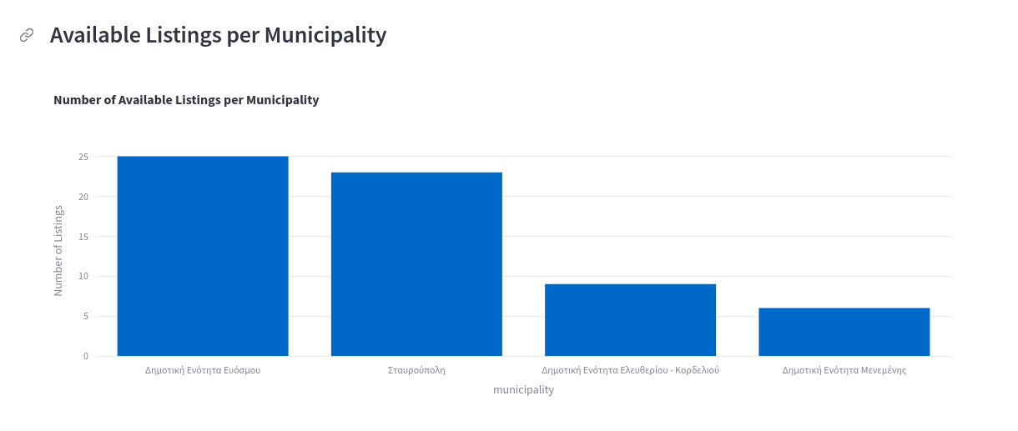
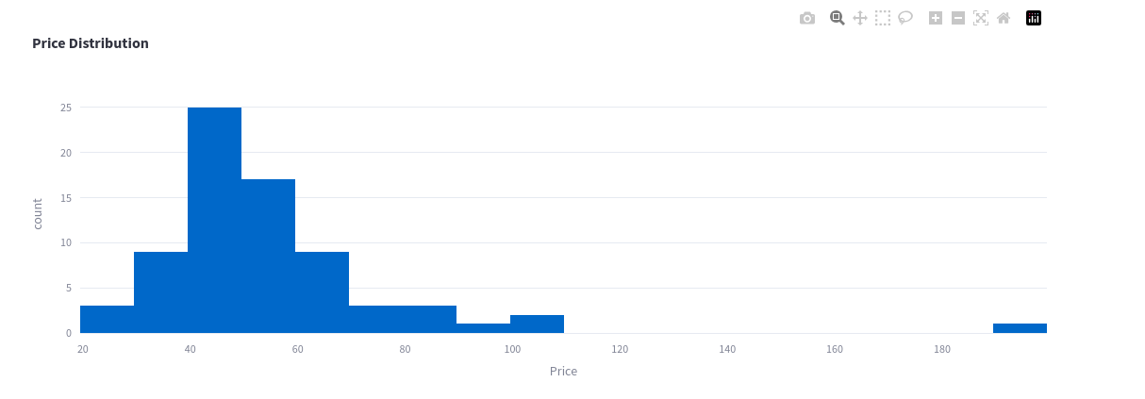
Main Observations
Listings per Municipality
Most of the listings are located in the Evosmos and Stavroupoli Municipalities.
Price Distribution
Most listings tend to have prices between 30 and 70 with some outliers being present (above 190 euros price.)

Slide 15
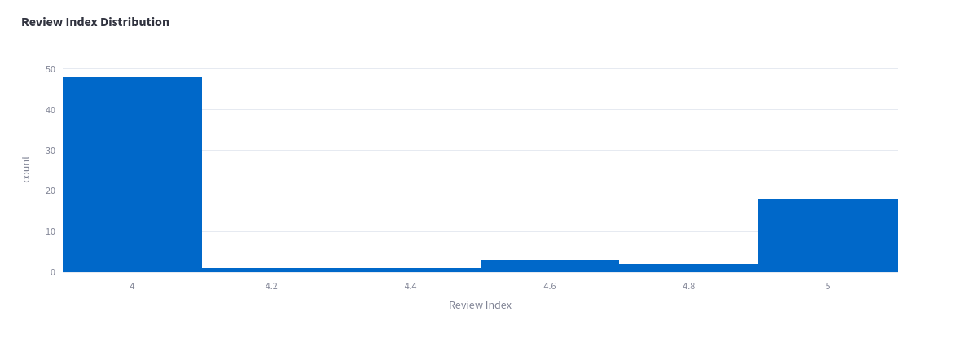
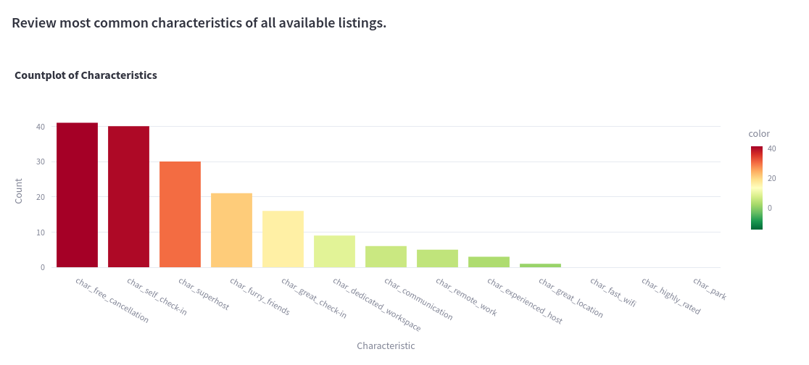
Main Observations
Review Index Distribution
All listings available had review index values between 3.9 and 5. Most listings have review index appr. 4 stars.
Characteristics
Most listings have free cancellation and self check in. The most uncommon characteristics are great location, experienced host and remote work characteristics.

Slide 16
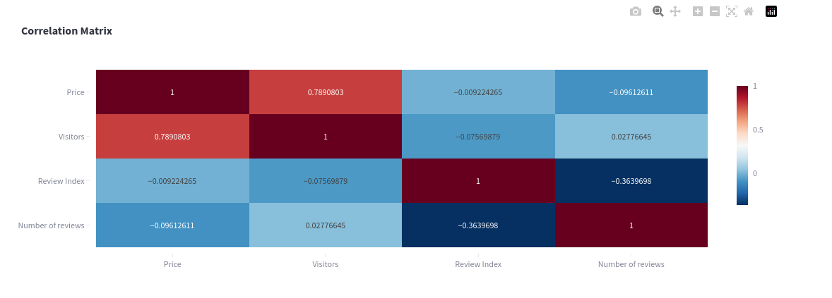
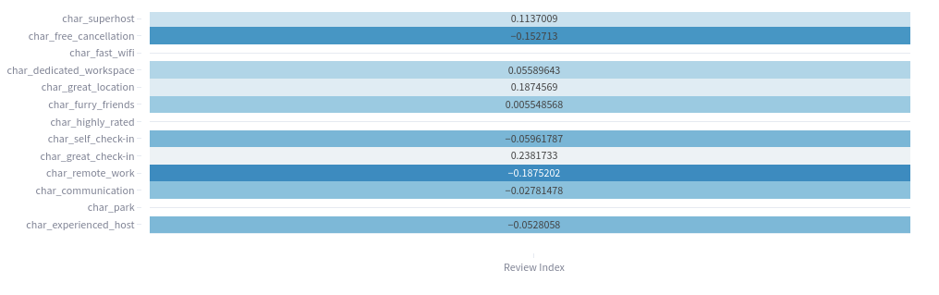
Main Observations
Correlations of Features
Strong positive correlation of Price and Visitors. Slight negative correlation is observed between review index and reviews number.
Reviews vs Characteristics
The remote work and free cancellation characteristics seem to have a slight negative correlation with the review index.

Slide 17
05
Engaging Points

Slide 18
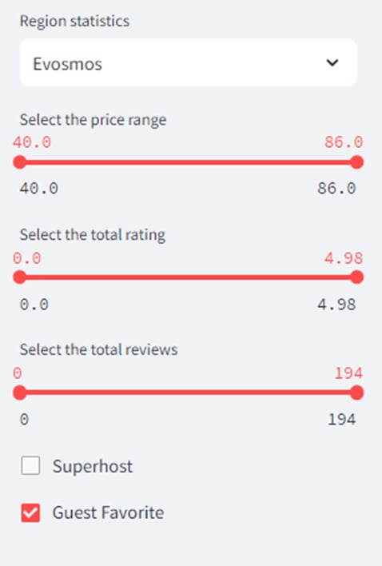
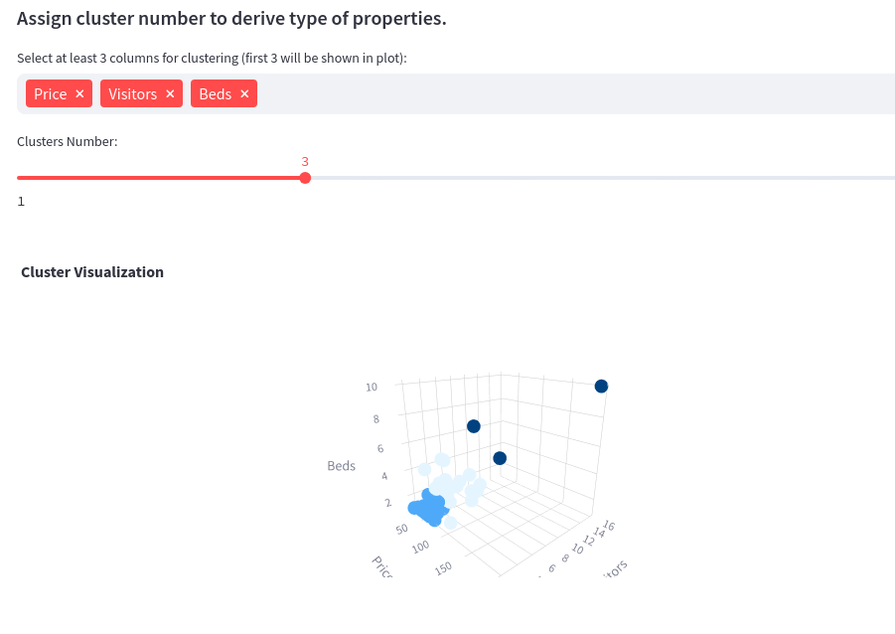
Interactive App Features
Dynamic selection of filters for rendering summary and general statistics plots. Selections vary to municipalities, price range, visitor range.
Interactive clustering widget for enhancing analysis workflow and derive type of properties according to selected features.

Slide 19
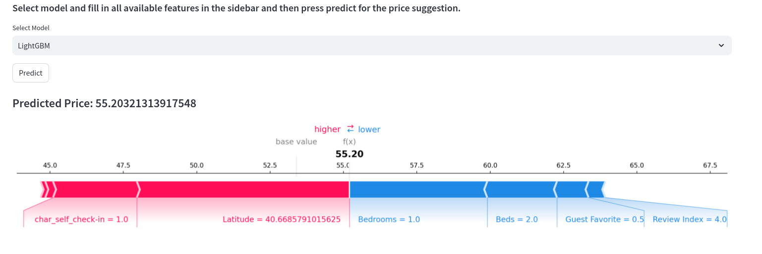
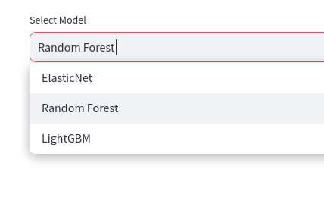
Interpretability
Visualization of SHAP values to interpret the model predictions and understand feature contributions. Understanding which feature impacted the model and how?
Model selection has been implemented to enable comparison between different model predictions. Available models are ElasticNet, Random Forest and Gradient Boosting Trees framework LightGBM.

Slide 20
06
Conclusions

Slide 21
Accomplishments
Scraping
Streamlit App
Data Analysis
Successfully scraped preprocessed and analyzed Airbnb listings data to gain valuable insights for the specific municipalities assigned.
Developed a Streamlit app with interactive features for data exploration and price prediction.
Identified significant factors influencing Airbnb listing prices.
Clustering
SHAP
Utilized clustering to segment the market and derive types of properties.
Utilized SHAP (SHapley Additive exPlanations) values for model interpretability and feature importance analysis.

Slide 22
Challenges
Limited Data
UI Changes
Erroneous Data Fetch
Faced challenges due to the availability of only approximately 80 listings in the assigned municipalities.
Airbnb site updates, impacted our scraping scripts which needed to be updated almost weekly.
Airbnb website mostly fetched data outside the requested region leading to many data being filtered out.
Dynamic Website
Execution Time
Pagination and lazy loaded is implemented in the AirBnB website which needed additional implementations for the scraping to be performed.
Scripts to run, took several hours and often were concluded with exceptions leading to code changes with Try – Excepts.

Slide 23
Future Ideas
Fine Tuning
Error Metrics
Feature Engineering
Fine-tuning of machine learning models to optimize performance and generalize better to new data.
Implement error metrics to evaluate and compare the performance of predictive models more effectively.
Incorporate additional features and refine existing models to improve price prediction accuracy.
MongoDB Integration
App Improvement
Integrate MongoDB for efficient data storage, retrieval, and management to support scalability and real-time data updates.
Gather user feedback to identify areas for app enhancement and implement improvements for a better user experience.

Slide 24
07
References

Slide 25
References
Beautiful Soup Docs, 2024. https://www.crummy.com/software/BeautifulSoup/bs4/doc/
Streamlit Docs, 2024. https://docs.streamlit.io/get-started/tutorials/create-an-app
Selenium Docs, 2024. https://www.selenium.dev/
Airbnb, 2024. https://www.airbnb.gr/
MongoDB Docs, 2024. https://www.mongodb.com/
GeoPy Docs, 2024. https://geopy.readthedocs.io/en/stable/
Folium, 2024. https://python-visualization.github.io/folium/latest/
SHAP, 2024. https://shap.readthedocs.io/en/latest/

Slide 26
Thanks!
Do you have any questions?

