Slide 1
实验二 汇编程序设计
2024春季
zjx@ustc.edu.cn

Slide 2
实验目标
理解龙芯架构32位精简(LoongArch32 Reduced, LA32R) 处理器基础整数指令的功能和编码格式
掌握LA32R简单汇编程序设计、仿真和调试的基本方法，以及下载测试代码和数据(COE文件) 的生成方法

Slide 3
实验内容
理解LA32R基础整数指令功能和编码格式
算术/比较运算：add.w, sub.w, addi.w, lu12i.w, pcaddu12i, slt, sltu, slti, sltui
逻辑运算：and, or, nor, xor, andi, ori, xori
移位运算：sll.w, srl.w, sra.w, slli.w, srli.w, srai.w
访存：st.w, ld.w, st.h, st.b, ld.h, ld.b, ld.hu, ld.bu
转移：beq, bne, blt, bge, bltu, bgeu, b, bl, jirl
设计汇编程序，实现数组排序
数组数据：1024个32位无符号数
排序算法：冒泡降序排序
Notes:
算术/比较运算：add.w, sub.w, addi.w, lu12i.w, pcaddu12i, mul.w, slt, sltu, slti, sltui
逻辑运算：and, or, nor, xor, andi, ori, xori
移位运算：sll.w, srl.w, sra.w, slli.w, srli.w, srai.w
访存：st.w, st.h, st.b, ld.w, ld.h, ld.b, ld.hu, ld.bu
转移：beq, bne, blt, bge, bltu, bgeu, b, bl, jirl

Slide 4
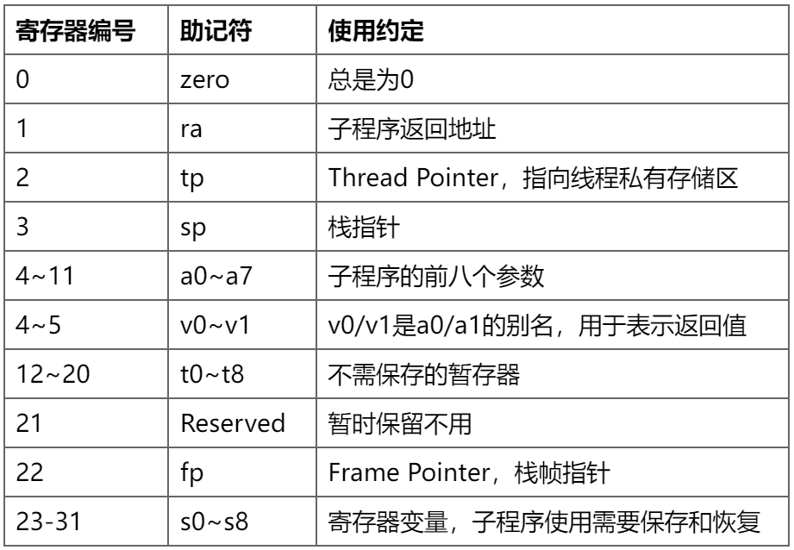
LA32R寄存器
32个通用寄存器（寄存器堆）
r0 ~ r31
助记符与rn等价
例如，ra = r1
有无$前缀等价
例如，$ra = ra,
大小写等价
例如，R1 = r1
PC
Notes:
应用程序二进制接口（Application Binary Interface, ABI）
寄存器名称首个'$'符号可以省略，即zero和$zero是等价的, r0和$r0是等价的。
寄存器名称不区分大小写，即$zero和$ZERO是等价的, $r0和$R0是等价的。

Slide 5
加/减/比较运算指令
add.w rd, rj, rk # rd = rj + rk
sub.w rd, rj, rk # rd = rj - rk
addi.w rd, rj, si12 # rd = rj + SE(si12)
lu12i.w rd, si20 # rd = {si20, 12’b0}
pcaddu12i rd, si20 # rd = pc + {si20, 12’b0}
slt rd, rj, rk # rd = rj <_{s} rk
sltu rd, rj, rk # rd = rj <_{u} rk
slti rd, rj, si12 # rd = rj <_{s} SE(si12)
sltui rd, rj, si12 # rd = rj <_{u} SE(si12)

Slide 6
逻辑运算指令
and rd, rj, rk # rd = rj & rk
or rd, rj, rk # rd = rj | rk
nor rd, rj, rk # rd = ~ (rj | rk)
xor rd, rj, rk # rd = rj ^ rk
andi rd, rj, ui12 # rd = rj & ZE(ui12)
ori rd, rj, ui12 # rd = rj | ZE(ui12)
xori rd, rj, ui12 # rd = rj ^ ZE(ui12)

Slide 7
移位运算指令
sll.w rd, rj, rk # rd = rj << rk[4 : 0]
srl.w rd, rj, rk # rd = rj >> rk[4 : 0]
sra.w rd, rj, rk # rd = rj >>> rk[4 : 0]
slli.w rd, rj, ui5 # rd = rj << ui5
srli.w rd, rj, ui5 # rd = rj >> ui5
srai.w rd, rj, ui5 # rd = rj >>> ui5

Slide 8
访存指令
ld.w rd, rj, si12 # rd = MemW[rj + SE(si12)]
ld.b rd, rj, si12 # rd = SE(MemB[rj + SE(si12)])
ld.h rd, rj, si12 # rd = SE(MemH[rj + SE(si12)])
ld.bu rd, rj, si12 # rd = ZE(MemB[rj + SE(si12)])
ld.hu rd, rj, si12 # rd = ZE(MemH[rj + SE(si12)])
st.w rd, rj, si12 # MemW[rj + SE(si12)] = rd
st.b rd, rj, si12 # MemB[rj + SE(si12)] = rd[7:0]
st.h rd, rj, si12 # MemH[rj + SE(si12)] = rd[15:0]
Notes:
对于LD.{H[U]/W}和ST.{B/H/W}指令，只要其访存地址是自然对齐的，都不会触发非对齐例外；否则的话将触发非对齐例外。
对于写，可以令写使能信号为4位，从而实现单个字节写入

Slide 9
转移指令
beq rj, rd, offs16 # if (ri == rd) pc += SE({offs16, 2'b0})
bne rj, rd, offs16 # !=
blt rj, rd, offs16 # <_{s}
bge rj, rd, offs16 # !<_{s}
bltu rj, rd, offs16 # <_{u}
bgeu rj, rd, offs16 # !<_{u}
b offs26 # pc += SE({offs26, 2'b0})
bl offs26 # r1 = pc + 4, pc += SE({offs26, 2'b0})
jirl rd, rj, offs16 # rd = pc + 4, pc = rj + SE({offs16, 2'b0})
Notes:
下一半三条为无条件跳转
bl 跳转同时存储跳转前下一地址，默认存在r1里

Slide 10
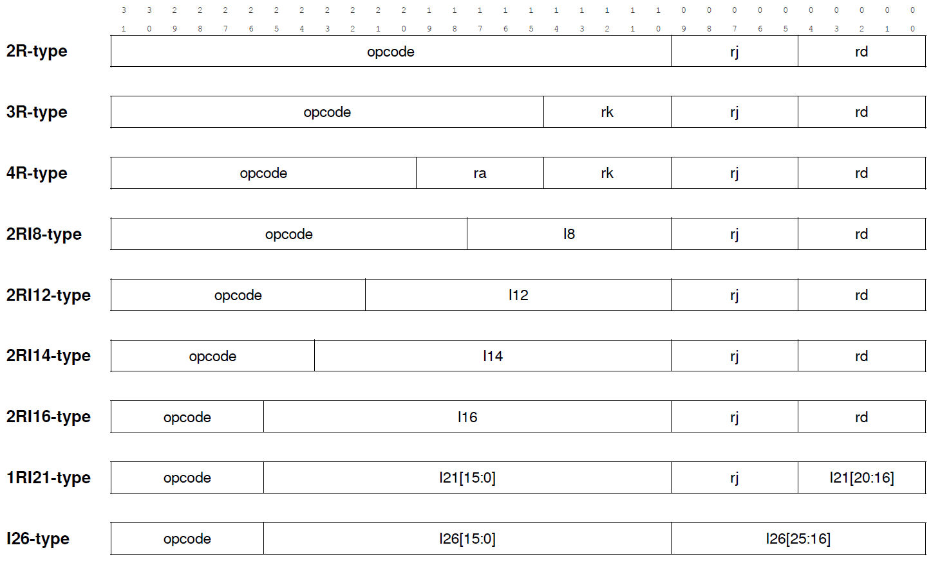
指令编码格式
Notes:
操作码变长度

Slide 11
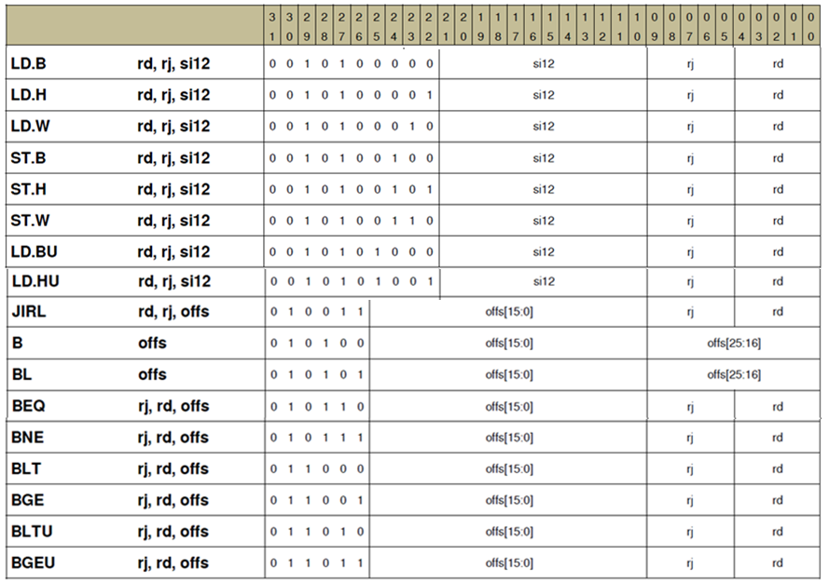
Notes:
并行译码
先always @ 译码前六位，独热码
另一个always译码后四位，独热码
两个结果与，得到指令具体是什么

Slide 12
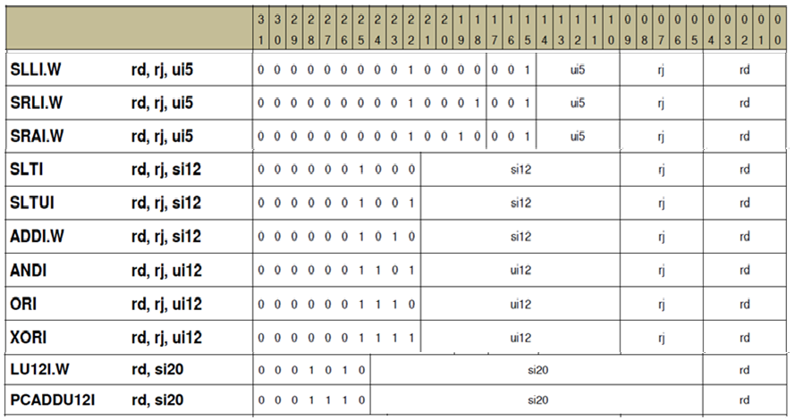
Notes:
三个译码器

Slide 13
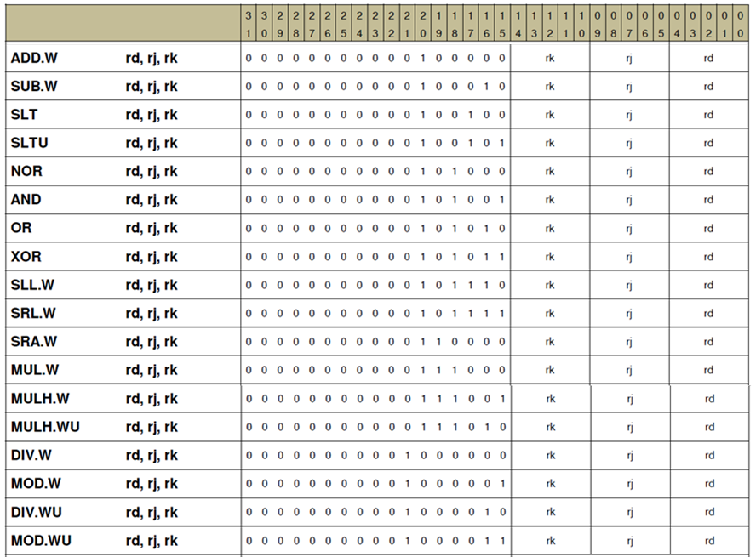

Slide 14
汇编器指令和宏指令
汇编器指令
.data, .text # 数据段，代码段
.word, .half, .byte, .string # 字，半字，字节，字符串
.align n # 2^{n} 字节对齐
… …
宏指令
nop # 空操作，等价 andi/ori r0, r0, 0
li.w rd, imm # rd = imm, 最多转换为 lu12i.w 和 ori 两条指令
la.local rd, label # rd = label, 最多转换为 lu12i.w 和 ori 两条指令
… …
Notes:
.ascii “hello\0”
.asciz “hello”
.string “hello”
li，load immediate
la load address

Slide 15
LA32R简单测试程序
# inst_ram.txt, 计算斐波拉契数列
1c000000: addi.w $t0, $zero, 0x0 # f0 = 0
1c000004: addi.w $t1, $zero, 0x1 # f1 = 1
1c000008: addi.w $s0, $zero, 0x0 # 循环计数i = 0
1c00000c: addi.w $s1, $zero, 0x1 # 计数步长 = 1
1c000010: ld.w $a0, $zero, 1024 # 输入循环终值n
loop:
1c000014: add.w $t2, $t0, $t1 # fi = fi-2 + fi-1
1c000018: addi.w $t0, $t1, 0x0 # fi-2 = fi-1
1c00001c: addi.w $t1, $t2, 0x0 # fi-1 = fi
1c000020: add.w $s0, $s0, $s1 # i++
1c000024: bne $s0, $a0, loop # if i! = n, 循环loop
1c000028: st.w $t2, $zero, 1028 # 结束，输出fn
end:
1c00002c: bne $s1, $zero, end # 进入死循环end
; inst_ram.coe
memory_initialization_radix = 16;
memory_initialization_vector =
0280000c
0280040d
02800017
02800418
28900004
0010358e
028001ac
028001cd
001062f7
5ffff2e4
2990100e
5c000300
Notes:
另一个版本的测试程序
.data #数据段
.align 2
num:
.word 20 #数列项数
fib:
.word #数列存储
.text # 代码段
.align 2
la.local $a0, fib # a0 = fib地址
ld.w $a1, $a0, -4 # a1 = num
addi.w $t0, $zero, 1 # t0 = 1
addi.w $t1, $zero, 0x1 # t1 = 1
loop:
add.w $t2, $t0, $t1 # t2 = t0 + t1
st.w $t2, $a0, 0 # save t2
addi.w $t0, $t1, 0 # t0 = t1
addi.w $t1, $t2, 0 # t1 = t2
addi.w $a0, $a0, 4 # a0 = a0 + 4
addi.w $a1, $a1, -1 # a1 = a1 - 1
bne $a1, $zero, loop
end:
bne $a0, $zero, end

Slide 16
LA32R指令功能测试程序
参考资料
CPU设计实战：LoongArch版
https://bookdown.org/loongson/_book3/
https://gitee.com/loongson-edu/cdp_ede_local
mycpu_env/func/inst/*.S ：针对每条指令或功能点的汇编测试程序
mycpu_env/func/start.S ：主函数，执行必要的启动初始化后调用func/inst/下的各汇编程序
mycpu_envfunc/include/*.h ：测试程序配置信息和宏定义
Notes:
CPU设计实战：LoongArch版
https://bookdown.org/loongson/_book3/
配套实验环境
https://gitee.com/loongson-edu/cdp_ede_local

Slide 17
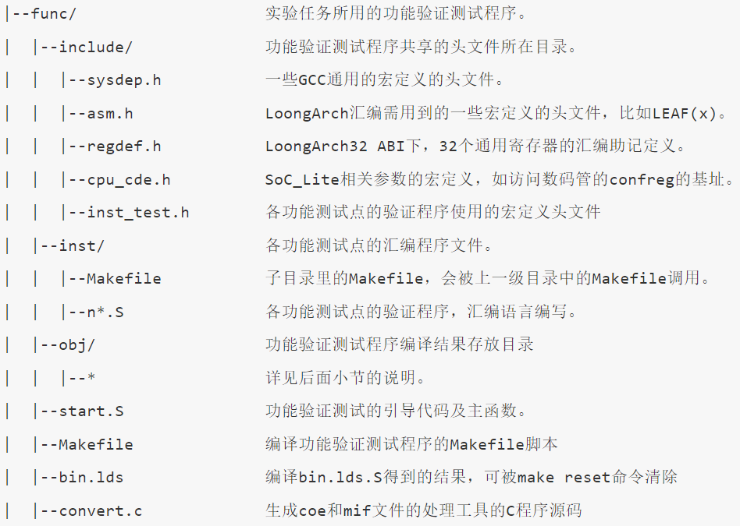

Slide 18
实验要求
阅读理解用于LA32R指令测试的汇编程序
设计汇编程序，实现数组排序，并生成COE文件
使用LARS（Loongarch32R Assembler and Runtime Simulator）
https://soc.ustc.edu.cn/COD/lab1/lars/
Notes:
排序，

Slide 19
The End

Slide 20
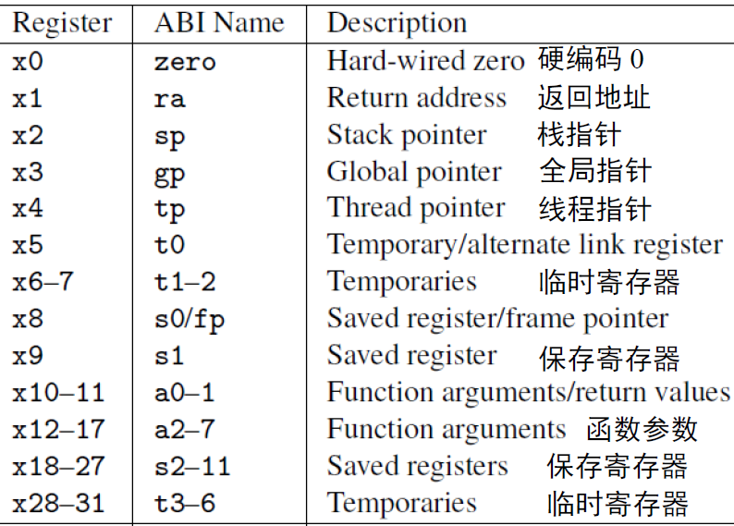
RISC-V寄存器
PC和32个通用寄存器（合称寄存器堆）
Notes:
In practice, the programmer doesn't use this notation for the registers. Though x1 to x31 are all equally general-use registers as far as the processor is concerned, by convention certain registers are used for special tasks. In assembler, they are given standardized names as part of the RISC-V application binary interface (ABI). This is what you will usually see in code listings. If you really want to see the numeric register names, the -M argument to objdump will provide them.
As a general rule, the saved registers s0 to s11 are preserved across function calls, while the argument registers a0 to a7 and the temporary registers t0 to t6 are not. The use of the various specialized registers such as sp by convention will be discussed later in more detail.

Slide 21
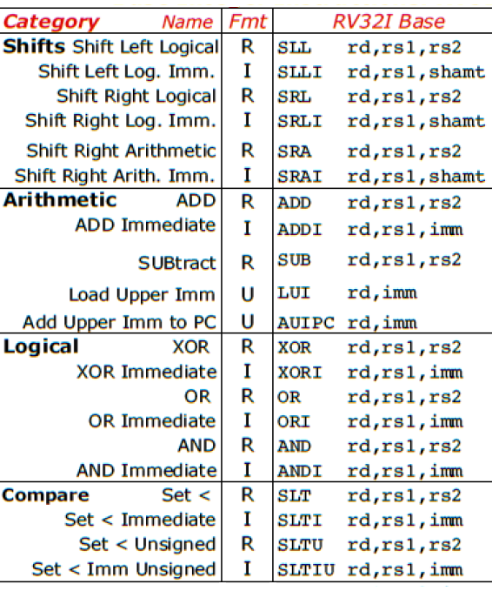
RV32I指令类型
运算类
算术：add, sub, addi, auipc, lui
逻辑：and, or, xor, andi, ori, xori
移位(shift)：sll, srl, sra, slli, srli, srai
比较(set if less than)：slt, sltu, slti, sltiu

Slide 22
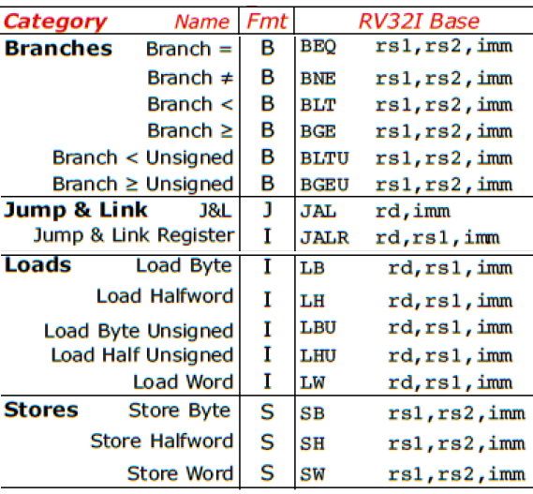
RV32I指令类型 (续)
访存类
加载(load)：lw, lb, lbu, lh, lhu
存储(store)：sw, sb, sh
转移类
分支(branch)：beq, blt, bltu, bne, bge, bgeu
跳转(jump)：jal, jalr
Notes:
RV32I provides two types of control transfer instructions: unconditional jumps and conditional branches. Control transfer instructions in RV32I do not have architecturally visible delay slots.

Slide 23
RV32I指令功能
add rd, rs1, rs2 # x[rd] = x[rs1] + x[rs2]
addi rd, rs1, imm # x[rd] = x[rs1] + sext(imm)
sub rd, rs1, rs2 # x[rd] = x[rs1] - x[rs2]
auipc rd, imm # x[rd] = pc + imm[31:12] << 12
lui rd, imm # x[rd] = imm[31:12] << 12
and rd, rs1, rs2 # x[rd] = x[rs1] & x[rs2]
or rd, rs1, rs2 # x[rd] = x[rs1] | x[rs2]
xor rd, rs1, rs2 # x[rd] = x[rs1] ^ x[rs2]
slli rd, rs1, shamt # x[rd] = x[rs1] ≪ shamt
srli rd, rs1, shamt # x[rd] = x[rs1] ≫_{𝑢} shamt
srai rd, rs1, shamt # x[rd] = x[rs1] ≫_{s} shamt

Slide 24
RV32I指令功能
lw rd, offset(rs1) # x[rd] = M[x[rs1] + sext(offset)]
sw rs2, offset(rs1) # M[x[rs1] + sext(offset)] = x[rs2]
beq rs1, rs2, offset # if (rs1 == rs2) pc += sext(offset)
blt rs1, rs2, offset # if (rs1 < _{s} rs2) pc += sext(offset)
bltu rs1, rs2, offset # if (rs1 < _{u} rs2) pc += sext(offset)
jal rd, offset # x[rd] = pc+4, pc += sext(offset)
jalr rd, offset(rs1) # t = pc + 4; pc = (x[rs1] + sext(offset)) & ~1; x[rd]=t

Slide 25
汇编指示符和伪指令
汇编指示符（Assembly Directives）
.data, .text
.word, .half, .byte, .string
.align
……
伪指令（Pseudo Instructions）
li, la, mv
nop, not, neg
j, jr, call, ret
……
参考资料：RISC-V Assembly Programmer's Manual
https://github.com/riscv-non-isa/riscv-asm-manual/blob/master/riscv-asm.md#risc-v-assembly-programmers-manual
Notes:
RISC-V Assembly Programmer's Manual
https://github.com/riscv/riscv-asm-manual

Slide 26
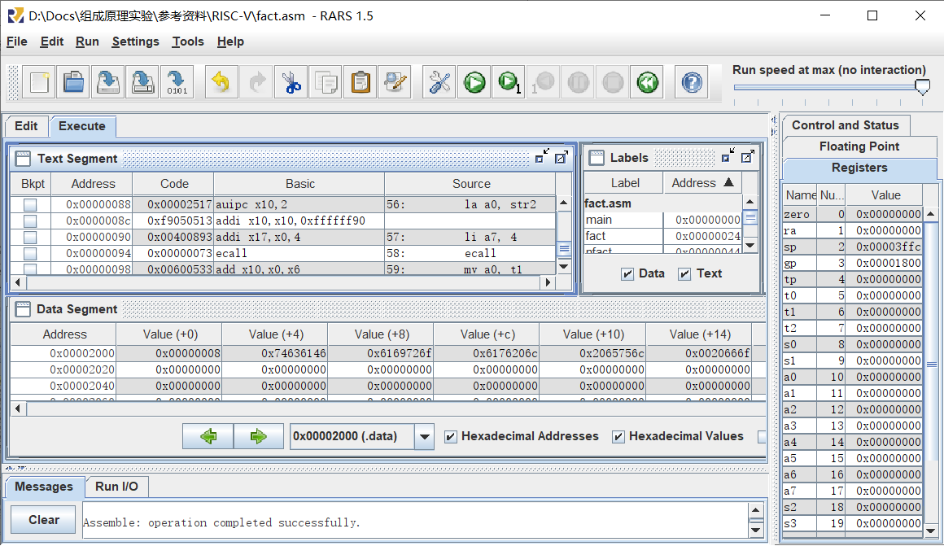
RARS
RISC-V Assembler & Runtime Simulator

Slide 27
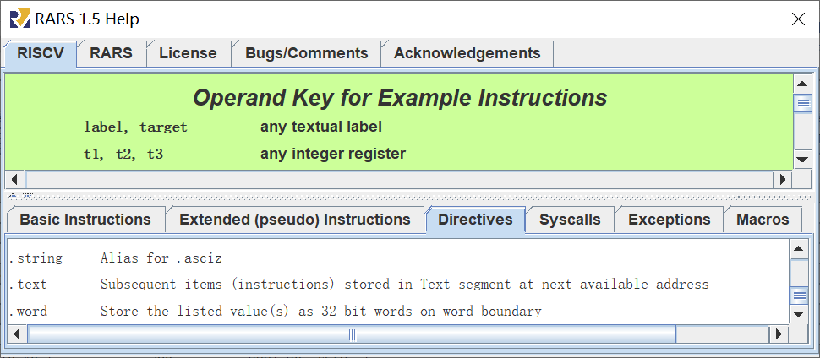
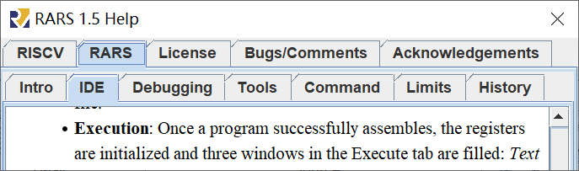
Help
RISCV：指令、伪指令、指示符、系统调用……
RARS：IDE、调试、工具……

Slide 28
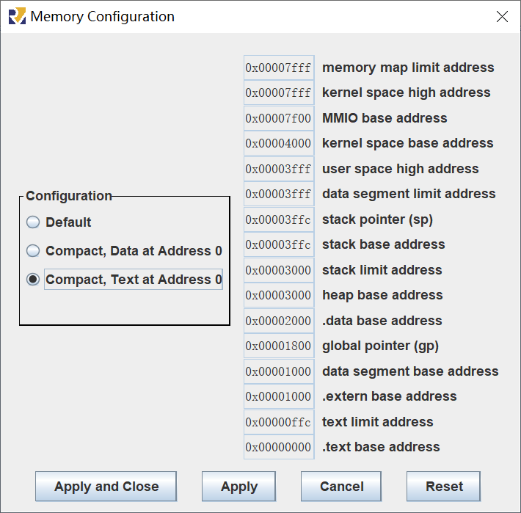
存储器配置
Setting >> Memory Configuration…
假定配置为紧凑型
代码地址：
0x0000 ~ 0xffc
数据地址：
0x2000 ~ 0x2ffc

Slide 29
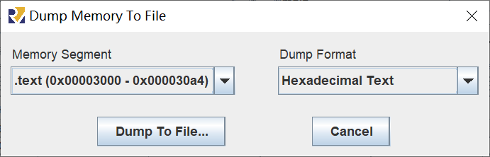
汇编程序转COE文件
配置存储器：Setting >> Memory Configuration…
汇编程序：Run >> Assemble
导出代码和数据：File >> Dump Memory…
生成COE文件：导出文本的开头添加以下两行
memory_initialization_radix = 16;
memory_initialization_vector =

