Slide 1
Methodology, Ethics and Practice of Data Privacy
实验部分
Lan Zhang
School of Computer Science and Technology
University of Science and Technology of China
Autumn 2024

Slide 2
Lab 1
实验题目：K-Anonymity的实现与分析
实验内容：使用Mondrian算法实现关系型数据匿名化 并进行实验分析
实验目标：
评价标准：补充代码50%+实验报告50%
提交内容：实验报告PDF+代码压缩包
截止时间：11.15 23:59（下周五）
禁止抄袭或使用AI工具
1、完成面向数值属性的基础型Mondrian
2、完成拓展到类别属性的通用型Mondrian 3、设计实验方案对Mondrian算法进行分析

Slide 3
K-Anonymity 简介
Every QI-cluster contains k or more tuples. (k=4)
 | Name | Age | Gender | Zip Code | Nationality | Condition
1 | Ann | 20-29 | Any | 130** | Asian | Heart disease
2 | Bruce | 20-29 | Any | 130** | Asian | Heart disease
3 | Cary | 20-29 | Any | 130** | Asian | Viral infection
4 | Dick | 20-29 | Any | 130** | Asian | Viral infection
5 | Eshwar | 40-59 | Any | 14*** | Asian | Cancer
6 | Fox | 40-59 | Any | 14*** | Asian | Flu
7 | Gary | 40-59 | Any | 14*** | Asian | Heart disease
8 | Helen | 40-59 | Any | 14*** | Asian | Flu
9 | Igor | 30-39 | Any | 1322* | American | Cancer
10 | Jean | 30-39 | Any | 1322* | American | Cancer
11 | Ken | 30-39 | Any | 1322* | American | Cancer
12 | Lewis | 30-39 | Any | 1322* | American | Cancer
Identifier attributes
Quasi-identifiers, QI
Sensitive attributes
3

Slide 4
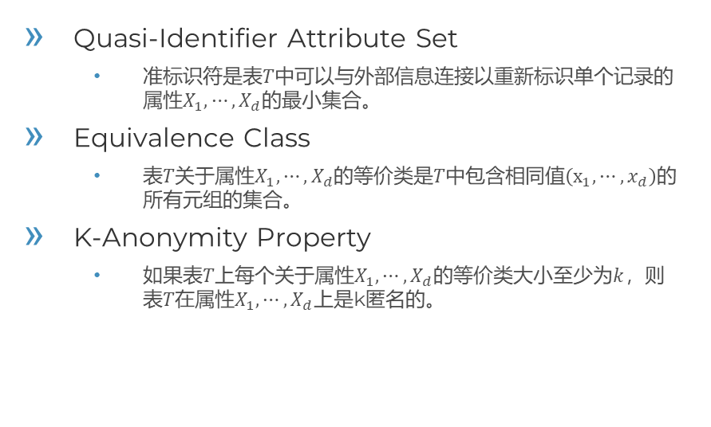
K-Anonymity 简介
Quasi-Identifier Attribute Set
准标识符是表$T$中可以与外部信息连接以重新标识单个记录的 属性$X_{1},⋯,X_{d}$的最小集合。
Equivalence Class
表$T$关于属性$X_{1},⋯,X_{d}$的等价类是$T$中包含相同值$\left(x_{1},⋯,x_{d}\right)$的 所有元组的集合。
K-Anonymity Property
如果表$T上$每个关于属性$X_{1},⋯,X_{d}$的等价类大小至少为$k$，则 表$T在$属性$X_{1},⋯,X_{d}$上是k匿名的。
LeFevre K, DeWitt D J, Ramakrishnan R. Mondrian Multidimensional K-Anonymity[C]//Proceedings of the 22nd International Conference on Data Engineering. 2006: 25.
Notes:
K=2

Slide 5
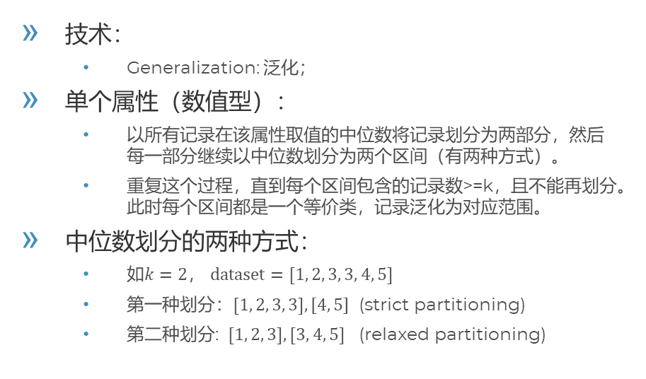
K-Anonymity 算法 -- Mondrian
技术：
Generalization: 泛化；
单个属性（数值型）：
以所有记录在该属性取值的中位数将记录划分为两部分，然后每一部分继续以中位数划分为两个区间（有两种方式）。
重复这个过程，直到每个区间包含的记录数>=k，且不能再划分。此时每个区间都是一个等价类，记录泛化为对应范围。
中位数划分的两种方式：
如$k=2$， $dataset=[1, 2, 3, 3, 4, 5]$
第一种划分：$[1, 2, 3, 3],\left[4, 5\right]$ (strict partitioning)
第二种划分: $[1, 2, 3], [3, 4, 5]$ (relaxed partitioning)
Notes:
K=2

Slide 6
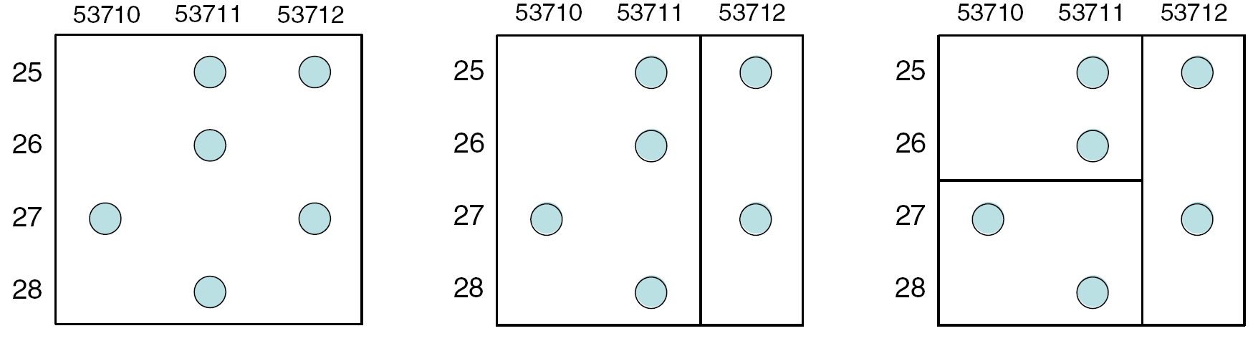
K-Anonymity 算法 -- Mondrian
多个属性（数值型） ：
每个Partition单独选择一个属性，可以选择范围最大的属性，或者随机选；
找到属性的中位数，对Partition划分；
重复上述过程，直到不能划分为止。
Notes:
K=2

Slide 7
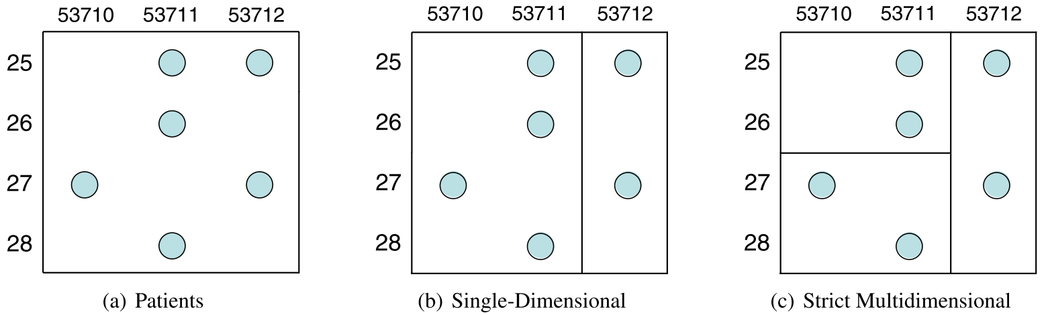
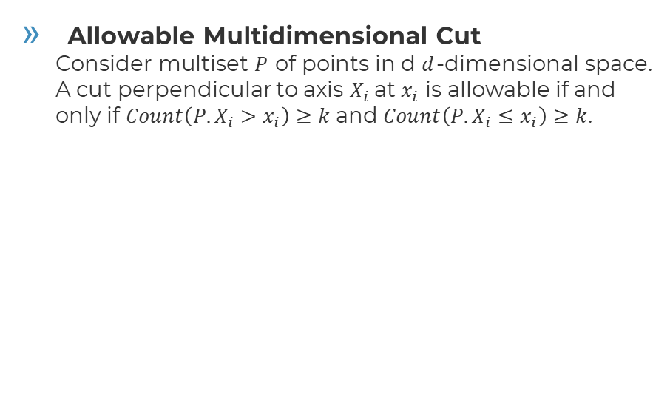
K-Anonymity 算法 -- Mondrian
Allowable Multidimensional Cut Consider multiset $P$ of points in d $d$-dimensional space. A cut perpendicular to axis $X_{i}$at $x_{i}$ is allowable if and only if $Count\left({P.X}_{i}>x_{i}\right)≥k$ and $Count\left({P.X}_{i}≤x_{i}\right)≥k$.
Spatial representation of Patients and partitionings (quasi-identifiers Zipcode and Age)
Notes:
K=2

Slide 8
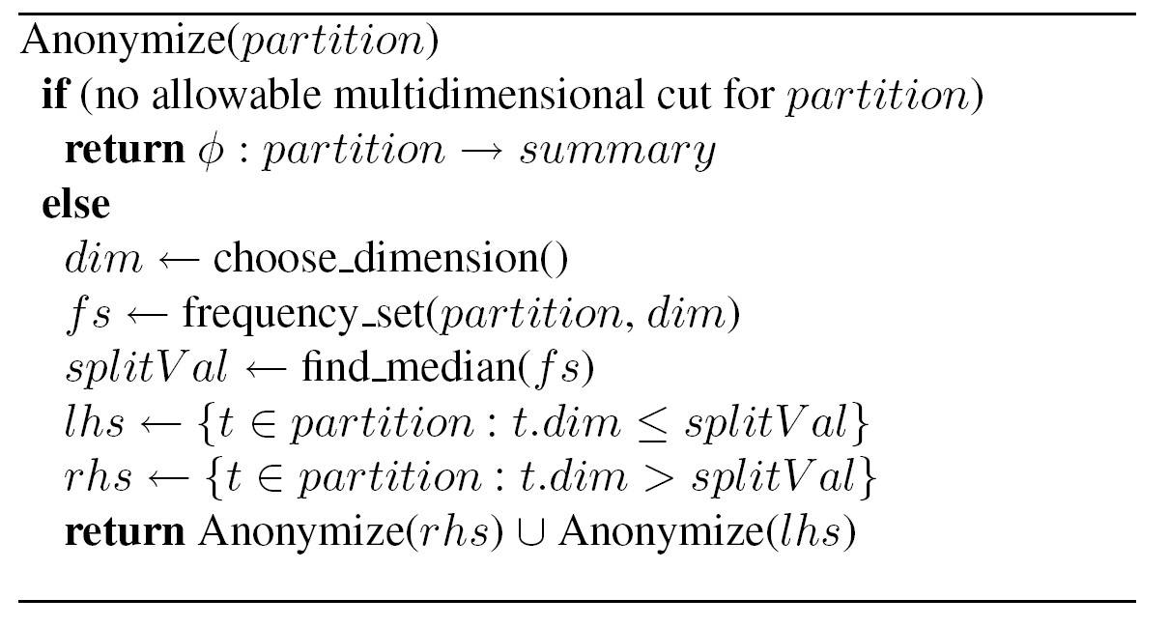
K-Anonymity 算法 -- Mondrian
算法（strict multidimensional partitioning）：
自顶向下的贪心算法
Notes:
K=2

Slide 9
K-Anonymity 算法 -- Mondrian
算法（relaxed multidimensional partitioning）：
The partitioning algorithm is easily adapted for relaxed partitioning. The points falling at the median (where t.dim = splitVal) are divided evenly between lhs child and rhs child such that |lhs_child| = |rhs_child| (+1 when |partition| is odd).
Notes:
K=2

Slide 10
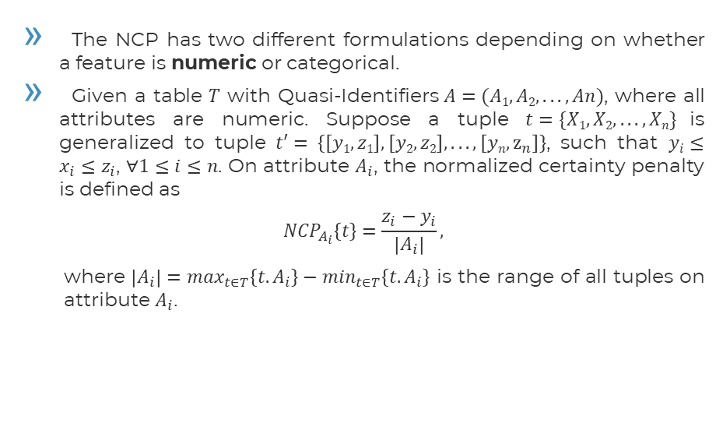
评价指标 Normalized Certainty Penalty (NCP)
The NCP has two different formulations depending on whether a feature is numeric or categorical.
Given a table $T$ with Quasi-Identifiers$A=(A1, A2, . . . , An)$, where all attributes are numeric. Suppose a tuple $t=\{X1, X2, . . . , Xn\}$is generalized to tuple $t′= \left\{\left[y1, z1\right], \left[y2, z2\right], . . . ,\left[yn, z_{n}\right]\right\}$, such that $yi≤x_{i}≤z_{i}$, $∀1≤i≤n$. On attribute $A_{i}$, the normalized certainty penalty is defined as
$${NCP}_{A_{i}}\left\{t\right\}=\frac{z_{i}−y_{i}}{\left|A_{i}\right|},$$
where $\left|A_{i}\right|=\max_{t∈T}\left\{{t.A}_{i}\right\}−\min_{t∈T}\left\{{t.A}_{i}\right\}$ is the range of all tuples on attribute $A_{i}$.
Xu J, Wang W, Pei J, et al. Utility-based anonymization using local recoding[C]//Proceedings of the 12th ACM SIGKDD international conference on Knowledge discovery and data mining. 2006: 785-790.

Slide 11
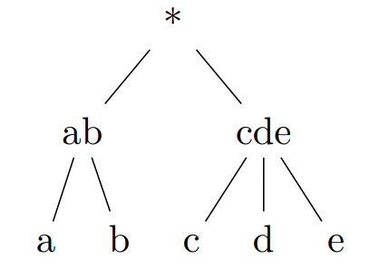
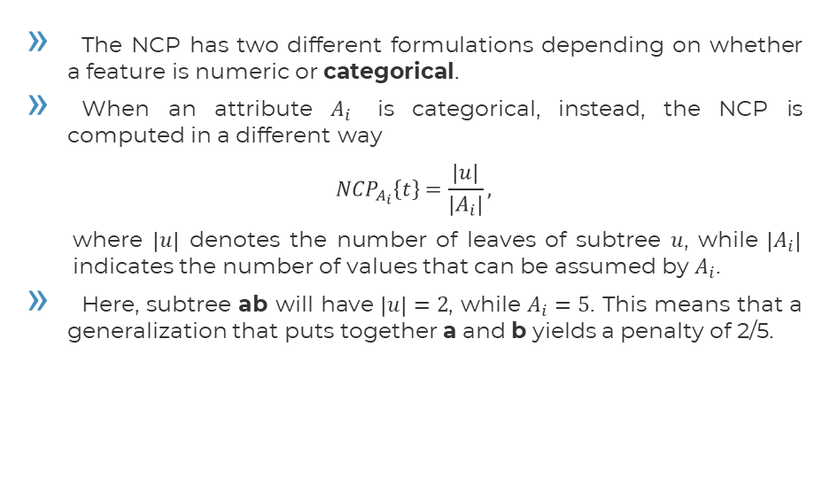
评价指标 Normalized Certainty Penalty (NCP)
The NCP has two different formulations depending on whether a feature is numeric or categorical.
When an attribute $A_{i}$ is categorical, instead, the NCP is computed in a different way
$${NCP}_{A_{i}}\left\{t\right\}=\frac{\left|u\right|}{\left|A_{i}\right|},$$
where $\left|u\right|$ denotes the number of leaves of subtree $u$, while $\left|A_{i}\right|$ indicates the number of values that can be assumed by $A_{i}$.
Here, subtree ab will have $\left|u\right|=2$, while $A_{i}=5$. This means that a generalization that puts together a and b yields a penalty of 2/5.

Slide 12
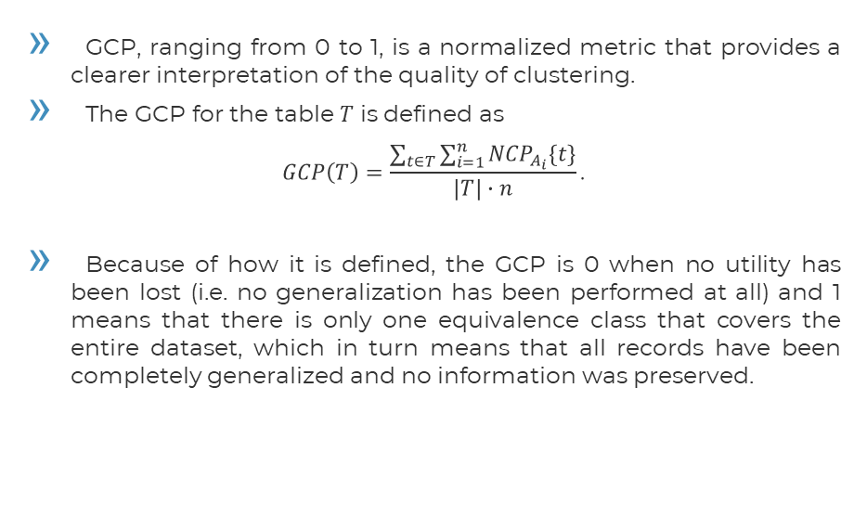
评价指标 Global Certainty Penalty (GCP)
GCP, ranging from 0 to 1, is a normalized metric that provides a clearer interpretation of the quality of clustering.
The GCP for the table $T$ is defined as
$$GCP\left(T\right)=\frac{\sum_{t∈T}{\sum_{i=1}^{n}{{NCP}_{A_{i}}\{t\}}}}{\left|T\right|∙n}\text{.}$$
Because of how it is defined, the GCP is 0 when no utility has been lost (i.e. no generalization has been performed at all) and 1 means that there is only one equivalence class that covers the entire dataset, which in turn means that all records have been completely generalized and no information was preserved.
Ghinita G, Karras P, Kalnis P, et al. Fast data anonymization with low information loss[C]//Proceedings of the 33rd international conference on Very large data bases. 2007: 758-769.

Slide 13
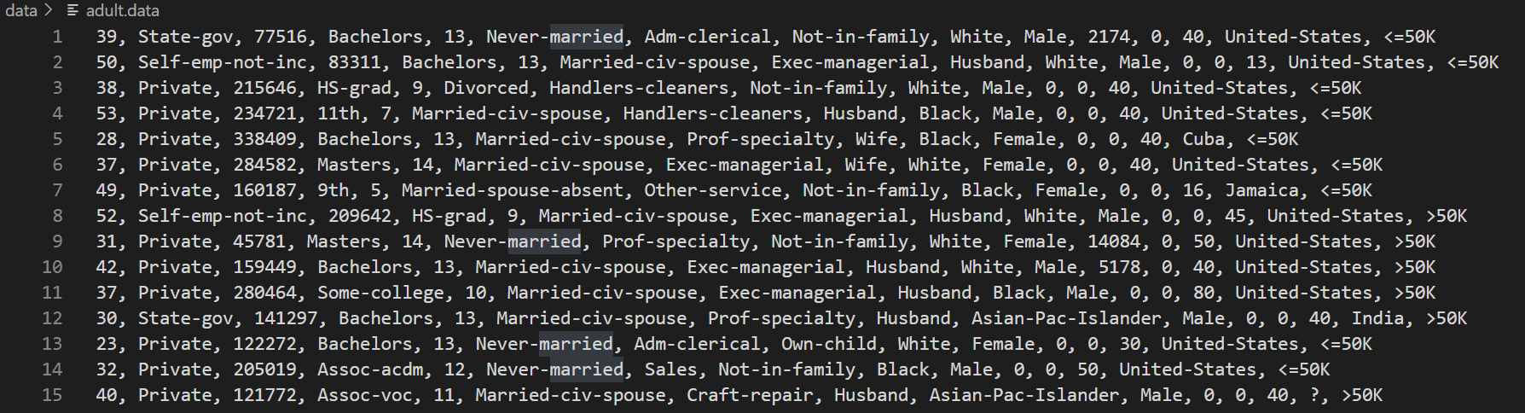
Adult数据集介绍（文件夹中有提供）
下载链接：https://archive.ics.uci.edu/ml/datasets/adult
[‘age’, ‘work_class’, ‘final_weight’, ‘education’, ‘education_num’, ‘marital_status’, ‘occupation’, ‘relationship’, ‘race’, ‘sex’, ‘capital_gain’, ‘capital_loss’, ‘hours_per_week’, ‘native_country’, ‘class’]
9 Categorical attributes & 6 Numerical attributes

Slide 14
实验要求
补充代码 50：
补充实验代码中的缺失部分，正确实现 基础型Mondrian 和 通用型Mondrian 40
代码清晰有注释 10
实验报告 50：
问题描述5、解决思路10、算法具体流程图 10
分析 (k、qi、datasize)对(GCP、RunTime)的影响 10
讨论全局损失、执行时间、安全性之间的关系 10
总结Mondrian算法的特点 5
补充的代码截图
代码抄袭或使用AI工具 0

Slide 15
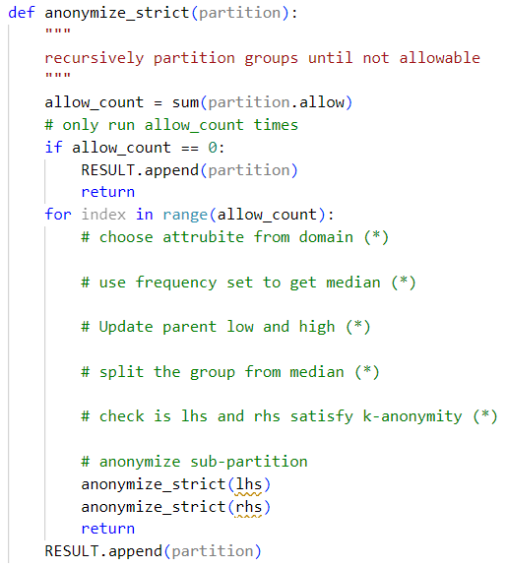
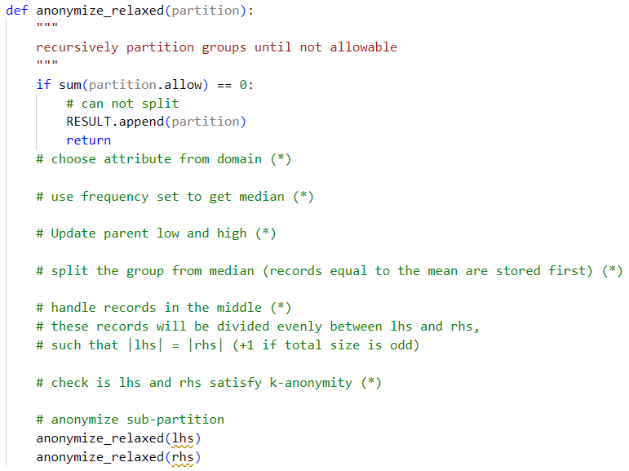
实验说明
基础型Mondrian:
主要面向数值属性
对于类别属性在处理前映射到数值上，并在处理后恢复
按照说明补充anonymize_strict()、anonymize_relaxed()
mondrian.py
mondrian.py

Slide 16
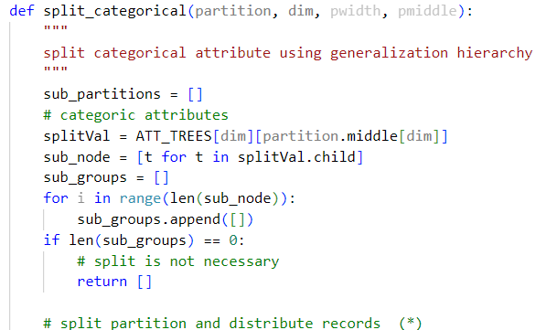
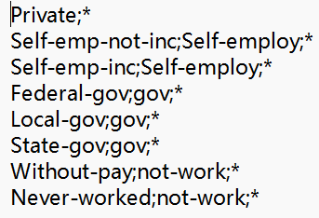
实验说明
通用型Mondrian:
面向数值属性和类别属性
类别型值的范围值是没有意义的，例如Male~Female， State-gov~Self-emp-not-inc~Private，ICD09[291~295]
通过引入了预定义的泛化层次结构，所有涉及的值都可以转换为其共同祖先中的更一般的值
按照说明补充split_categorical()
（每行格式 子节点;父节点）
\data\adult_work_class.txt
mondrian_2.py

Slide 17
文件结构
K-Anonymity-code
- data - adult.data : 原始数据 - adult_x.txt : 类别属性的泛化层次 （每行格式 子节点;父节点） - anonymized.data : 方法1输出的匿名后数据 - anonymized_2.data : 方法2输出的匿名后数据
- utils - read_adult_data.py : 读取数据 - utility.py : 比较函数 - gentree.py : 树结构 - numrange.py : 数值范围
- mondrian.py (待补充) : 基础型Mondrian
- anonymizer.py : 不同参数的使用方法
- mondrian_2.py (待补充) : 通用型Mondrian
- anonymizer_2.py :不同参数的使用方法

Slide 18
关键变量
QI_LEN: 定义的准标识符个数
QI_ORDER[i] : 第i个准标识符对应的排序后属性值序列
QI_RANGE[i] : 第i个准标识符的属性值范围大小
QI_DICT[i][qi_value] : 第i个准标识符的属性值qi_value在QI_ORDER[i]上对应的索引 QI_ORDER[i][index] = qi_value => QI_DICT[i][qi_value] = index
RESULT : 存储每个划分段

Slide 19
运行方法
基础型Mondrian
python anonymizer.py [r|s] [k | qi | data | k-value]
r: relax mondrian, s: strict Mondrian
k: varying k, qi: varying qi numbers, data: varying size of dataset, k-value: run with the specific k-value
通用型Mondrian
python anonymizer_2.py [k | qi | data | k-value]
k: varying k, qi: varying qi numbers, data: varying size of dataset, k-value: run with the specific k-value

Slide 20
参考资料
LeFevre K, DeWitt D J, Ramakrishnan R. Mondrian Multidimensional K-Anonymity[C]//Proceedings of the 22nd International Conference on Data Engineering. 2006: 25.
LeFevre K, DeWitt D J, Ramakrishnan R. Workload-aware anonymization[C]//Proceedings of the 12th ACM SIGKDD international conference on Knowledge discovery and data mining. 2006: 277-286.
Xu J, Wang W, Pei J, et al. Utility-based anonymization using local recoding[C]//Proceedings of the 12th ACM SIGKDD international conference on Knowledge discovery and data mining. 2006: 785-790.
Ghinita G, Karras P, Kalnis P, et al. Fast data anonymization with low information loss[C]//Proceedings of the 33rd international conference on Very large data bases. 2007: 758-769.

Slide 21

THANKS!
Any questions?

