Slide 1
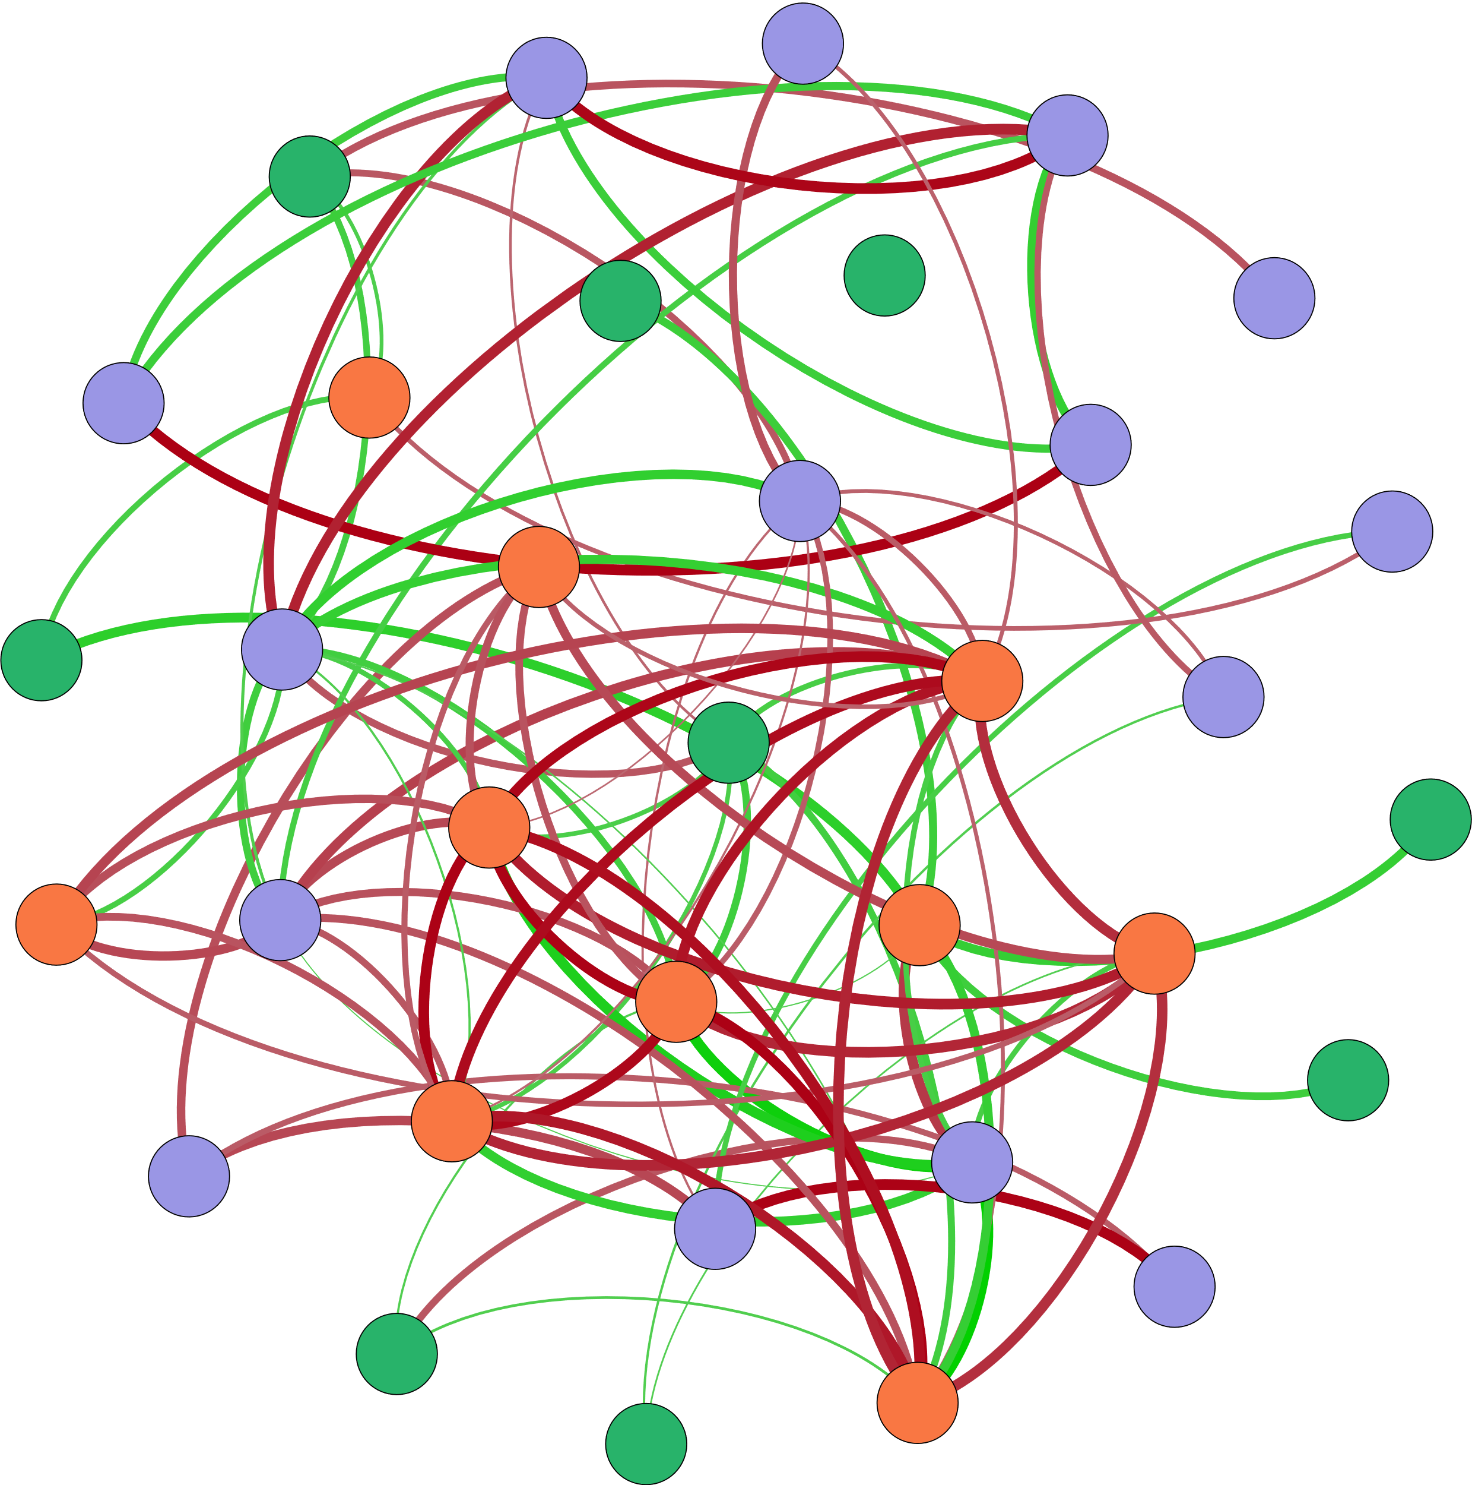




枯水期功能基因与环境因子相关性
Ⅳ-Area
Ⅴ-Area
Ⅲ-Area
cnorB
nifH
AOB_amoA
S-TN
β:α
W-${PO}_{4}^{3−}$
BIX
Ⅰ-Area
S-Size-d[(0.9-01)/0.5]
W-T
AOA_amoA
HIX
W-TP
Ⅱ-Area
hzsA
W-${NH}_{4}^{+}$
nirK
$${W−NO}_{2}^{−}$$
FI
W-pH
W-DO
W-TN
nosZ
W-${NO}_{3}^{−}$
S-Size-d(0.1)
S-TP
S-Size-d(0.5)
S-Size-d(0.9)
Archaeal 16S rRNA
W-COD
hzsB

Slide 2
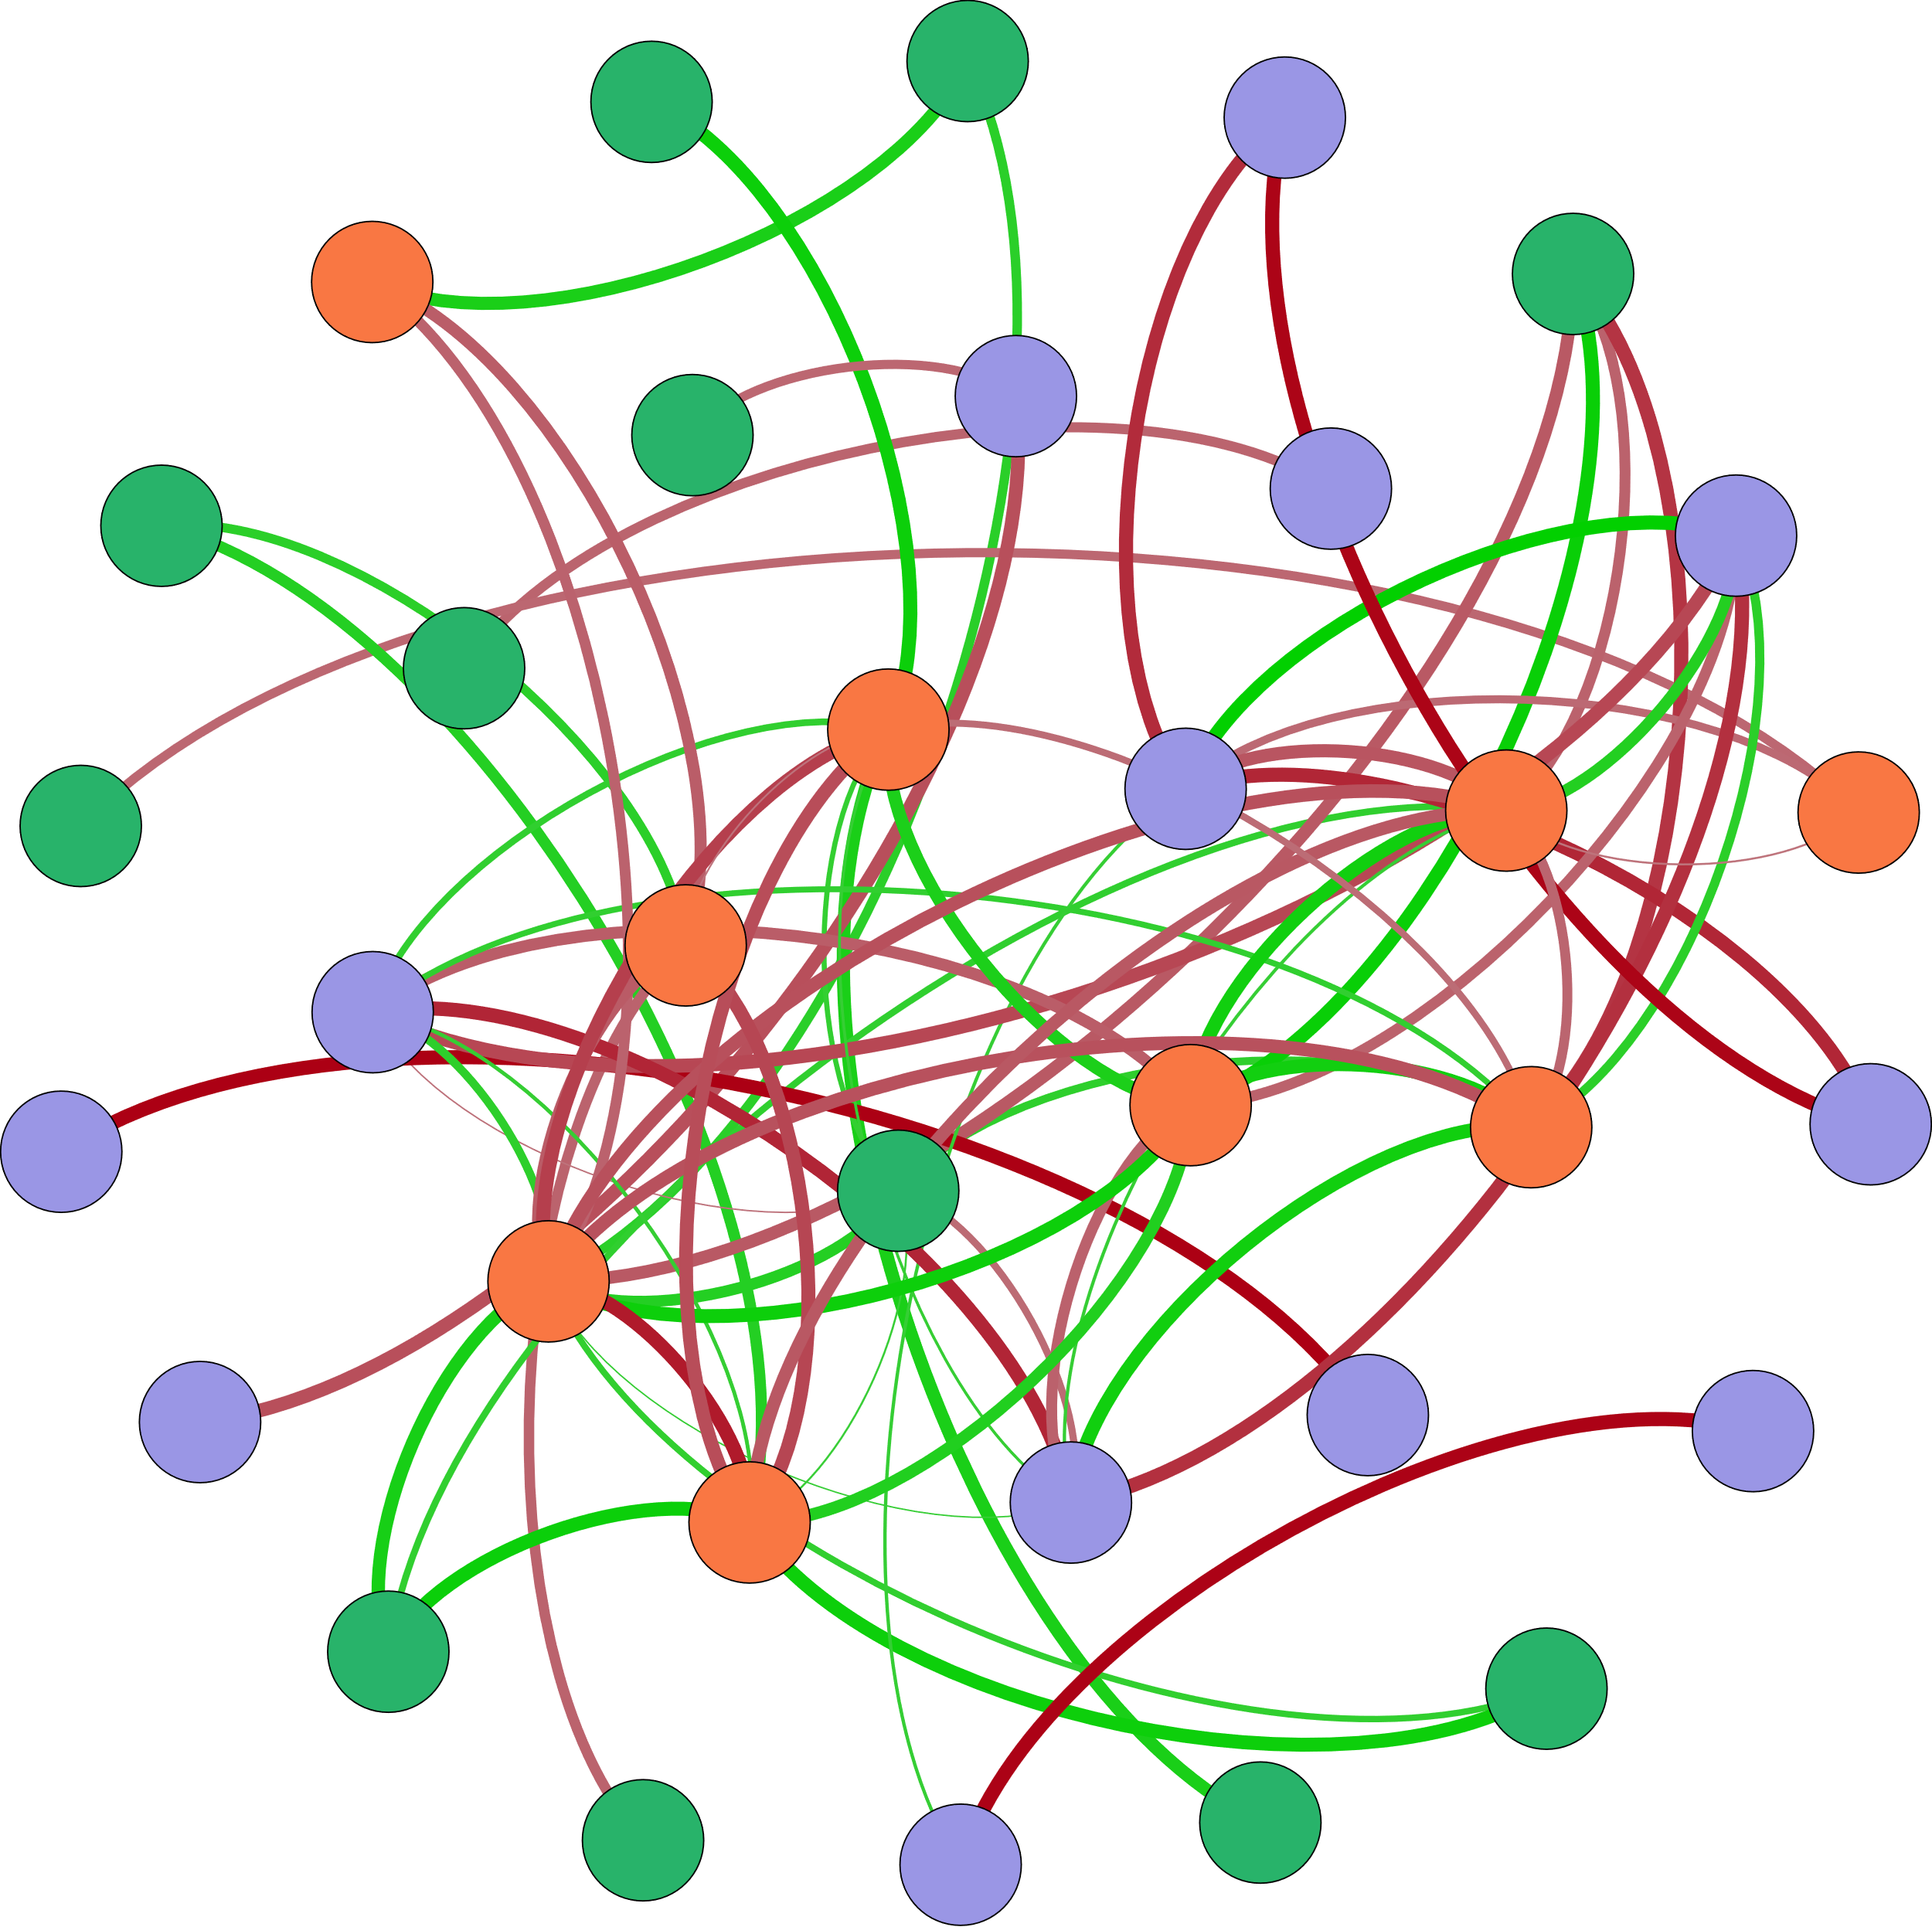




Archaeal 16S rRNA
cnorB
Ⅴ-Area
W-pH
hzo
S-Size-d(0.1)
nifH
napA
S-TN
Ⅰ-Area
Bacterial 16S rRNA
W-COD
nxrA
HIX
W-${PO}_{4}^{3−}$
W-${NO}_{3}^{−}$
$${W−NO}_{2}^{−}$$
Ⅱ-Area
W-DO
W-TP
Ⅲ-Area
S-Size-d(0.9)
hzsB
W-TN
S-Size-d(0.5)
S-Size-d[(0.9-01)/0.5]
β:α
W-${NH}_{4}^{+}$
Ⅳ-Area
nirS
hzsA
nirK
AOB_amoA
BIX

Slide 3
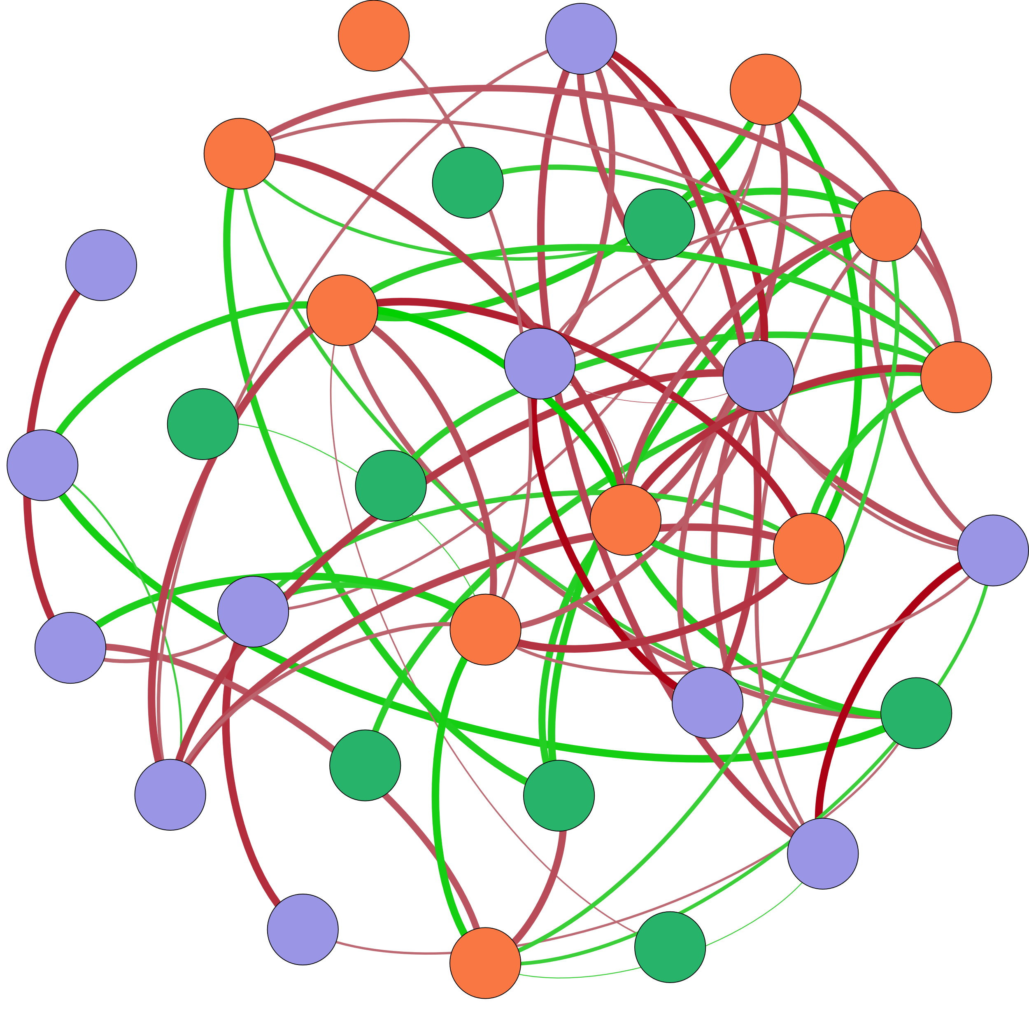




W-${PO}_{4}^{3−}$
Ⅱ-Area
S-TP
W-TN
hzsB
nxrA
W-${NO}_{3}^{−}$
S-Size-d[(0.9-01)/0.5]
W-pH
Ⅴ-Area
Ⅳ-Area
W-COD
napA
HIX
AOA_amoA
$${W−NO}_{2}^{−}$$
W-DO
β:α
S-Size-d(0.5)
W-T
S-Size-d(0.9)
Ⅲ-Area
Bacterial 16S rRNA
Archaeal 16S rRNA
Ⅰ-Area
hzsA
BIX
S-Size-d(0.1)
W-${NH}_{4}^{+}$
cnorB

Slide 4
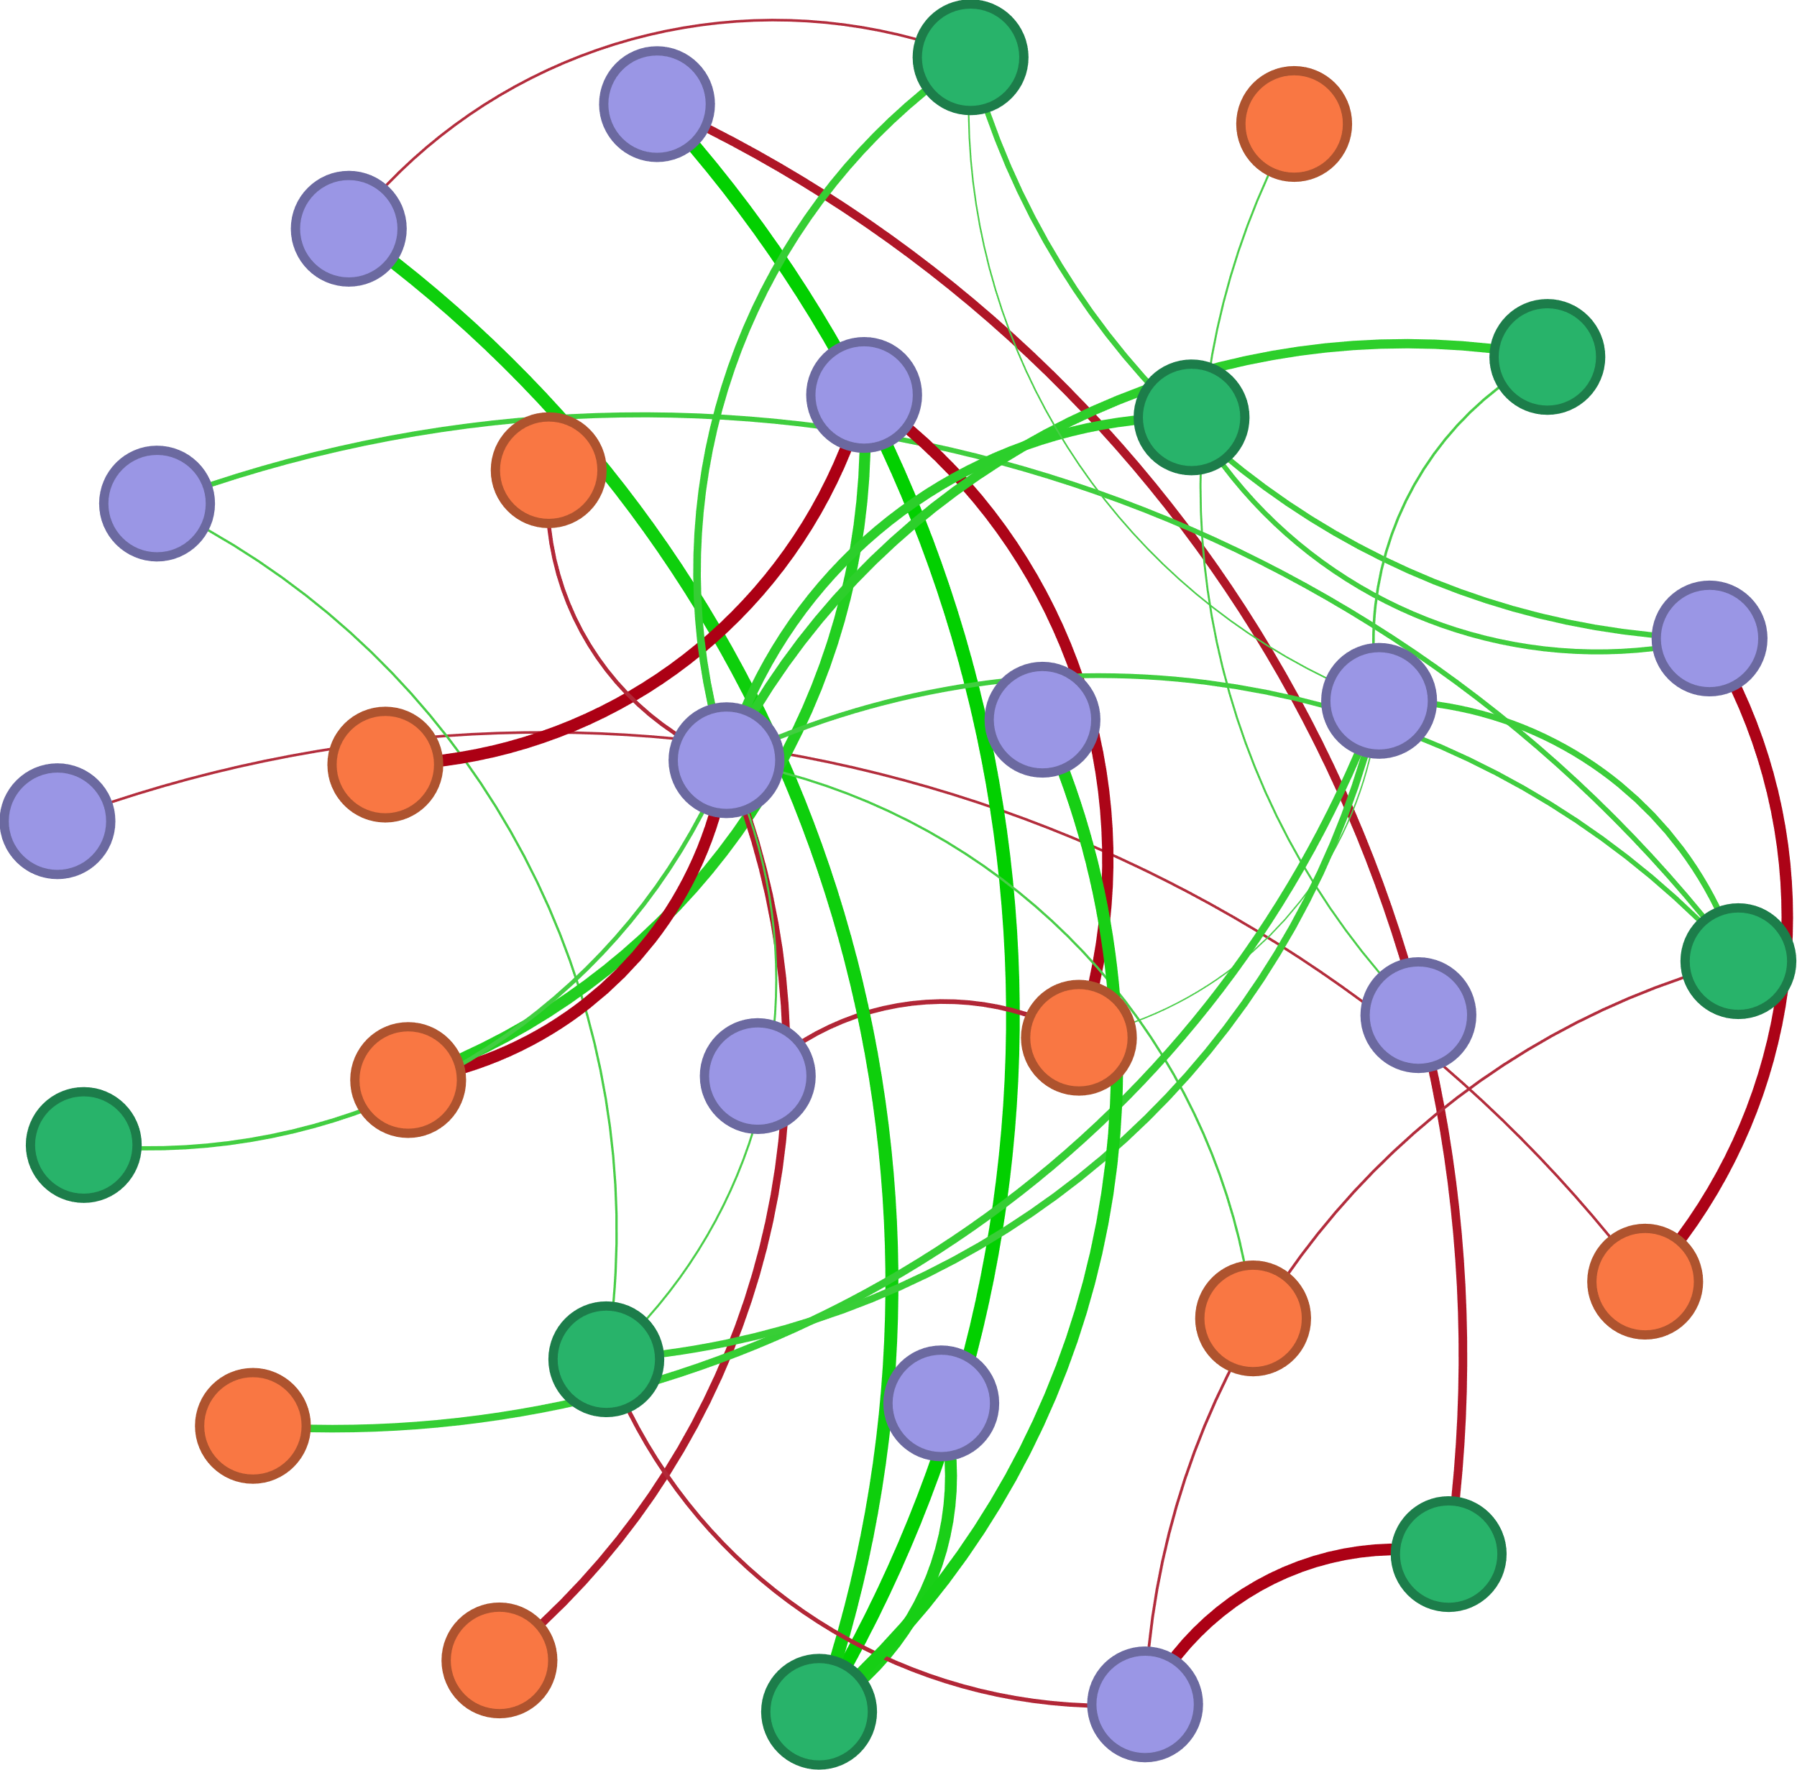



AOA_amoA
W-TN
Ⅳ-Area
nirK
norB
W-${NO}_{3}^{−}$
W-${NH}_{4}^{+}$
Ⅲ-Area
narG
Archaeal 16S rDNA
nifH
hzsB
S-TN
hzsA
Bacterial 16S rDNA
T
Ⅰ-Area
AOB_amoA
HIX
napA
W-${NO}_{2}^{−}$
S-TP
FI
DO
Ⅱ-Area
nosZ
COD
Ⅴ-Area
pH
hzo

Slide 5
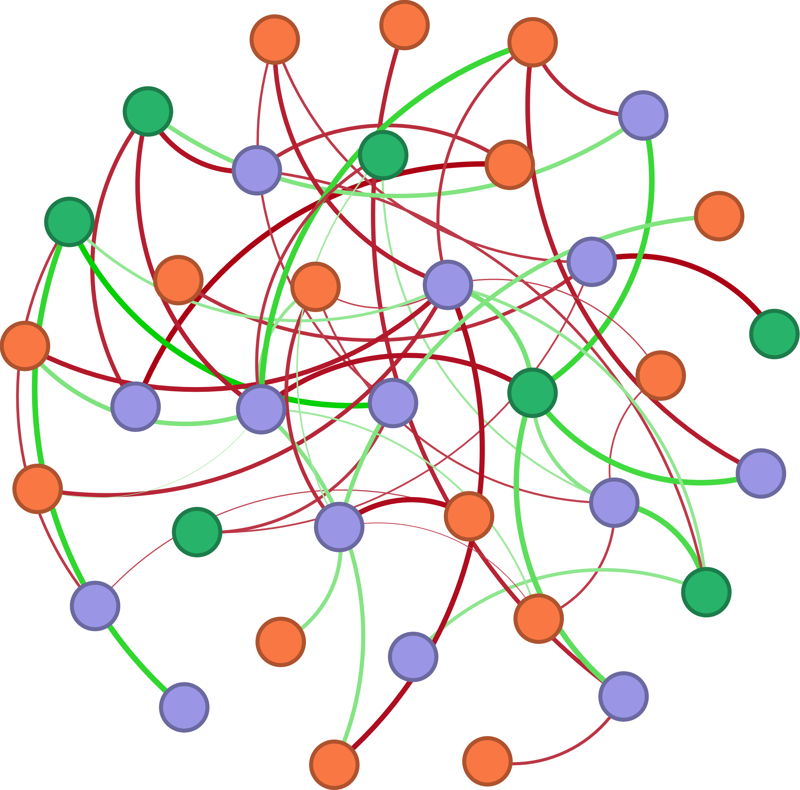



Ⅴ-Area
Size-d[(0.9-01)/0.5]
W-DO
W-${NO}_{2}^{−}$
nirS
nirK
W-TN
S-TN
COD
BIX
nxrA
HIX
S-Size-d(0.9)
hzsB
Ⅱ-Area
W-${NO}_{3}^{−}$
S-TP
Bacterial 16S rRNA
hzo
norB
W-${NH}_{4}^{+}$
Ⅰ-Area
hzsA
S-Size-d(0.1)
Archaeal 16S rRNA
T
nifH
AOA_amoA
pH
S-Size-d(0.5)
β:α
narG
AOB_amoA
napA
Ⅳ-Area
Ⅲ-Area

Slide 6
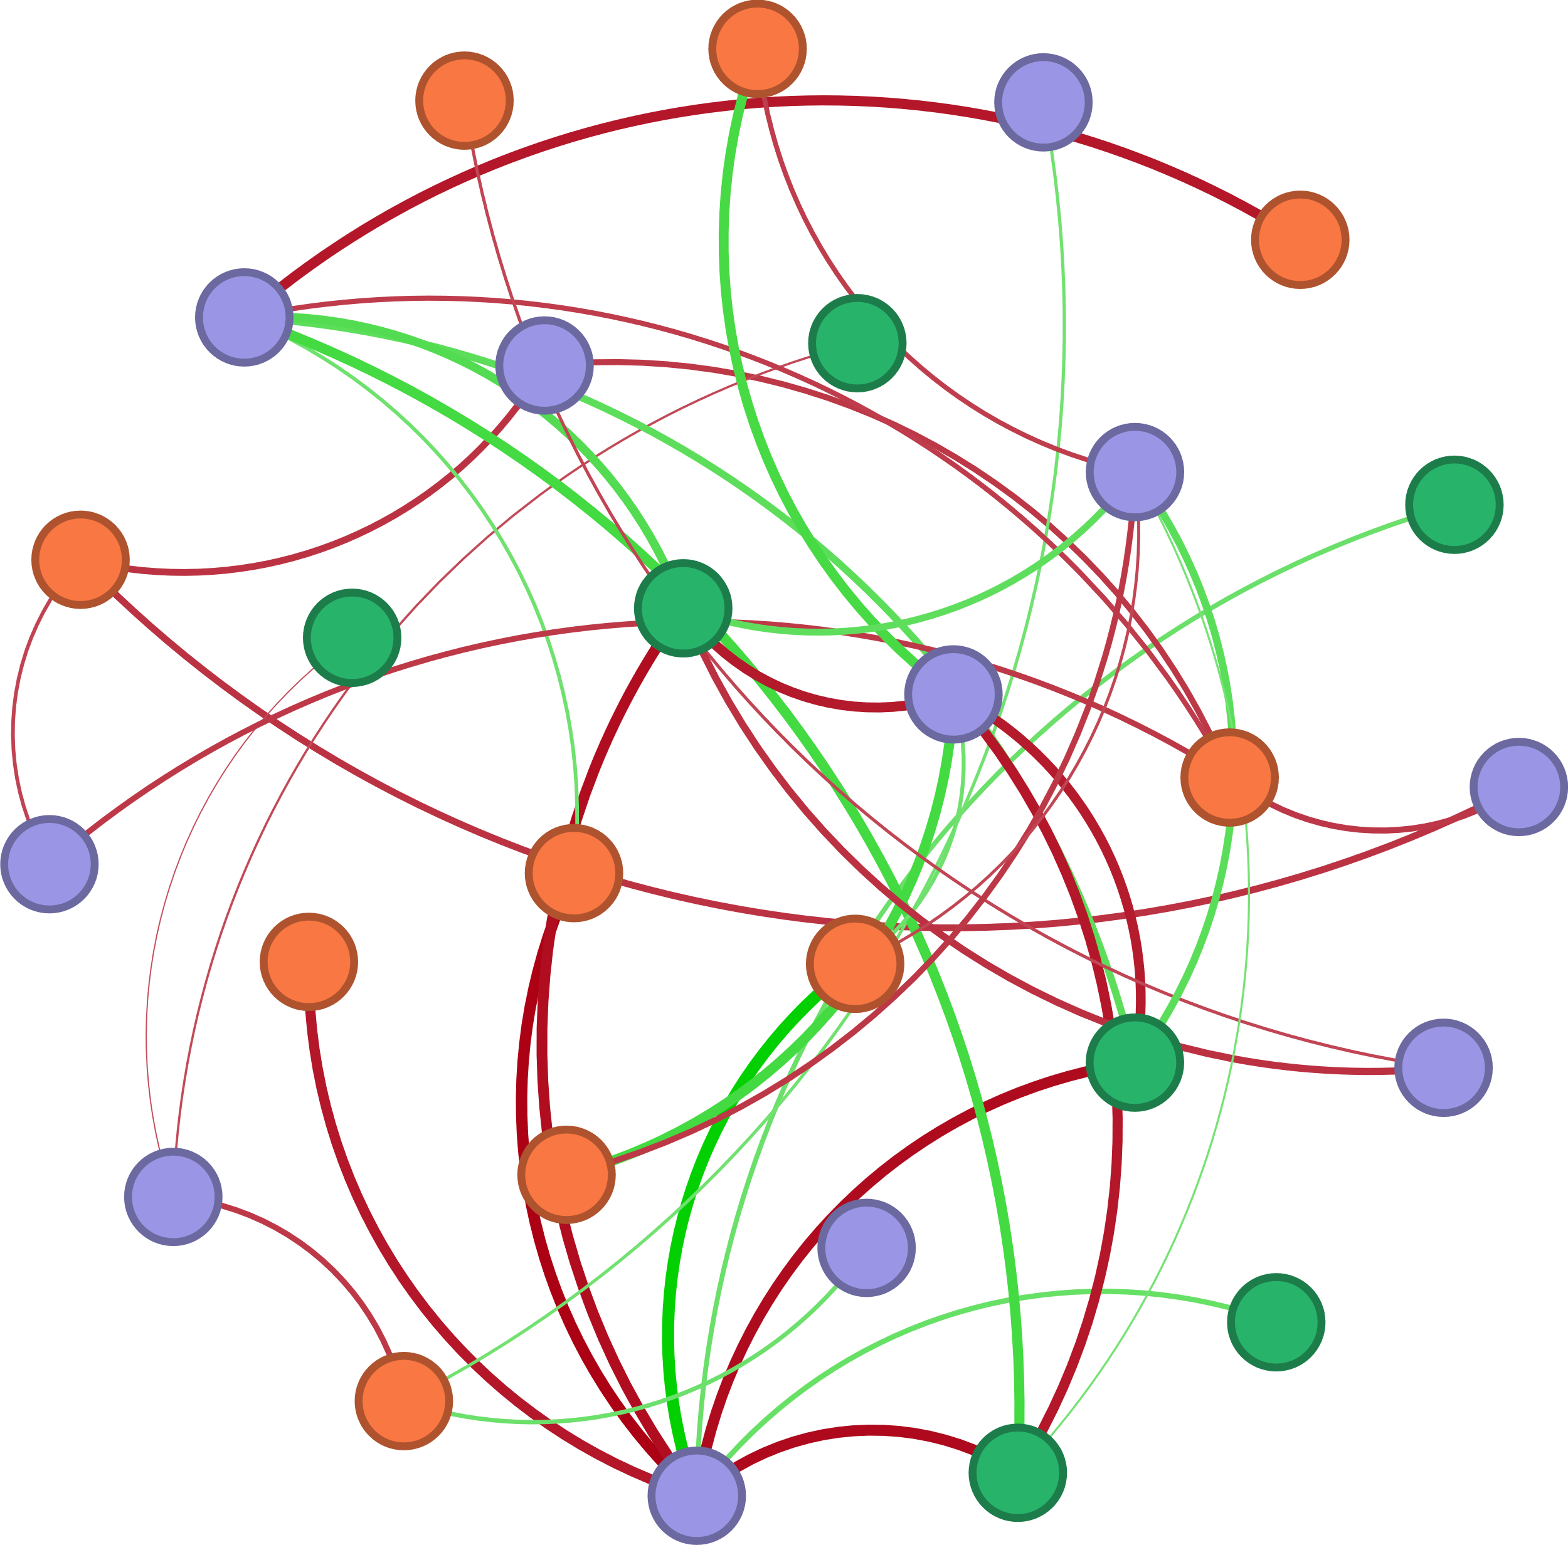


S-Size-d(0.9)
S-TN
narG
S-TP
napA
W-${NO}_{2}^{−}$
Archaeal 16S rRNA
hzo
W-${NH}_{4}^{+}$
Ⅲ-Area
COD
DO
norB
Ⅴ-Area
AOA_amoA
nirK
Ⅰ-Area
Ⅳ-Area
HIX
pH
hzsA
nxrA
S-Size-d(0.5)
nifH
W-TN
FI
Bacterial 16S rRNA
T

