Slide 1
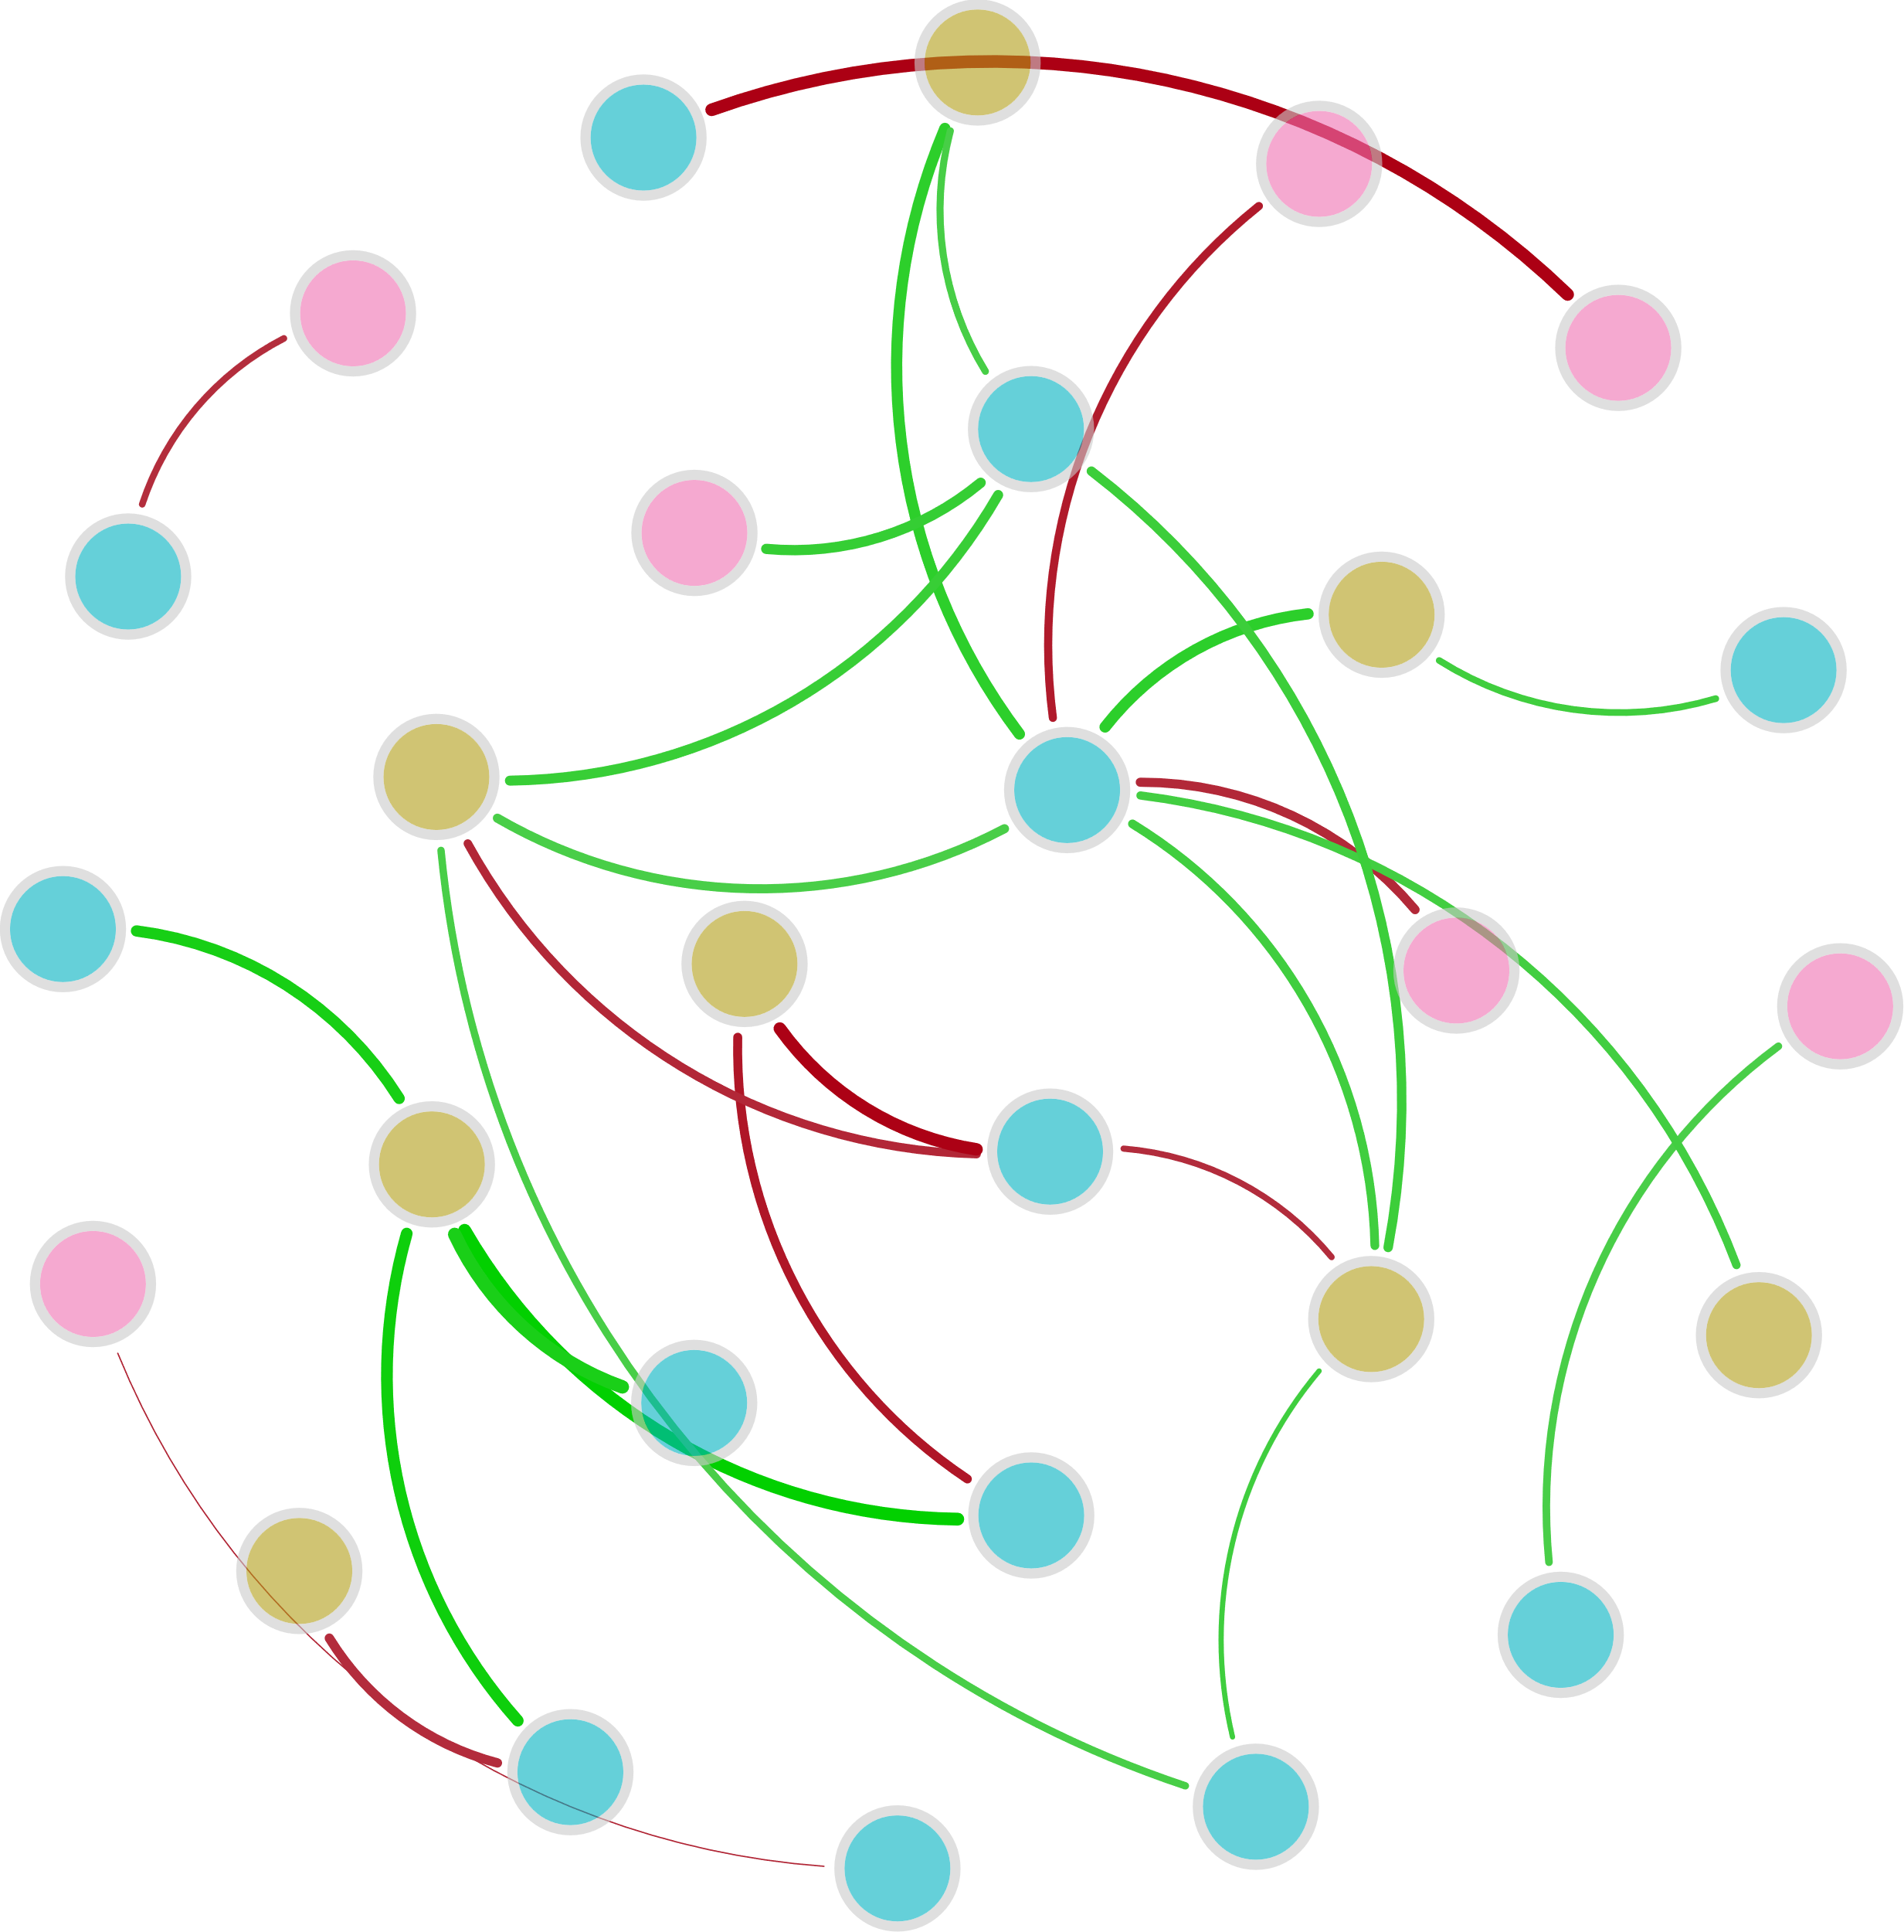



$${NO}_{3}^{−}$$
norB
Ⅴ-Area
S-TP
S-TN
hzsB
Bacterial 16S rRNA
Ⅱ-Area
$${NH}_{4}^{+}$$
Archaeal 16S rRNA
DO
hzsA
nifH
COD
Ⅲ-Area
Ⅳ-Area
pH
hzo
Ⅰ-Area
T
$${NO}_{2}^{−}$$
nosZ
AOA_amoA
TN
AOB_amoA
nirK
narG
napA

Slide 2
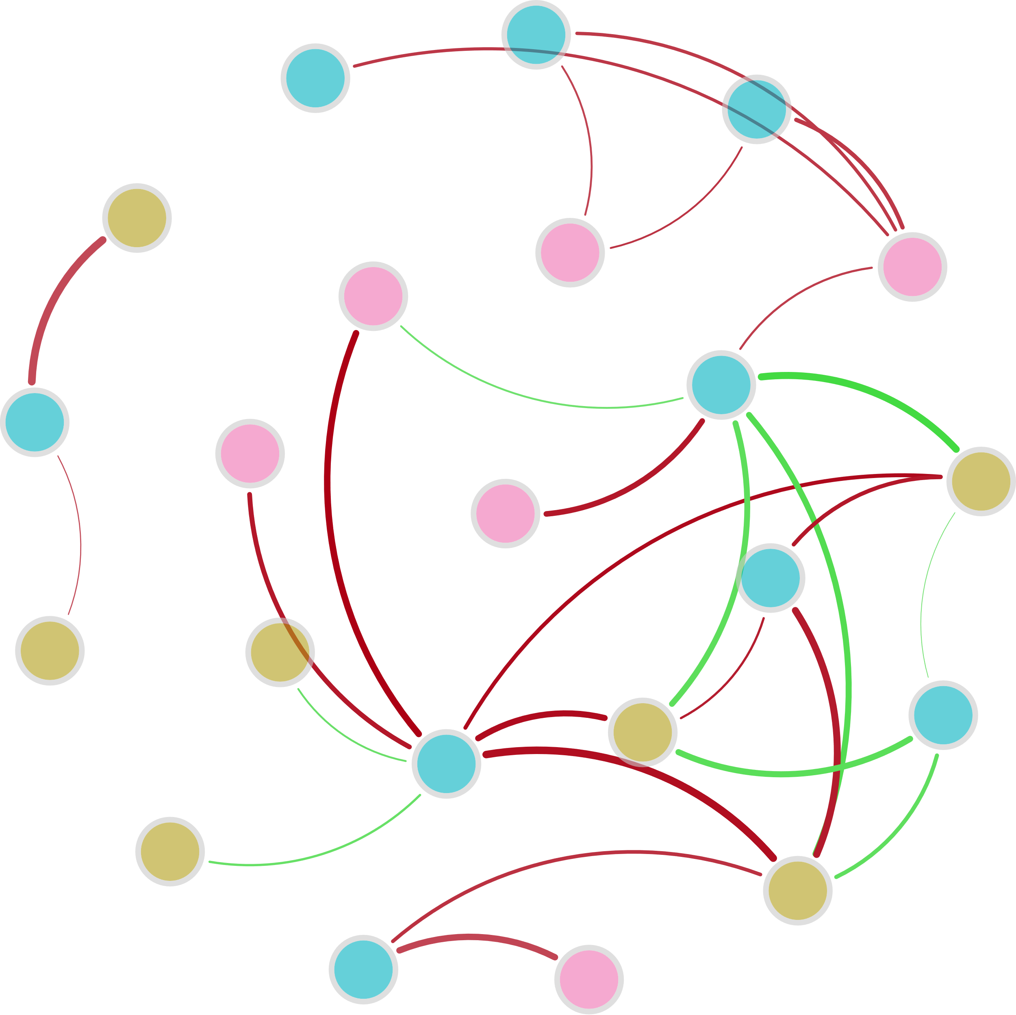


nirK
AOA_amoA
Archaeal 16S rRNA
$${NO}_{2}^{−}$$
Ⅲ-Area
Ⅴ-Area
Ⅰ-Area
napA
nxrA
Ⅳ-Area
T
S-TP
norB
COD
$${NH}_{4}^{+}$$
pH
hzo
Bacterial 16S rRNA
TN
DO
hzsA
S-TN

