Slide 1
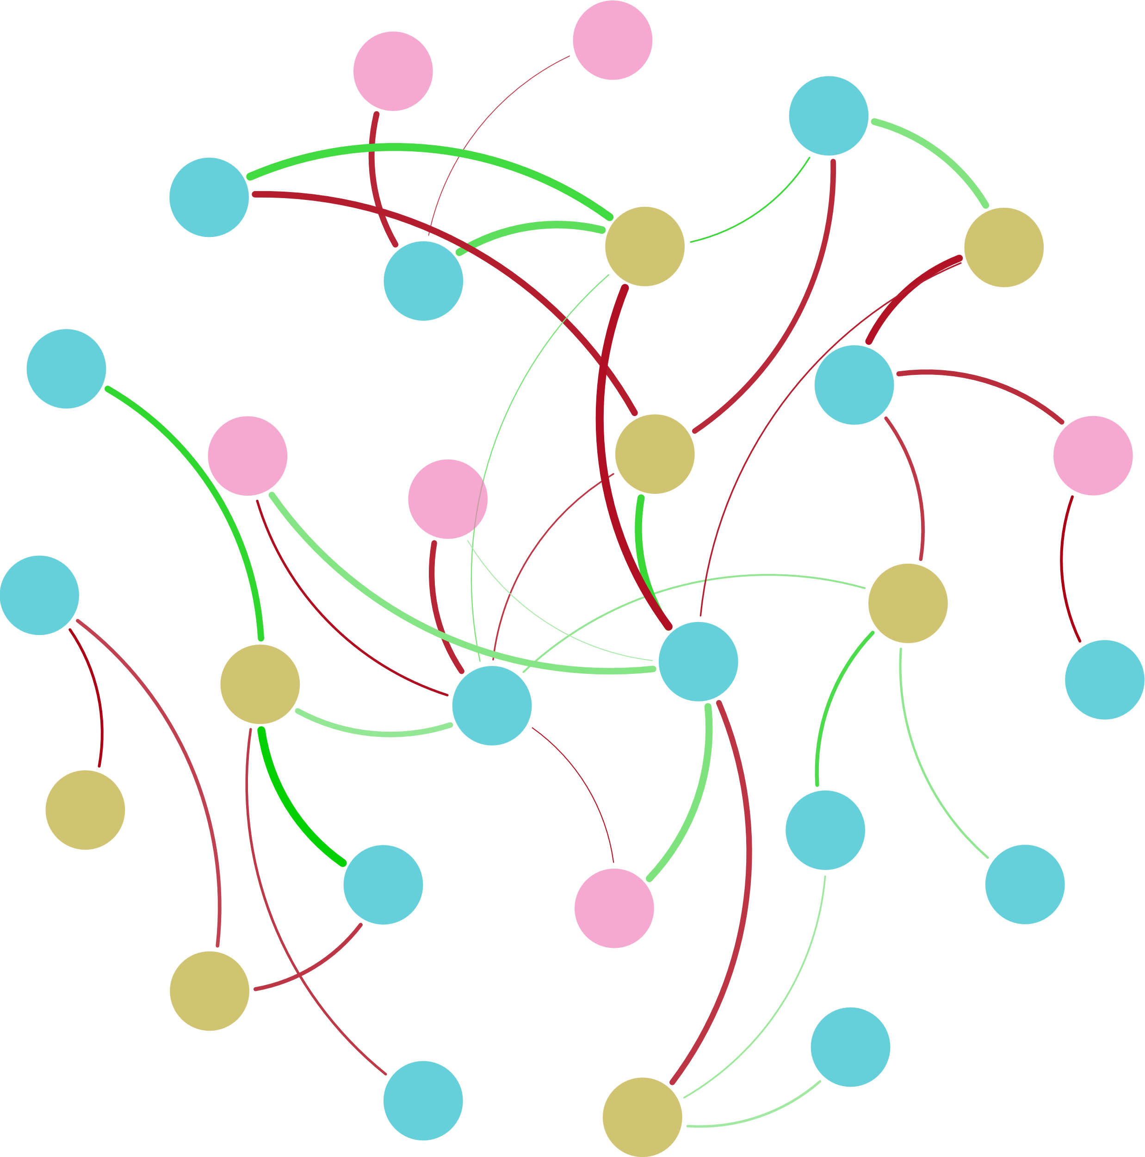



Ⅲ-Area
Ⅴ-Area
nirS
hzsA
$${NH}_{4}^{+}$$
$${NO}_{2}^{−}$$
napA
AOB_amoA
nirK
Ⅳ-Area
DO
S-TN
Ⅰ-Area
nxrA
pH
hzo
Bacterial 16S rRNA
COD
hzsB
$${NO}_{3}^{−}$$
Archaeal 16S rRNA
norB
narG
Ⅱ-Area
T
nifH
AOA_amoA
TN

Slide 2
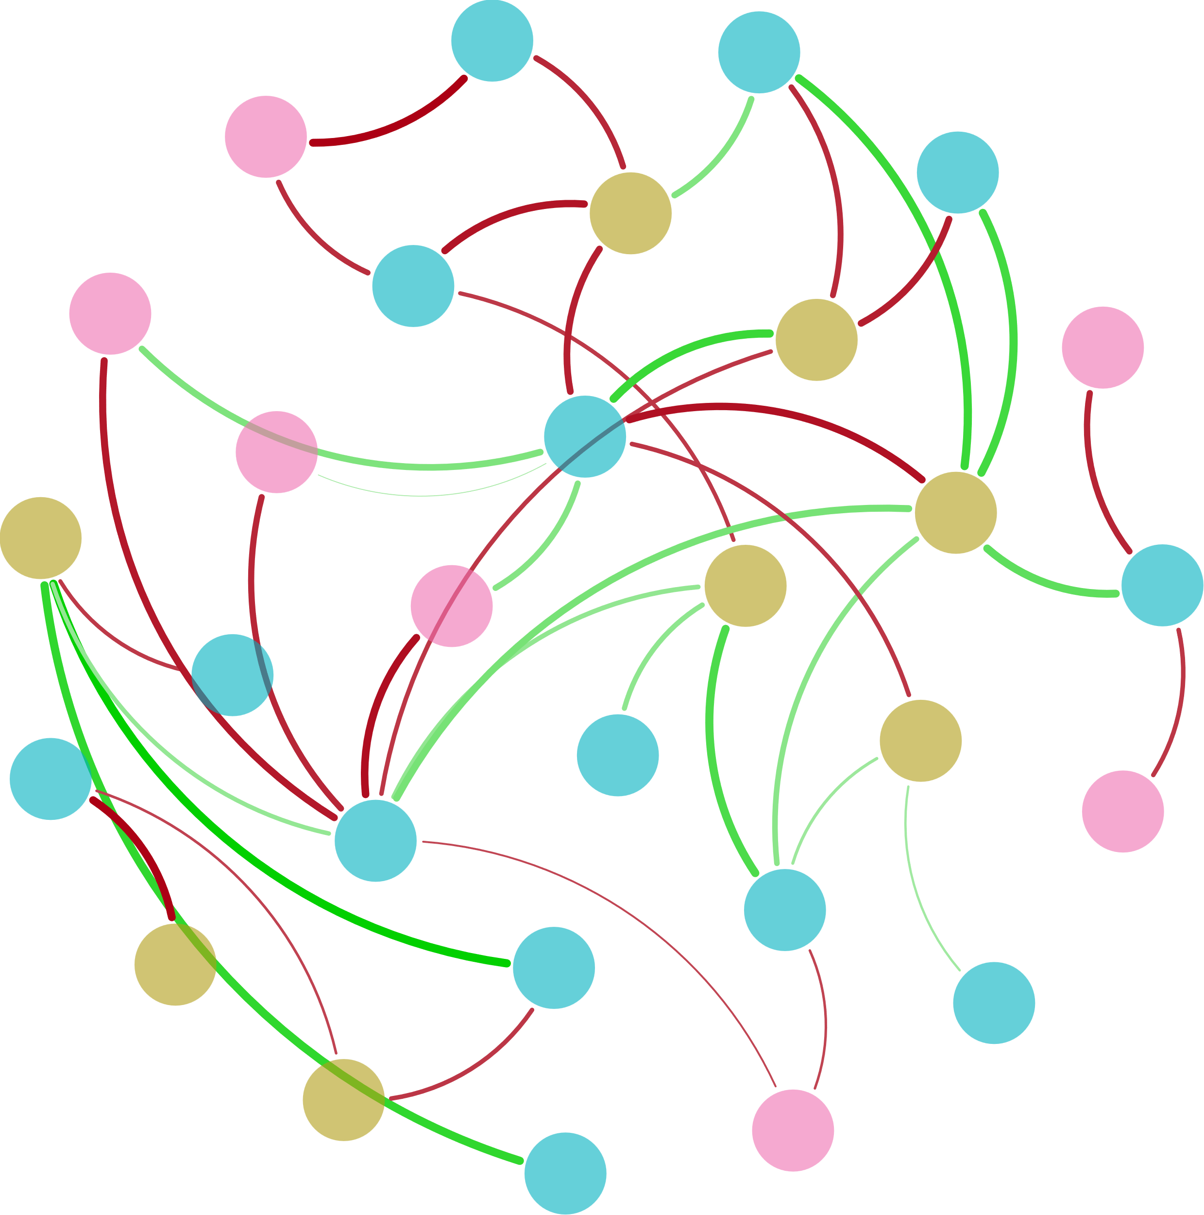



Bacterial 16S rRNA
nirS
S-TN
hzsA
$${NO}_{2}^{−}$$
nirK
Ⅱ-Area
DO
Ⅴ-Area
Ⅰ-Area
hzo
$${NH}_{4}^{+}$$
COD
Ⅳ-Area
pH
napA
AOA_amoA
narG
TN
nxrA
Ⅲ-Area
hzsB
Archaeal 16S rRNA
$${NO}_{3}^{−}$$
norB
nifH
T
S-TP
AOB_amoA

Slide 3
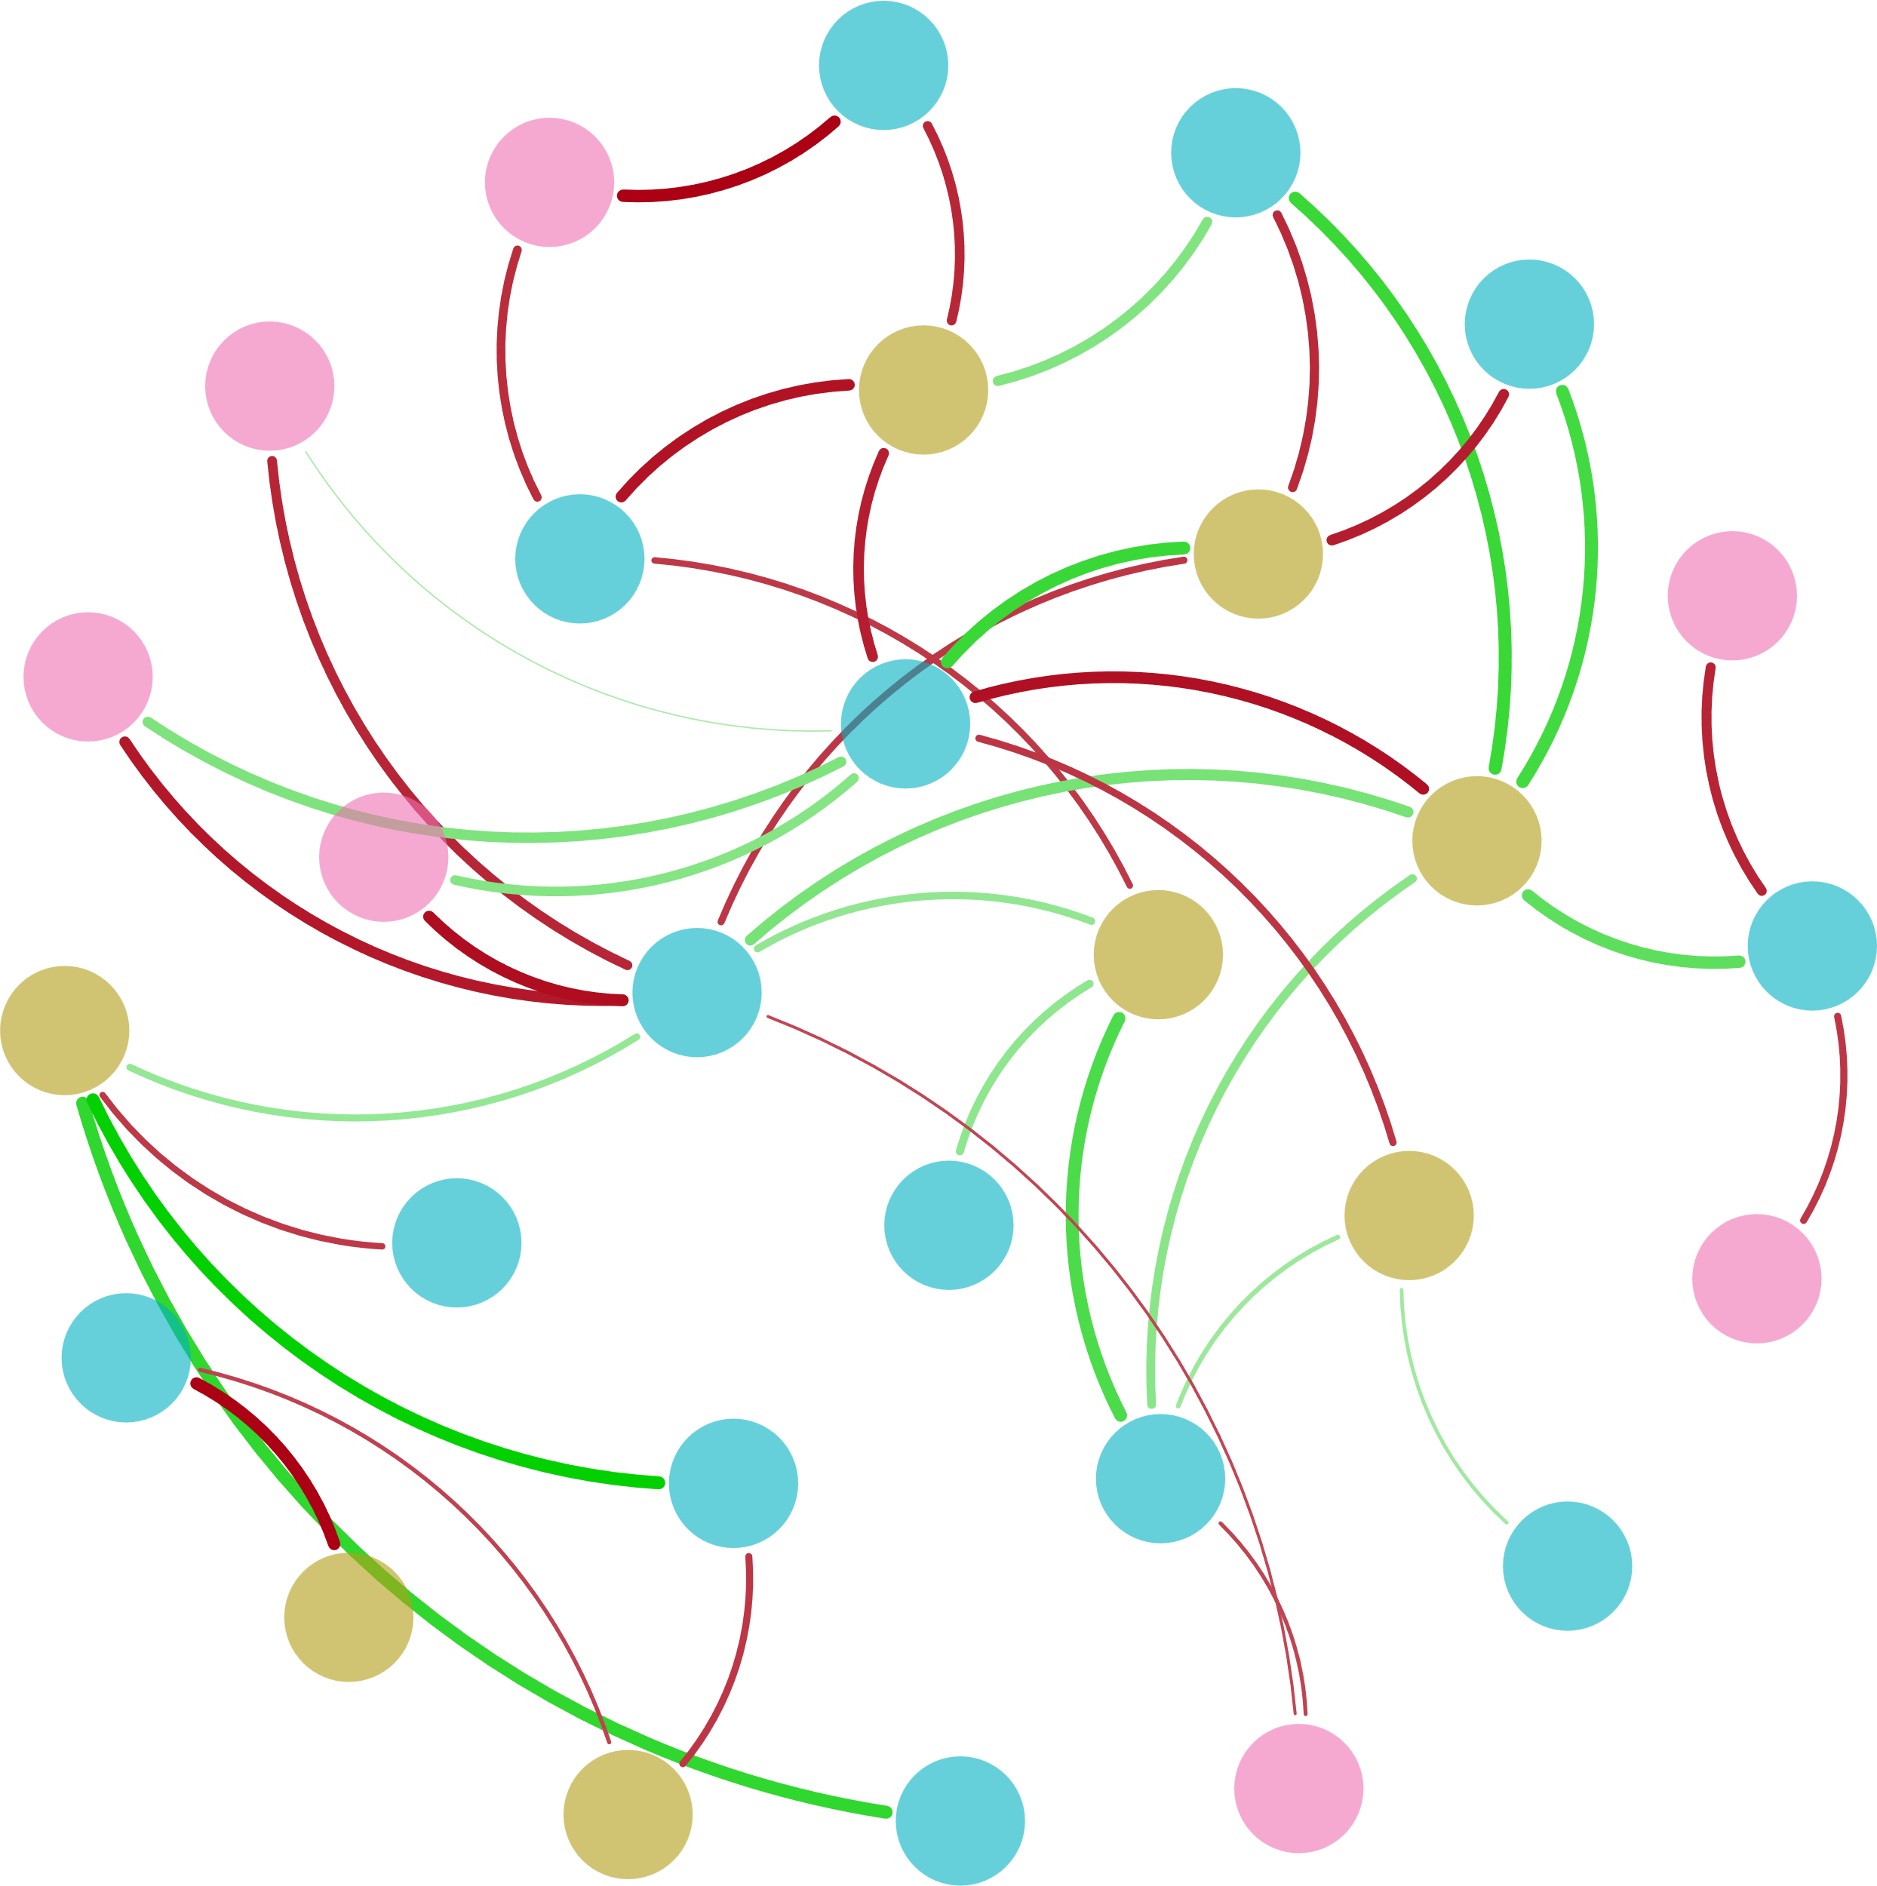



Bacterial 16S rRNA
S-TN
nirS
hzsA
Ⅰ-Area
$${NO}_{2}^{−}$$
nirK
DO
Ⅴ-Area
Ⅱ-Area
hzo
Ⅳ-Area
$${NH}_{4}^{+}$$
pH
napA
hzsB
COD
AOA_amoA
narG
TN
Ⅲ-Area
nxrA
norB
Archaeal 16S rRNA
nifH
$${NO}_{3}^{−}$$
T
S-TP
AOB_amoA

Slide 4
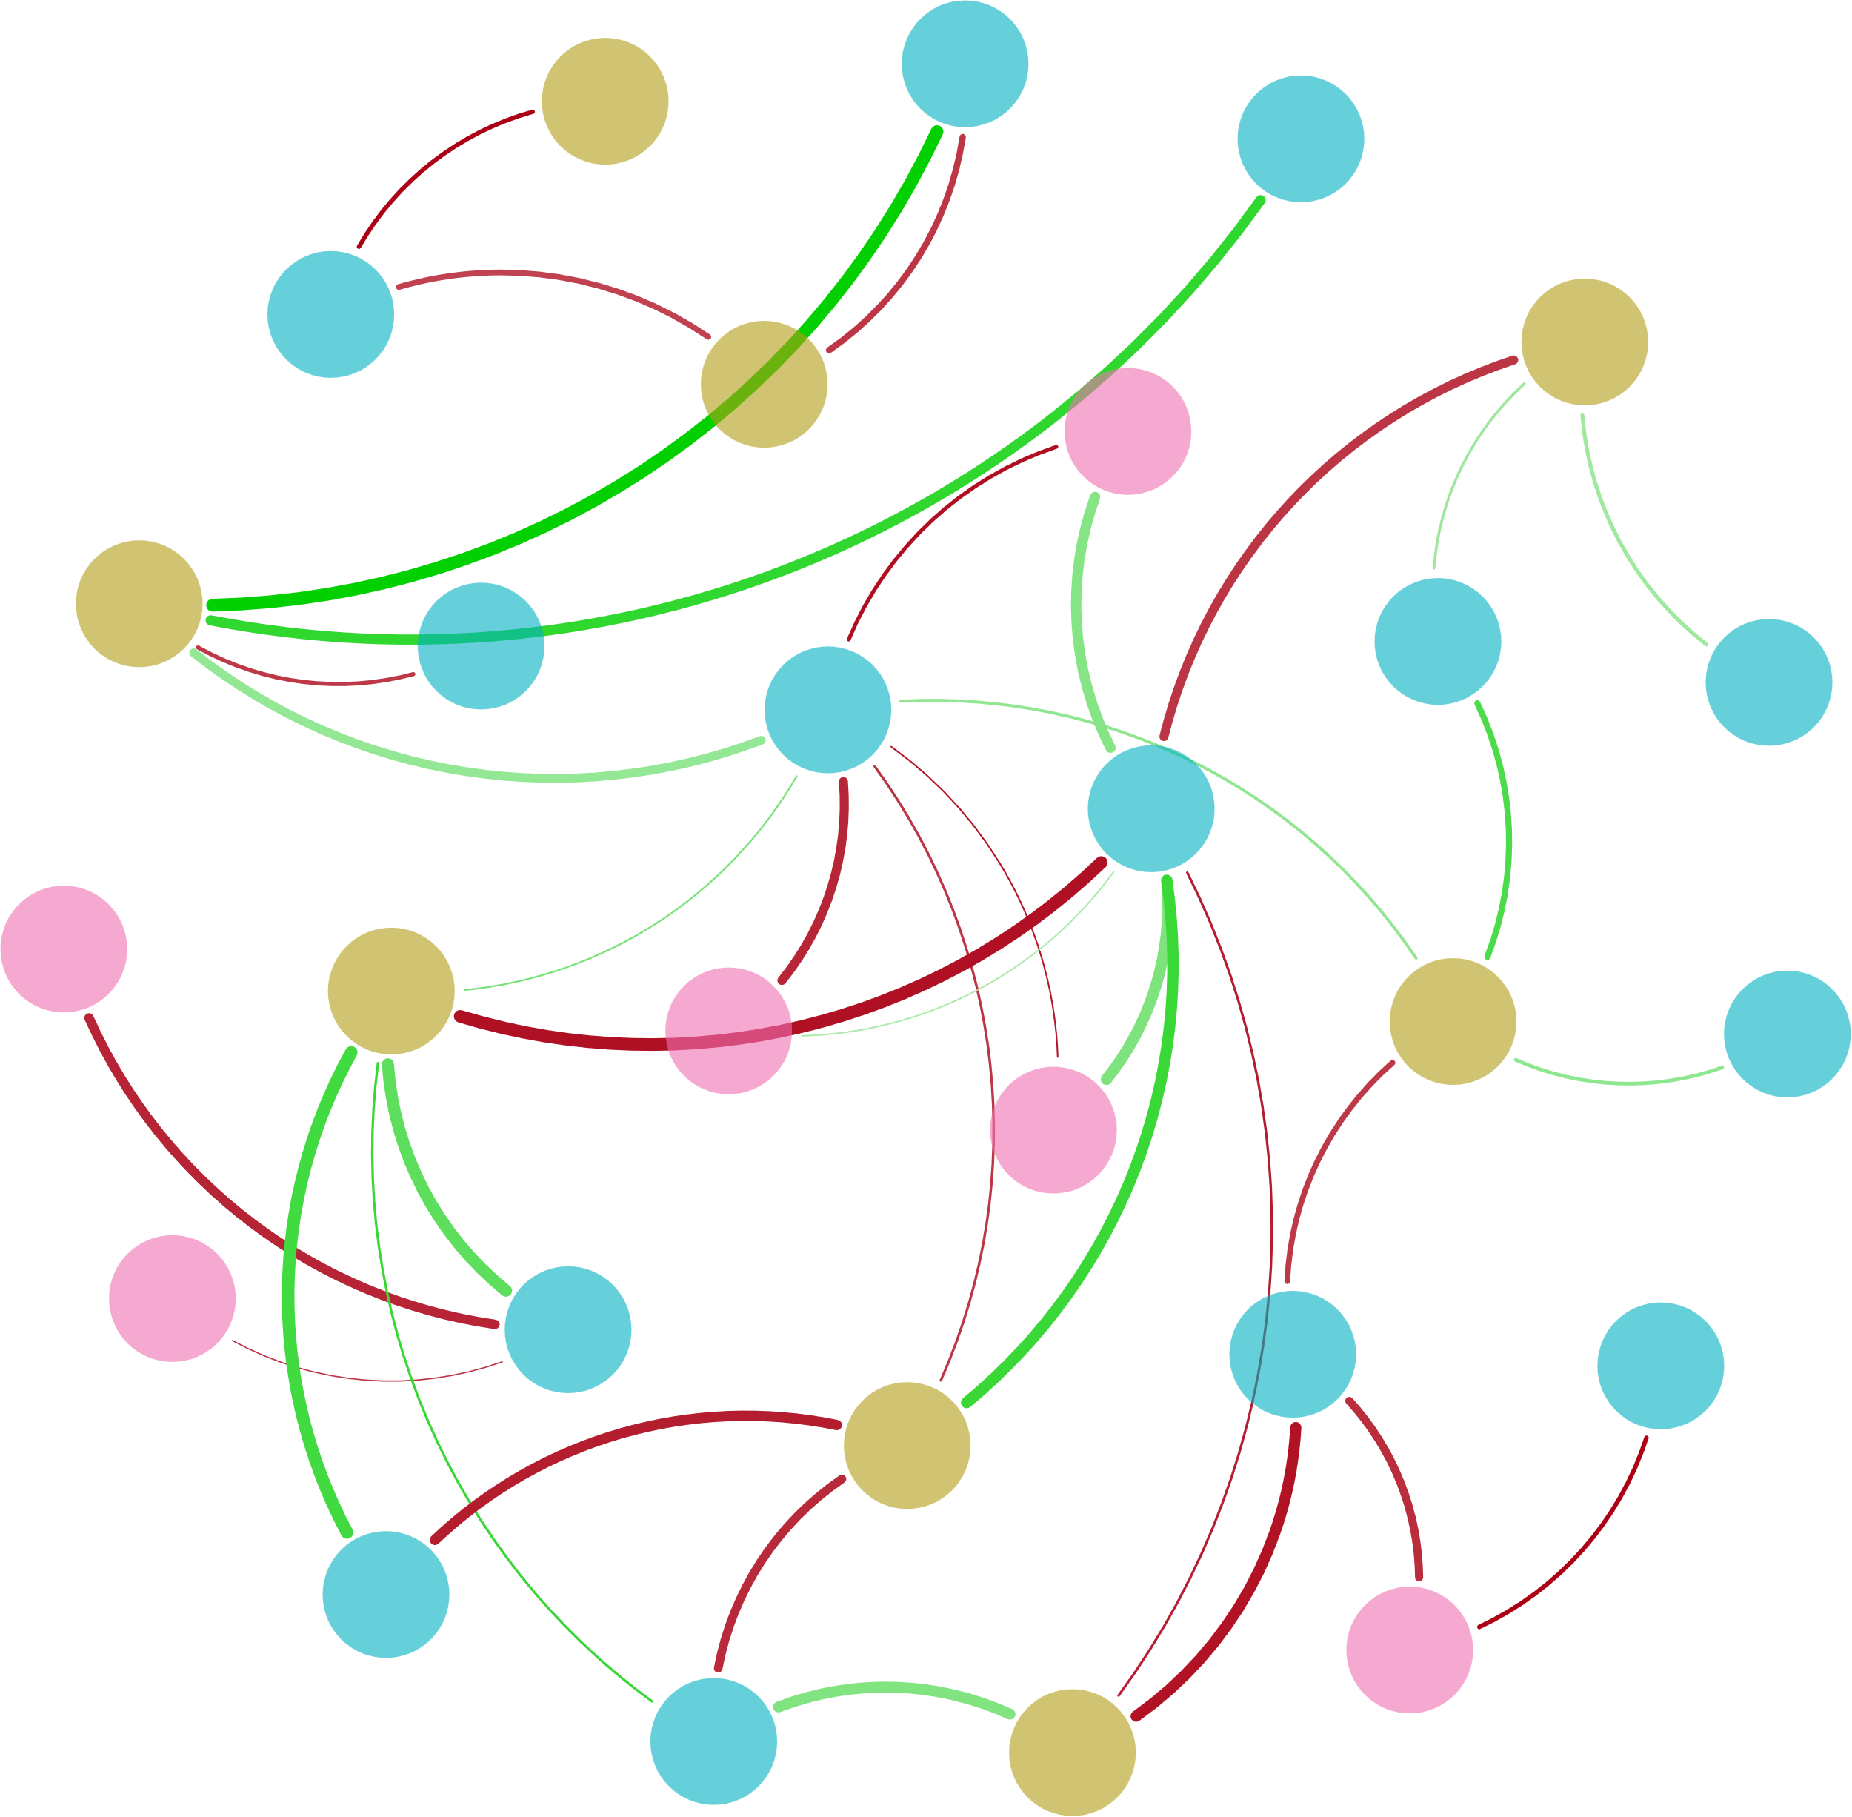



$${NO}_{3}^{−}$$
norB
AOB_amoA
nxrA
TN
T
Ⅳ-Area
COD
AOA_amoA
Archaeal 16S rRNA
hzsB
nifH
hzo
Ⅴ-Area
$${NH}_{4}^{+}$$
pH
Ⅰ-Area
narG
Ⅱ-Area
Ⅲ-Area
napA
nirK
Bacterial 16S rRNA
DO
hzsA
S-TN
nirS
$${NO}_{2}^{−}$$

Slide 5
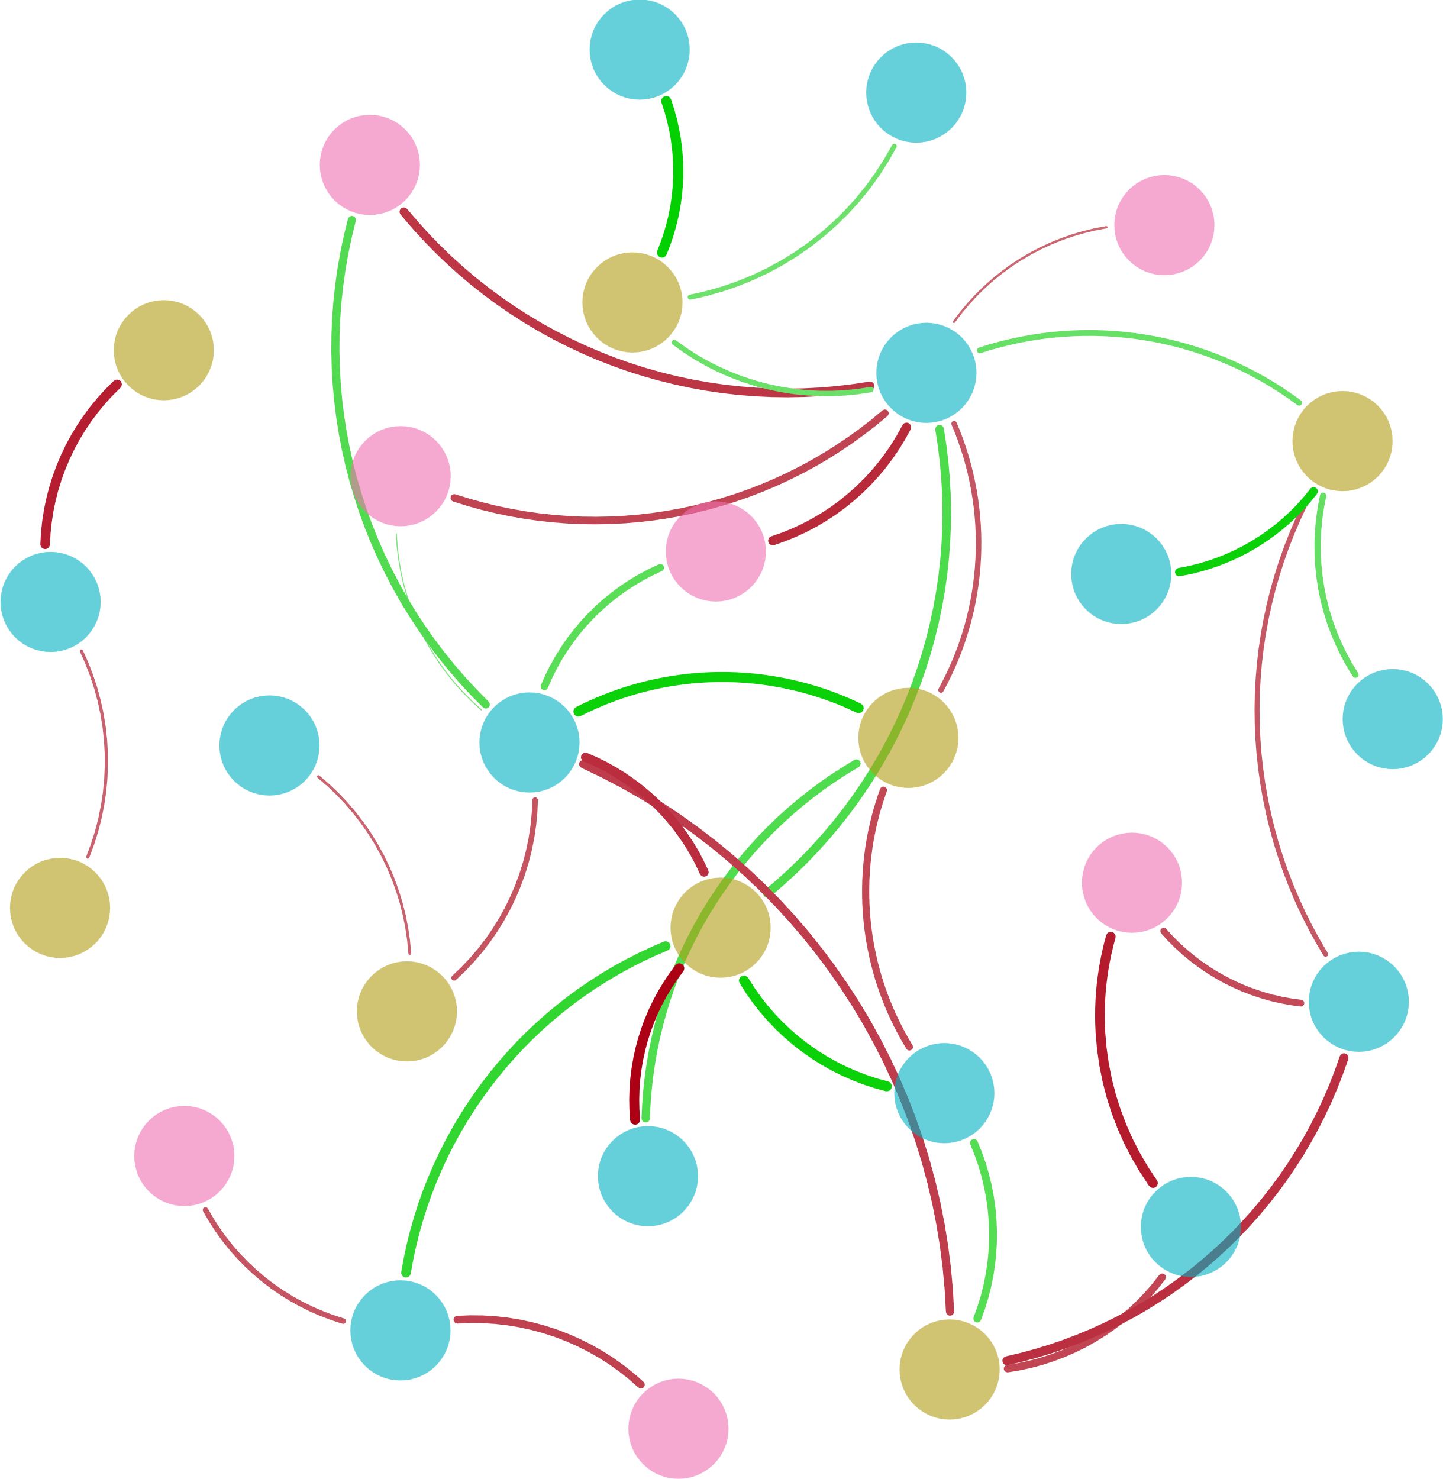



AOB_amoA
AOA_amoA
Ⅱ-Area
S-TP
COD
$${NO}_{3}^{−}$$
hzsB
pH
Ⅰ-Area
Ⅳ-Area
Archaeal 16S rRNA
nxrA
nifH
hzo
DO
narG
T
S-TN
$${NH}_{4}^{+}$$
TN
nirK
nirS
Ⅲ-Area
hzsA
Bacterial 16S rRNA
napA
$${NO}_{2}^{−}$$
Ⅴ-Area

Slide 6
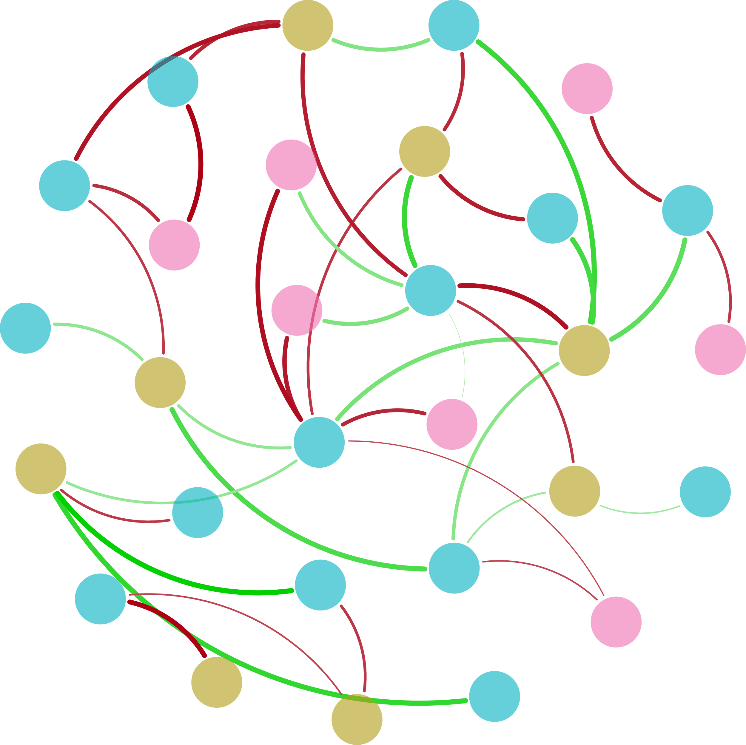



$${NO}_{2}^{−}$$
nirS
Bacterial 16S rRNA
Ⅴ-Area
Ⅳ-Area
DO
nirK
hzsA
napA
S-TN
hzo
Ⅱ-Area
narG
$${NH}_{4}^{+}$$
Ⅲ-Area
pH
Ⅰ-Area
hzsB
COD
TN
nifH
AOA_amoA
Archaeal 16S rRNA
nxrA
norB
S-TP
$${NO}_{3}^{−}$$
AOB_amoA
T

