Slide 2
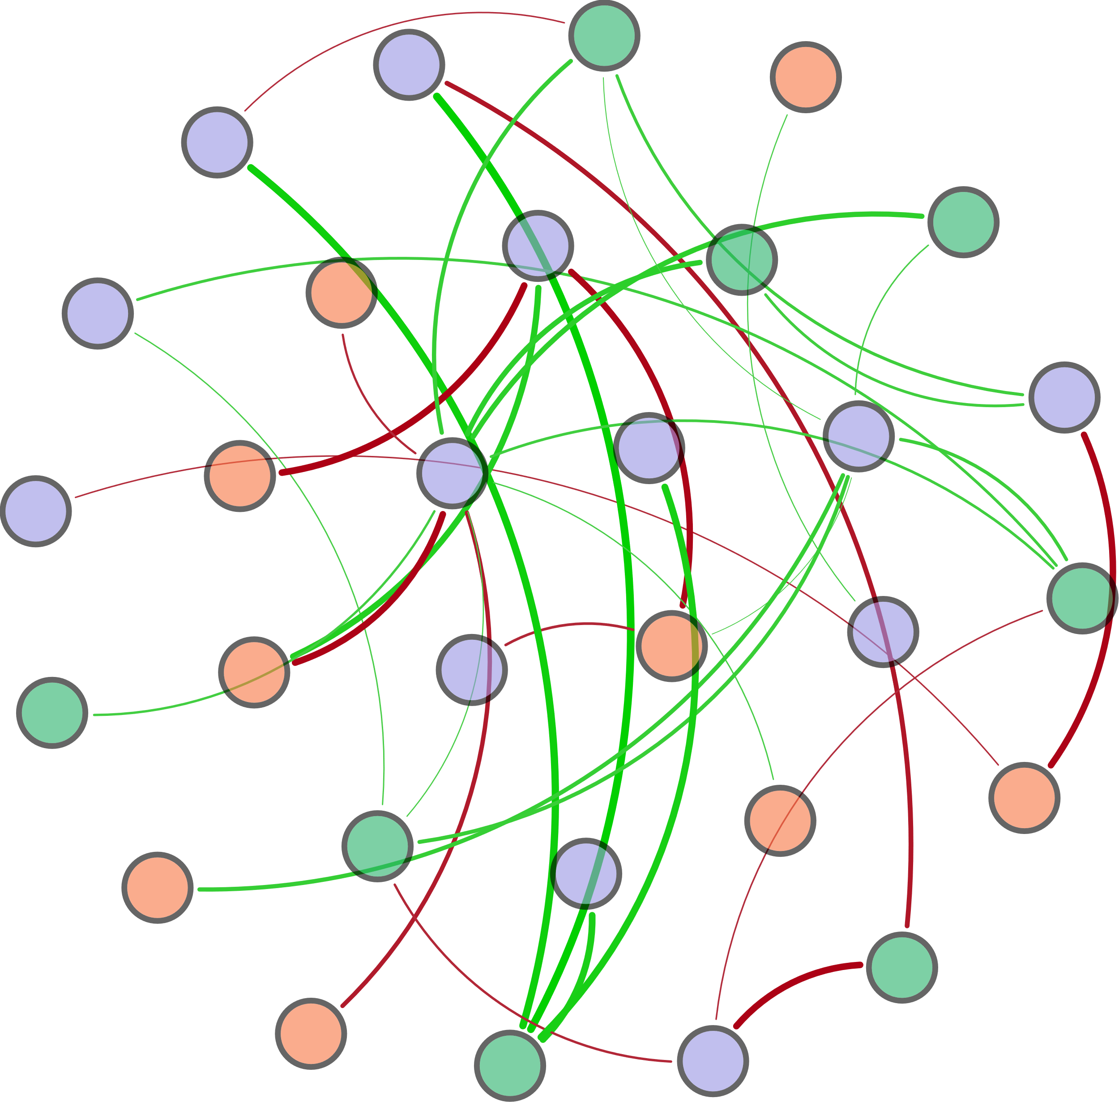
W-TN
AOA_amoA
Ⅳ-Area
nirK
norB
Ⅲ-Area
narG
Archaeal 16S rRNA
nifH
hzsB
S-TN
hzsA
Bacterial 16S rRNA
T
Ⅰ-Area
AOB_amoA
HIX
napA
TP
DO
FI
Ⅱ-Area
nosZ
COD
Ⅴ-Area
pH
hzo

Slide 3
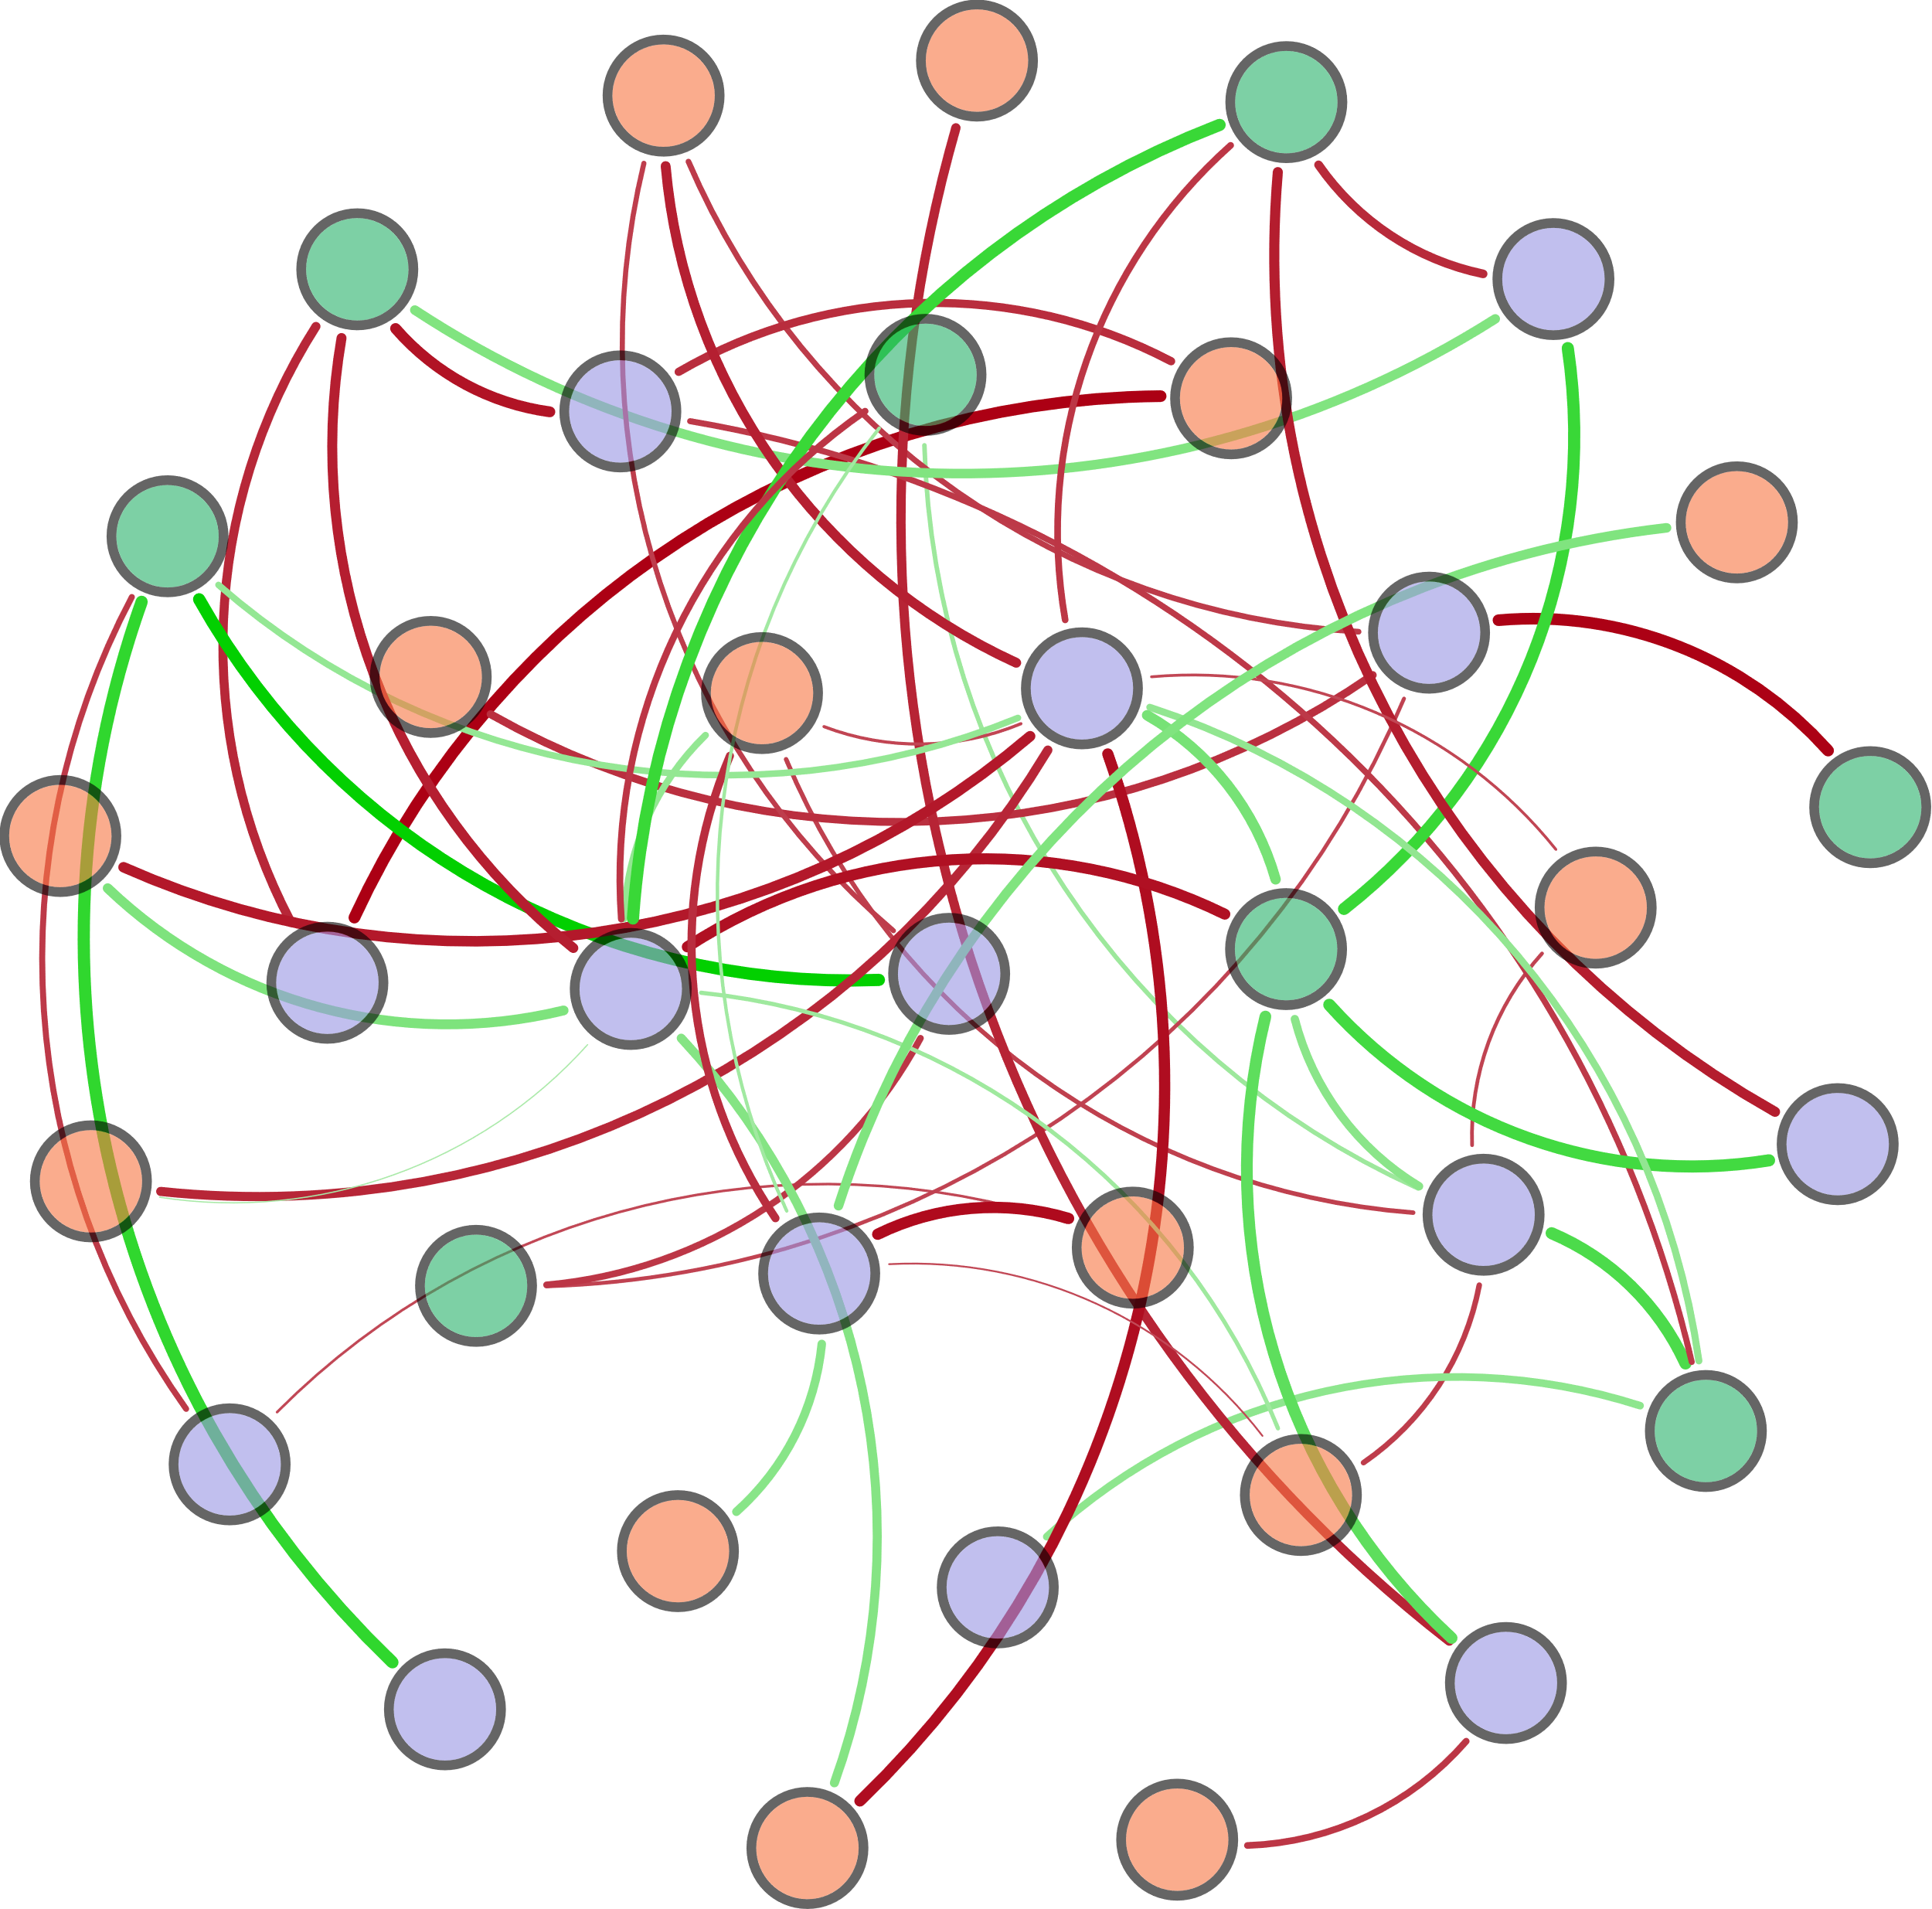
(d_{0.9}-d_{0.1})/d_{0.5}
Ⅴ-Area
DO
nirS
nirK
W-TN
S-TN
COD
BIX
nxrA
HIX
d_{0.9}
hzsB
Ⅱ-Area
TP
Bacterial 16S rRNA
hzo
norB
hzsA
Ⅰ-Area
Archaeal 16S rRNA
d_{0.1}
T
nifH
AOA_amoA
pH
d_{0.5}
β:α
narG
AOB_amoA
napA
Ⅳ-Area
Ⅲ-Area

Slide 4
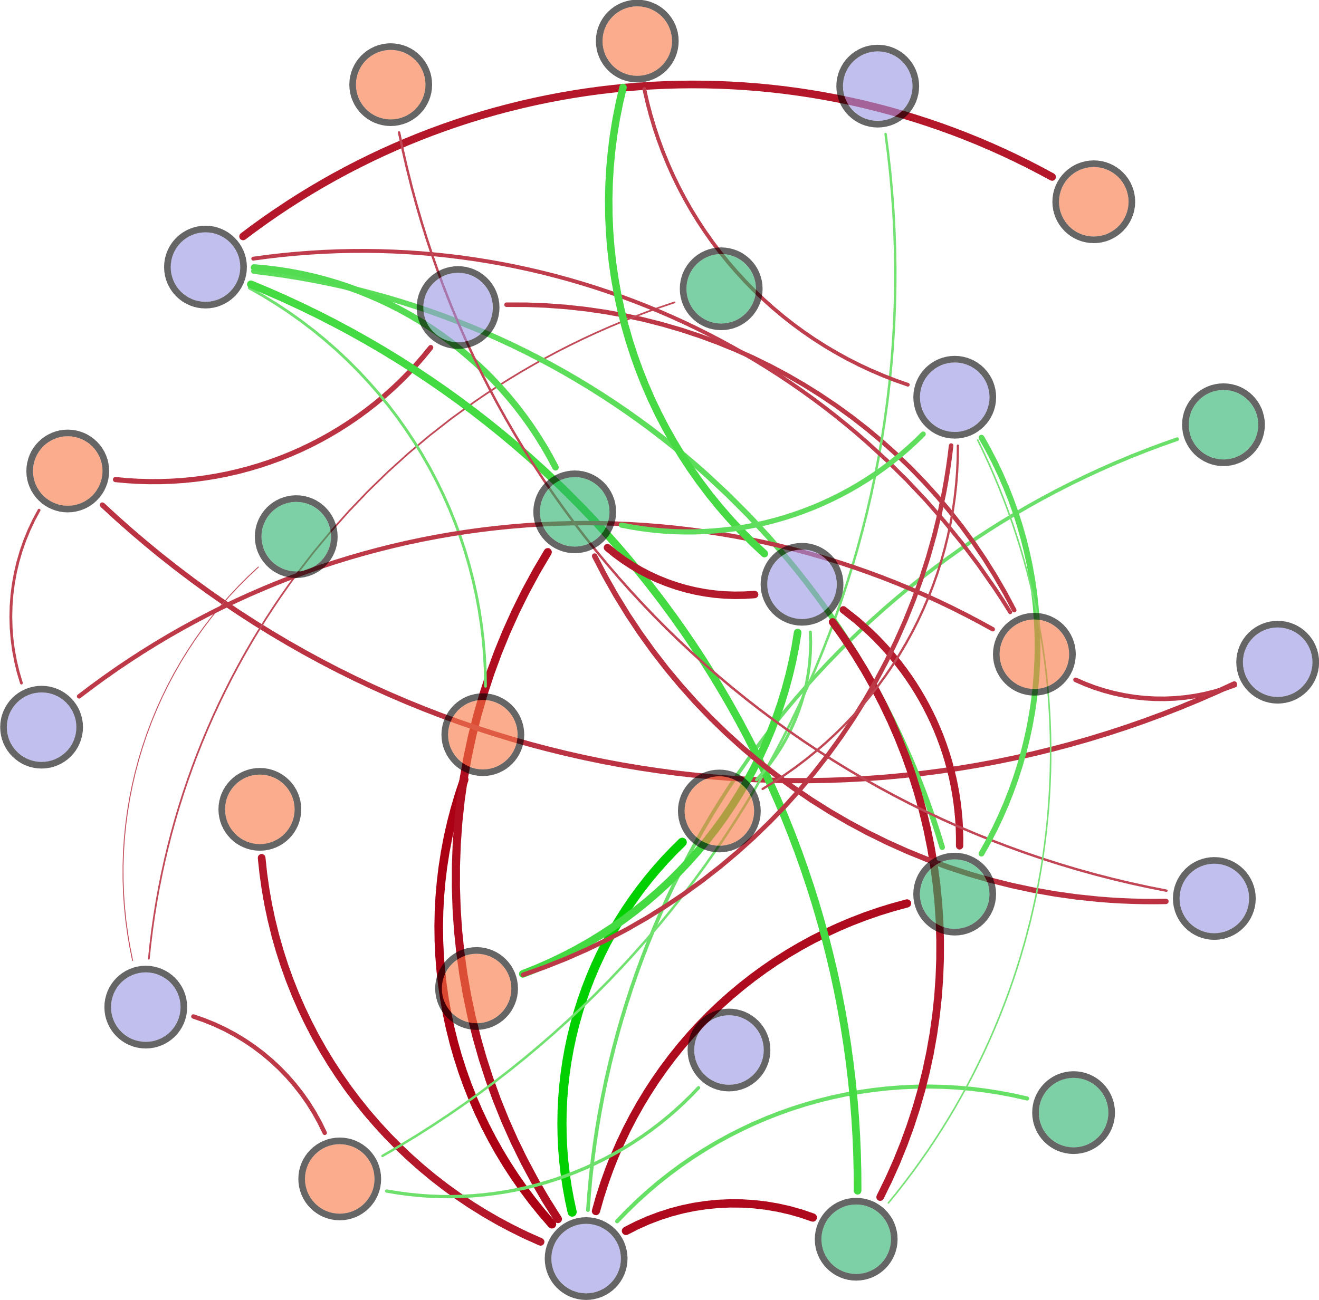
d_{0.9}
S-TN
narG
S-TP
napA
Archaeal 16S rRNA
hzo
Ⅲ-Area
COD
DO
norB
Ⅴ-Area
AOA_amoA
nirK
Ⅰ-Area
Ⅳ-Area
HIX
pH
hzsA
nxrA
d_{0.5}
nifH
W-TN
FI
Bacterial 16S rRNA
T

Slide 6
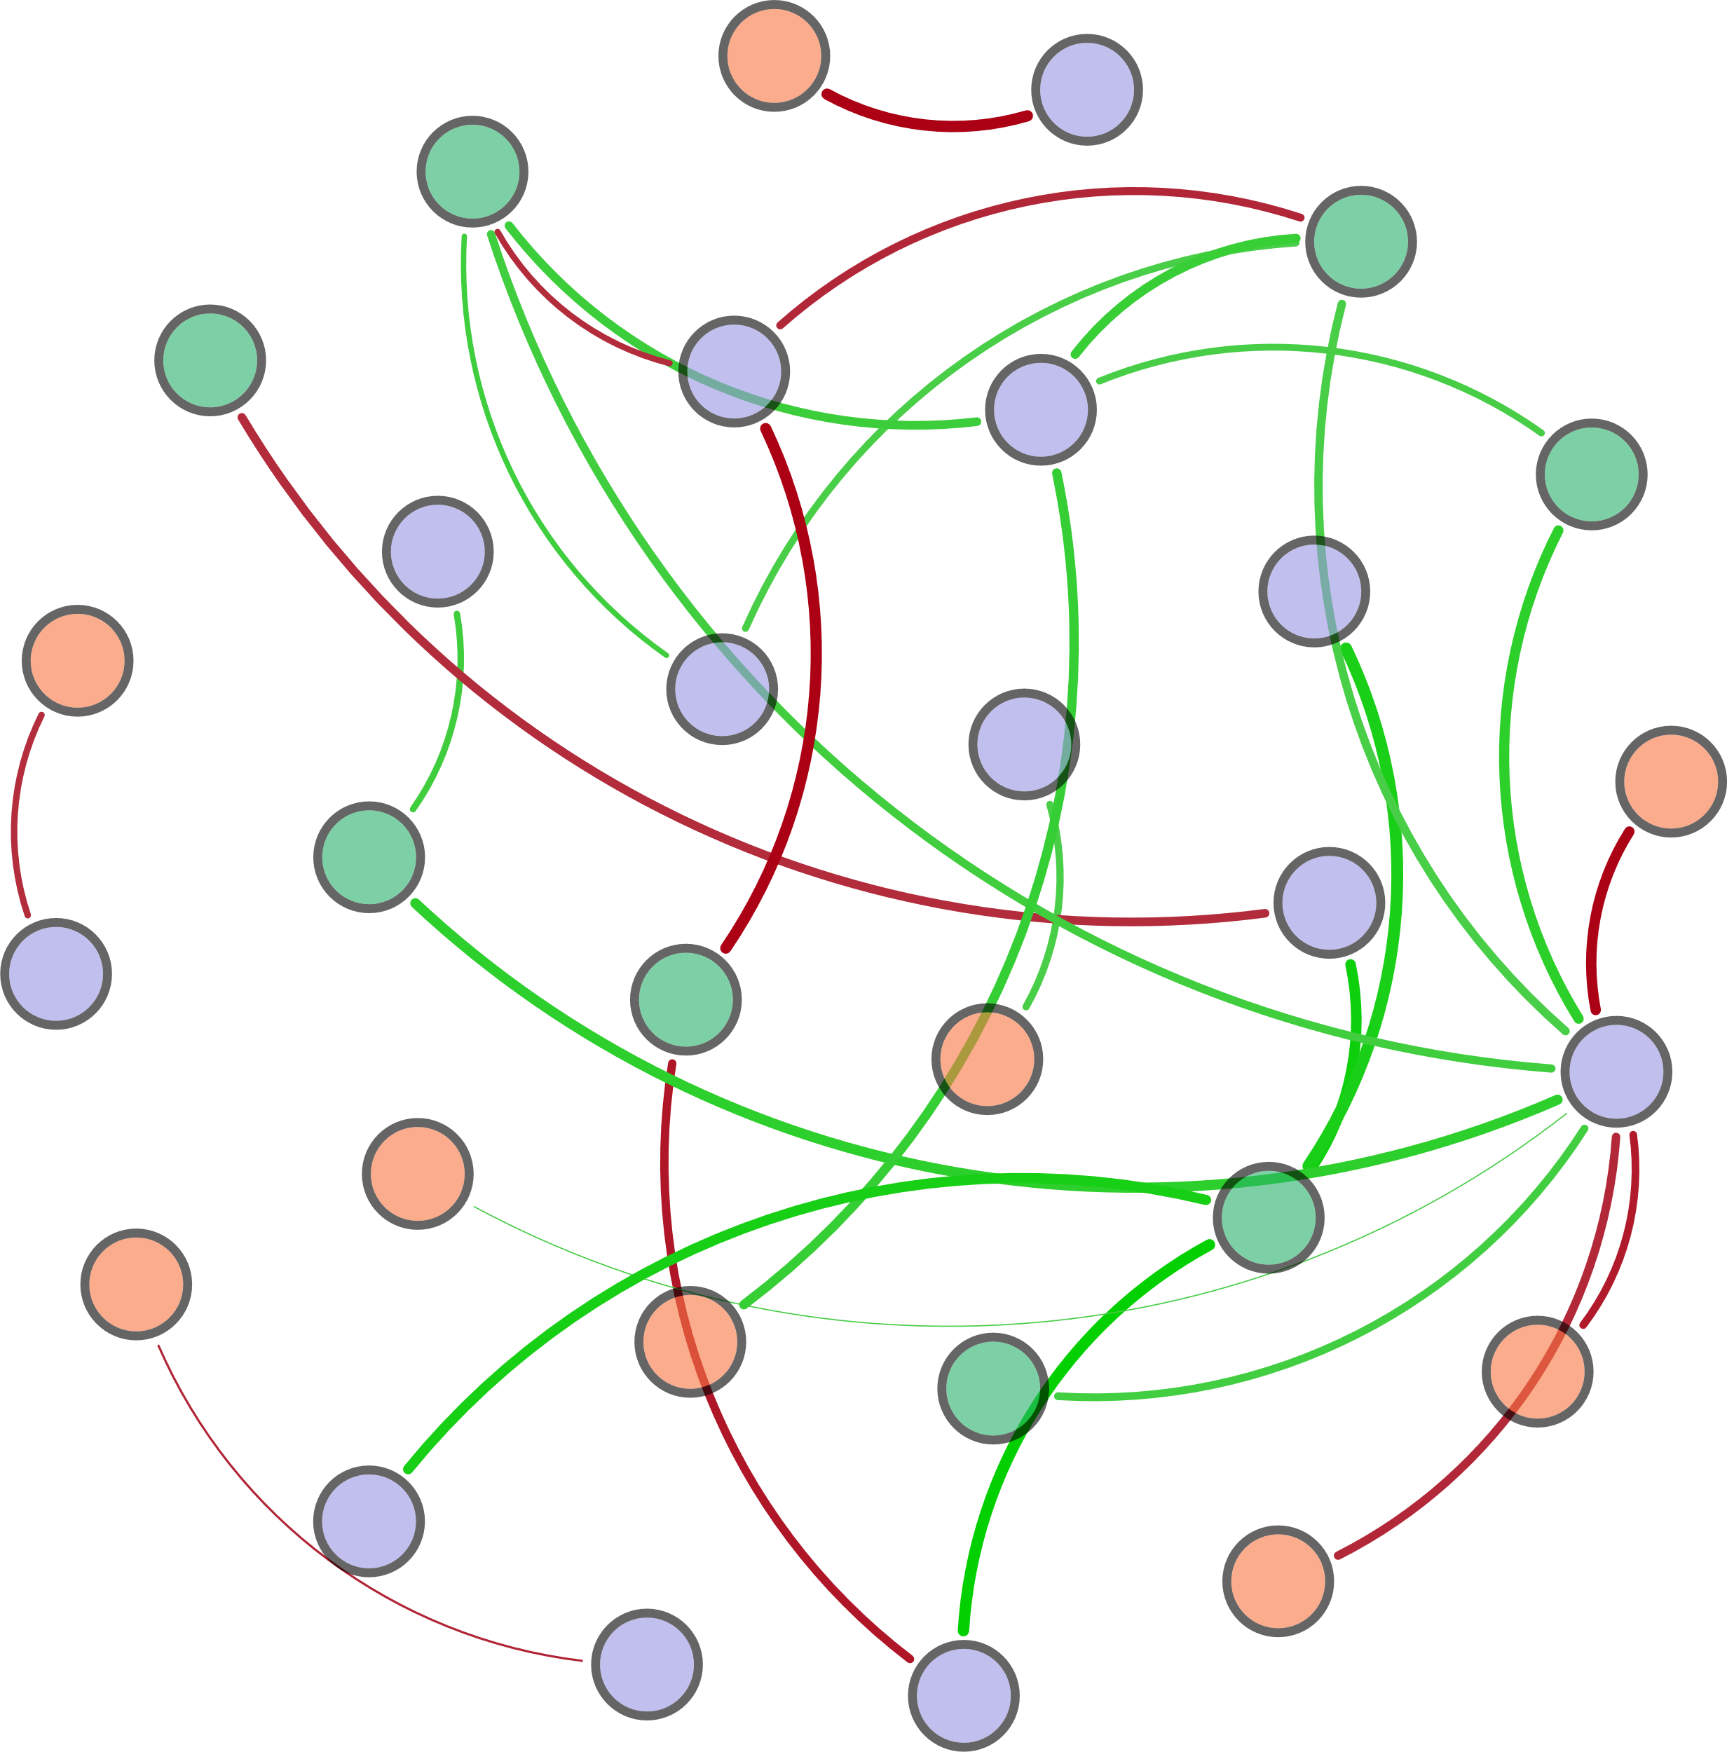
S-TN
norB
T
DO
W-TN
hzo
hzsB
Archaeal 16S rRNA
nosZ
TP
narG
AOB_amoA
HIX
nirK
Bacterial 16S rRNA
COD
Ⅳ-Area
hzsA
FI
pH
Ⅰ-Area
Ⅱ-Area
Ⅴ-Area
nifH
Ⅲ-Area
napA
AOA_amoA

Slide 7
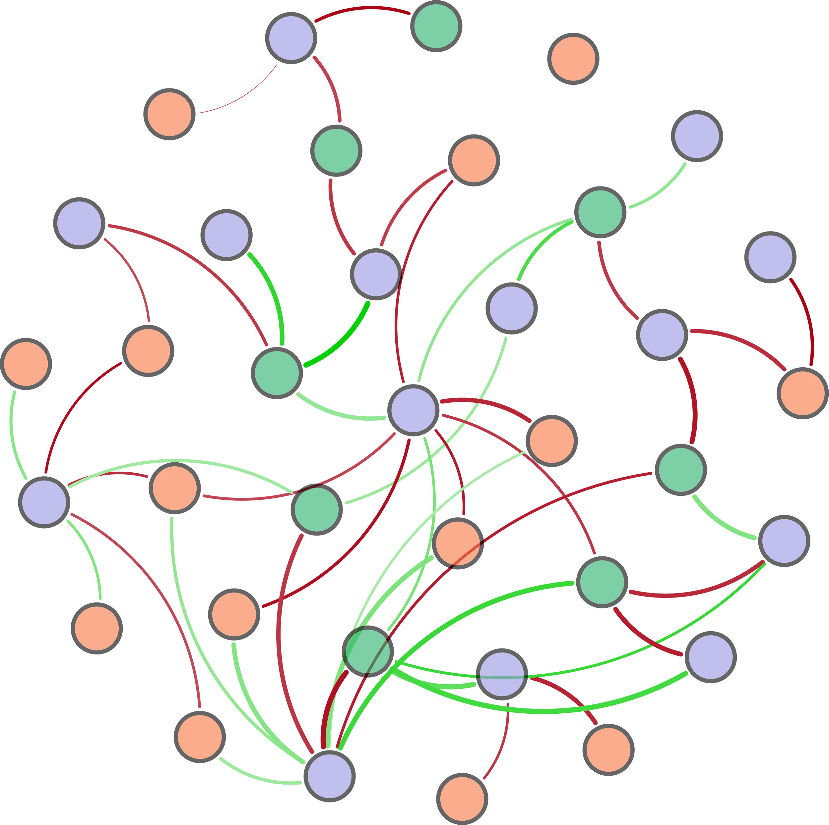
nxrA
TP
HIX
T
narG
(d_{0.9}-d_{0.1})/d_{0.5}
AOA_amoA
pH
AOB_amoA
Bacterial 16S rRNA
norB
Archaeal 16S rRNA
d_{0.1}
nirK
β:α
COD
hzsB
S-TN
Ⅰ-Area
nifH
d_{0.9}
W-TN
Ⅱ-Area
nirS
DO
BIX
Ⅳ-Area
hzsA
napA
d_{0.5}
Ⅴ-Area
hzo
Ⅲ-Area

Slide 8
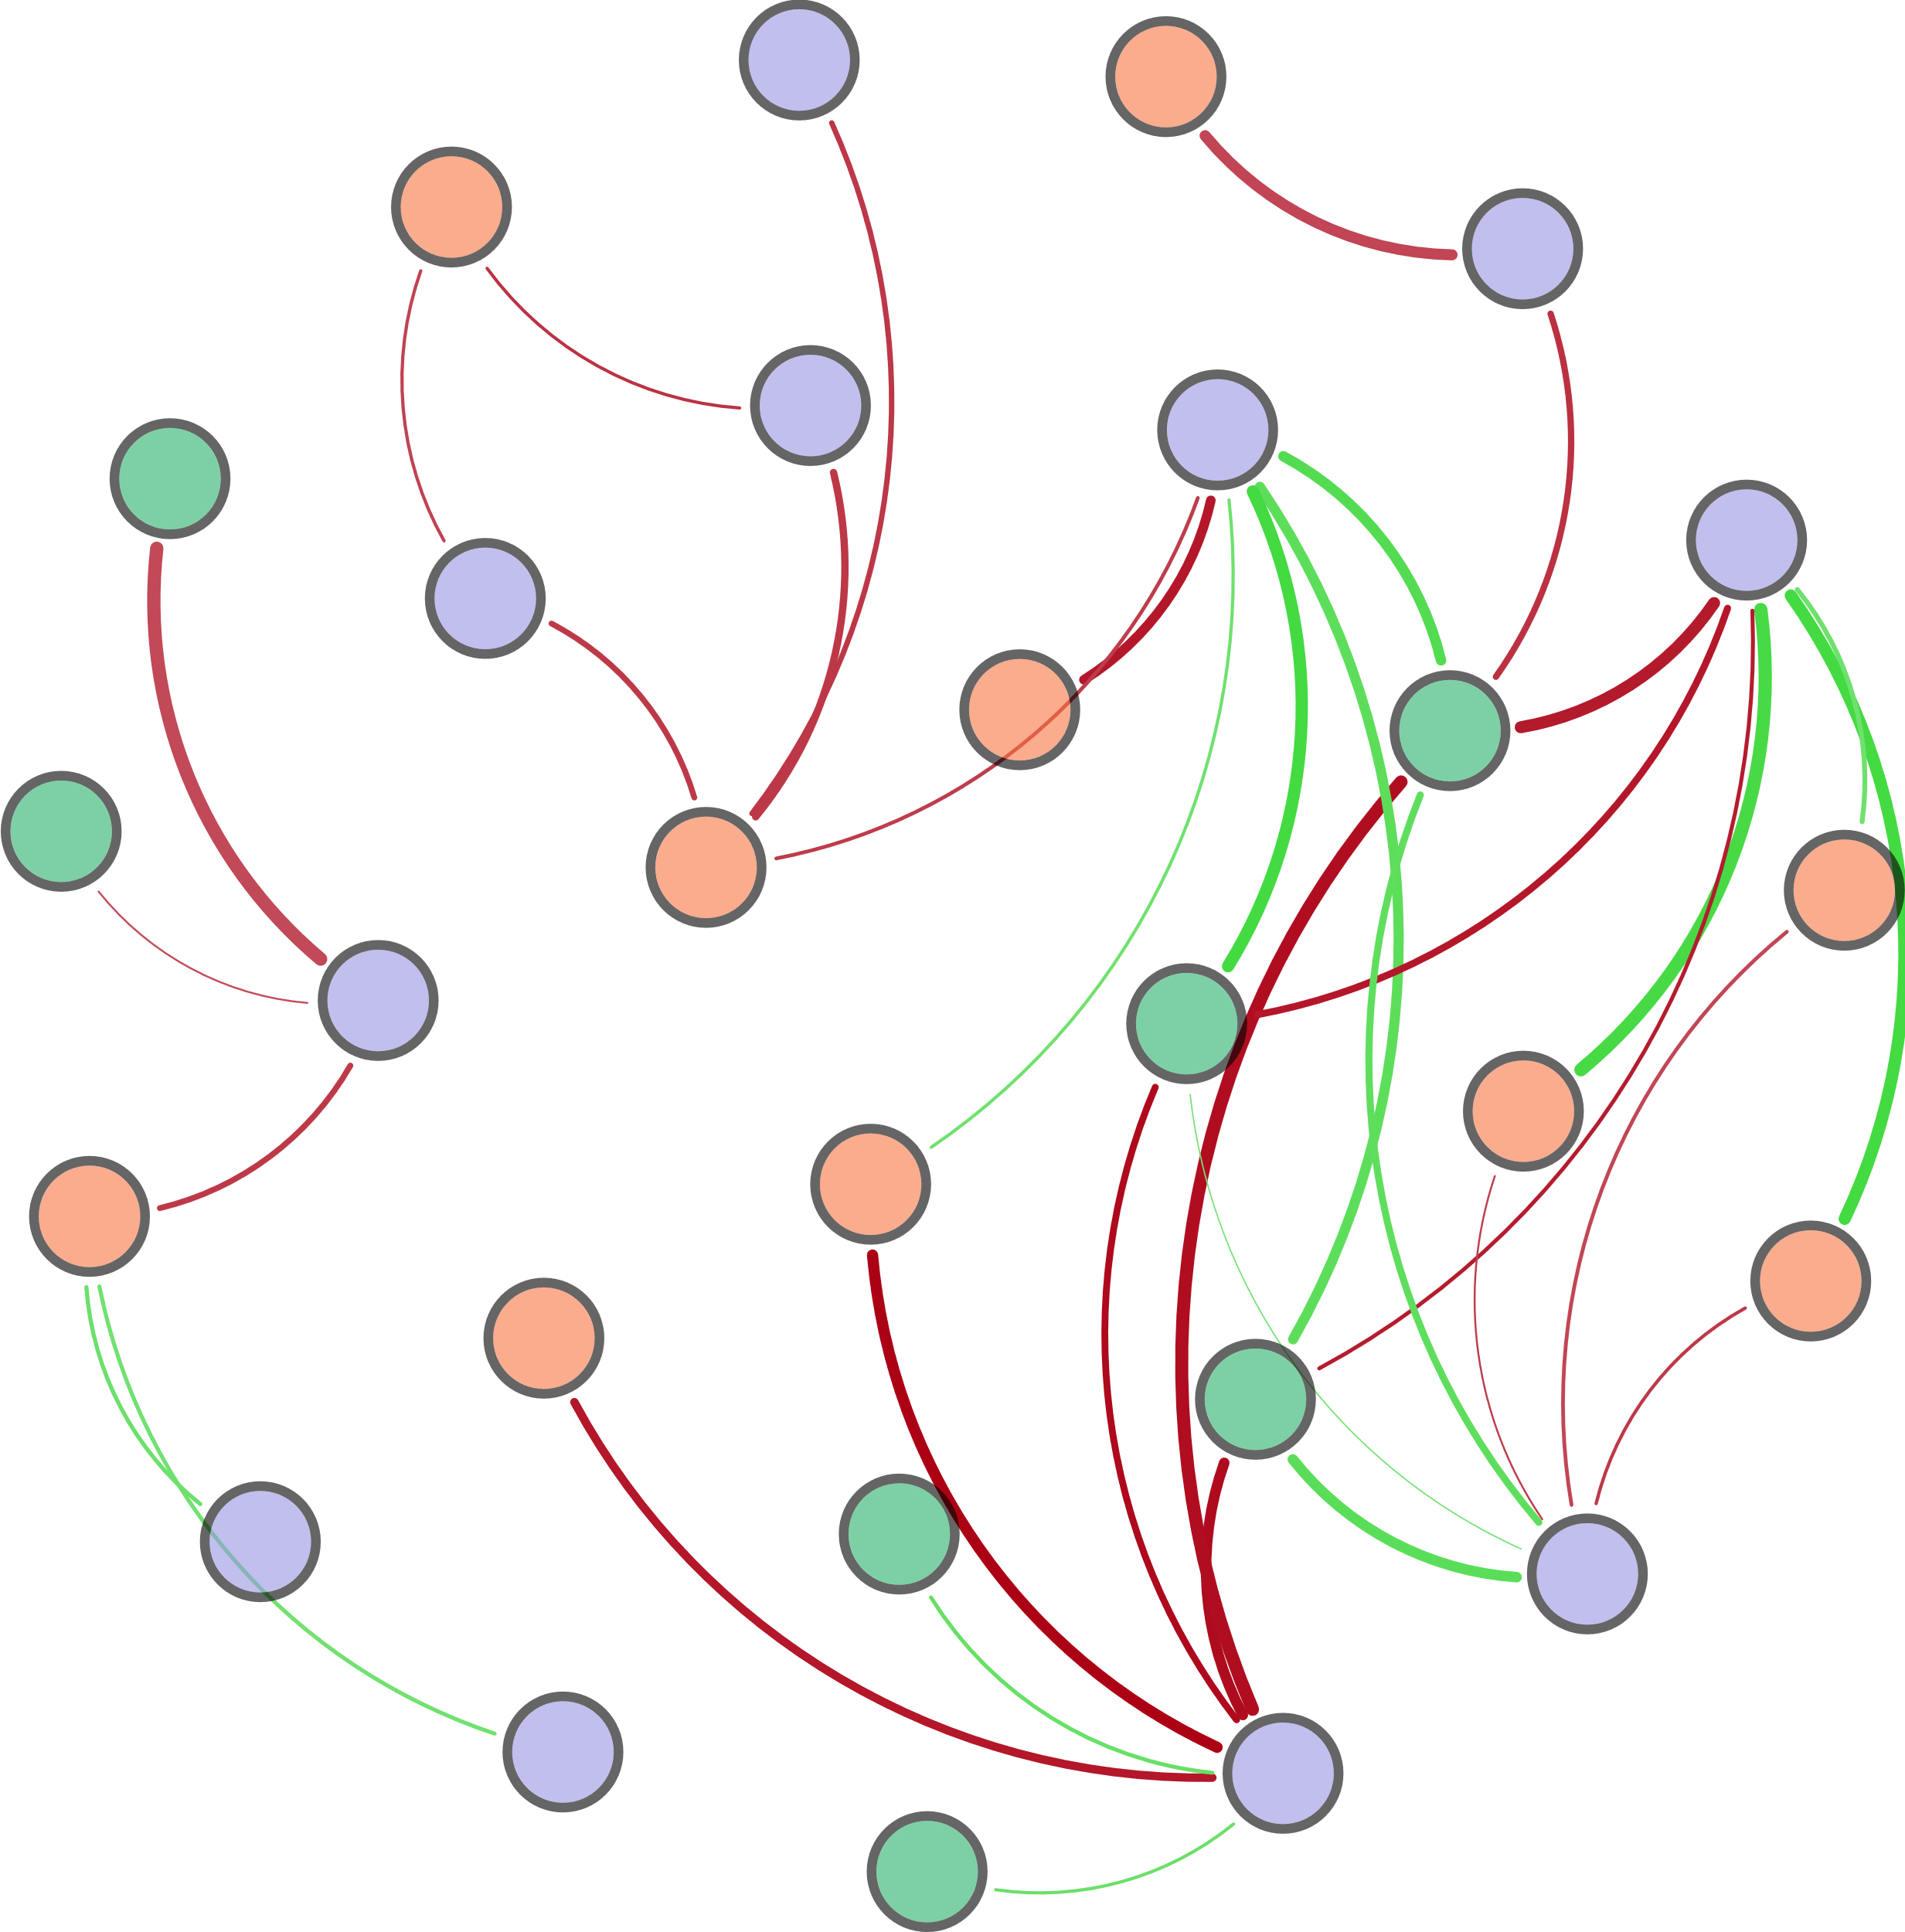
AOA_amoA
S-TN
Ⅲ-Area
hzsA
Archaeal 16S rRNA
napA
norB
nirK
TP
DO
COD
Ⅴ-Area
HIX
nxrA
T
d_{0.9}
FI
Ⅰ-Area
d_{0.5}
Ⅳ-Area
pH
nifH
W-TN
hzo
narG
Bacterial 16S rRNA

