Slide 1

E-COMMERCE WEBSITE
(MINI-PROJECT)
By-
Manas Gupta(2019b101187)
Prazual Flodya(2019
CSE-B

Slide 2
Topics covered
Problem Introduction
Related previous work
Hardware and software requirement
Flowchart of project
Snapshots
Deliverables
Stakeholders
Gantt chart
Conclusion
References

Slide 3
Problem Introduction
Motivation:
To increase my efficiency of front end web development which I learnt from online course of coursera and from this knowledge I wanted to built a project. A project that will train me for future endeavours.

Slide 4
Problem Introduction
Objective:
To become first choice of consumers.
To help the consumer to buy product from home.
Time saving platform with wide variety of exquisite products.
To gain some profit and help needy.

Slide 5
Problem Introduction
Scope of project:
The scope of the project is very wide as the website can be accessed from any part of the world.
The consumers can buy from many brands including ADIDAS, NIKE, ZARA, UNDERARMOUR etc.
To give consumer wide variety of products irrespective of gender, age, and financial status.

Slide 6
Related previous work
Myntra:
Myntra is an Indian fashion e-commerce company headquartered in Bengaluru, Karnataka, India.
The company was founded in 2007 to sell personalized gift items.
In July, 2016 Myntra acquired their rival Jabong.com to become India’s largest fashion platform.
Myntra is a fashion destination that is committed to making customers look good anytime.

Slide 7
Hardware and software
HARDWARE
CPU
INTEL i5/i7
RAM-8GB
HDD/SSD-32GB
SOFTWARE
WINDOWS OS(10/8.1/VISTA/7)
NOTEPAD++
INTERNET BROWSER(CHROME)

Slide 8
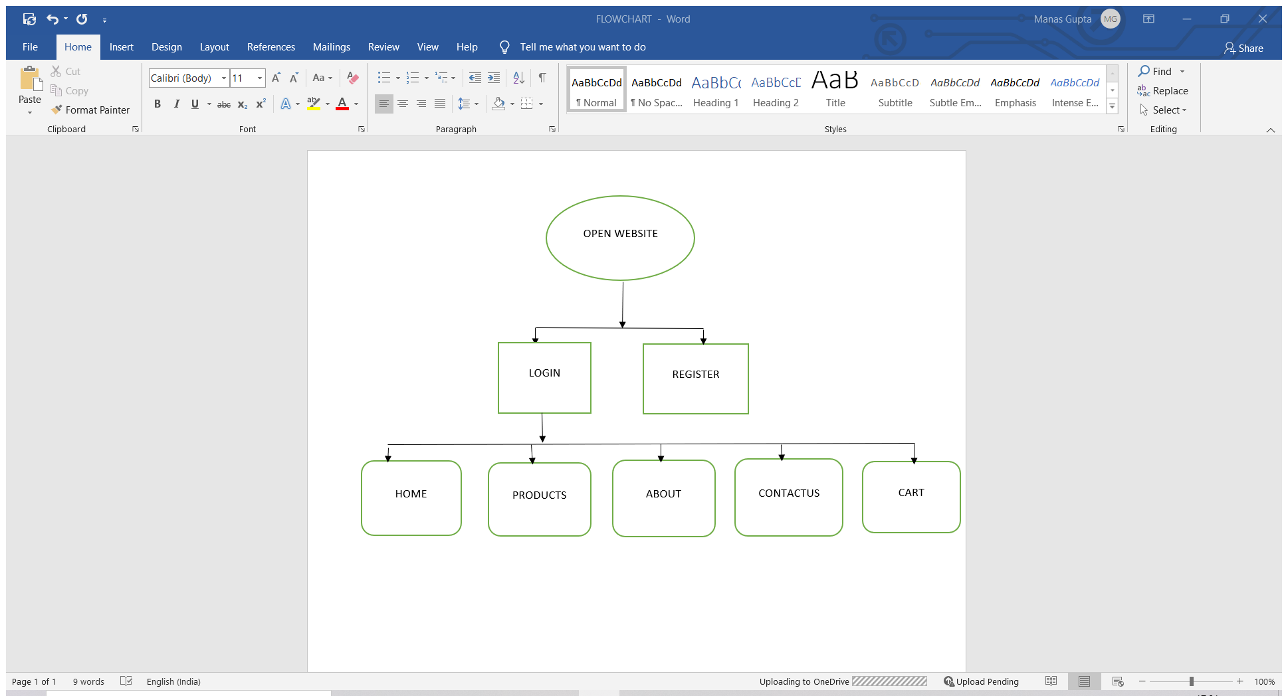
FLOWCHART OF PROJECT

Slide 9
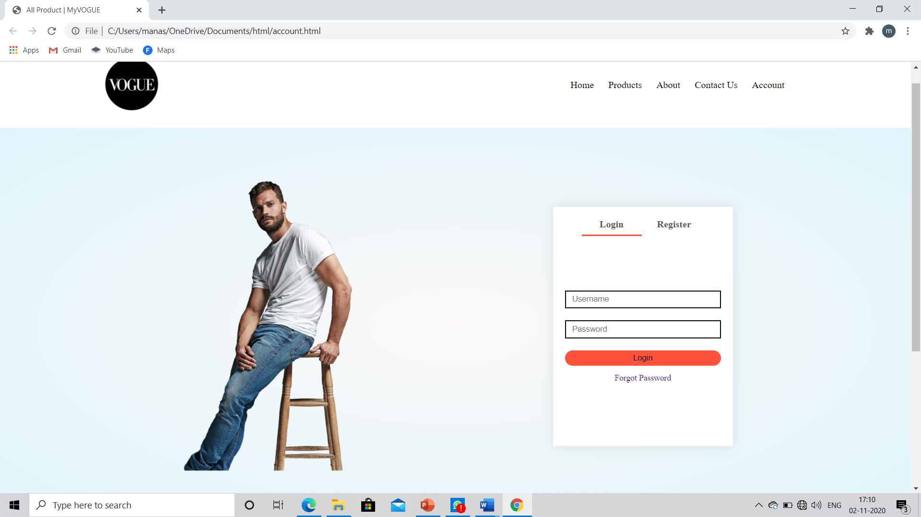
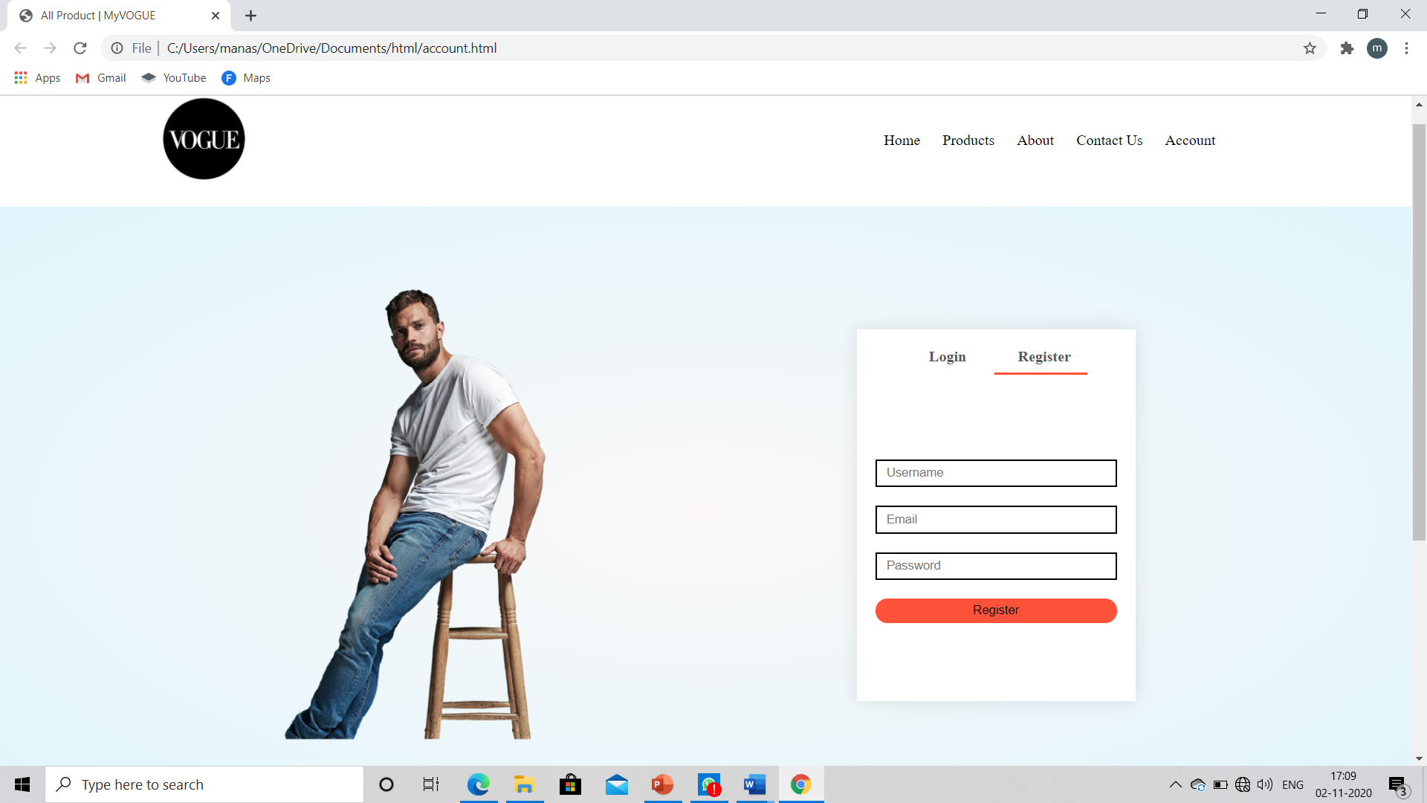
SNAPSHOTS
Login and Register Page:

Slide 10
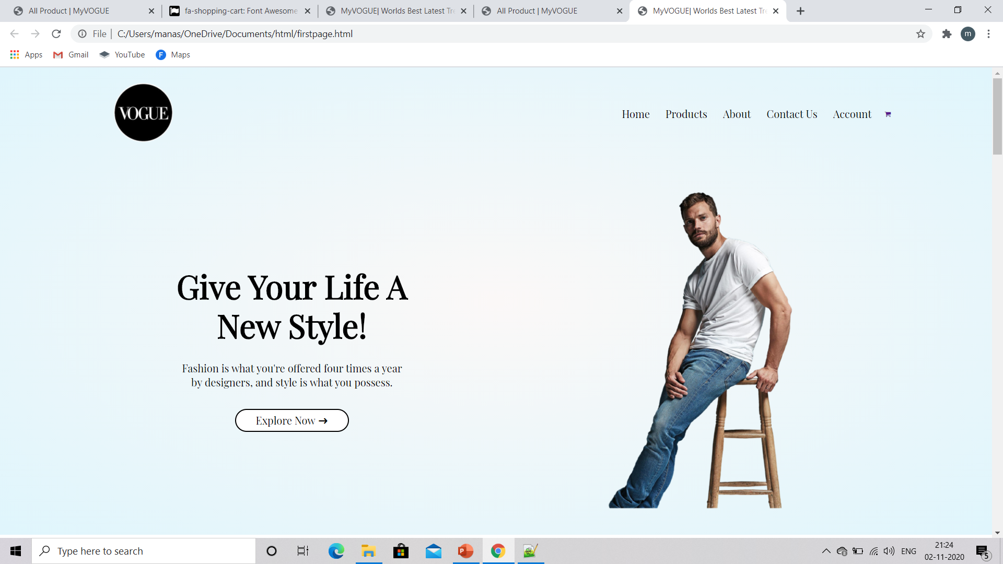
snapshots
Home page:

Slide 11
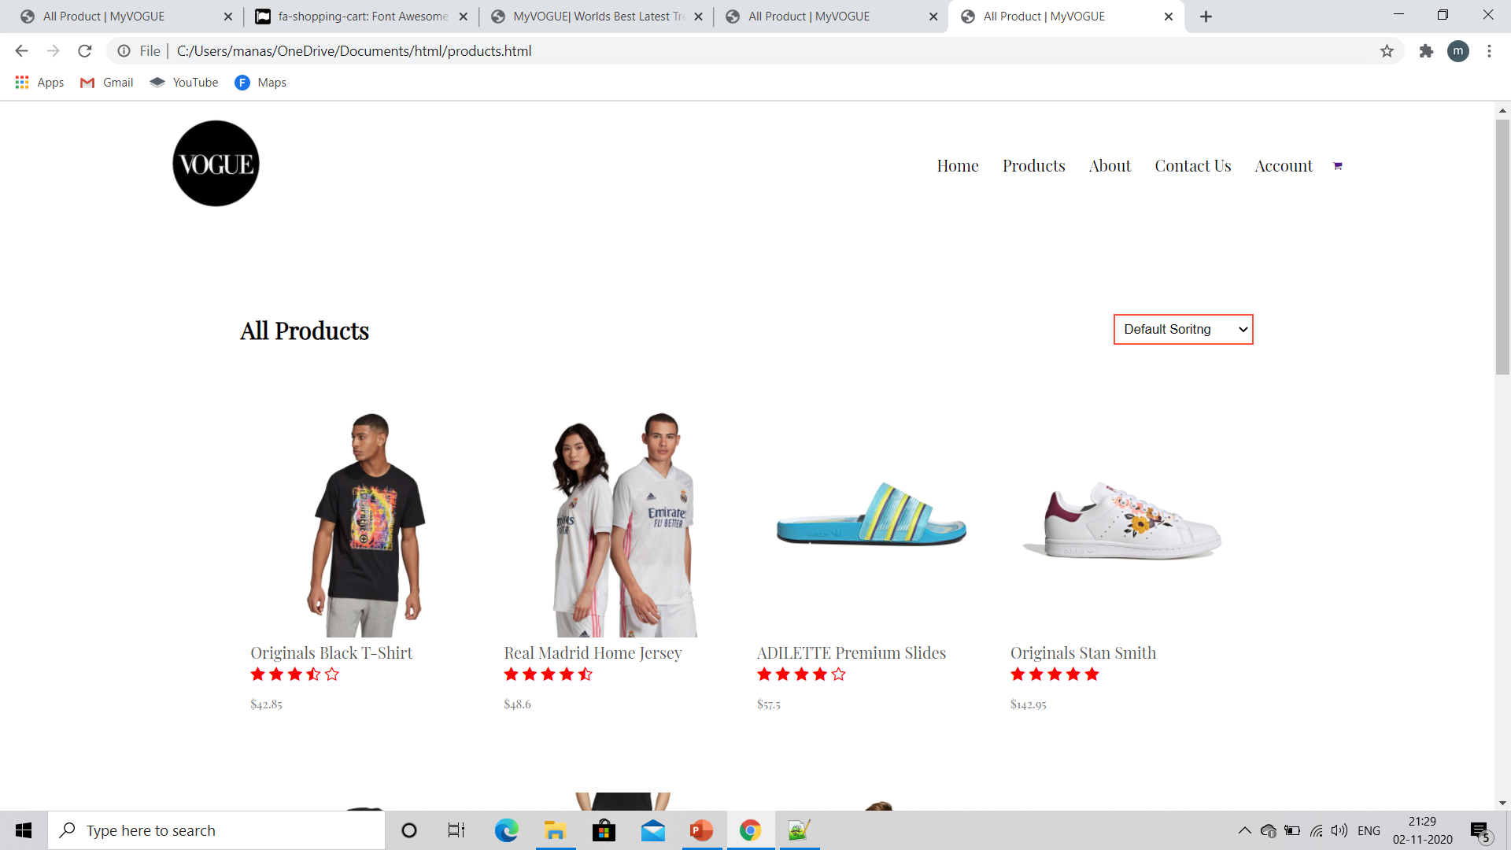
snapshots
Products page:

Slide 12
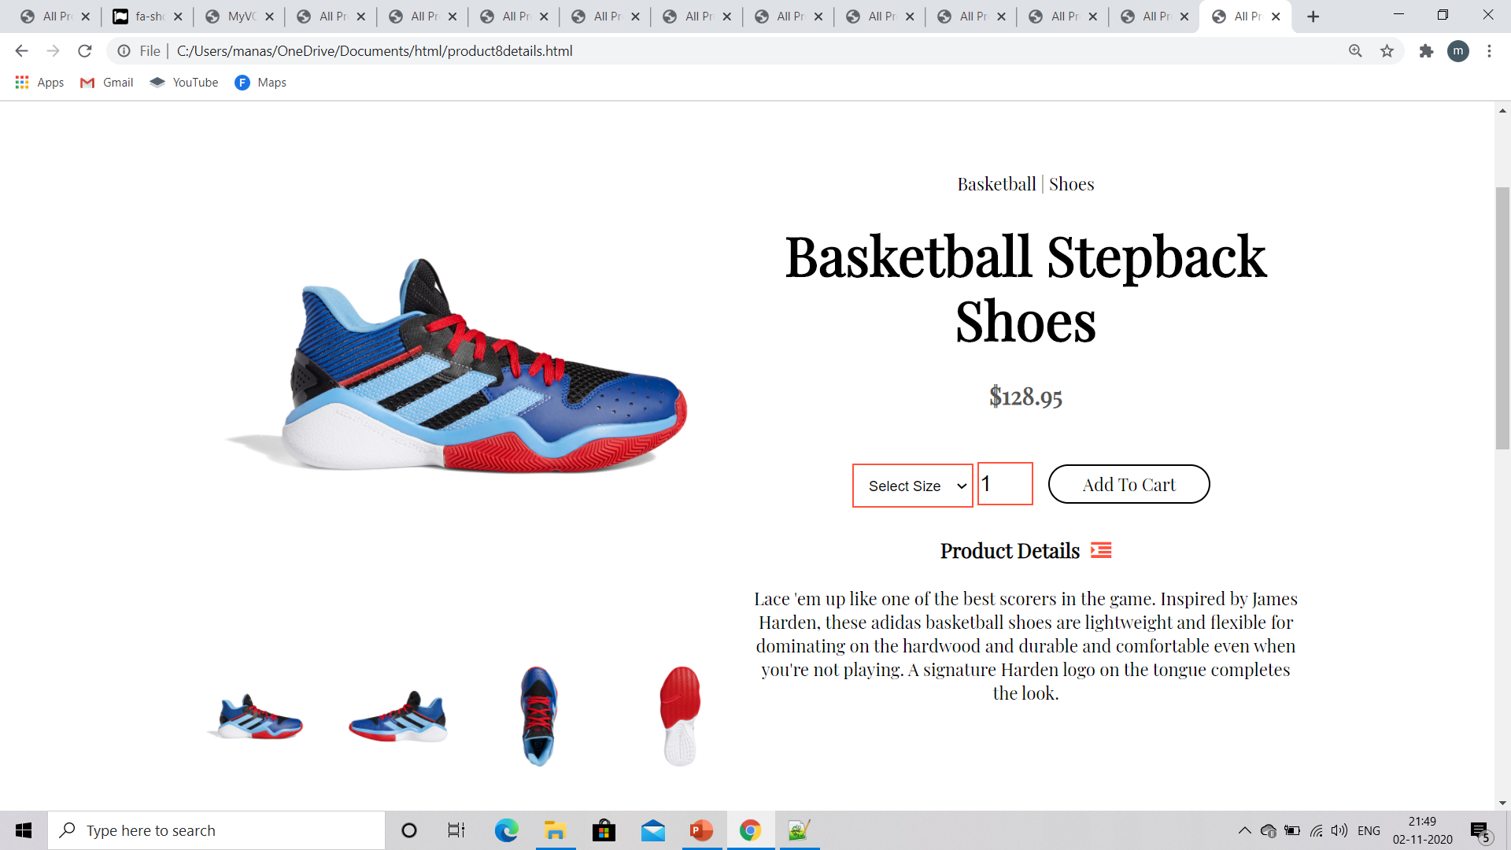
snapshots
Single Product Detail Page:

Slide 13
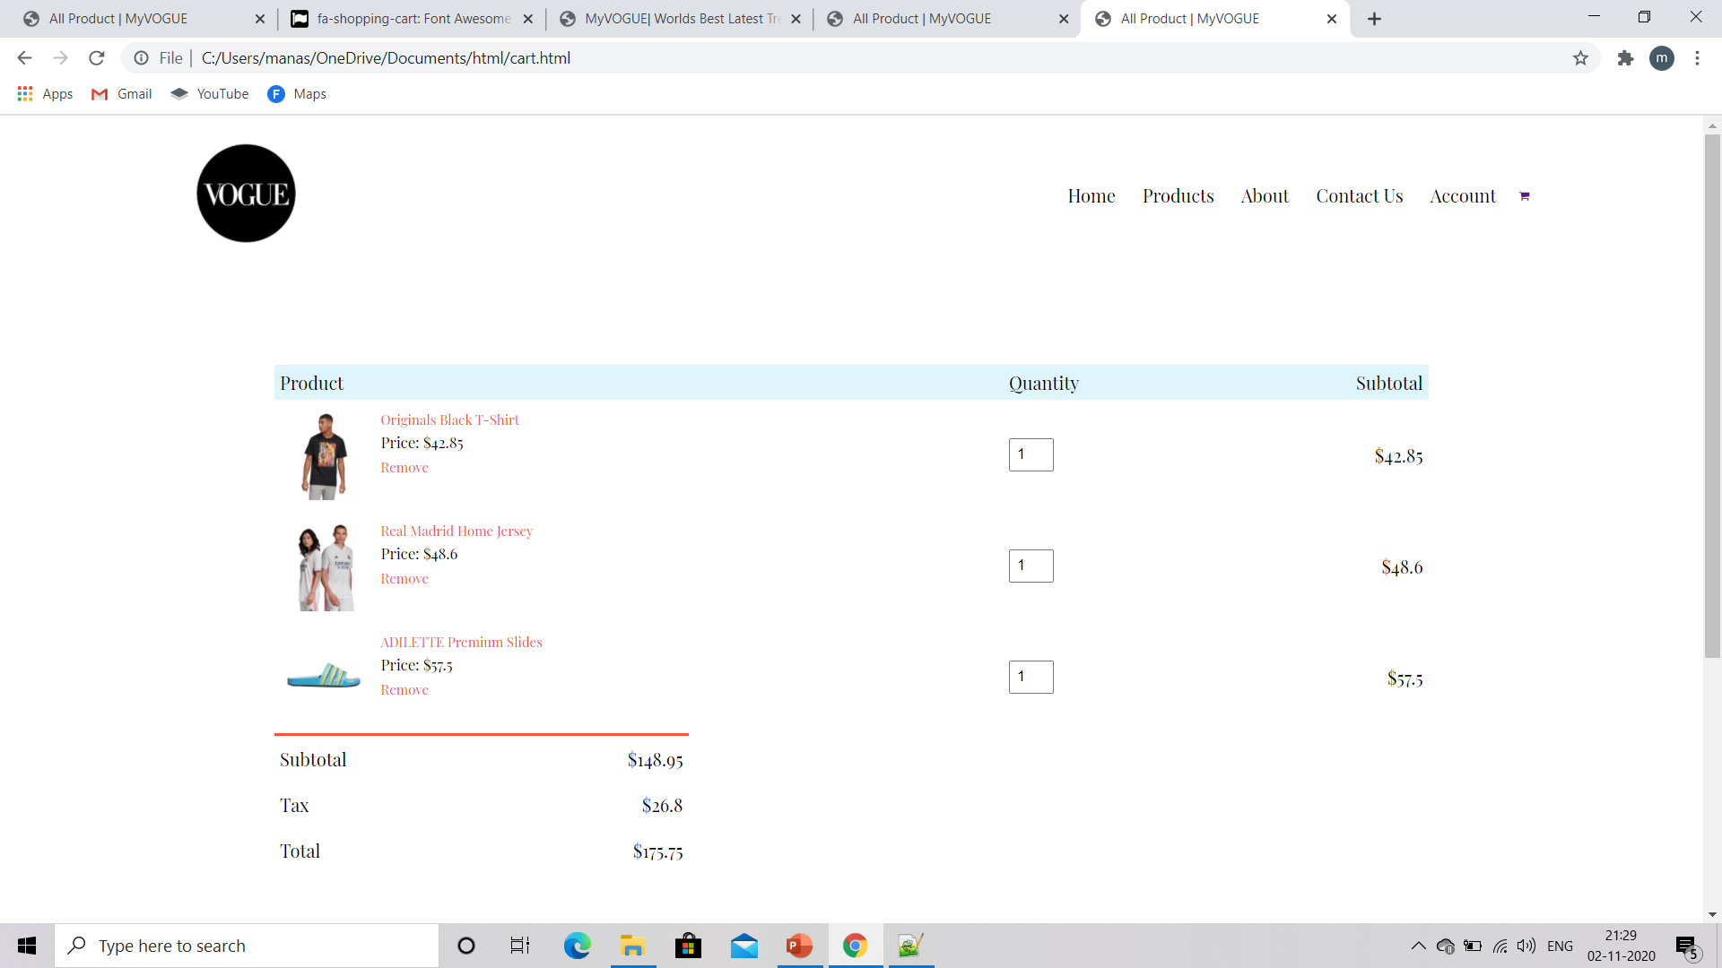
snapshots
Cart Page:

Slide 14
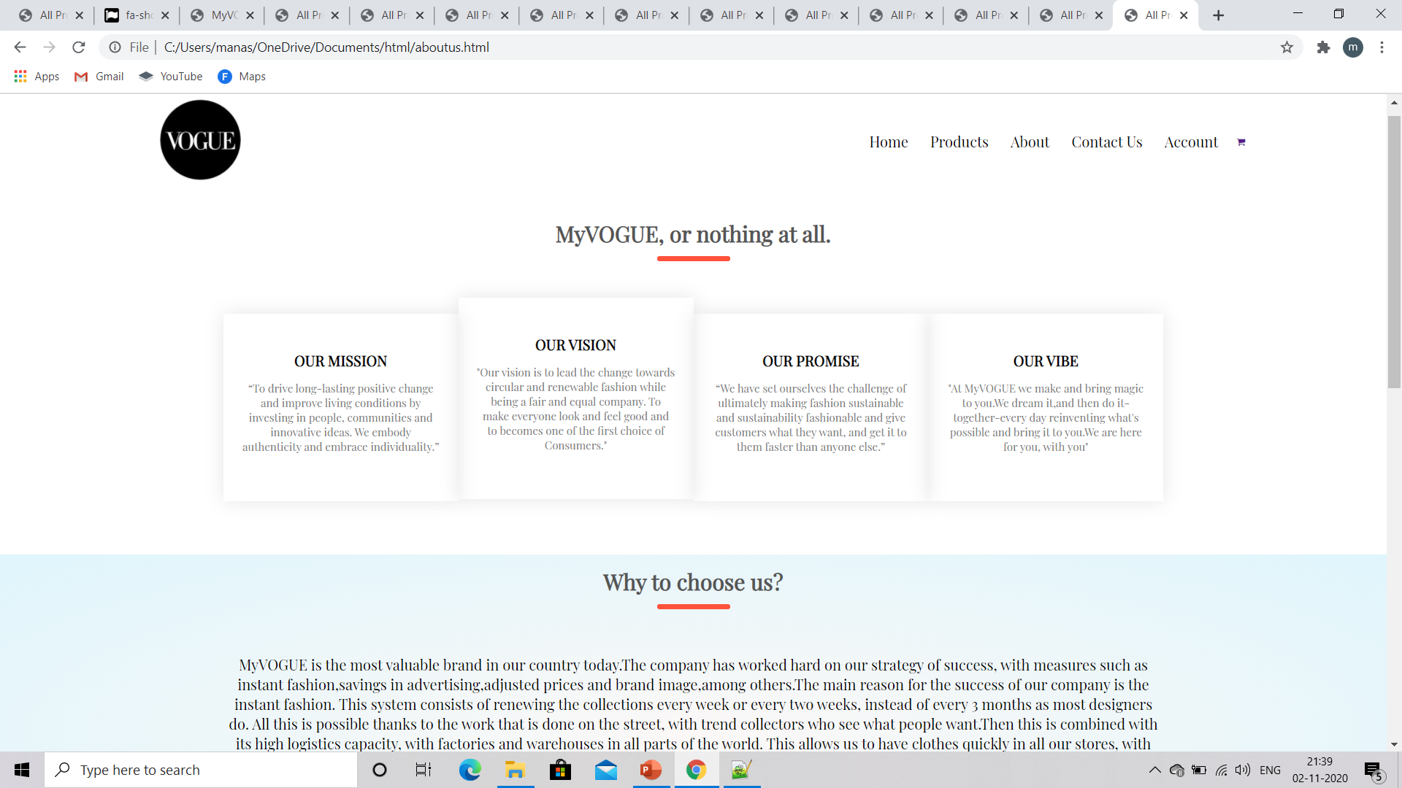
snapshots
About-us Page:

Slide 15
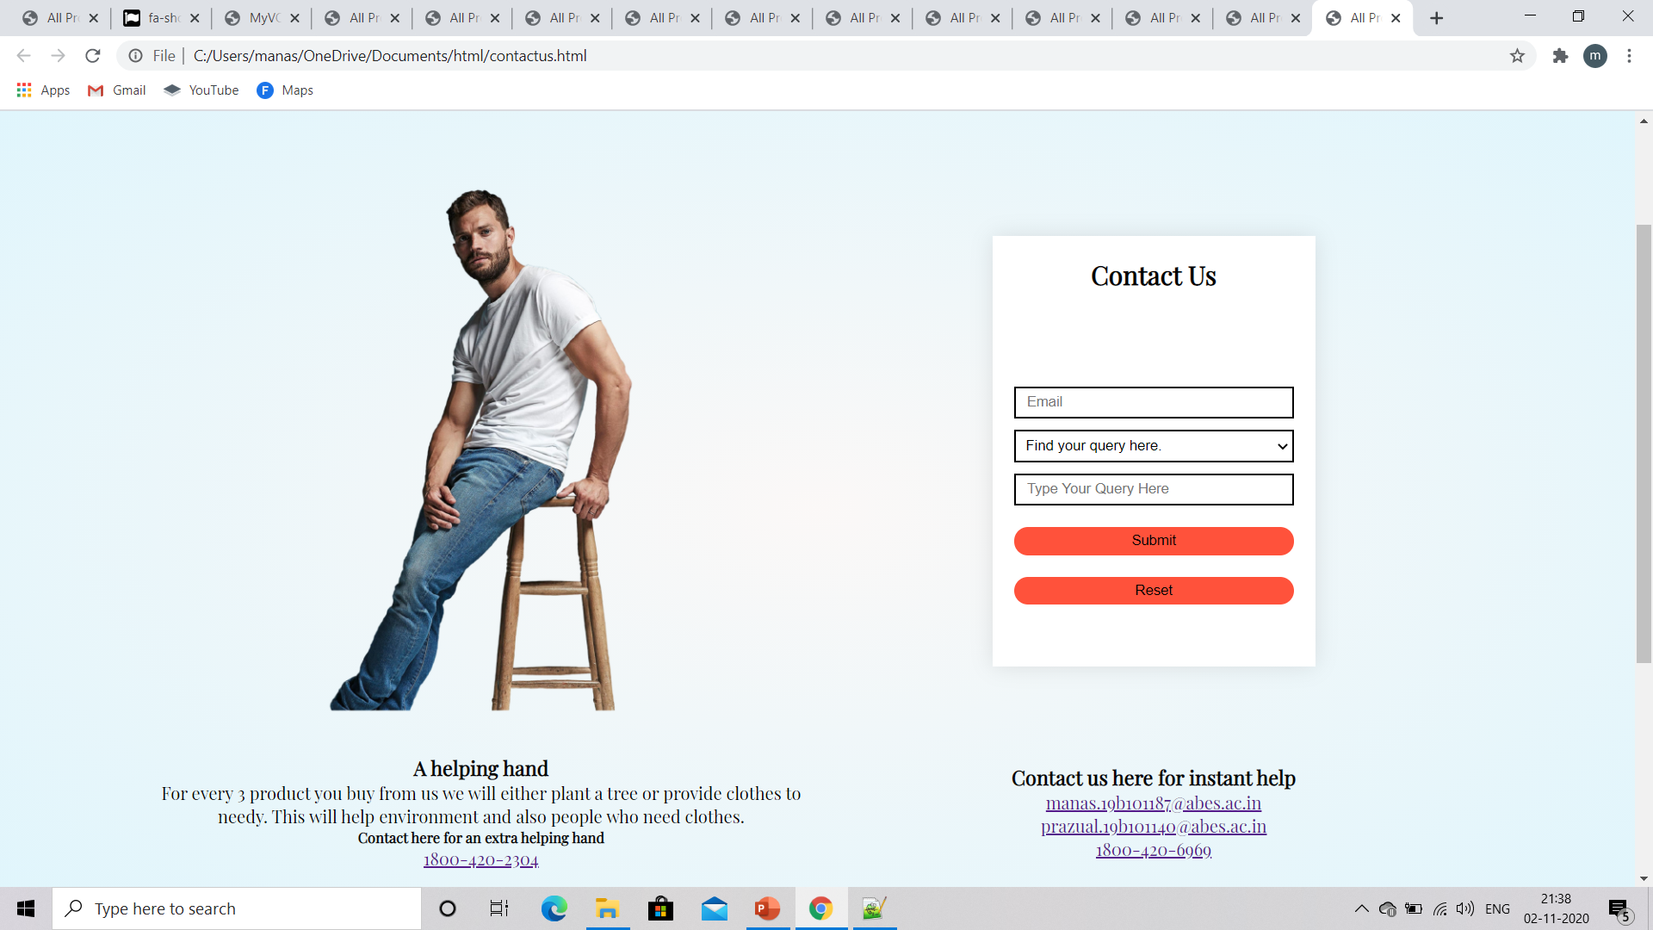
snapshots
Contact-us Page:

Slide 16
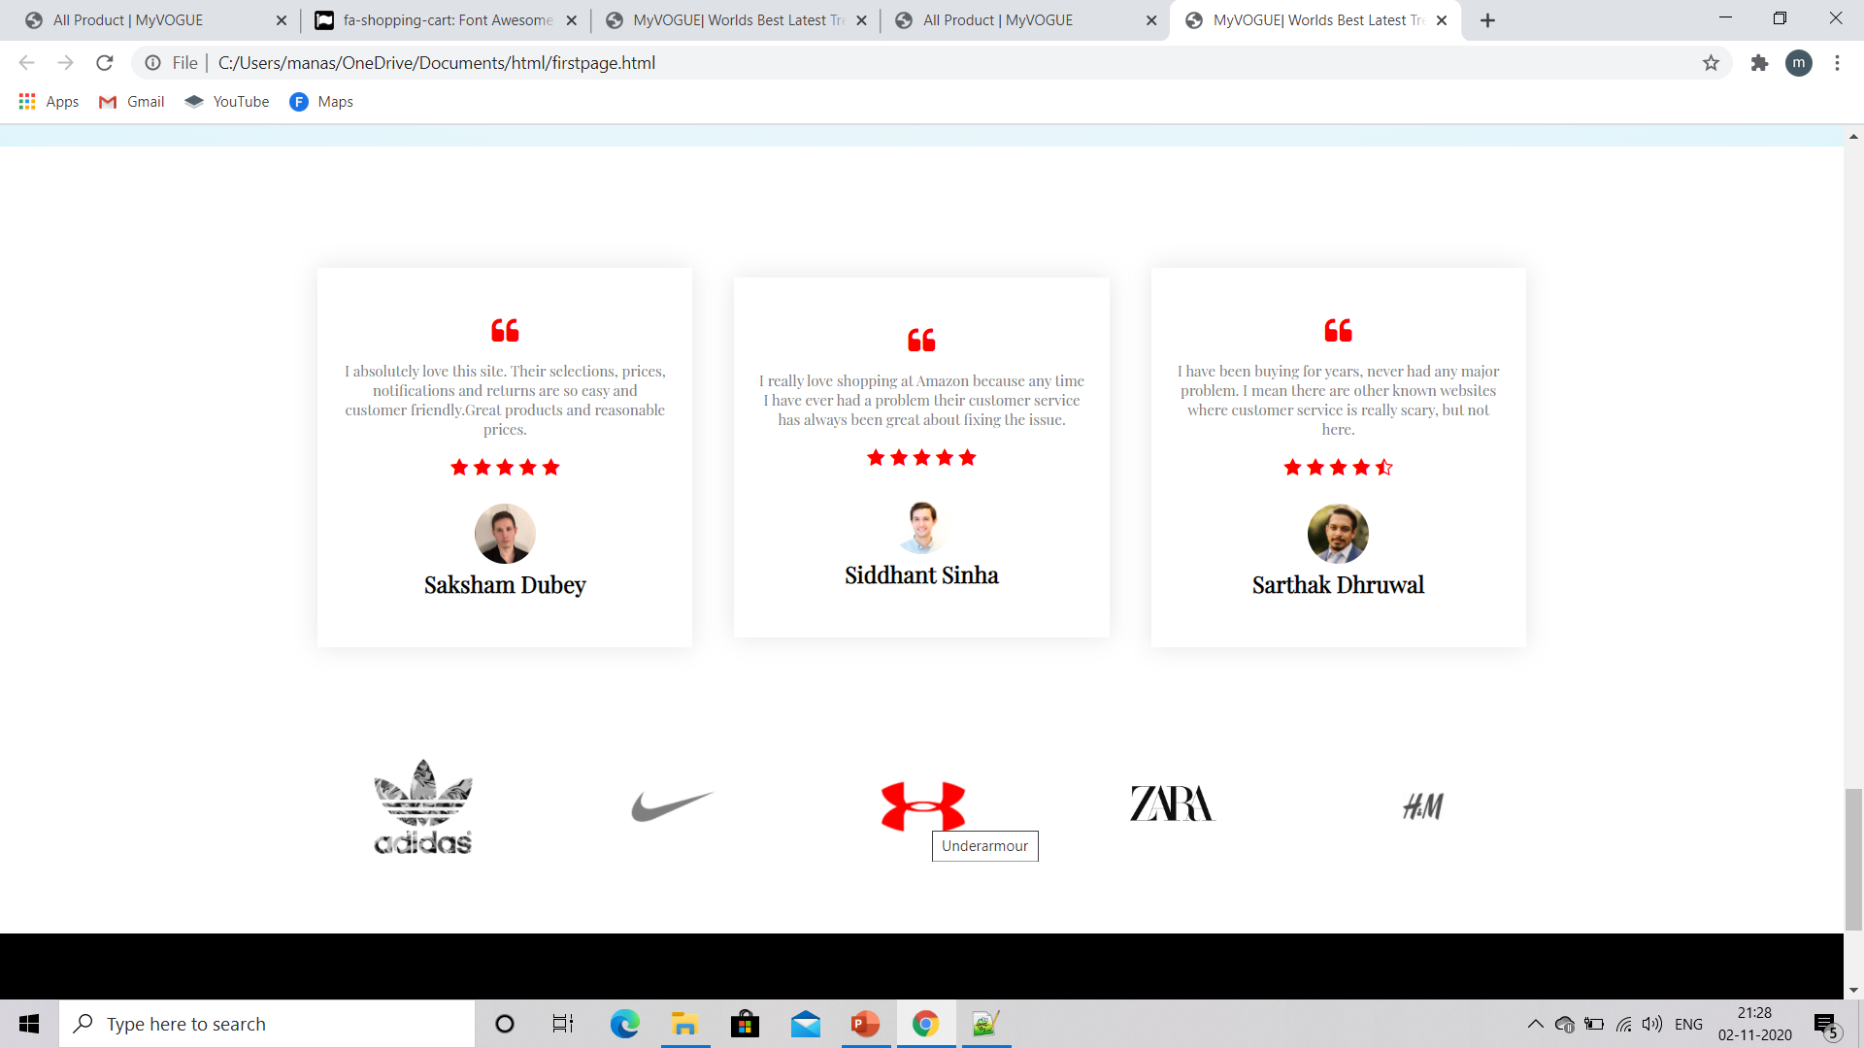
snapshots
Testimonials:

Slide 17
deliverables
Make account and login.
Choose the wearable.
Select the size and all other option.
Add to cart.
Give your details for future complaints and query.

Slide 18
stakeholders
This website targets mainly fashion enthusiasts.
It is helpful for the customers seeking decent products at reasonable price.
It is also helpful for small business organization who will buy product at cheaper price and make profit by selling them.
For every third product we will give some amount of money to NGOs working for environment as our one motive is also to contribute in saving greens.

Slide 19
conclusion
Html, Css, Js are very simple and practical programming language which we have used to make our website more aesthetic and pleasing.
Not everything ignored is insignifact, NOTEPAD++ proves the statement.

Slide 20
references
https://en.wikipedia.org/wiki/Myntra
https://www.w3schools.com/js/DEFAULT.asp
https://developer.mozilla.org/en-US/docs/Web/HTML
https://www.w3schools.com/css/

Slide 21
Thankyou

