Slide 1
HW 1 (Due :04/03)
Photometric Stereo

Slide 2
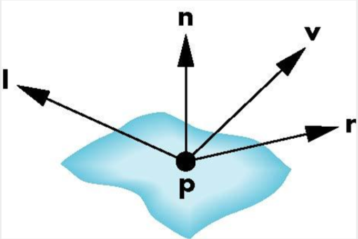
Phong reflection model
A simple model that can be computed or analyzed rapidly.
Has three components
Ambient
Diffuse
Specular
Uses four vectors
To source l
To viewer v
Normal n
Perfect reflector r

Slide 3

Ambient light
The result of multiple interactions between (large) light sources and the objects in the environment.
$I_{Ambient}=K_{a}∗I_{a}$

Slide 4
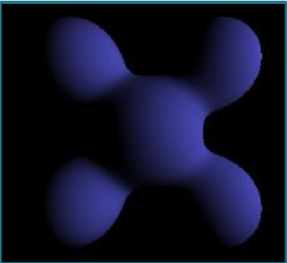
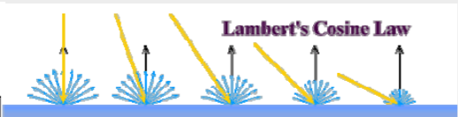
Diffuse light
Light scattered equally in all directions
Reflected intensities vary with the direction of the light
Lambertian Surface
Perfect diffuse reflector
$I_{Diffuse}=K_{d}∗I_{d}(nl)$

Slide 5

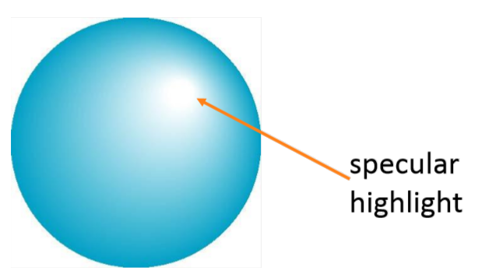
Modeling specular reflections
Phong proposed
$I_{r}\sim K_{s}I\cos^{a}Φ$
Shininess coef.
Reflected
intensity
Incoming intensity
Absorption coef.

Slide 6

Photometric stereo
Given multiple images of the same surface under different known lighting conditions, can we recover the surface shape?

Slide 7
Photometric stereo
Given multiple images of the same surface under different known lighting conditions, can we recover the surface shape?

Slide 8
Photometric stereo
Given multiple images of the same surface under different known lighting conditions, can we recover the surface shape?

Slide 9
Photometric stereo
Given multiple images of the same surface under different known lighting conditions, can we recover the surface shape?

Slide 10
Photometric stereo
Reminder: surface reflection is related to surface normal N and light source L (and view direction V in specular reflection)

Slide 11
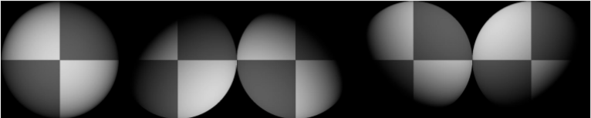
Photometric stereo
Using a local shading model
A set of point sources that are infinitely distant
A set of pictures of an object, obtained in exactly the same camera/object configuration but using different light sources
A Lambertian (diffuse) object for simplification
(or the specular component has been identified and removed)

Slide 12
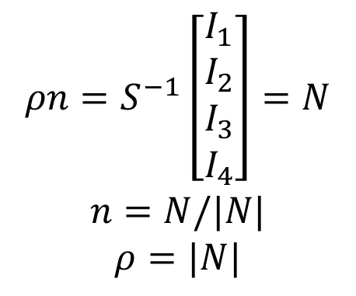


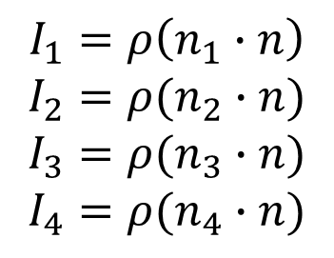


Lambertian Surfaces
對畫面中任一個點顏色值為$I_{i}$, $i=1 to 4$：
該點的法向量(unknown)：
光線方向(known)：
$$n=(n_{x},n_{y},n_{z})$$
$$s_{i}=(s_{x_{i}},s_{y_{i}},s_{z_{i}})$$
$$ρn=S^{−1}\left[\begin{aligned}\begin{matrix}I_{1} \\ I_{2} \\ I_{3}\end{matrix} \\ I_{4}\end{aligned}\right]=N$$
$$n=N/|N|$$
$$ρ=|N|$$
$$I_{1}=ρ\left(n_{1}∙n\right)$$
$$I_{2}=ρ(n_{2}∙n)$$
$$I_{3}=ρ(n_{3}∙n)$$
$$I_{4}=ρ(n_{4}∙n)$$
$\left[\begin{aligned}\begin{matrix}I_{1} \\ I_{2} \\ I_{3}\end{matrix} \\ I_{4}\end{aligned}\right]$=$ρ\left[\begin{aligned}\begin{matrix}s_{1}^{T} \\ s_{2}^{T} \\ s_{3}^{T}\end{matrix} \\ s_{4}^{T}\end{aligned}\right]n$
=
S

Slide 13
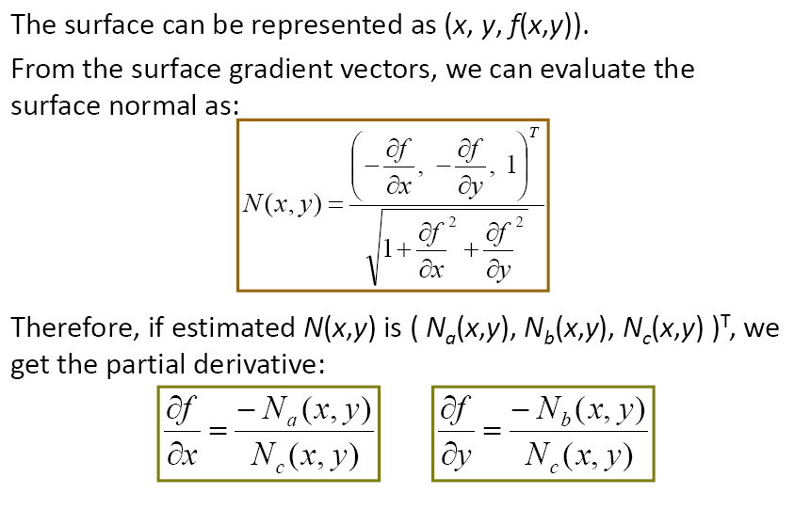
Recovering the surface

Slide 14
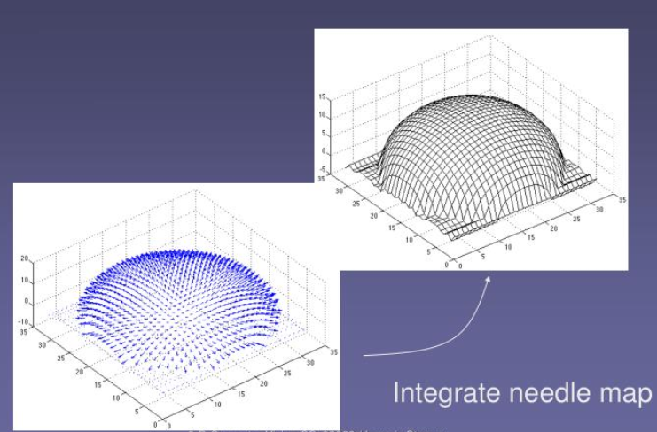
還原深度
Normal 可以視為兩點間的梯度，所以…
從任意位置開始(四角 or 中間)，根據梯度累加出平面
缺點：平面會歪、只考慮單一方向而非考慮整體的梯度關係
How to solve?

Slide 15
Algorithm₋₁
Obtain many images in a fixed view under different illuminants
Determine the matrix S from light source
Create arrays for albedo, normal (3 components),
p (measured value of ∂f/∂x) and
q (measured value of ∂f/∂y )

Slide 16
Algorithm₋₂
For each point in the image array
Stack image values into a vector i
Construct the weight matrix w
Solve wi = wSb to obtain b for this point
Albedo ρ at this point is |b|
Normal N at this point is b/|b|
p at this point is -N_{a}/N_{c}
q at this point is -N_{b}/N_{c}
End
Check: is (∂p/∂y − ∂q/∂x)² small everywhere?

Slide 17
Algorithm₋₃
top left corner of height map is zero
for each pixel in the left column of height map
height value=previous height value + corresponding q value
End
for each row
for each element of the row except for leftmost
height value = previous height value + corresponding p value
end
end

Slide 18
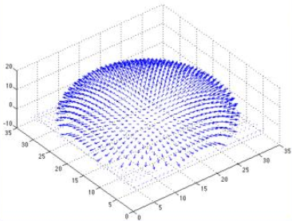
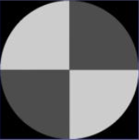
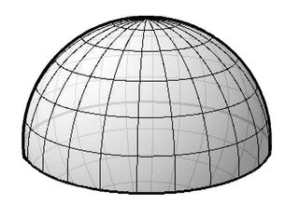
作業要求
根據範例測資計算出albedo、orientation... 70%
根據範例測資計算出三維表面(累加)… 20%
自己挑選一個模型拍攝並計算出其三維表面 10%
Bonus: 改良計算出來的三維表面Ex: 最佳化 20%
嚴禁抄襲

Slide 19
輸出
For each case (範例測資1、2 & 自己拍的測資):
Output orientation as a color map
Output albedo as a color map
Output depth file as a text file
依照row/colomn, 一個一個輸出每個點的深度值，中間用空白隔開，一行過後換行
Ex: 255 255 240 240 10 10
255 255 240 240 10 10
240 240 240 240 10 10
10 10 10 10 10 10
0 0 0 0 0 0
0 0 0 0 0 0

Slide 20
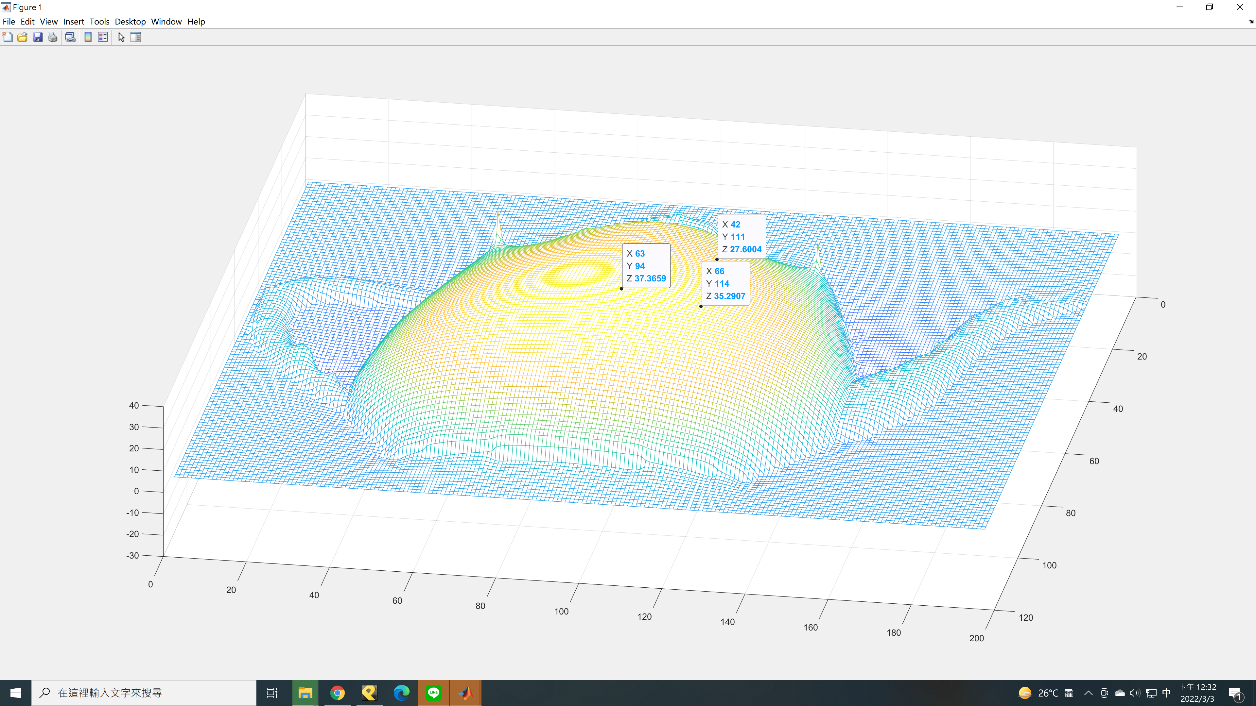

Slide 21
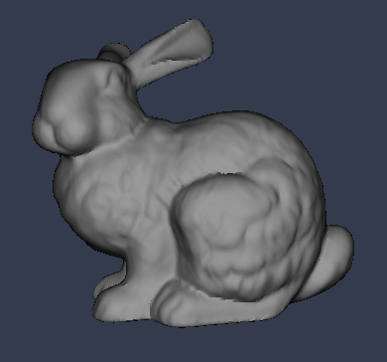
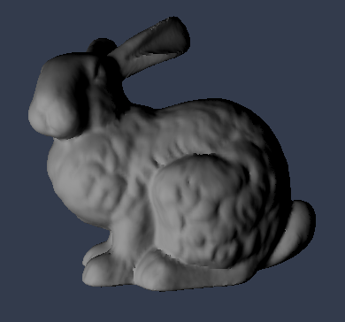
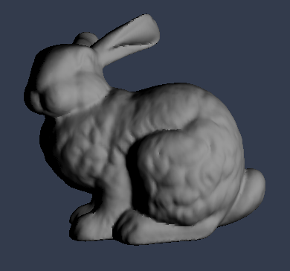
繳交方式
Deadline : 04/03(SUN) 23:59:59
請將
報告(包含code, 註解,心得 兩組測資分別的結果圖包含albedo, Nx, Ny, Nz, Normal的彩色圖)，
還原出來的深度值矩陣存成純文字檔(.txt)
壓縮後上傳至ilearn
要Demo
我來想想怎麼Demo…

