Slide 1
HW 2 (Due :04/24)
Stereo Depth Estimation

Slide 2
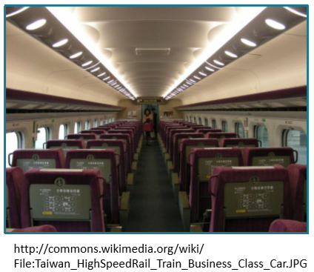
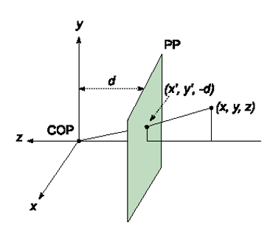
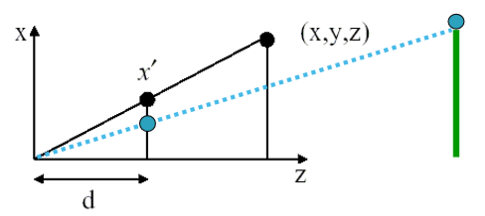
Recall: Prespective Projection

Slide 3


Depth images

Slide 4
A
Paste
B

Slide 5
A
Paste
B

Slide 6
A
Paste
B

Slide 7
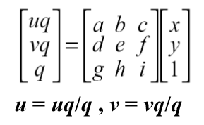
Why?
Image transform works on 2D image
Assume source/target are plane images
For depth images, the position of point projected onto image plane depending on it’s depth.
Recall:
反過來說，我們可以利用p點在左右影像中的視差回推深度值!

Slide 8
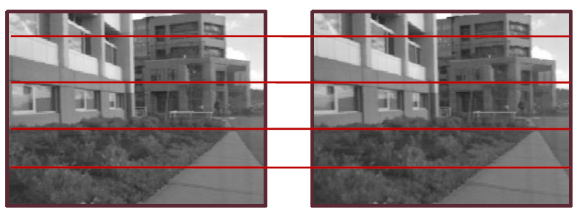
Simplest case: rectified images
Image planes of cameras are parallel.
Focal points are at same height.
Focal lengths are the same.
Then, epipolar lines fall along the horizontal scan lines of the images

Slide 9
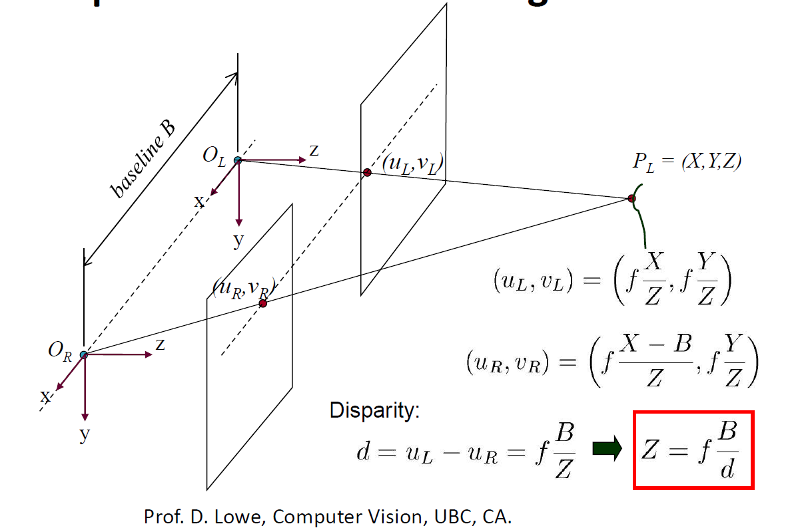
Simplest case: rectified images

Slide 10
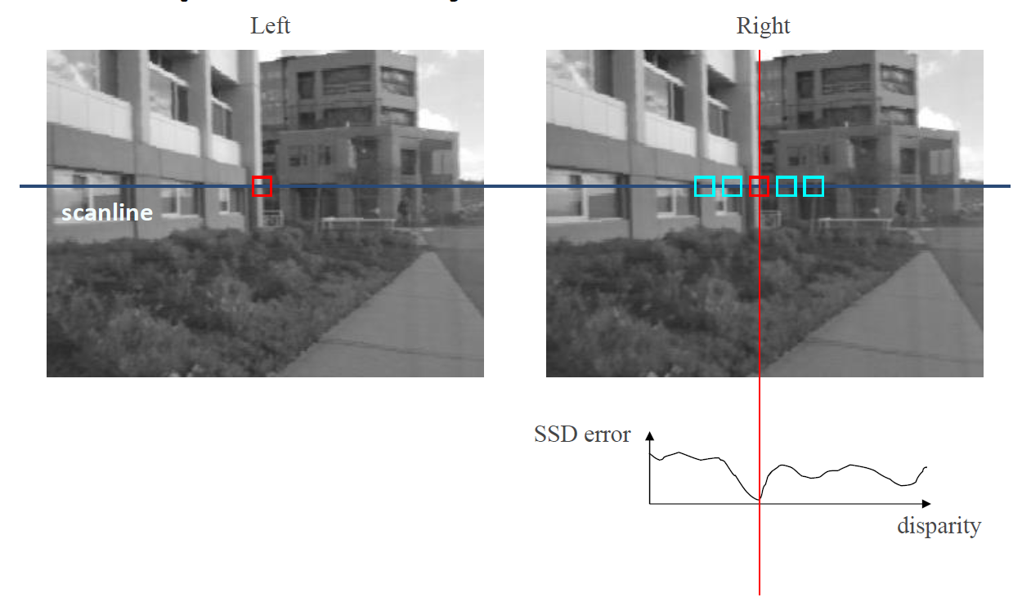
Correspondence by correlation

Slide 11
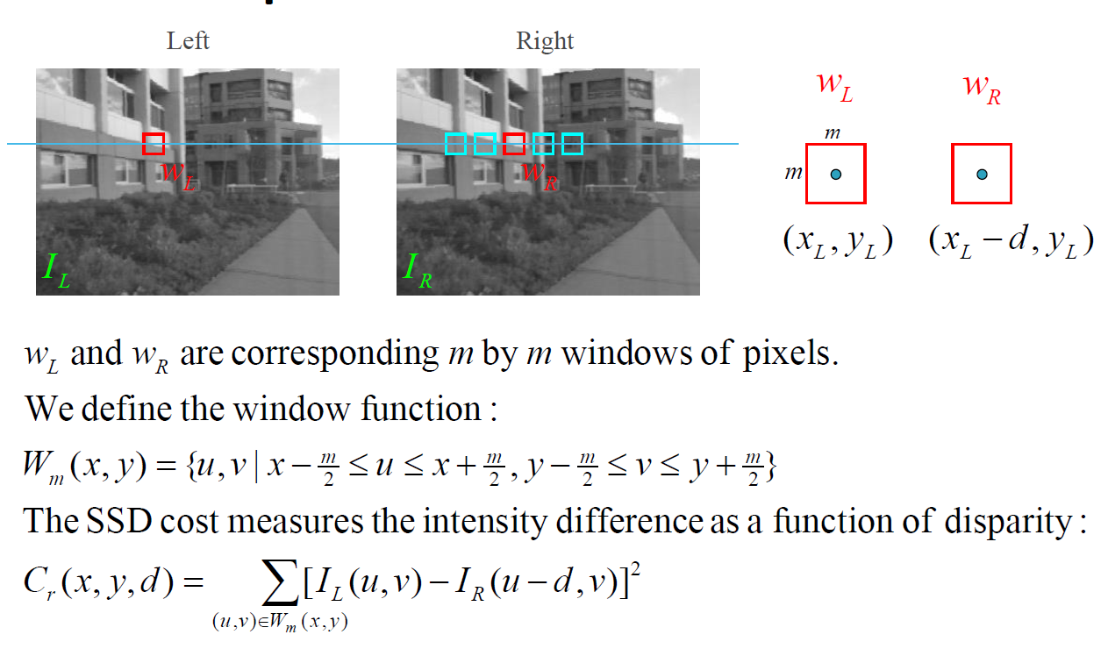
SUM of squared differences

Slide 12
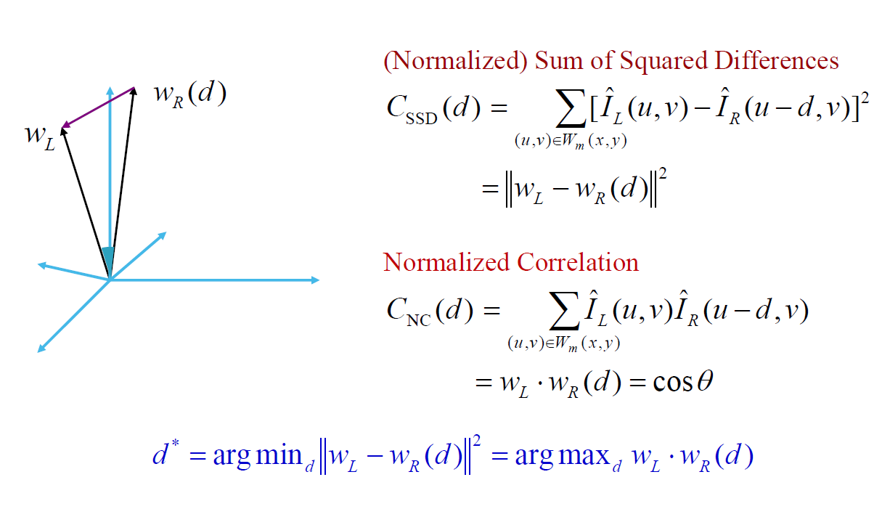
Image Metrics

Slide 13
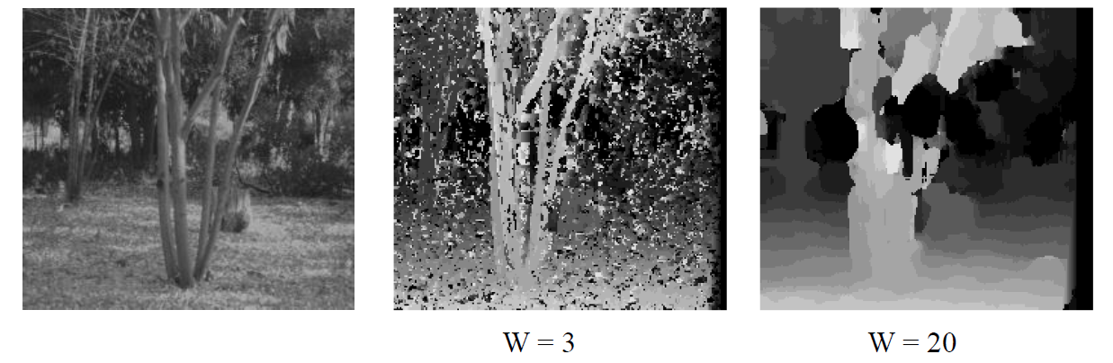
Window size
Effect of window size.
Some approaches have been developed to use an adaptive window size (try multiple sizes and select best match)

Slide 14
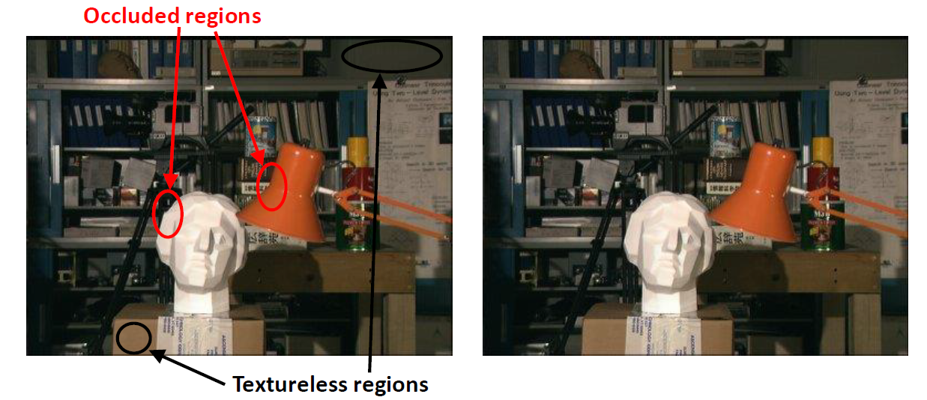
TWO MAJOR ROADBLOCKS
Textureless regions create ambiguities
Occlusions result in missing data

Slide 15
Dealing with ambiguities and occlusion
Ordering constraint:
Impose same matching order along scanlines.
Uniqueness constraint:
Each pixel in one image maps to unique pixel in other.
Can encode these constraints easily in dynamic programming.

Slide 16
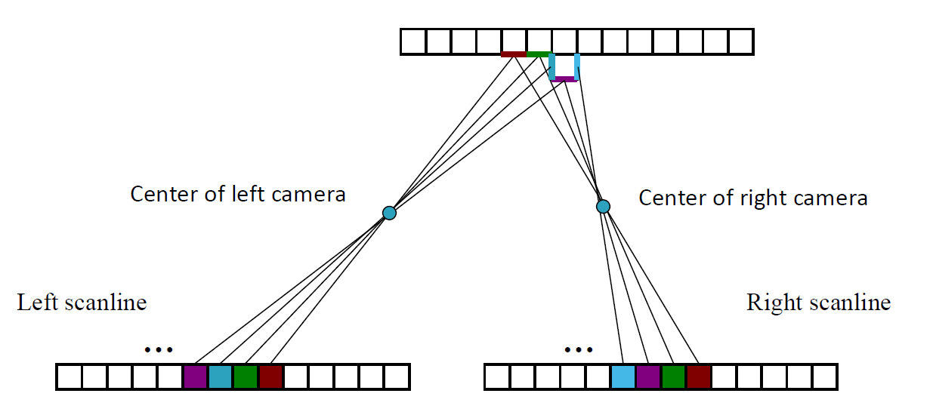
Pixel-based stereo

Slide 17
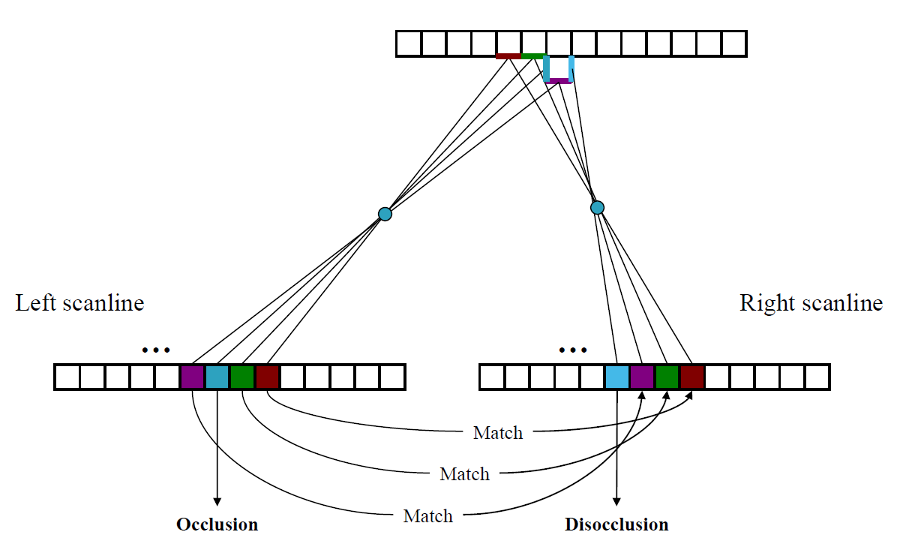
Stereo correspondences

Slide 18
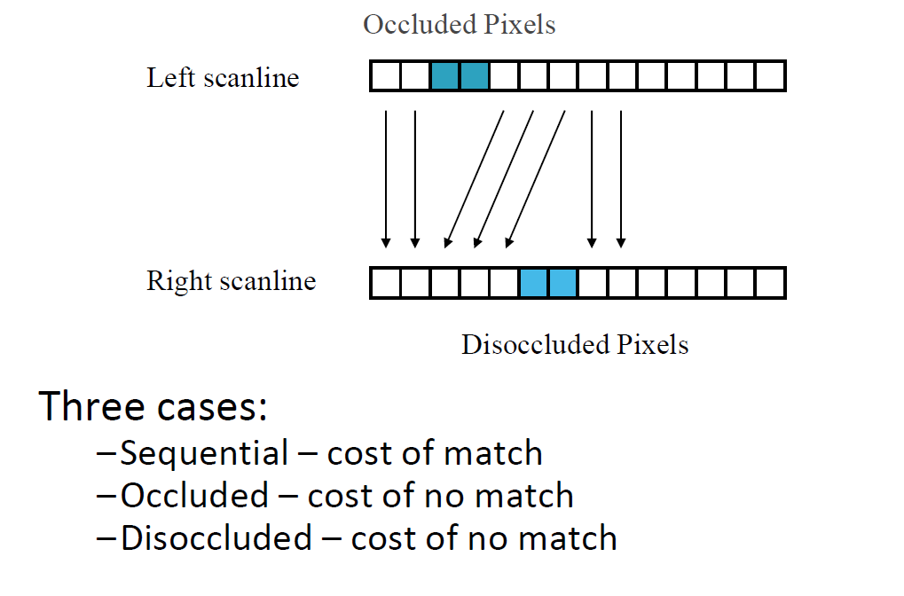
Search over correspondences

Slide 19
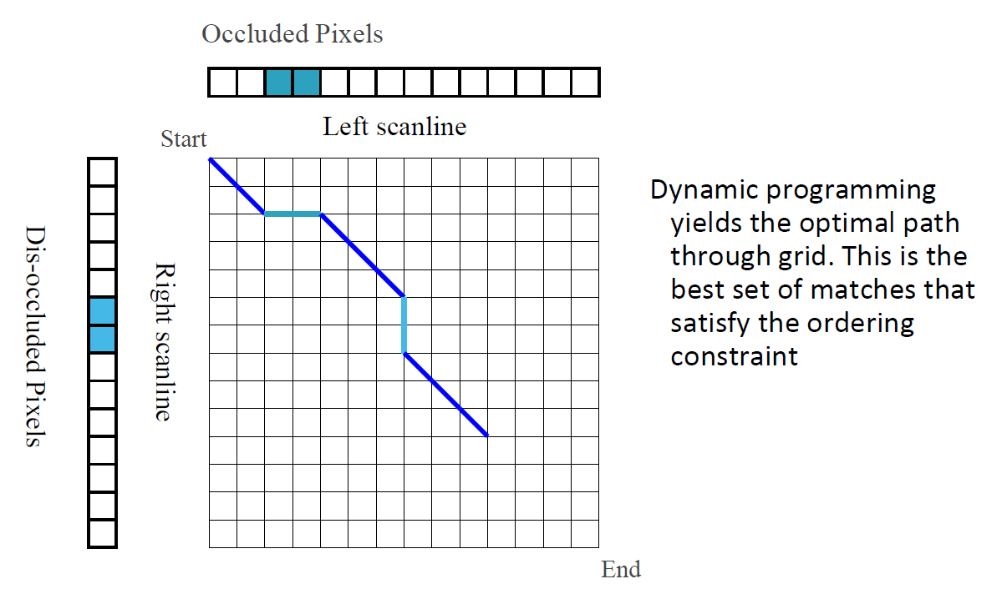
Matching with dynamic programming

Slide 20
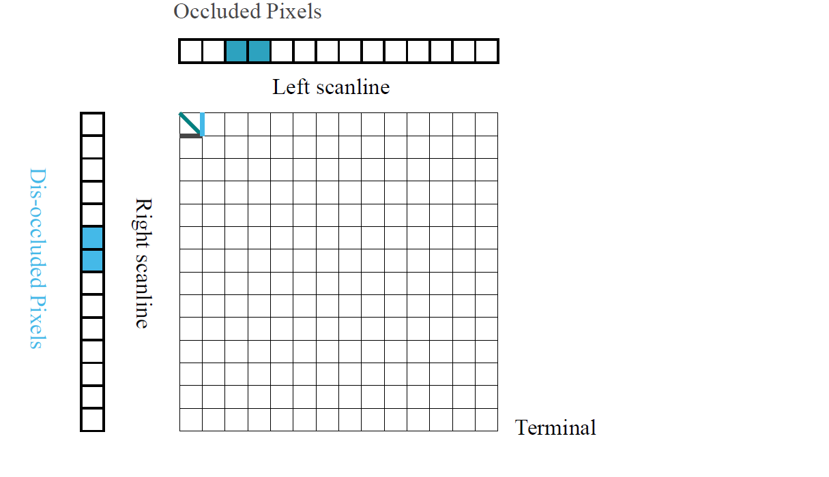
Matching with dynamic programming

Slide 21
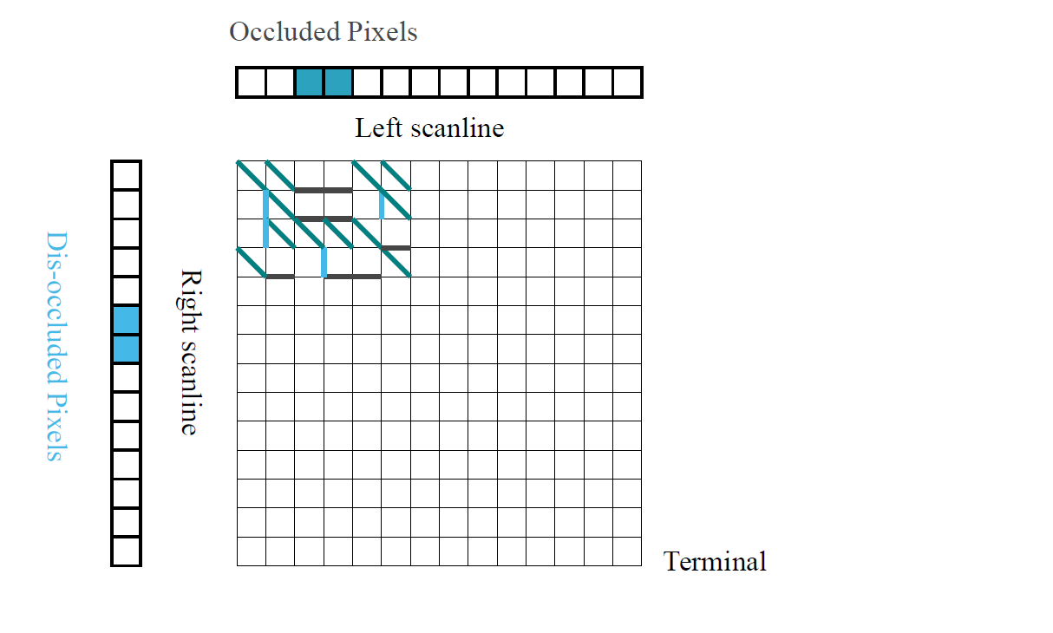
Matching with dynamic programming

Slide 22
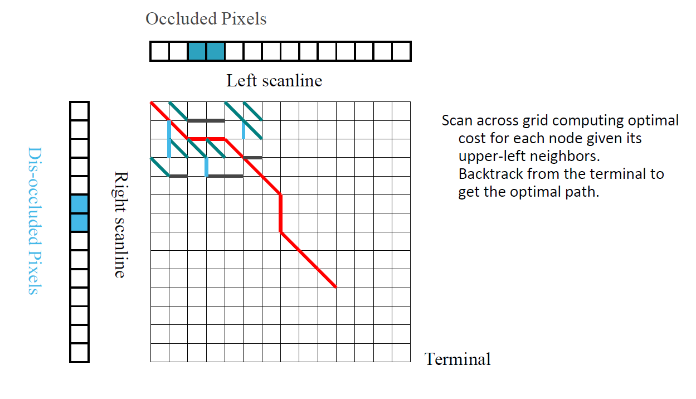
Matching with dynamic programming

Slide 23
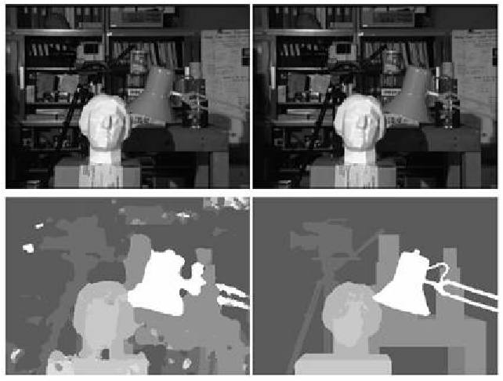
Results

Slide 24
Requirements
Due: 04/24(SUN) 23:59:59
輸入：Two stereo image pairs
https://vision.middlebury.edu/stereo/data/
輸出：depth map (像上次一樣的純文字檔讓我可以用matlab打開看深度)、disparity map
Bonus：拿自己拍攝的影像建立深度值
注意相機位置要平行放置
Well callibrated

Slide 25
評分標準
輸出Disparity Map 80%
輸出Depth Map 20%
自己拍攝影像並成工輸出Depth Map 20%

