Slide 1
AI-Driven Data Research in Quantitative Finance
SEC Item 1A risk disclosures -> semantic peer graphs -> ST-GAT forecasts
Final Year Project Review Submission
CHAN Ho Lam Myles | CHOI Man Hou | TSOI Ching Yi
IEDA4920 | HKUST | WorldQuant Consulting (Beijing) Co., Ltd.
01

Slide 2
The thesis: risk text is most useful when treated as topology
MOTIVATION
02
The project converts annual disclosures into a clean graph-learning experiment.
One empirical story
1
Risk disclosures define peers
Meso-level semantic peer graphs improve OOS forecasting relative to a strict identity baseline.
Item 1A paragraphs become macro/meso exposure vectors.
2
Peers define topology
Cosine similarity creates annual semantic risk graphs.
3
Topology is tested directly
A_t = I removes every off-diagonal peer edge.
Takeaway
The main contribution is not another text score; it is a leakage-safe topology test.

Slide 3
The problem is alignment: text, time, graph, and target must agree
MOTIVATION
03
A finance project fails if the data panel is elegant but mistimed.
Item 1A text
Risk taxonomy
Firm-year vectors
Peer graph
Forward targets
1
Availability
Use only information observable before the target window.
2
Comparability
Keep train, validation, and OOS periods chronological.
3
Ablation clarity
Hold financial features fixed and change only graph topology.
Takeaway
The experiment is designed around timing discipline before model complexity.

Slide 4
Three questions organize the report and presentation
MOTIVATION
04
Each question has a direct artifact and a direct validation test.
RQ1
Can Item 1A text be mapped into stable macro-meso risk vectors?
taxonomy and exposure matrices
RQ2
Does semantic risk topology improve return and volatility forecasts?
full graph vs. identity baseline
RQ3
Do forecasts carry economically meaningful ranking information?
monthly quintile backtest
Takeaway
The deck follows the same chain: construct the panel, test the topology, then test ranking value.

Slide 5
The workflow is one pipeline, not disconnected experiments
METHOD
05
Every downstream result inherits timing and taxonomy choices from the text pipeline.
Extract
Structure
Score
Connect
Forecast
Validate
SEC Item 1A risk paragraphs
dynamic macro/ meso taxonomy
firm-year exposure vectors
semantic peer risk graph
topology-only ST-GAT
econometrics + portfolio tests
1
2
3
4
5
6
Core design choice
Risk similarity defines edges; the GAT learns attention weights from topology and financial node features.
Takeaway
The report's result tables are interpretable because each stage has an explicit input and output.

Slide 6
The data pipeline combines disclosures, market data, and validation artifacts
DATA PIPELINE
06
Section 3 of the report is the bridge from raw filings to the ST-GAT panel.
SEC EDGAR
Daily market data
10-K filing histories and Item 1A Risk Factors text
adjusted prices, volume, benchmark prices, and SPY returns
Macro proxies
Output artifacts
S&P 500, VIX, and 10-year Treasury yield features
forecast, portfolio, DAV, FMB, and network validation files
Canonical artifact
Role
all_risk_factors_master.csv
paragraph-level Item 1A corpus
risk_scores_macro/meso_annual.csv
firm-year textual risk exposures
fin_data_matrix_enhanced.csv
financial features and forward targets
Takeaway
The data story starts with source traceability before moving to modeling results.

Slide 7
SEC Item 1A extraction turns raw 10-K HTML into paragraph-level risk text
DATA PIPELINE
07
The report describes a four-stage extraction process before any LLM scoring is applied.
Stage 1
Stage 2
Stage 3
Stage 4
Acquire
Isolate
Structure
Export
download 10-K HTML from EDGAR
extract Item 1A Risk Factors
separate headings and descriptions
write company CSVs and master corpus
Boundary detection removes table-of-contents references and stops at the next filing item.
Formatting heuristics identify risk headings, subheadings, and paragraph descriptions.
The master CSV is the auditable text corpus used by taxonomy and classification scripts.
Takeaway
The NLP model never sees an arbitrary full 10-K; it sees a cleaned Item 1A corpus.

Slide 8
Risk scoring converts paragraph labels into normalized firm-year exposures
DATA PIPELINE
08
This is the quantitative representation consumed by the graph construction step.
Paragraph corpus
Taxonomy classifier
Firm-year aggregation
Exposure vector
Company, year, heading, paragraph text
macro and meso risk labels
category counts per firm-year
positive rows sum to one
20
105
2,387
macro exposure columns
meso exposure columns
risk-score firm-year rows
Takeaway
The graph is built from normalized risk exposure vectors, not raw legal text.

Slide 9
Financial features and forward targets share the same July-to-June clock
DATA PIPELINE
09
This alignment is the main timing safeguard in the supervised forecasting problem.
Feature family
Implemented fields
Firm-specific
Vol, Downside_Vol, MA_200_Ratio, Momentum_11M, Dollar_Volume, Log_Dollar_Volume
Market/macro
SP500_Ret, SP500_Vol, VIX_Avg, VIX_Change, TenY_Yield_Avg, TenY_Yield_Change
Targets
Target_Ret and Target_Vol over the next July-to-June window
features + graph
July t -> June t+1
forward target
July t+1 -> June t+2
Takeaway
The target is strictly forward-looking: risk year t predicts the following July-to-June return and volatility.

Slide 10
Sample construction is timed around annual disclosure availability
DATA PIPELINE
10
The forecasting panel uses a July-to-June alignment for realized outcomes.
2,387
485
2,367
risk-score firm-years
tickers in risk matrices
financial feature/target rows
Train
2006-2016
Validation
2017-2020
OOS review
2021-2024
Standardization and imputation use training-year statistics.
Model selection uses validation years only.
Review-submission OOS results use the current exported 2021-2024 panel.
Takeaway
The key anti-leakage controls are chronological splits, train-only transforms, and forward targets.

Slide 11
Macro explains broad exposure; meso gives the graph usable resolution
METHOD
11
The strongest forecasting evidence comes from the granular meso topology.
Macro layer
Meso layer
Firm-year vector
broad risk families
specific vulnerabilities
normalized exposure weights
Layer
Role
Forecast implication
Macro
Interpretability
dense graph, broad similarities
Meso
Discrimination
sparse graph, cleaner peer links
Takeaway
The meso layer is not cosmetic; it changes the graph density and signal-to-noise tradeoff.

Slide 12
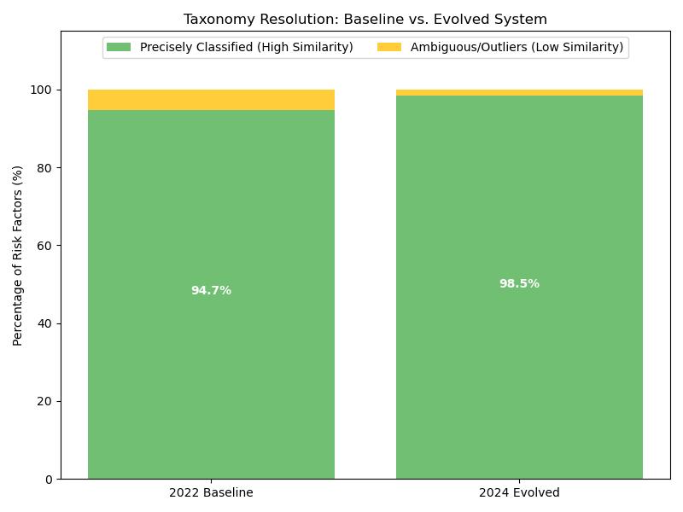
Taxonomy evolution is kept as a method claim, not a headline result
METHOD
12
Coverage percentages are deferred until their source table and rerun script are regenerated.
1
Detect deviations
Embed new paragraphs and compare them with existing meso centroids.
2
Cluster emerging themes
Group low-similarity paragraphs into candidate risk concepts.
3
Update taxonomy
Use ADD, MERGE, or REORGANIZE decisions before rescoring.
Takeaway
The final review report separates the evolution mechanism from unsupported percentage claims.

Slide 13
Risk exposure vectors become annual semantic peer networks
METHOD
13
The graph is binary and topology-only: edges define peer availability, not edge weights.
cosine similarity between firms
threshold by year and layer
A_t = I + A_risk,t
R_i,t
firm-year risk vector
Self-loops are always included.
Off-diagonal edges are generated only from risk exposure similarity.
Identity baseline keeps only self-loops and removes textual peer information.
Takeaway
The graph tests whether disclosure-implied peers help after own-firm features are already present.

Slide 14
Topology-only ST-GAT learns from peer structure and temporal history
METHOD
14
Spatial attention is applied over annual risk-peer graphs, then forecasted through time.
X_t
A_t
H_t
H_1:T
y_hat
financial node features
risk graph snapshot
GATConv spatial encoder
temporal forecaster
return + vol heads
Design element
Purpose
Masked multi-task Huber loss
joint return and volatility training
Chronological graph snapshots
no random cross-sectional split
Validation-only Optuna tuning
model selection before OOS review period
Takeaway
The model is advanced, but the experiment remains interpretable because the ablation is simple.

Slide 15
The identity baseline is the cleanest spatial ablation
EXPERIMENT
15
Only off-diagonal peer edges change between the full graph and the baseline.
Full graph
Identity
1
Same feature panel
The comparison does not swap in a different feature set.
A_t = I + A_risk,t
A_t = I
2
Same model family
The comparison does not rely on a weaker baseline architecture.
remove off-diagonal edges
3
Different topology
Forecast gains can be attributed to semantic peer links.
risk-peer edges active
self-loops only
Takeaway
This baseline makes the central topology claim defensible.

Slide 16
The model-selection path stops before OOS evaluation
EXPERIMENT
16
Hyperparameters are chosen on validation years, then evaluated on the review panel.
Stage
Years
What happens
Train
2006-2016
fit model, scaling, imputation statistics
Validation
2017-2020
Optuna selection and early stopping signal
OOS review
2021-2024
reported forecast and portfolio diagnostics
No random split is used for the main reported forecasting experiment.
Forward return and volatility targets are constructed after the feature year.
Portfolio formation uses model signals before realized holding-period returns.
Takeaway
The review-submission results are OOS relative to the tuning period.

Slide 17
Macro and meso graphs test a resolution tradeoff
EXPERIMENT
17
Broad categories increase coverage; granular categories reduce noisy peer links.
Macro graph
Meso graph
3,900-4,460 OOS edges/year about 5.1%-5.5% density
38-118 OOS edges/year below 0.14% active-node density
Broad similarity
Specific similarity
high connectivity, weaker discrimination
sparse connectivity, cleaner peer selection
Takeaway
The meso graph is sparse enough that improvements are not just dense smoothing.

Slide 18
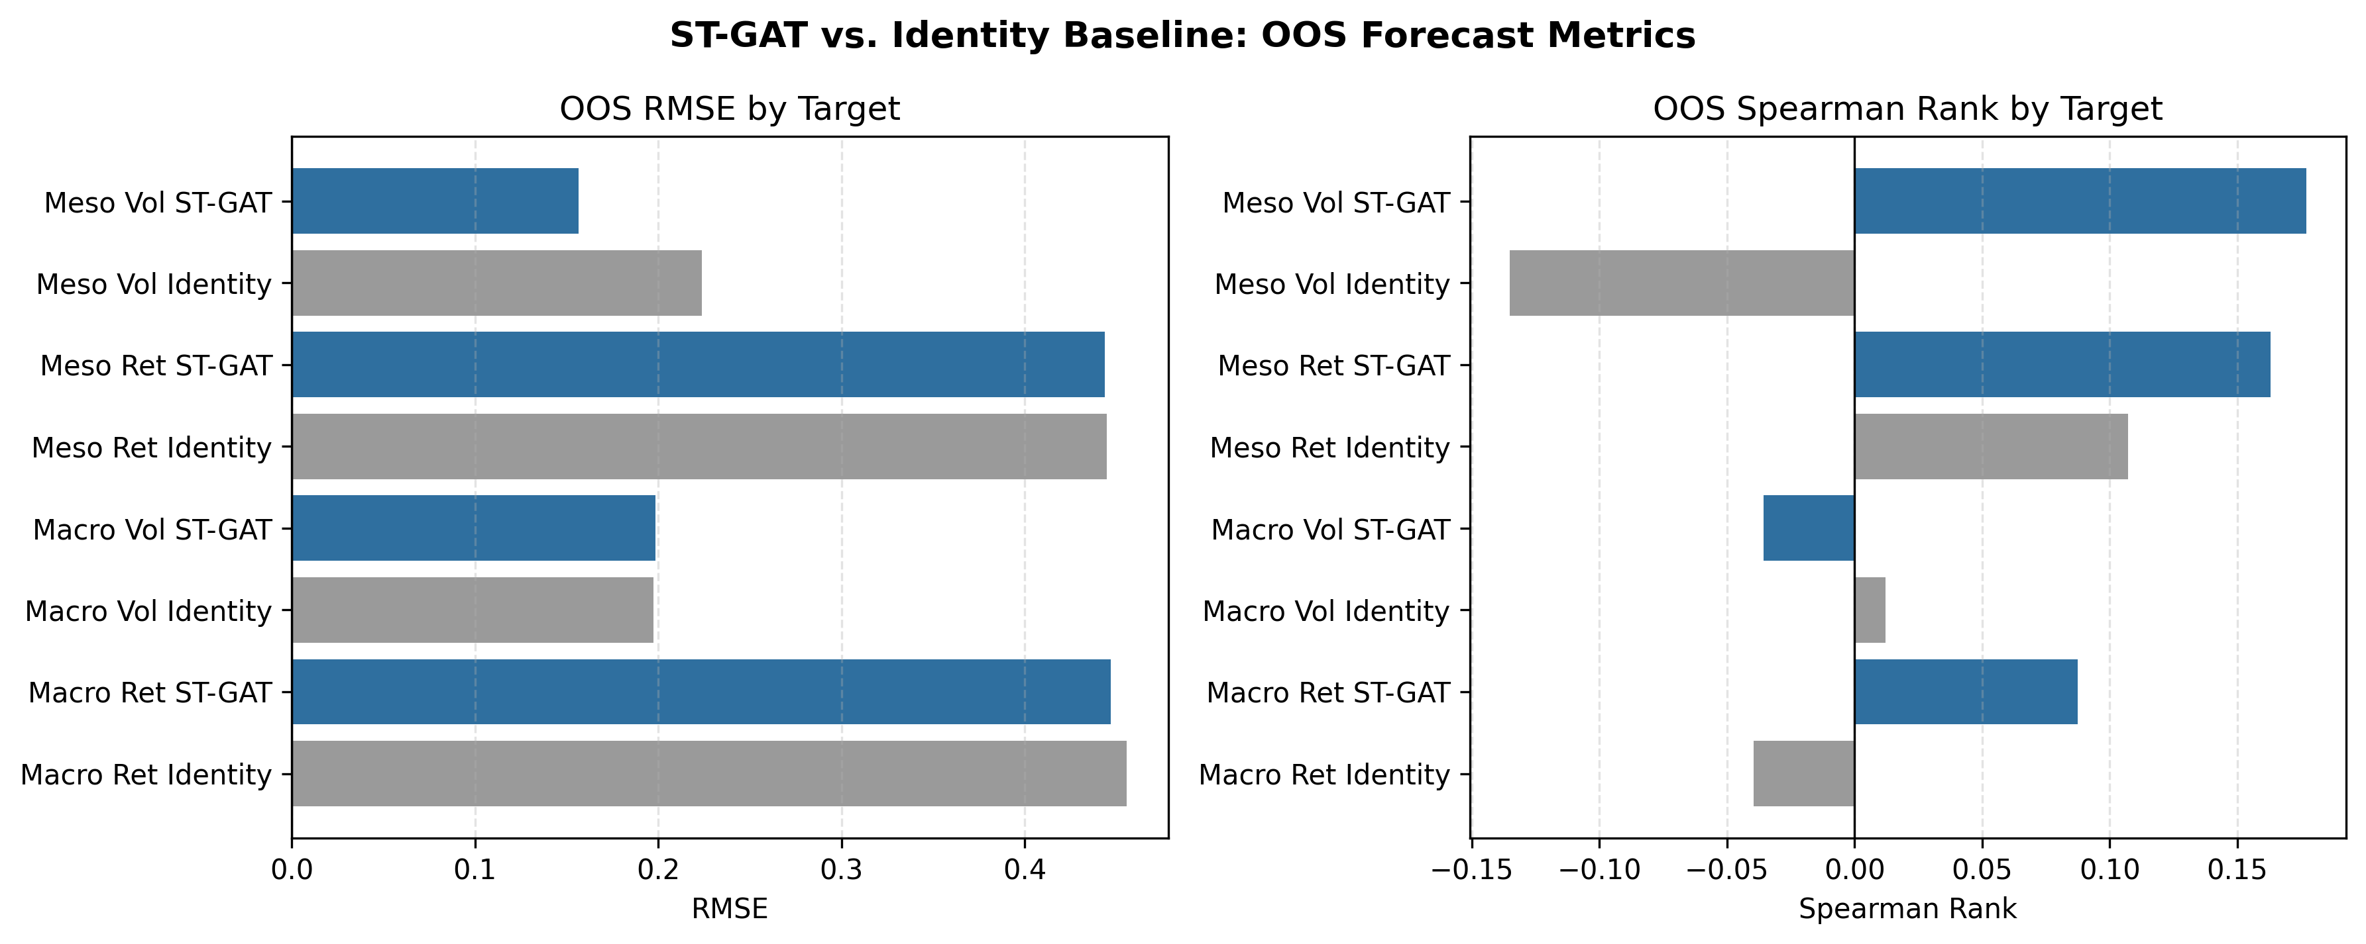
Meso ST-GAT improves the core OOS forecasting metrics
RESULTS
18
The strongest verified model specification is the meso full graph.
0.3345 -> 0.3001
averaged RMSE
0.2314 -> 0.1991
averaged MAE
-0.0139 -> 0.1701
averaged Spearman
Takeaway
The headline result is a verified OOS comparison against the identity baseline.

Slide 19
The clearest forecasting gain is in volatility
RESULTS
19
Risk disclosures naturally align with realized risk outcomes more than point-return forecasts.
0.2240 -> 0.1565
Interpretation
Evidence strength
volatility RMSE, identity to meso ST-GAT
Volatility forecast
strongest verified improvement
-0.1351 -> 0.1770
Return forecast
ranking signal is suggestive but noisier
volatility Spearman rank correlation
Portfolio evidence
economic extension, not trading claim
topology-only
edge information enters as peer structure
Takeaway
The report should emphasize risk forecasting and ranking separability, not causal trading language.

Slide 20
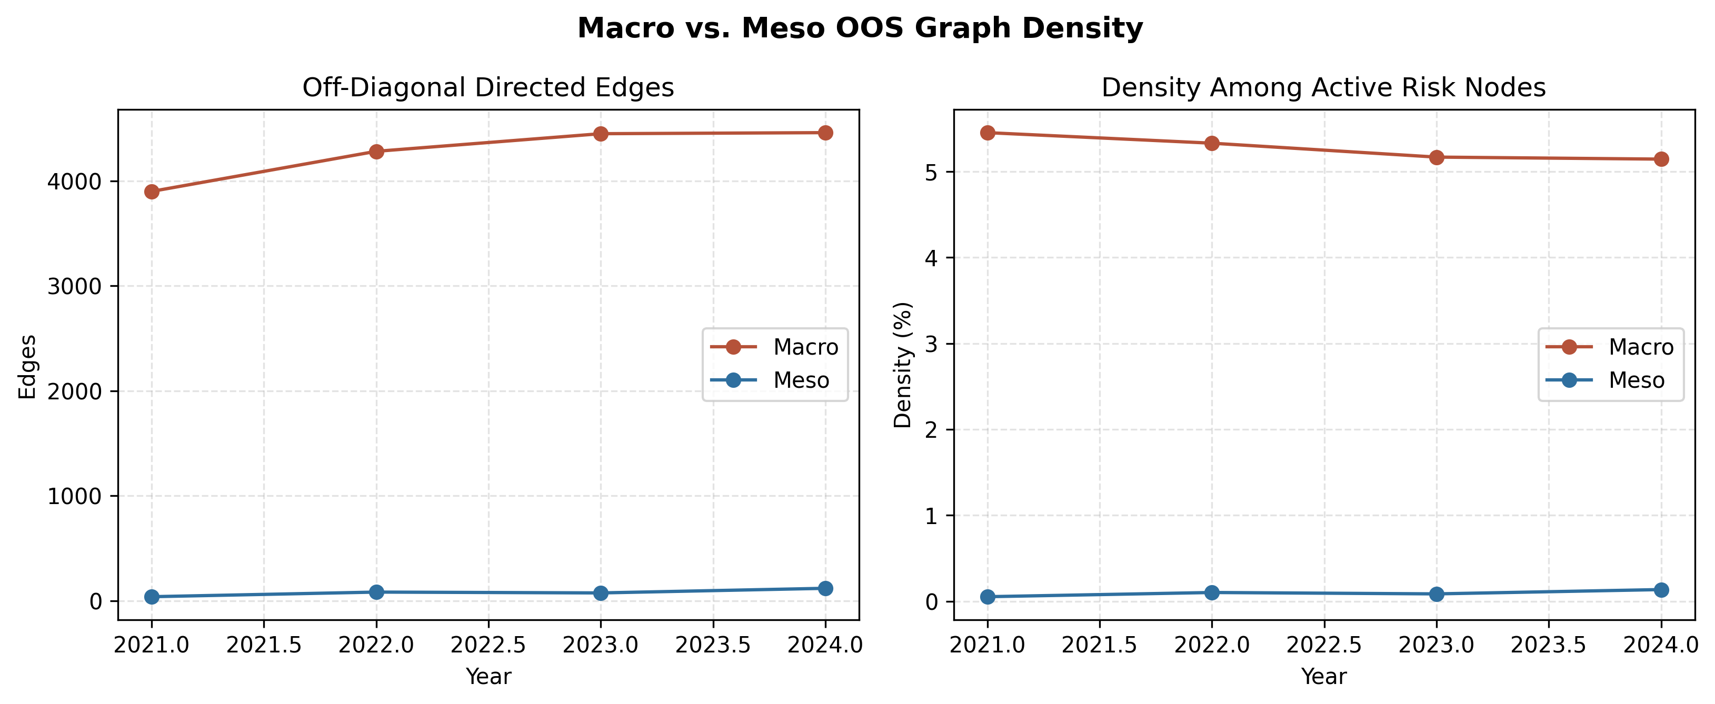
Graph density explains why meso topology is more informative
RESULTS
20
Sparse meso links concentrate attention on high-confidence textual peers.
1
Macro
Dense enough to blur many broad risk-family similarities.
2
Meso
Sparse enough to behave like a peer-selection mechanism.
3
Forecast impact
Resolution improves the quality of the graph, not only its size.
Takeaway
The graph-density diagnostic supports the report's macro-versus-meso interpretation.

Slide 21
Portfolio tests translate annual forecasts into monthly ranking diagnostics
PORTFOLIO
21
This is an academic validation layer, not a live-trading recommendation.
Annual ST-GAT forecast
Score firms
Form quintiles
Rebalance monthly
forward return and volatility
return-only, return-over-vol, composite
top, bottom, and long-short
10 bps cost + 5 bps slippage
Signal timing follows the annual forecast and realized holding-period month.
Top-minus-bottom spreads diagnose cross-sectional ranking value.
Transaction costs are included before final performance metrics.
Takeaway
The backtest is useful because it checks whether forecast rankings survive portfolio formation.

Slide 22
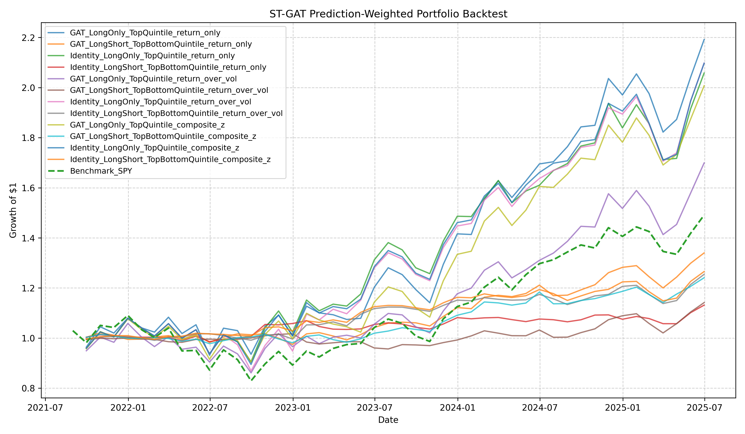
The best ST-GAT ranking portfolio is economically suggestive
PORTFOLIO
22
Performance is reported as validation evidence, with short-sample caveats.
GAT LongShort TopBottomQuintile return only
best strategy
7.93%
annualized return
1.06
Sharpe ratio
-6.90%
max drawdown
Takeaway
Portfolio evidence supports ranking value but is not presented as deployable alpha.

Slide 23
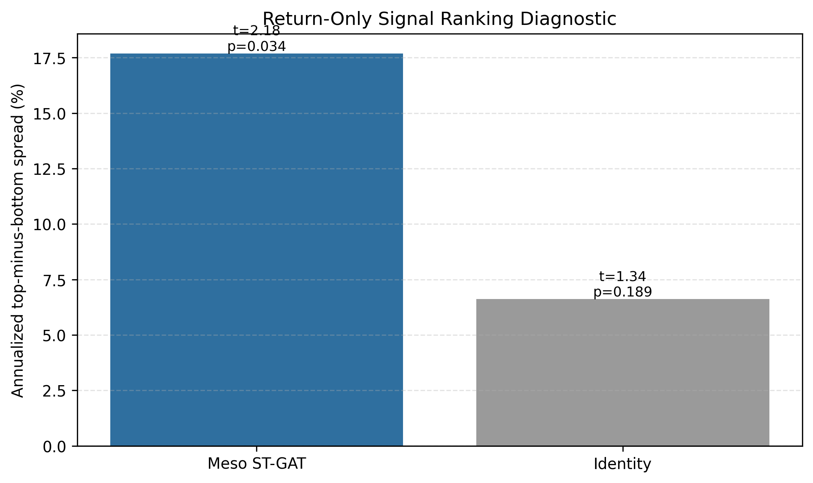
Top-minus-bottom spreads test whether the ranking separates winners from losers
PORTFOLIO
23
The return-only ST-GAT signal has the strongest spread result in the current outputs.
17.69%
annualized top-minus-bottom
2.18 / 0.034
simple t-stat / p-value
2.54 / 0.049
HAC t-stat / q-value
Interpretation remains conservative: short sample, multiple comparisons, and academic backtest design.
Takeaway
The spread test is a useful economic diagnostic, not proof of live-trading profitability.

Slide 24
Econometric appendices are treated conservatively
VALIDATION
24
New DAV peak files add useful diagnostics but do not overturn the main ST-GAT evidence.
93
1
Use as a diagnostic
DAV peak figures parsed
DAV peak outputs describe a robustness experiment.
20 / 73
2
Avoid headline overclaiming
The distribution is mixed and should not be framed as broad outperformance.
positive / negative peak improvements
-2.40%
3
Keep appendix language precise
FMB, SAR, and DAV BIC tables remain deferred when source tables are missing.
mean peak-improvement diagnostic
Takeaway
The report now separates verified main results from appendix material needing complete regeneration.

Slide 25
The final findings are narrower and stronger
VALIDATION
25
The presentation foregrounds claims supported by current outputs.
1
Meso ST-GAT is the strongest verified forecasting specification.
2
Granular risk topology creates sparse, high-confidence semantic peer links.
3
The identity baseline makes the spatial ablation clean.
4
Volatility forecasting evidence is stronger than return point forecasting.
5
Portfolio results are economically suggestive but interpreted as academic validation.
Takeaway
The strongest story is precise, reproducible, and modest about inference.

Slide 26
Limitations are explicit rather than hidden in appendix claims
VALIDATION
26
Unsupported numerical claims are framed as future validation work.
Area
Current treatment
Taxonomy coverage percentages
deferred until source table and rerun script are present
AAPL migration case study
future case-study artifact
Fama-MacBeth and SAR tables
methodology extensions unless regenerated
DAV BIC benchmark
deferred; DAV peak diagnostics are mixed
Portfolio evidence
academic ranking validation, not investment advice
Takeaway
This slide is intentionally reviewer-facing: it shows research integrity, not weakness.

Slide 27
Q&A
Discussion: taxonomy design, identity ablation, OOS evidence, and portfolio interpretation
AI-Driven Data Research in Quantitative Finance
28

