Slide 1

Mini Project Proposal Presentation Thyristor Firing Angle Control for Battery Charger Presented by Ishant Gadhave(Roll No.TE23209) Soham Joshi(Roll No. TE23211) Reshma Nawale(Roll No. TE23215) Guided by
Dr. Varsha Degaonkar Prof. Ashwini Kulkarni
Dept. of Electronics and Telecommunication
Hope Foundation’s
International Institute of Information Technology Hinjawadi Pune

Slide 2
Outline
Introduction
Literature survey
Gap Identification
Problem statement and Objectives
Proposed Methodology
Requirement analysis
Simulation
Conclusion
Future Scopes
References

Slide 3
Introduction
Thyristor firing angle control is a widely employed technique in power electronics for regulating the power delivered to loads, notably in battery charging applications.
In this method, the conduction angle of thyristors is adjusted, enabling control over the timing of current flow in each cycle of the alternating current waveform.
Integrating thyristor firing angle control into battery charging systems enhances overall efficiency and enables automated control, facilitating seamless operation and maintenance of charging infrastructure.
As power electronics continue to evolve, thyristor firing angle control remains a cornerstone in the realm of battery charging, playing a crucial role in advancing the efficiency and sustainability of modern energy systems.

Slide 4
Literature survey
Sr.No. | Paper Name | Published by | Highlights
1. | Initial firing angle control of 12-pulse parallel connected thyristor dual converter for urban railway power substations | Sung-An Kim (Department of Electrical Engineering), Gab-Jin Han (R&D Center, Busan Transportation Corporation, Busan, Korea), Sung-Wo Han (Department of Electrical Engineering, Dong-A University, Busan, Korea), Yun-Hyun Cho (Department of Electrical Engineering, Dong-A University, Busan, Korea), ICTC 2020, IEEE 2020. | This paper proposes an initial firing angle control algorithm according to the energy consumption and regenerative energy.
2. | Analysis, Design, and Implementation of a Single-Stage Multipulse Flexible-Topology Thyristor Rectifier for Battery Charging in Electric Vehicles | Damin Zhang and Huipin Lin (School of Electrical Engineering and Automation, Xiamen University of Technology, Xiamen, FJ, China), Zhengyu Lu (College of Electrical Engineering, Zhejiang jiang University, Hangzhou, ZJ, China) Volume 2017, Article ID 9742170, 16 pages. | This paper proposes which can be a suitable candidate for high-power fast-charging battery charger for the Evs.
3. | Industrial Battery Charger by Thyristor Firing Angle Control | Kang Eun Jeon, James She, Perm Soonsawad, and Pai Chet Ng, IEEE INTERNET OF THINGS JOURNAL, VOL. A, NO. B, MONTH 2018. | This abstract outlines a research project focused on developing a thyristor-based battery charger.
4. | Fast current control for thyristor rectifiers | M. Nedeljković, Z. Stojiljković, IEE Proceedings - Electric Power Applications, Volume 150, Issue 6, 2003 , p. 636 – 638 | Method of current control for thyristor rectifiers
5. | Thyristor-based Rechargeable Battery Charger | Protik Parvez Sheikh,Bezon Dey Tushar (1) , Sadman Shahriar Alam , Abu Shufian, Istiaq Mahmood Ruddra Journal of Engineering Research and Reports, 2024, 26 (3), pp.104-112. | Design an automatic battery charger using Silicon-Controlled Rectifier (SCR)

Slide 5
Sr.No. | Paper Name | Published by | Highlights
6. | Initial Firing Angle Control of Parallel Multi-Pulse Thyristor Dual Converter for Urban Railway Power Substations | Kim, Sung-An(Dept. of Electrical and Electronic Engineering, Dong-A University), Han Sung-Wo(R&D Center of Busan Transportation Corporation), Cho, Yun-Hyun (Dept. of Electrical Engineering, Dong-A University) | This paper presents an optimal initial firing angle control based on the energy consumption and regenerative energy of a parallel multi-pulse thyristor dual converter
7. | Battery chargers for electric vehicles | M.M. Morcos Kansas State University, Manhattan, KS, US N.G. Dillman, C.R. Mersman Method and apparatus for charging batteries, 1990. | This article presents a comparative study of the performance of two types of battery chargers being developed for electric vehicles.
8. | Firing Angle Control of Thyristor Converter using PID Controller with Parallel Data Loop | Lee, Jae-Sung, Jang, Jin-Seok, Choo, Young-Bae, Lee Dong-Hee D. J. Perreault and J. G. Kassakian, 'Effects of Firing Angle Imbalance on 12-pulse Rectifiers with Interphase Transformers', IEEE Trans. on Power Electronics, Vol. 10 | This paper presents a firing angle controller of a thyristor converter for DC power supply using PID controller with parallel data loop to improve the dynamic response
9. | A Review on Industrial Battery Charger by Thyristor Firing Angle Control | Pravin S Phutane, Bhagyashri S Dhembre , Akash M Kawle, Aditi V Nishankar, Kedar S Wadkar Assistant Professor, Dept. of EE, Dr. D.Y. Patil Institute of Engineering and Technology, Ambi, Pune | This project is designed to charge batteries using DC from AC power supply
10. | Thyristor-equipped D.C. to D.C. Regulated Power Converter for an Exceptionally Wide Range of Input Voltages | IVAN HORVAT Brown Bovcri, Baden, Switzerland, DOETSCH , G. , 1956 , Anleitung zum praktischen Gebrauch der Laplace-Transformation ( Deutschland : R. Oldenburg ). | This article deals with the description of the operating principle of a d.c. to d.c. converter equipped with the thyristors

Slide 6
Gap Identification
Critical analysis:
GPS inaccuracy of location (+/- 5m)
Going in rounds for finding the required shop or item
Only thing available to guide is a floor plan on each floor.
Need of the proposed system:
Real time positioning of shops, items
Keeping a track of people with you especially in crowded situation
Finding the exact location of accident or person in distress in enclosed, no network spaces like tunnels.

Slide 7
Problem statement and Objectives
Problem statement
Thyristor firing angle control for Battery charging
Objectives
Regulate power delivery to battery.
Control charging process efficiently.
Prevent overcharging or damaging battery.
Adapt to different battery types and sizes.
Optimize charging for various battery chemistries.
Ensure versatility for bullet applications.

Slide 8
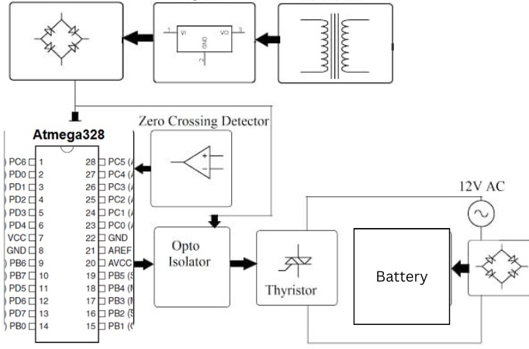
Proposed Methodology
1.1 Basic layout of the system

Slide 9
Requirement Analysis
Software Requirement:
Programming Languages:- Embedded C, ALP(Assembly Language)
Compiler:- Proteus
Hardware Requirement:
Power Supply Block
Microcontroller (ATMEGA328)
Opto-Isolator
SCR
1N4007 & 1N4148
Zero Crossing Detector
Lcd Display

Slide 10
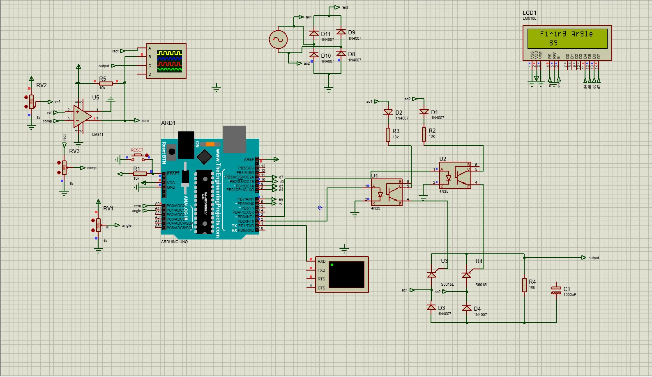
Simulation
10

Slide 11
Conclusion

Slide 12
Future Scope
Integration of smart charging algorithms: Implement advanced algorithms for optimized charging based on battery type, state of charge, and environmental conditions.
Wireless charging capabilities: Develop wireless charging solutions for greater convenience and versatility in bullet applications.
Enhanced energy management: Explore methods to maximize energy efficiency and minimize charging time, improving overall system performance.
Eco-friendly features: Introduce sustainable practices such as energy harvesting or renewable energy sources to reduce environmental impact.

Slide 13
References
The ATMEL 89S52 Data Sheets.
M. H. Rashid and H. Khatib, ”A thyristor-controlled battery charger with voltage and current regulation”, Transactions on Industry Applications vol. 21, no. 5, 1139-1146, 1985.
B. K. Bose and M. Swamy, ”A thyristor-controlled DC-DC converter-fed electric vehicle propulsion system”, Transactions on Industry Applications vol. 27.
S. Ahmed and Z. Salam, ”A microcontroller-based reversible battery charger with angle shift control”,IEEE Transactions on Industry Applications, vol.54, no. 3, pp. 2310-2319, 2018.

