Slide 1

Elastic build infrastructure
Compile applications on AWS

Slide 2
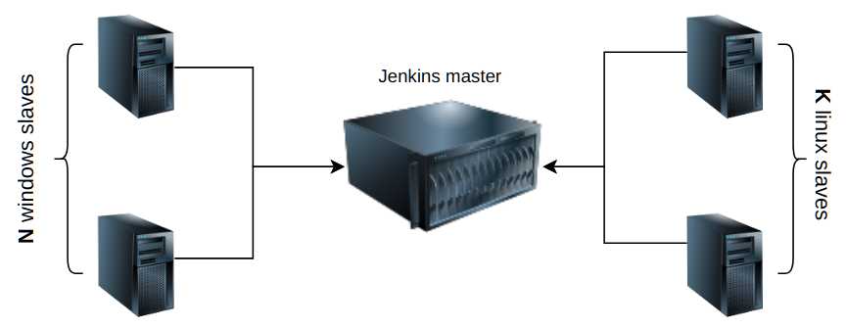
On-prem build system
Thor and Odin cannot do all the job
The system has limited capacity.

Slide 3
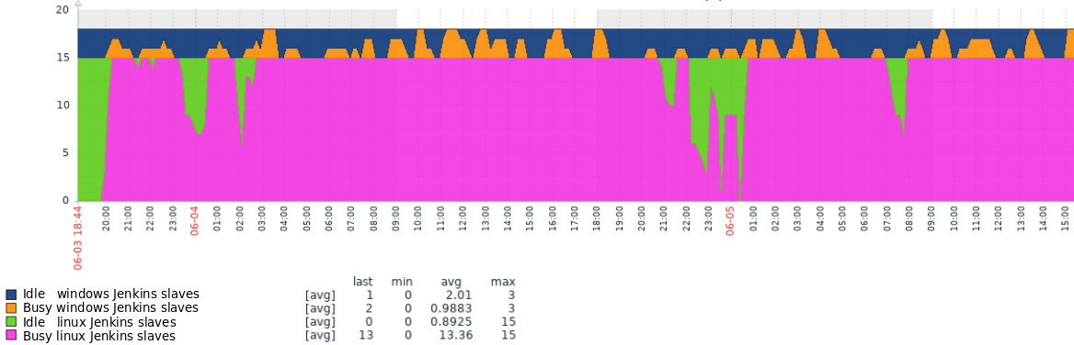
On-prem build system utilization
Linux slaves are busy most of the time
What it means for developers?

Slide 4
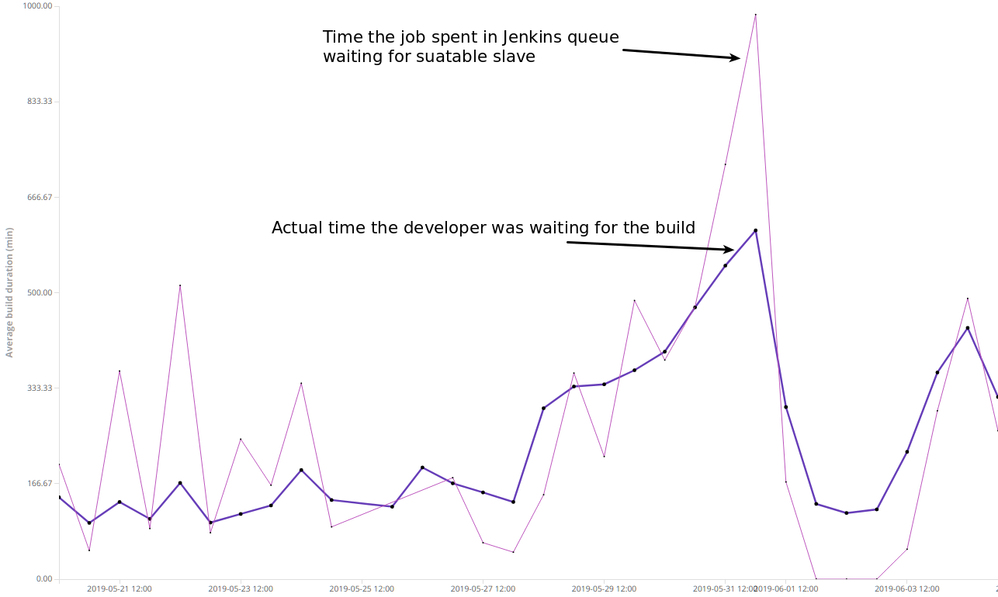
Build time vs wait time
Builds are long. In bad days developers had build's results in a day.
Builds duration is unpredictable. You cannot be sure when the build will be completed.
So ...

Slide 5

… developers must switch to other tasks.

Slide 6
Up to 40% of productivity Lost by Task Switching
"Although switch costs may be relatively small, sometimes just a few tenths of a second per switch, they can add up to large amounts when people switch repeatedly back and forth between tasks. Thus, multitasking may seem efficient on the surface but may actually take more time in the end and involve more error. Meyer has said that even brief mental blocks created by shifting between tasks can cost as much as 40 percent of someone's productive time."
https://www.apa.org/research/action/multitask

Slide 7
The hypothesis
Faster and more predictable builds will let developers avoid multitasking and will increase efficiency

Slide 8
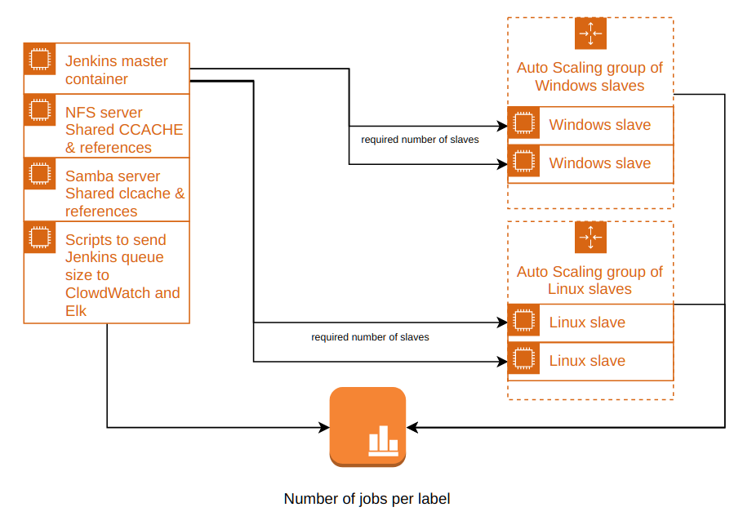
We developed Elastic Build system on AWS
We can have as many slaves as we need in theory(currently it is limited manually).
Fully automated deployment and update.
Monitoring key metrics (AppTargets duration, builds duration, Queue size ...)
https://bitbucket.navico.com/projects/BI/repos/aws-build-infrastructure/browse

Slide 9
Jenkins master instance
EC2 (virtual server 8vCPU/16GB)
Use Amazon linux for master and slaves' hosts.
Use 2 EBS volumes (virtual hard drives) to store Jenkins master home folder and CCACHE and references for NFS and Samba server.
Docker services:
  NFS server docker container shares git references and CCACHE cache - NFS v3 server: async; on clients: noac, noatime, async.
  Samba server docker container shares references.
  Jenkins master lts docker container – specified Java memory settings, JMX monitoring
asg_manager – Auto scale group manager.

Slide 10
asg_manager
  Python script, python script triggered by cron:
  Sent size of Jenkins queue by labels to CloudWatch (used to scale slave groups).
  Sent size of Jenkins queue and ASG size to Elk to have dashborads in one place
  Sent builds durations to Elk
  Terminate idle slaves

Slide 11
Jenkins slaves
Slaves are EC2 (virtual server 16vCPU/32GB)
ASGs monitor CloudWatch metrics and adjust the size of the group based on the size of the Jenkins Queue
If Queue for docker_client is >0 then spawn a linux slave
  Mount ccache and references shares as docker volumes
  Run Jenkins slave docker image
If Queue for windows-vs2017 is >0 then spawn a windows slave
  Run jenkins slave docker image
    Mount references share as network drive inside a slave

Slide 12
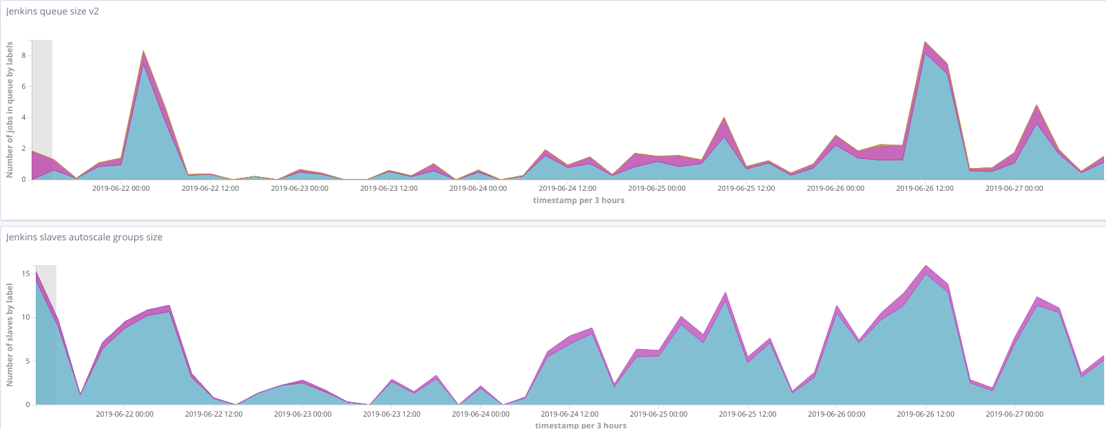
Number of jobs in queue and ASG size

Slide 13
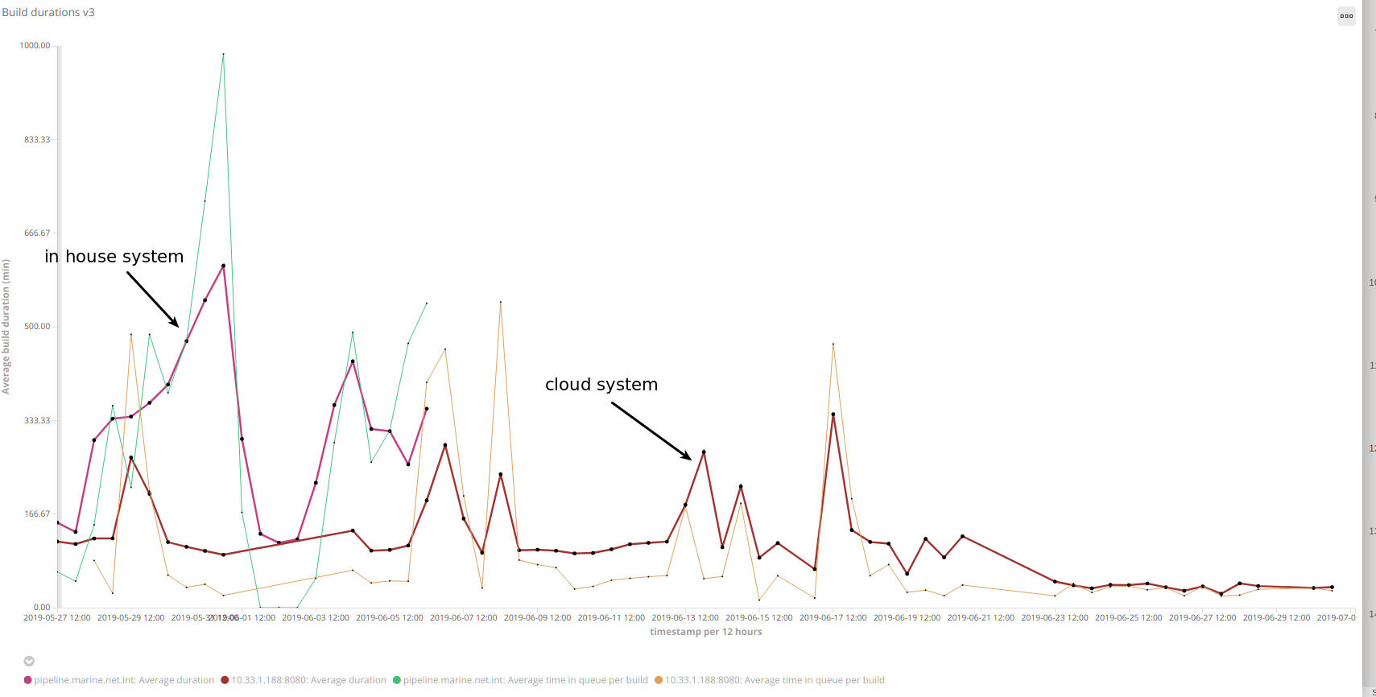

Slide 14
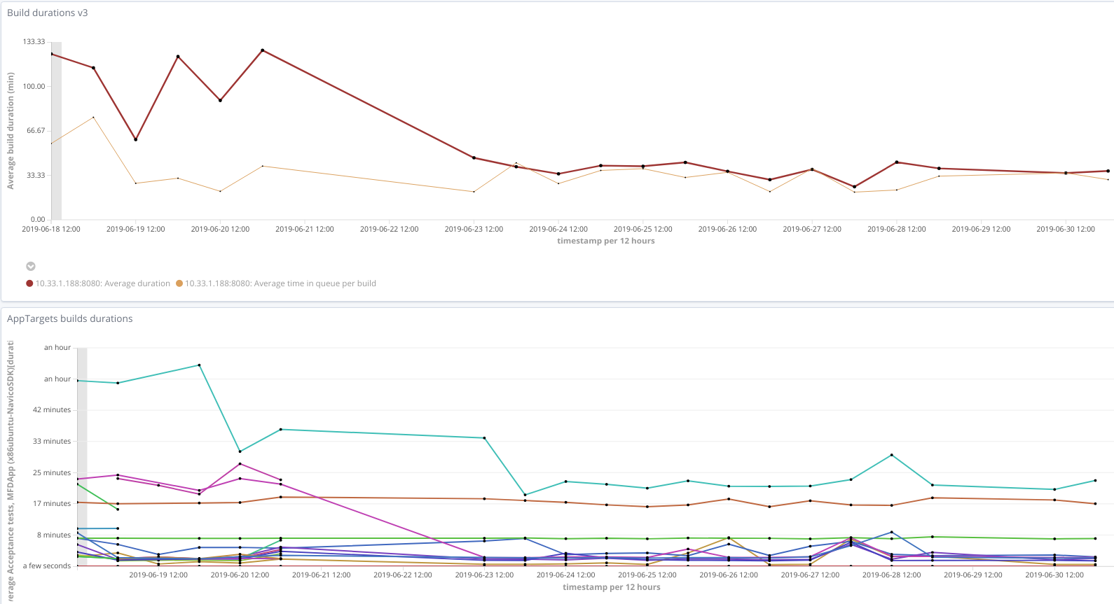

Slide 15
How asg_manager works
Sent metrics to elk to visualise them in kibana
Sent current Jenkins queue to CloudWatch to scale groups
Terminate idle slaves
  If a slave is idle for >= 5 min and online, then mark it offline
  If a slave is idle for >= 5 min and offline, then terminate it
  If slave is busy and offline, then mark it online
  Why we see offline nodes?

Slide 16
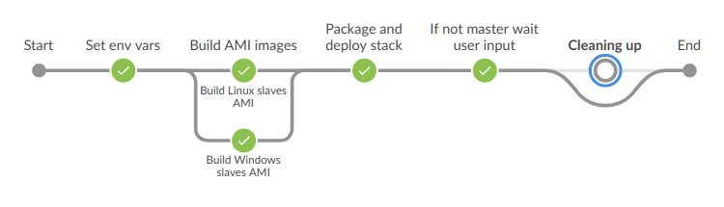
Jenkinsfile
Create AMI images with all needed docker images in it
Deploy (create or update) environment with new settings
If branch != master wait for user input 3 hours, then delete environment
Limitations
  Cannot have more than 1 PROD and 1 DEV simultaneously, because we have 1 set of volumes per env type
Differences between PROD and DEV
  Use different volumes for PROD and DEV
  DEV environment and AMIs will be automatically removed

Slide 17
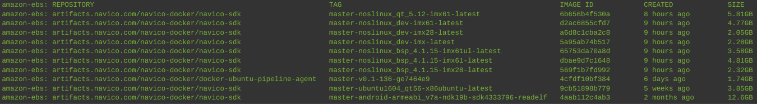
Why we must create AMIs with pulled sdk images?

Slide 18
How to create/update/remove cloud environments
DEV environments are managed from Jenkins master of PROD build environemnt
PROD environrment lifecycle
Create environment
  deployPROD.sh (arguments must be checked from the last successful build)
  copy commands from the last successful build log.
  We can use another Jenkins with this Jenkinsfile to manage PROD AWS build infrastructure
Update – just build Jenkins job on master branch
Remove – CloudFormation web interface

Slide 19
Q & A

