Slide 1

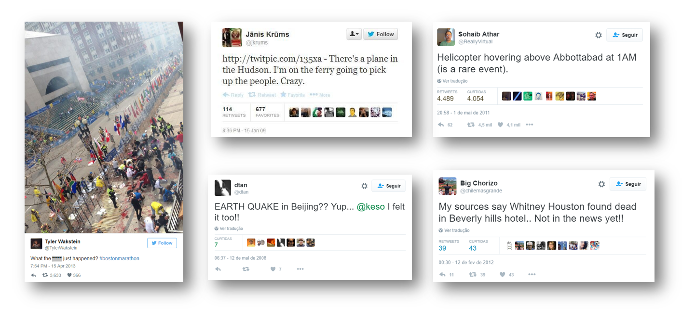
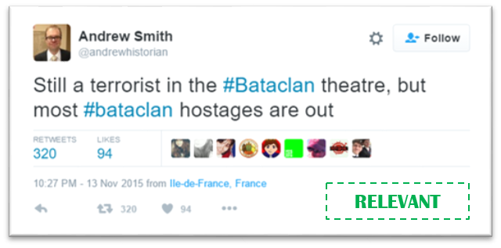
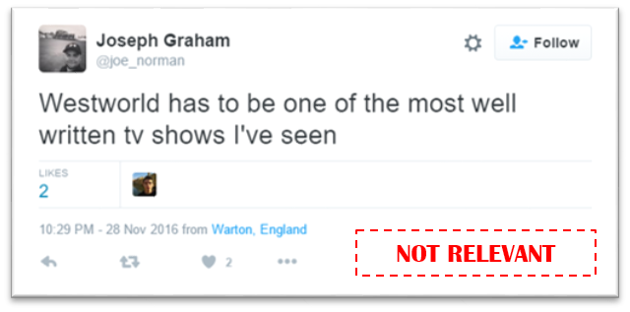



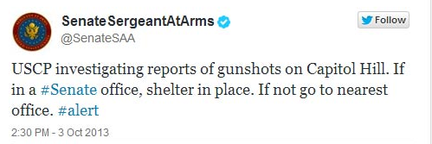

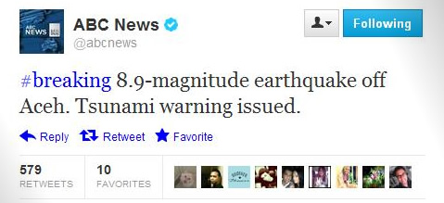
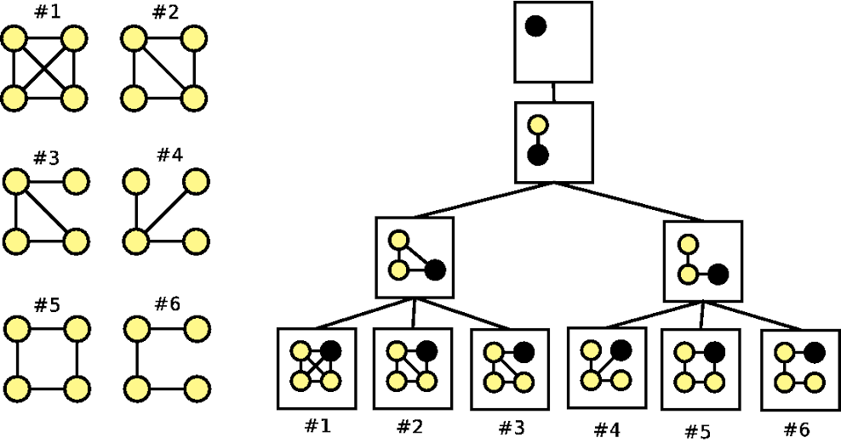
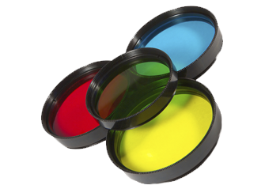














CRACS - CentRE for RESEARCH in Advanced Computing Systems
Relevance Mining Detection System
Project: UTAP-ICDT/EEI-CTP/0022/2014
In project REMINDS we develop systems to perform an analysis of public information transmitted through Social Networks, to automatically filter and show the information that is potentially relevant to a general audience. Although Social Networks are a source for a tremendous amount of information, much of the information is either private (yet granting public access in most cases), personal, not important or simply irrelevant to the general audience. Despite this situation, we have witnessed in the last years many important news and mass opinions on relevant issues being conveyed by social networks, usually surpassing in speed the broadcast through the traditional media of important events.
Relevant information travels through social media
...yet, not every post contains relevant information.
We must filter and detect relevant information from the private, personal or just irrelevant information
What is relevant information?
How to detect relevancy?
Text-Mining
Sentiment Analysis
Named Entity Recognition
Temporal Detection
Machine Learning
Data-Mining
Information that can be used by a journalist to produce a news. It needs to be factual, original, have a wide-scope, ...
Identify Relevancy
Identify Irrelevancy
Identify Network Patterns of Relevancy
Try to match the journalistic criteria for considering some information as news: search for:
Who?
What?
Where?
Understand if some other features can be identified:
Is wide-scope?
Is original?
Is polemic?
Is reliable?
Is trendy?
...
Try to prove for irrelevancy:
It is not true
It is personal only
It is very limited scope
Entities are not known
There is no reference to time, place and subject
It has been said many times
Source is not reliable
...
If the resulting index is lo,w then there is the possibility to have find relevant information
Roles, Clusters and Anomalies Analysis of time evolving graphs Novel hyperbolic community model Fast MDL based algorithms Fingerprinting networks
Discovery of subgraph patterns G-Tries: specialized data structure Faster than competing algorithms Sequential and parallel versions available
Index of
relevancy
Index of
irrelevancy
Index of pattern matching
Indicators (in the first 20 months):
Publications: 16
PhD theses: 1
MSc theses: 2 + 2 undergoing
Partners: Univ. Porto, Univ. Coimbra, UT@Austin IBM, TACC

