Slide 1

inQueue
Book events in your surroundings

Slide 2
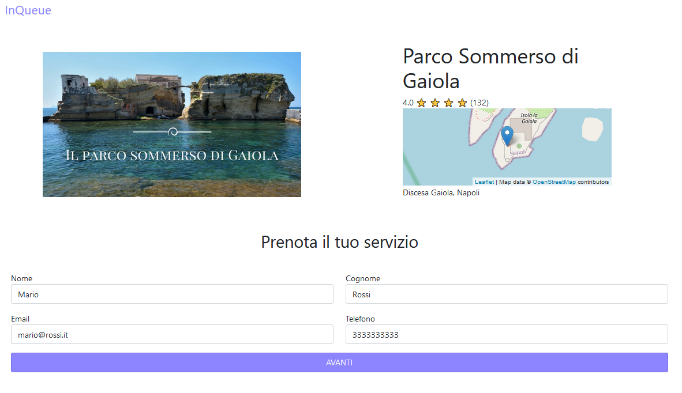
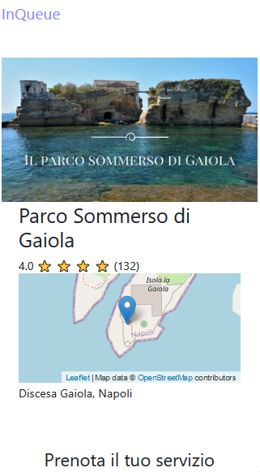
inQueue
inQueue is a small web application which aims to deliver an easy and fast service for booking events in your surroundings.

Slide 3
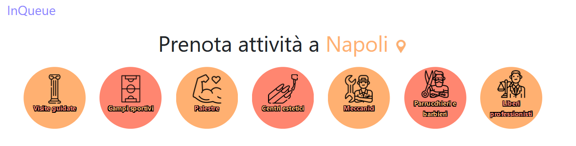
inQueue – The businesses
As of now, the supported bussinesses are:

Slide 4
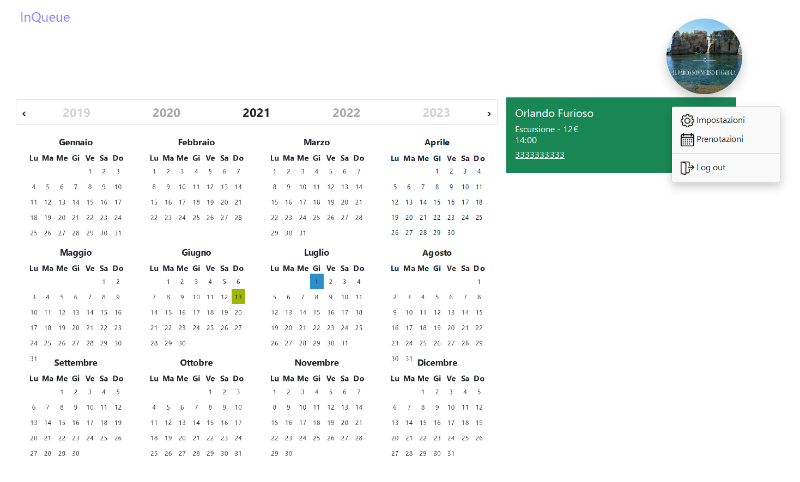
inQueue – The businesses
Each business defines the kind of service, as well as the length of the time slots for each offered service. Via a calendar, it can keep track of the bookings received.

Slide 5
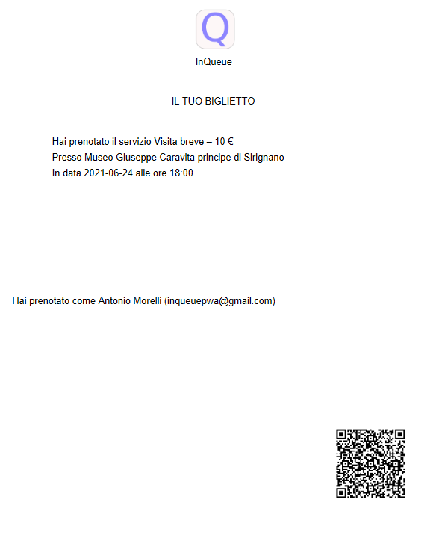
inQueue – The users
The users can view a list of businesses which are in the selected city.
When something is booked, they receive a memo, via email, which works as a booking confirmation.

Slide 6
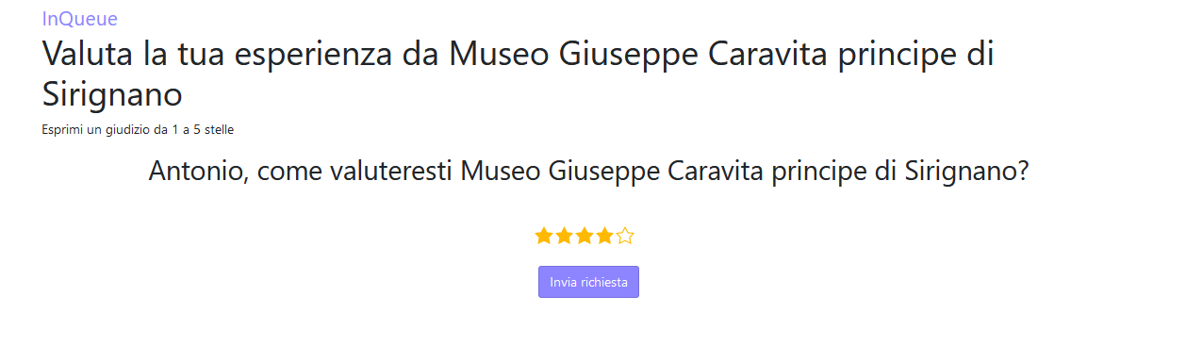
inQueue – The users
The user receives, again by email, a link to a page which prompts him to review the experience received. This contributes to grant more visibility to the best businesses.

Slide 7
inQueue – The tecnologies
Some of the technologies used in the project:
Leaflet
Bootstrap
Flask
Qrcode
ReportLab
MongoDB Atlas
Docker
Nginx
uWSGI

Slide 8
inQueue – Flask, uWSGI, Nginx
Flask is a micro-framework based on Werkzeug and Jinja2. They provide various tools useful to the construction of a web app.
uWSGI is the interface, the server which executes the Python code. It represents a standard which grants flexibility and scalability.
Nginx, it’s web server, a tool which allows to manage multiple requests in an efficient way.

Slide 9
inQueue – Docker
The 3 tools represent 3 levels of comunication. Via a composite script, 2 Docker images are created, from which 2 containers are executed; this is done considering the good habit of isolating each process in it’s own container, while merging uWSGI and Nginx for a necessity.

Slide 10
inQueue – MongoDB Atlas, Leaflet, ReportLab, qrcode
Because of the simplicity of the project, we decided to use MongoDB Atlas instead of a local instance of MongoDB. The cloud service is easy and intuitive.
Leaflet is a JavaScript open-source library which provides different tools to manage maps.
The provided memos are PDFs, create in Python via ReportLab, with a qrcode appended to them.

Slide 11
inQueue – TODO
The system is still a work-in-progress. Many features could be included, such as:
Payment management, to book an event
Service subscription logic
Clients’ account
Textual reviews
Profanity filtering

Slide 12
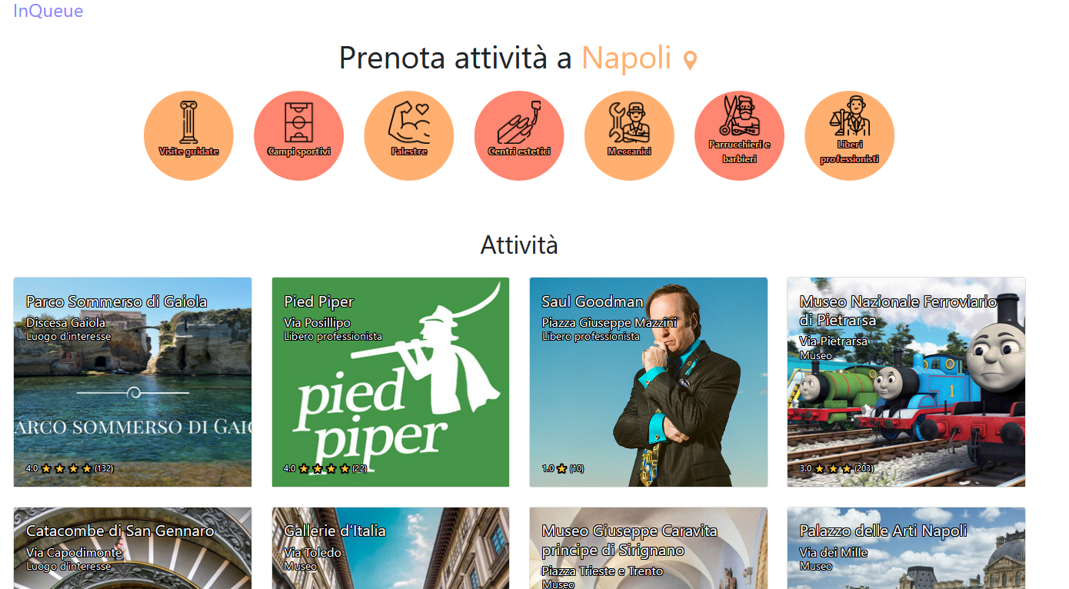
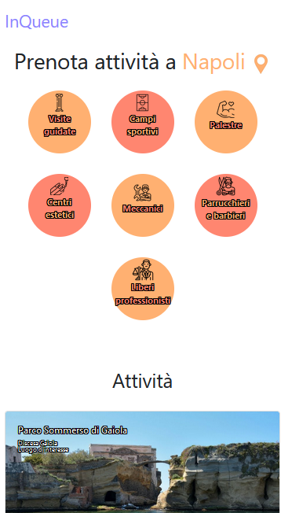
Visit inQueue and… get in queue!
Mattia Ripoli
Francesco Pollasto
Antonio Morelli

