Slide 1

Jaypee University of Information Technology, Waknaghat – 173234 (India)
Minor Project (18B19CI691) P2 Presentation | AY 2023-24
Human Activity Detection and Anomaly recognition
Supervisor
Name: Prof. Dr. Amit Kumar Jhakar
Designation: Professor and Head
Department: Department of Computer Science & Engineering and Information Technology
Group No.: 67
Team Member (s)
Ritesh Dhiman (211138)
Manas Tiwari (211165)

Slide 2

Outline
Introduction
Objectives
System Design
Use Case Diagram
Methodology
1st Phase(Model Creation)
Program Code
Output of Phase 1
2nd Phase(Model Prediction)

Slide 3
Outline (cont…)
Program Code
Output of Phase 2
Results
Application
Conclusion
Future Scope
Work Contribution
References

Slide 4
Introduction
Human behavior recognition in real-world environments is increasingly essential for applications like intelligent video surveillance and shopping behavior analysis. Video surveillance, crucial for security, is now a part of everyday life. Manual monitoring of CCTV footage is impractical, making automated systems necessary for identifying and analyzing abnormal events efficiently.
Advanced technologies like Artificial Intelligence (AI), Machine Learning (ML), and Deep Learning (DL), empowered by GPU processors and extensive datasets, are revolutionizing video surveillance by enabling automated detection of suspicious activities in public spaces.
The proposed system for campus security integrates CCTV footage analysis with intelligent event detection and human behavior recognition, employing techniques like Convolutional Neural Networks (CNN) for visual pattern learning and Long Short-Term Memory (LSTM) models for capturing long-term dependencies in video streams.

Slide 5
Objectives
Accurate Activity Detection:
Utilize LRCN model to precisely detect and classify human activities in video streams.
Identify common actions like walking, running, sitting, and interactions with objects.
Anomaly Recognition:
Train the model to identify abnormal behaviors indicating potential security threats or safety hazards.
Detect sudden movements, loitering, unauthorized access, or other suspicious activities.
Adaptability and Scalability:
Design a flexible system capable of adapting to diverse environments and surveillance scenarios.
Ensure robust performance across different lighting conditions, camera angles, and locations.
Continuous Learning and Improvement:
Incorporate mechanisms for ongoing learning and model refinement.
Update the model with new activity patterns and emerging threats through periodic retraining.
Privacy and Compliance:
Implement measures to safeguard privacy and comply with relevant regulations.
Ensure data anonymization, encryption, and access control to protect sensitive information.

Slide 6
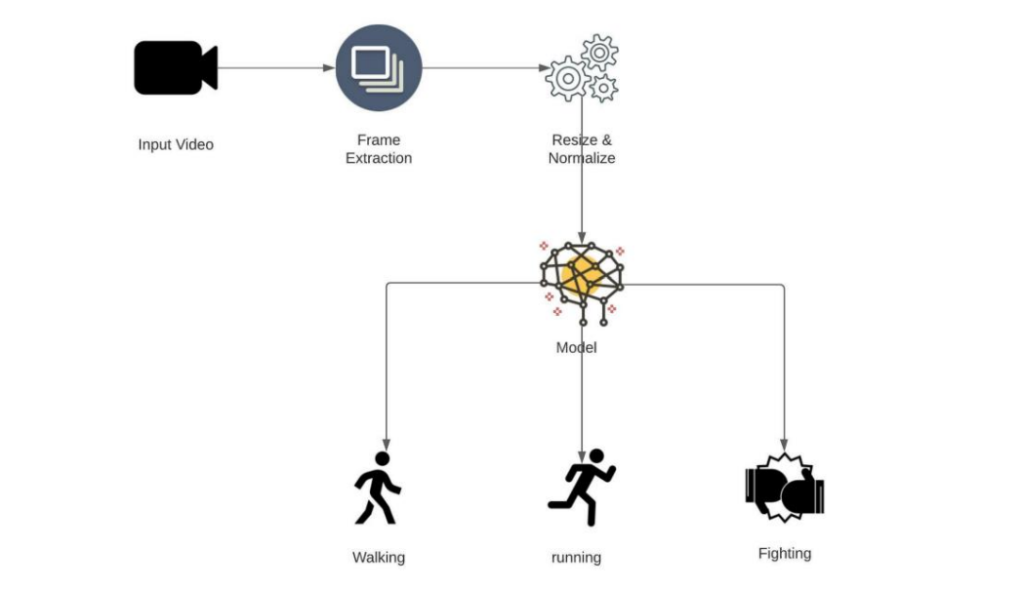
System Design
This system is designed to classify human activities such as walking, running, and fighting from video inputs. The system leverages frame extraction, preprocessing, and a machine learning model to perform activity recognition. By following this system design, we can effectively recognize and classify human activities from video inputs with high accuracy.

Slide 7






Use Case Diagram
Human Activity detection system
Feed in
The video.
Detect humans
include
Extract frames
include
Acitvity detection
People involved in a violent activity
6
Concerned Authority
include
Detect
Anomaly
Alert System
Figure 2 : Use Case Diagram

Slide 8
Methodology
⬡ A dataset having 100 videos each of violence category and non-violence
category was chosen for Anomaly Detection as well as A dataset of 100 videos each of running, jogging, walking, handwaving, handclapping, boxing catogaries is chosen.
⬡ A model was trained using LRCN which Combines Convolutional Neural Networks (CNNs) for feature extraction from frames and Incorporates Long Short-Term Memory (LSTM) networks to handle temporal dependencies.
⬡ Video footage is given as input
⬡ Output is obtained on the top left corner of video frames.

Slide 9
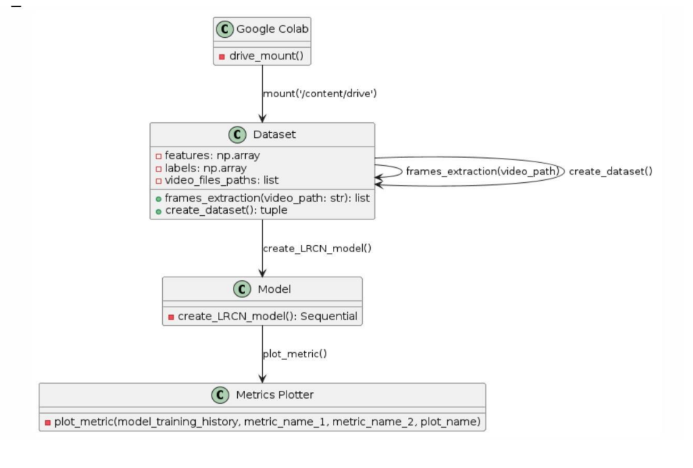
1st Phase(Model Creation)
Figure 3 : Methodology of Model Creation

Slide 10
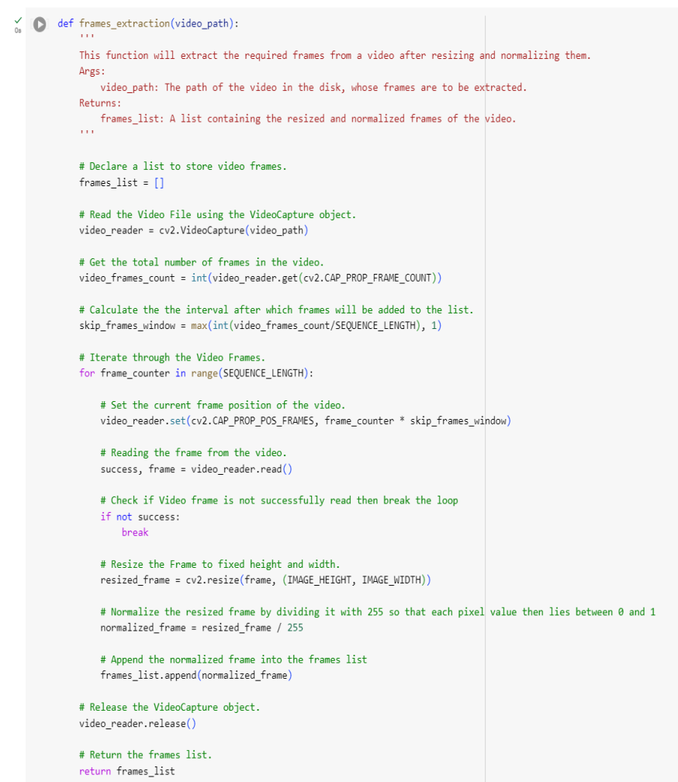
Program code
Figure 4 : Resizing the dataset and frame extraction

Slide 11
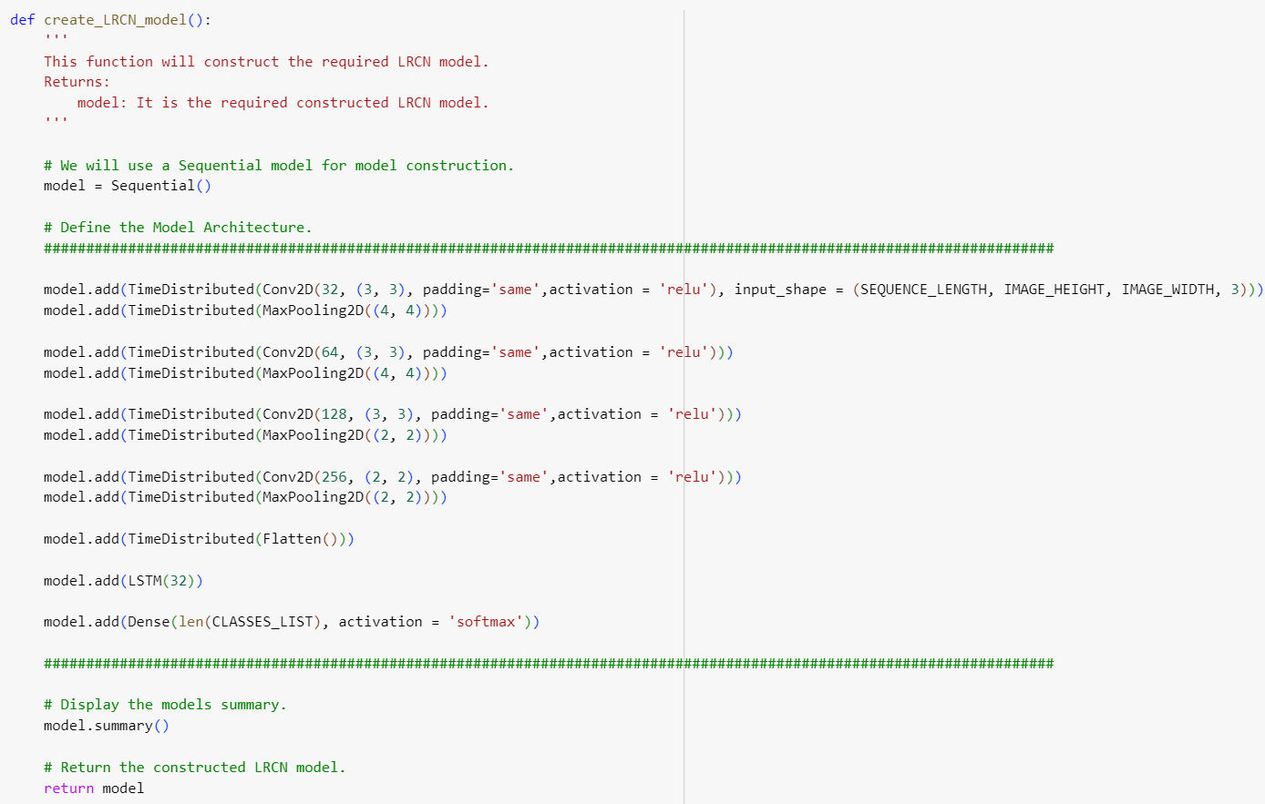
Program code
Figure 4 : Code snippet for Model Creation

Slide 12
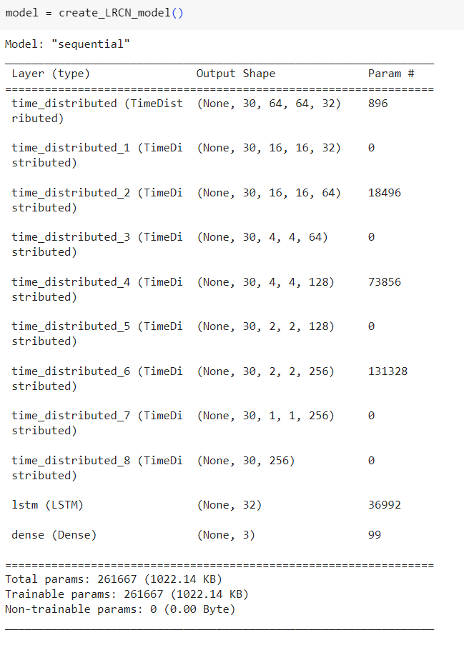
Program code (cont…)
Figure 5 : Code snippet to get summary of Model

Slide 13
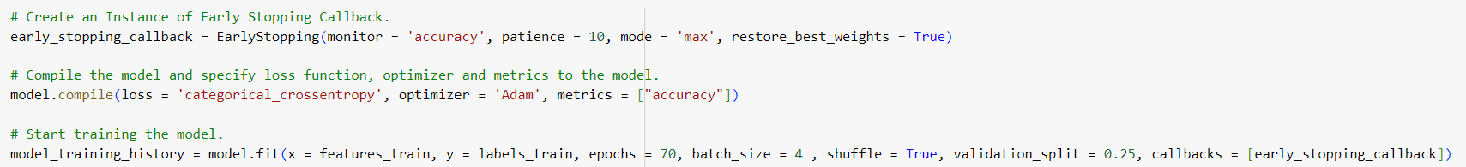
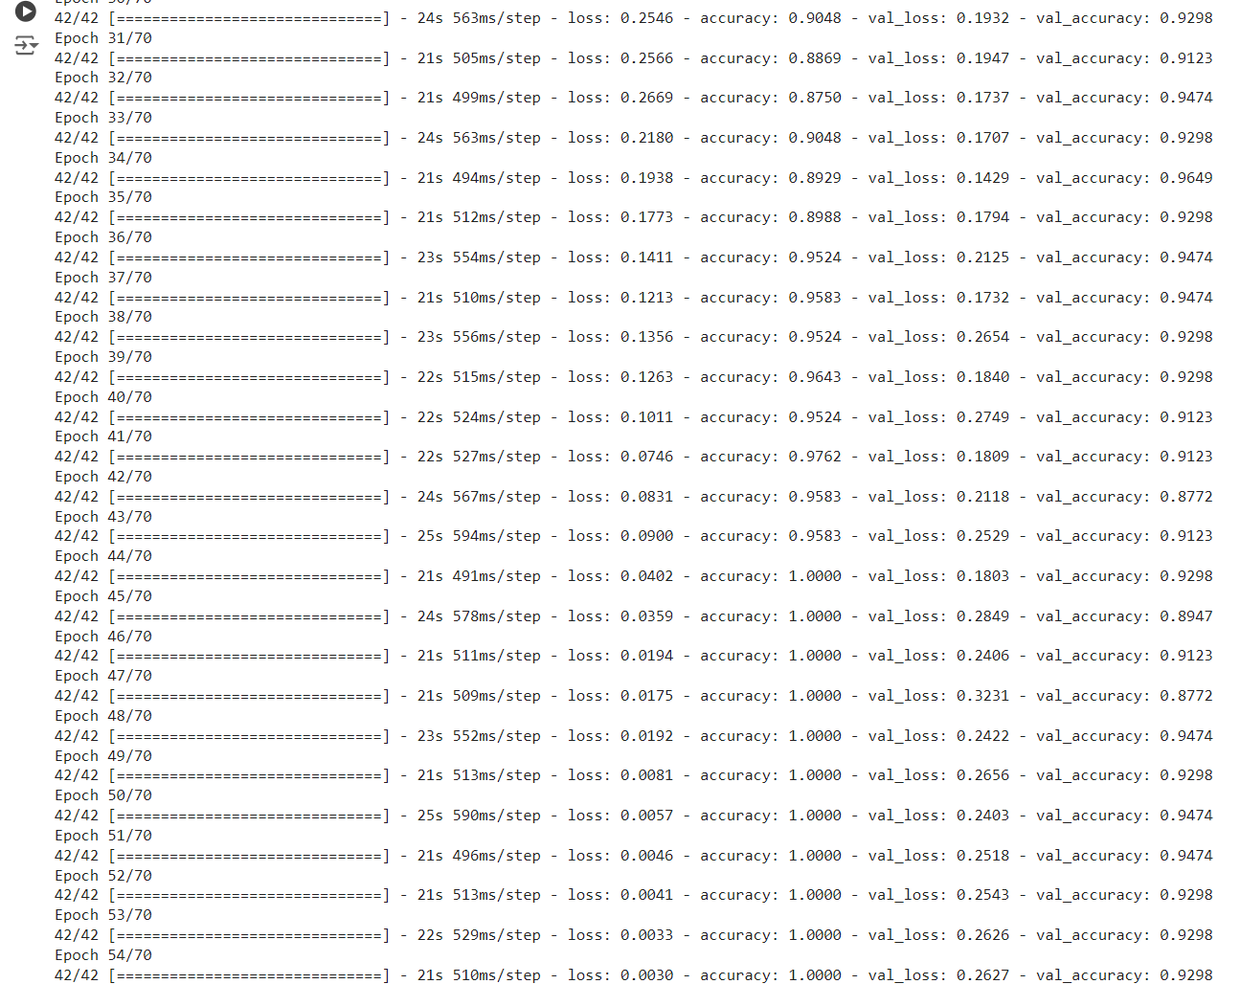
Program code (cont…)
Figure 5 : Model Training

Slide 14
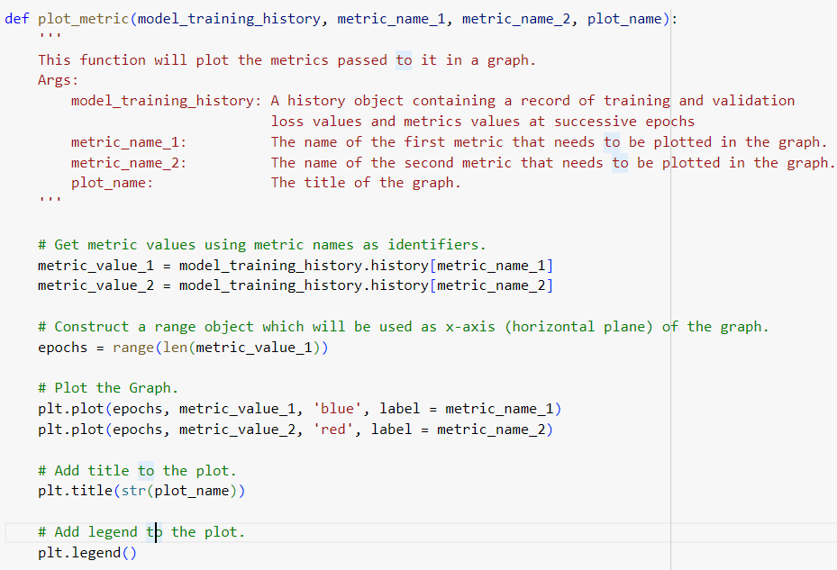
Program code (cont…)
Figure 6 : Saving the Model
Figure 6 : Creating chart to determine the model creation

Slide 15
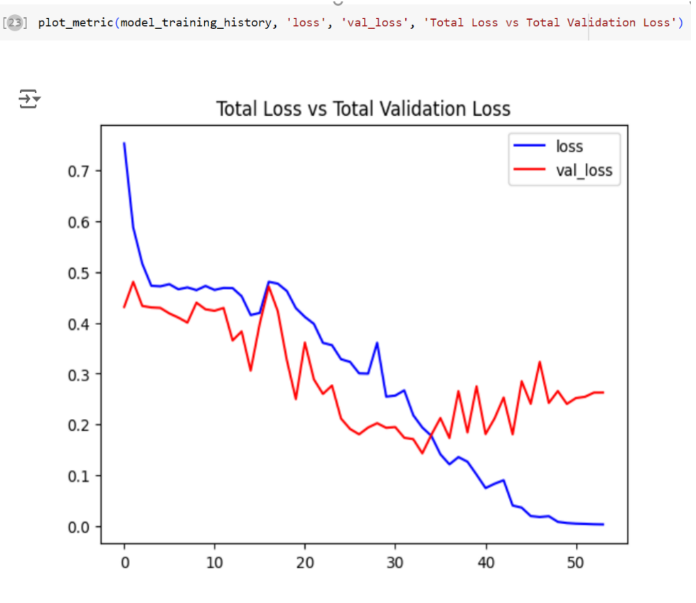
Program code (cont…)
Figure 6 : Model Training Losses

Slide 16
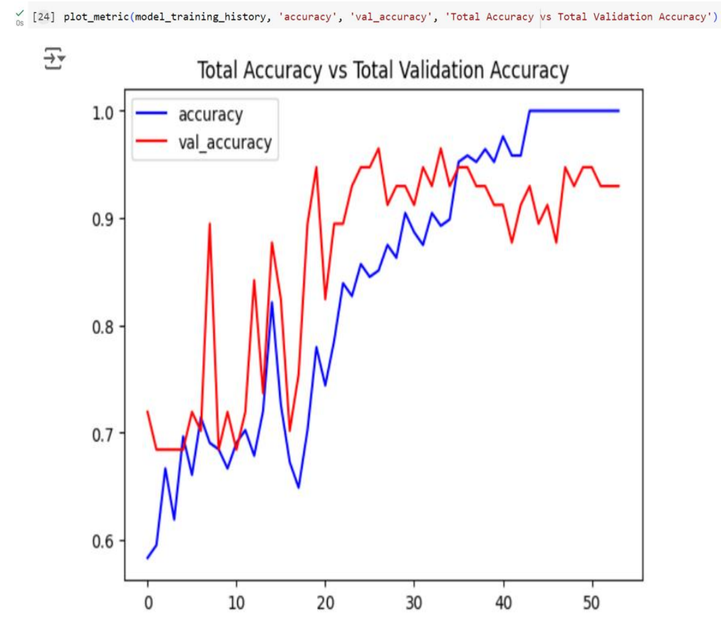
Program code (cont…)
Figure 6 : Model Accuracy Chart

Slide 17
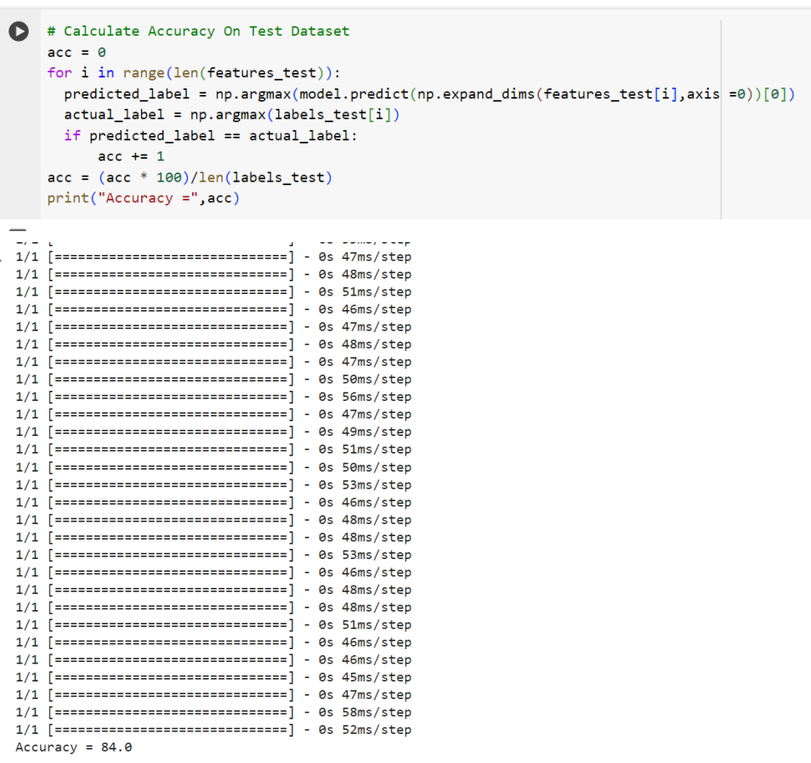
Output of Phase 1
Figure 7 : Accracy Calculation

Slide 18
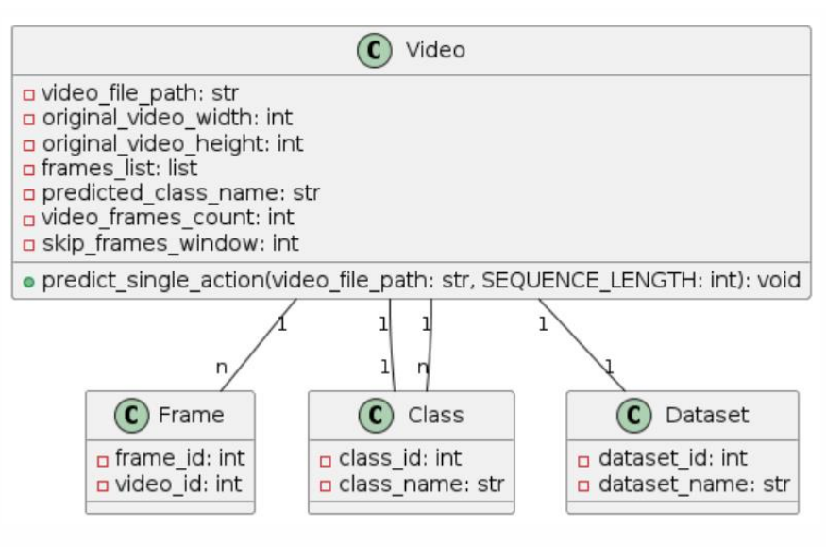
2nd Phase(Model Prediction)
Figure 8 : Methodology of Model Prediction

Slide 19
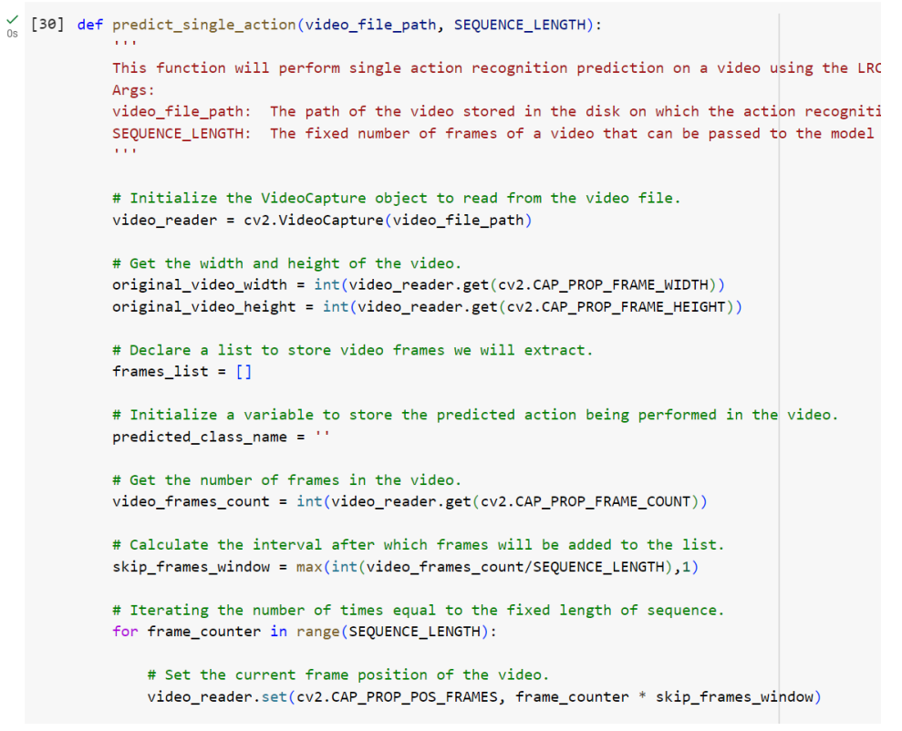
Program code
Figure 9 : Performing single action prediction

Slide 20
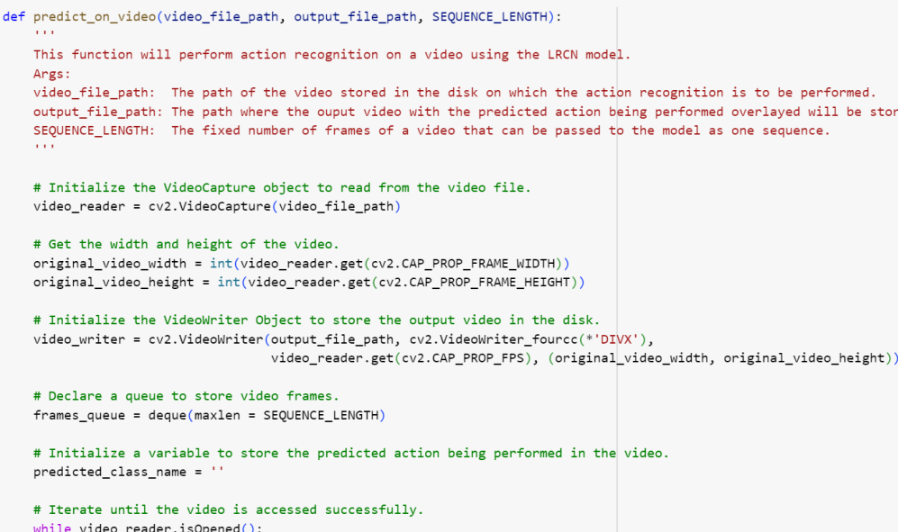
Program code
Figure 9.1 : Performing action prediction on video

Slide 21
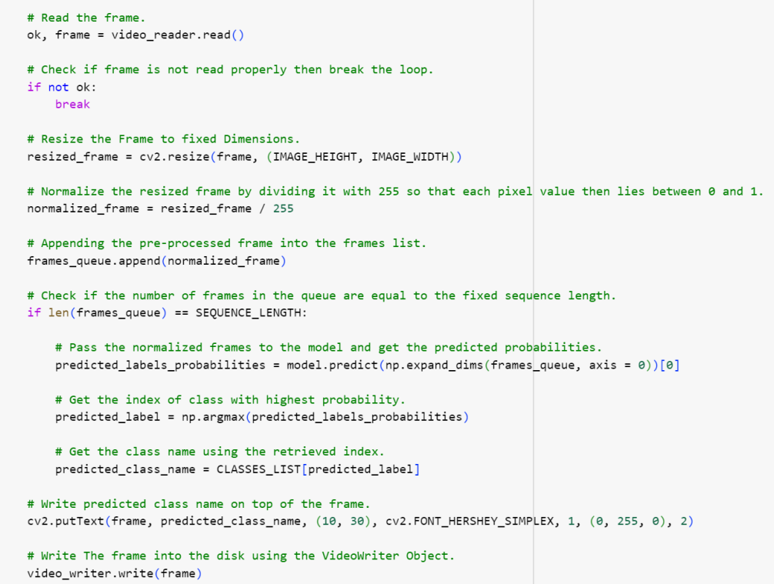
Program code
Figure 9.2 : Performing action prediction on video

Slide 22
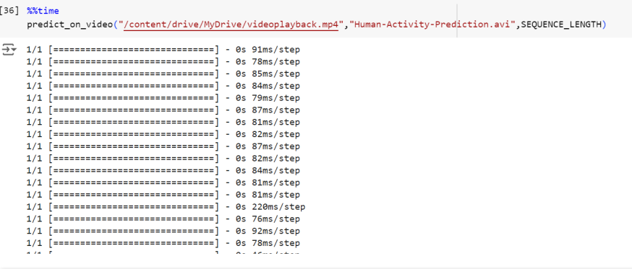
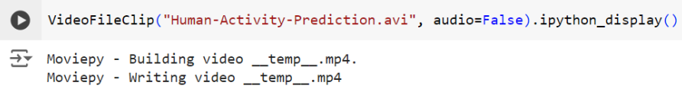
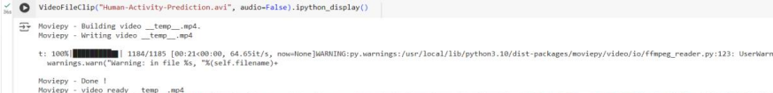
Program code
Figure 9.3 : Performing action prediction on video

Slide 23
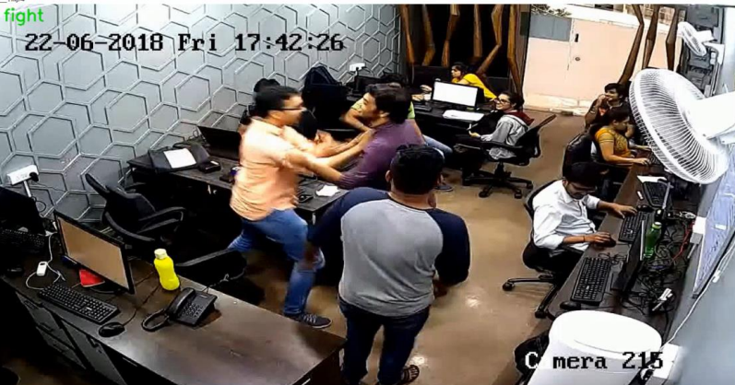
Output of Phase 2
Figure 10 : Human Activity Detection and Anomaly Recognition System Output

Slide 24
Results
Key Achievements:
Accuracy: Achieved 84% accuracy in detecting anomalous behavior (e.g., fighting) and normal activities (e.g., walking, running).
Real-Time Processing: Optimized for real-time video surveillance with efficient data handling.
Model Transition:
Previous Model: VGG-16 with LSTM
Layers: 19 layers
Accuracy: 85%
Current Model: Custom Long-term Recurrent Convolutional Network (LRCN)
Layers: 12 layers
Accuracy: 82%
Performance Enhancements:
Speed and Efficiency:
Faster training and prediction times with the custom LRCN model.
Suitable for real-time applications.
Data Processing Improvements:
Frame Size Reduction: From 224x224 pixels to 64x64 pixels.
Benefits:
More efficient data processing and storage.
Capability to load entire dataset on low-end devices.

Slide 25
Results (cont…)
Practical Deployment:
Advantages of Custom LRCN:
Slight drop in accuracy (from 85% to 82%) offset by substantial gains in speed and resource efficiency.
Enhanced feasibility for real-life surveillance applications.
Conclusion:
Model Suitability:
The custom LRCN model demonstrates significant potential for deployment in security-sensitive environments, thanks to its balance of accuracy, speed, and efficiency.
Visuals (Optional):
Graphical Comparison:
Accuracy vs. Speed for VGG-16 with LSTM and Custom LRCN.
Model Architecture Diagrams:
Highlight the layer differences and efficiency gains.
Overall Impact:
Real-World Application: The custom LRCN model's improvements underscore its practical application for enhancing security through efficient and accurate real-time video surveillance.

Slide 26
Application
The “Human Activity Detection and Anomaly Recognition from Surveillance Video" project presents significant potential for enhancing security measures across various sectors and environments. A key application is within educational institutions, particularly university campuses and academic facilities, where the system can monitor student activities to prevent theft, vandalism, and other suspicious behaviors. During examination periods, the system can help maintain academic integrity by identifying and deterring irregularities or cheating attempts, ensuring fair assessments and upholding academic credibility.
Additionally, the system can be deployed in sensitive areas such as hospitals, malls, parking lots, and transportation hubs like bus and railway stations. By continuously monitoring video feeds and alerting security personnel to any suspicious events, the system aids in mitigating risks associated with criminal activities, terrorism, and public safety concerns. This proactive approach to threat prevention and emergency response enhances the overall safety and security of various settings, safeguarding assets, infrastructure, and public well-being.

Slide 27
Conclusion
The transition to the custom Long-term Recurrent Convolutional Network (LRCN) model marks a significant advancement in our approach to real-time video surveillance. Achieving an impressive 84% accuracy in detecting anomalous behaviors such as fighting, alongside normal activities like walking and running, highlights the model's effectiveness. Despite a slight drop in accuracy compared to the VGG-16 model (from 85% to 82%), the custom LRCN model excels in speed and resource efficiency, making it highly practical for real-time applications. The reduction in frame size and the streamlined architecture enable efficient data processing and storage, even on low-end devices. These enhancements demonstrate the model's potential for deployment in various security-sensitive environments, ensuring quick and accurate monitoring. Overall, the custom LRCN model's balance of performance and efficiency underscores its suitability for enhancing real-world surveillance systems.

Slide 28
Future Scope
Moving forward, several avenues exist to enhance and expand the efficiency, accuracy, and applicability of the suspicious activity detection system from surveillance video.
Integration of Multimodal Data: Incorporating additional sensors such as audio and thermal cameras can provide complementary information for more robust detection. Integration with other surveillance technologies like drones or satellite imagery can extend monitoring capabilities beyond fixed locations.
Continuous Model Refinement: Continuous training with updated datasets can improve accuracy and adaptability to evolving threats. Techniques like transfer learning and online learning can facilitate ongoing model improvement
Behavioral Pattern Analysis: Advanced behavioral analytics can recognize complex patterns, enabling proactive threat detection and prediction. Anomaly detection techniques can more effectively identify deviations from normal behavior.

Slide 29
Work Contribution of Each Member
S. No. | Roll Number | Work Done | Contribution (%)
1. | 211138 | Literature review Data Analytics and data visualization | 50.00%
 |  | Model Designing & Hypertuning
2. | 211165 | Literature review Data Generation & code optimization | 50.00%
 |  | Model Designing & Hypertuning

Slide 30
Refrences
P. Bhagya Divya, S. Shalini, R. Deepa, and B. S. Reddy, “Inspection of suspicious human activity in the crowdsourced areas captured in surveillance cameras,” *International Research Journal of Engineering and Technology (IRJET)*, vol. 4, no. 12, Dec. 2017.
2. J. Musale, A. Gavhane, L. Shaikh, P. Hagwane, and S. Tadge, “Suspicious movement detection and tracking of human behavior and object with fire detection using a closed circuit TV (CCTV) cameras,” *International Journal for Research in Applied Science & Engineering Technology (IJRASET)*, vol. 5, no. 12, Dec. 2017.
3. E. Scaria, A. A. T, and E. Isaac, “Suspicious activity detection in surveillance video using discriminative deep belief network,” *International Journal of Control Theory and Applications*, vol. 10, no. 29, pp. 133-139, 2017.
4. D. J. Samuel R, F. E, G. Manogaran, V. G. N, T. Thanjaivadivel, J. S, and A. Ahilan, “Realtime violence detection framework for football stadium comprising of big data analysis and deep learning through bidirectional LSTM,” *The International Journal of Computer and Telecommunications Networking*, vol. 151, pp. 35-42, 2019

Slide 31
Thank You.

