Slide 1

RV Institute of Technology and Management
Department of Computer/Information Science and Engineering
JP Nagar, Kothanur, Bengaluru - 560076
21CSL55: DBMS LABORATORY WITH MINI PROJECT
CLOTHING MANAGEMENT : INVENTORY AND SALES
Presentation
Presented by:
Likitha B.K (1RF21CS064)
Manas S Kulkarni(1RF21CS065)
CSE
Batch 28
Under the Guidance of:
Mrs. Nandita Bangera
Designation Affiliation

Slide 2
Agenda
Introduction
Literature Survey
Proposed System
Motivation
Objective
Hardware and Software Specifications
Methodology
ER Diagram
Schema Diagram
Modules

Slide 3
INTRODUCTION
Our database system is designed to efficiently manage and process data related to the Stock Availability and Sales, within the clothing inventory.
The clothes production is classified into two main categories: "Gents" and "Ladies”.
Within each category, a range of clothing types is included according to customer preferences and trends.
Key parameters such as SIZE and PRICE are the primary attributes of the stored data.

Slide 4
Literature Survey
Related Papers :-
Year | Title | Authors | Description
2006 | Design of Distributed Data Warehouse for Sales Decision of Large-scale Clothing Enterprise | Ye Zheng Yang Chunjie Song Zhihuan | A Model of distributed data warehouse, for sales decision support system in clothing industry.
2021 | Comprehensive Information System for Management of Personalized Protective Thermally Active Clothing | Rafał Kotas Marek Kamiński Wojciech Tylman Sebastian Woźniak Michał Wojtera Anna Dąbrowska | The goal is to present the IT platform that was designed and developed for control and monitoring of the thermally active clothing.

Slide 5
Proposed System
MOTIVATION:-
The motivation behind our proposed Clothing Management System is to enhance the management of clothing inventories.
OBJECTIVE:-
The focus is on optimizing data management, improving inventory accuracy, and providing insightful reports for informed decision-making.
NOVELTY:-
The system's ability to handle diverse clothing types under specific categories and its streamlined approach to recording sizes and prices make it a novel and efficient solution for clothing inventory management.

Slide 6
Hardware and Software Requirements
1) Hardware Requirements :-
Laptop/Computer :- With sufficient storage, Internet connection and 64-bit processor.
2) Software Requirements :-
Compatible OS :- Windows,Mac,.etc.
Text Editor :- VS Code (preferably)
Web Browser :- Chrome,Firefox,Edge,.etc.
Database Management Tool :- MySQL or SQLite
Front End Tool :- Python Editor
Version Control :- GitHub

Slide 7
Methodology
FRONT END :- The front end of our Clothing Management System will be developed using Python.
BACK END :- SQLite as the database engine, due to its lightweight nature and good integration with Python.
MODULES:-
1)Admin :- The Admin module will be responsible for user authentication and access control.
2)Main page:- The Main Page module serves as the central dashboard, providing an overview of critical information such as total stock and recent sales.
3)Clothing:-The Clothing module handles the display,addition, modification, and deletion of clothing items.
4)Sales:- The Sales module facilitates the recording of sales transactions.

Slide 8
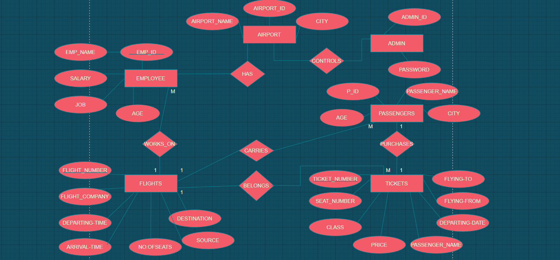
Methodology
ER Diagram (Sample is shown below)

Slide 9
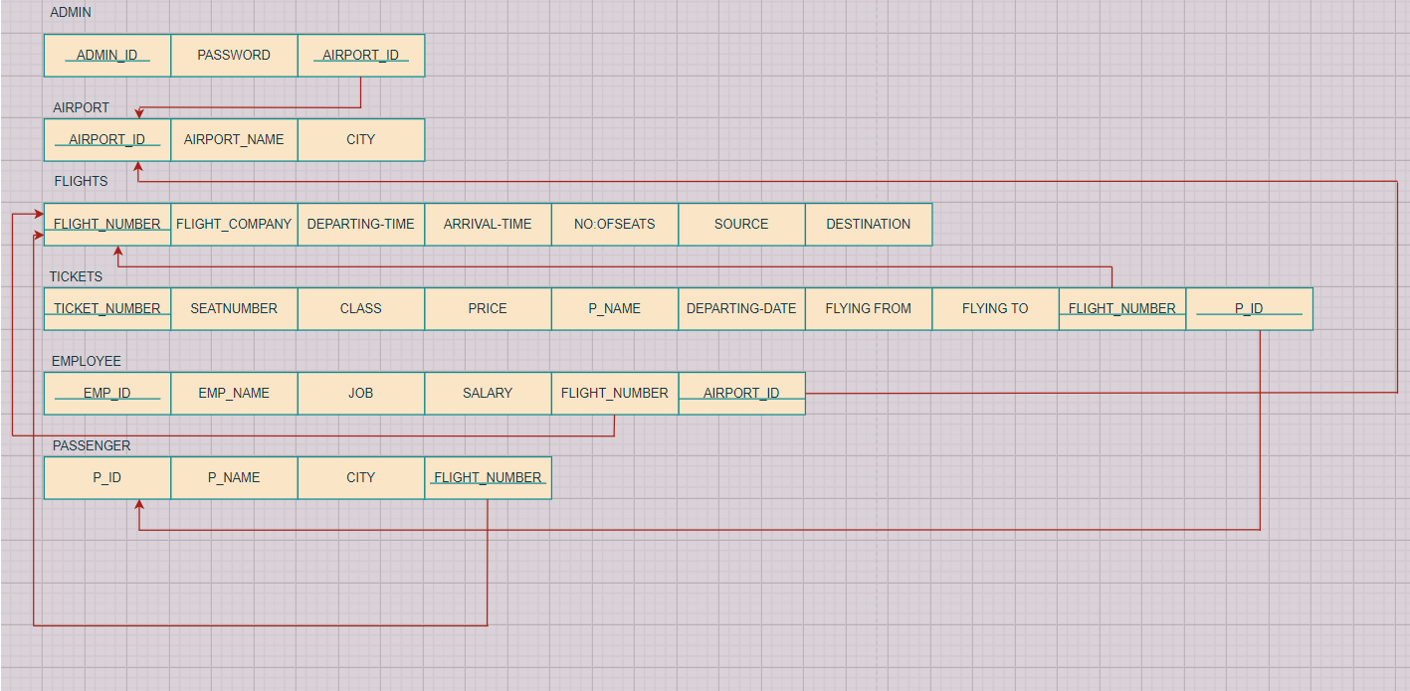
Schema Diagram (Sample is shown below)

Slide 10
REFERENCES

Slide 11
THANK YOU

