Slide 1


Image Search and Caption Generation System
Mana Saleh Al Aqeel

Slide 2

Introduction
The project aims to develop an image search and caption generation system using pre-trained models. It leverages the CLIP model for image search and the BLIP model for image captioning.

Slide 3
Approach
The project is divided into two main components:
Image Search: Uses the CLIP model to find the most relevant image based on a given text query.
Image Captioning: Uses the BLIP model to generate captions for images.

Slide 4
Image Search
Load Images: Convert all images to a consistent RGB format.
Process Inputs: Prepare both the images and the text query using the CLIPProcessor.
Compute Similarity:
Pass the prepared inputs through the CLIP model to get their features.
Extract the features for both images and text.
Measure how similar each image is to the text query by comparing their features.
Find Best Match: Determine which image has the highest similarity score to the te

Slide 5
Image Captioning
Loading and converting images to RGB format.
Using BLIP to generate captions for the images.

Slide 6
Challenges Faced
Model Loading and Compatibility: Ensured model and library compatibility through careful selection of versions and regular updates.
Handling Large Image Sets: Limited the number of images processed at a time to manage memory usage and considered batch processing for future improvements.
Processing Speed: Used GPU acceleration to speed up processing and explored optimizations like model quantization for better performance.
Text and Image Preprocessing: Converted images to RGB format and used preprocessing tools to ensure consistent input formatting.

Slide 7
Results
The CLIP model finds the most relevant image for a text query by comparing the similarity between text and image embeddings. The BLIP model generates accurate and contextually relevant captions for the images.

Slide 8
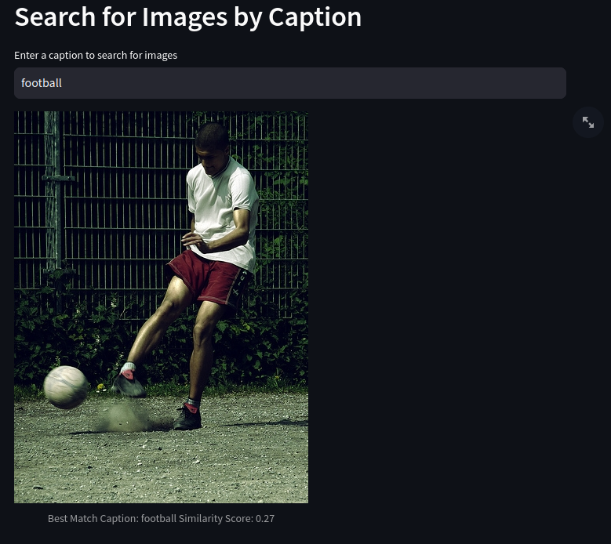
Results

Slide 9
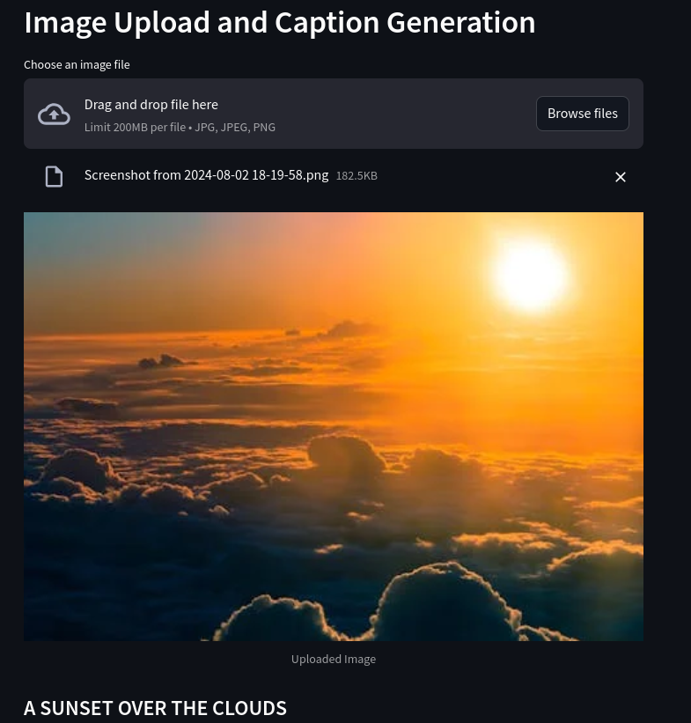
Results

Slide 10
Conclusion
The project showcases the effective use of pre-trained models for image search and caption generation. Despite facing some challenges, it delivers accurate and efficient results. Future improvements could include optimizing performance, managing larger datasets, and enhancing the user interface for better accessibility.

