Slide 1

Project 1
Course : Applied Computational Intelligence
Instructor name: Dr Ken Ferens
Student name: Mana Zandvakili
Student ID: 8034630
Department: Electrical and Computer Engineering

Slide 2
Simulation Result

Slide 3
Result Explanation
The logistic map equation is a simple model for population dynamics. For example, if we consider the current population of rabbits as L(n), and we want to predict the population growth for future years, we can multiply it by a growth factor r. However, the problem is that without any constraints, the population would grow exponentially. To address this, we introduce a constraint in the form of (1−L(n)), where L(n) represents the percentage of the theoretical maximum population. As the population approaches this maximum, the constraint term approaches zero.
Fixed behavior: For r = 2.5 (Fixed behavior) we can see that after sometimes the system converges to a single value. This means population stabilizes over time.
Periodic behavior: For r = 3.2 (Periodic behavior) we can see population oscillates between a few fixed values (here period 2 behavior). This means if the population increase one year the next year will decrease. This periodic behavior typically happen when r increases but not a lot that a system shows a chaotic behavior.
Chaotic behavior: For r = 4 (Chaotic behavior) the systems become chaotic and a very small change in initial value will have a really huge impact on outcomes. This is one of the first methods of generating random numbers on computers ( a way to get something unpredictable from a deterministic machine).
Bifurcation Diagram: This is a summary of the long-term behavior of logistic map. Starting from fixed behavior and as r increases the system has a period doubling bifurcation (period 2, 4, 8, 16, 32, …). After that the system becomes chaotic but sometimes it shows some periodic behavior and once again chaos!

Slide 4
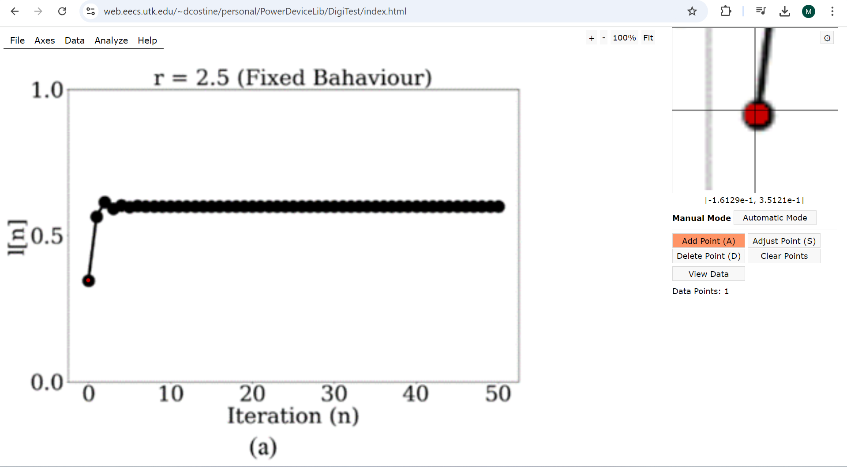
Code Explanation
Line 2: Based on the images provided in the project PowerPoint file, the number of iterations for the simulations is 50.
Line 3: For the initial value of initial0, since it wasn’t clearly defined in the PowerPoint file, I used image digitizer software to determine the exact initial condition. This was particularly important because the chaotic behavior is highly sensitive to the initial conditions, so I wanted to ensure the value matched that of the project file.
approximately = 0.35

Slide 5
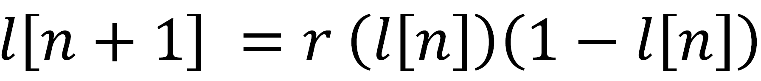
Code Explanation
Line 4: For the project, we consider the bifurcation values to be 2.5, 3.2 and 4.
Line 5: I used linspace to generate a linearly spaced vector with 1000 evenly spaced samples in this range. I chose 1000 samples to match the bifurcation diagram points exactly with those in the project file, though we could consider using fewer or more samples if necessary.
Line 7 to 9: These lines are for storing values during the iterations of the simulation. I use the zeros function for this purpose which creates a 1x(n_iterations + 1) array of zeros. The reason behind the “n_iterations + 1” is that the arrays need to hold values for all iterations, starting from the initial value (0.35).
Line 10 to 12: These lines are for setting the initial value and start each plot from the first initial value which is 0.35.
Line 14 to 27: We have a “for” loop that iterates over each element in the bifurcation_values array. we have if-else if nested loops. Each loop for one of the bifurcation values and we implement this equation:

Slide 6
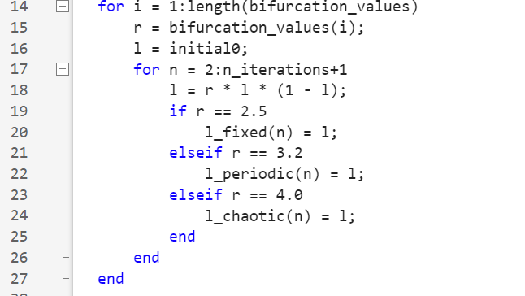
Code Explanation
Line 17:
The reason for start at n = 2:
The initial value has already been set outside the loop.

Slide 7
Code Explanation
Line 29 to 54: We set the figure and the location of each subplot. We:
Set the title (with title())
Set axis name for x and y axis (with xlabel() , ylabel())
Also, we use ylim for limiting y axis between 0 and 1.
Also, we use “Plot” instruction for plotting and the 'ko-’ means plotting in black color and plot a line (-) with circles (o).
The instruction “grid on” is for displaying the major grid lines for the current axes.
We do the same procedure for Figure (a), Figure (b) and Figure (c).

Slide 8
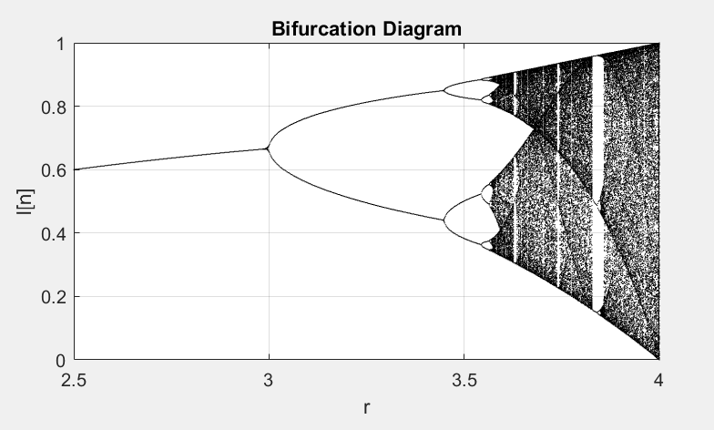
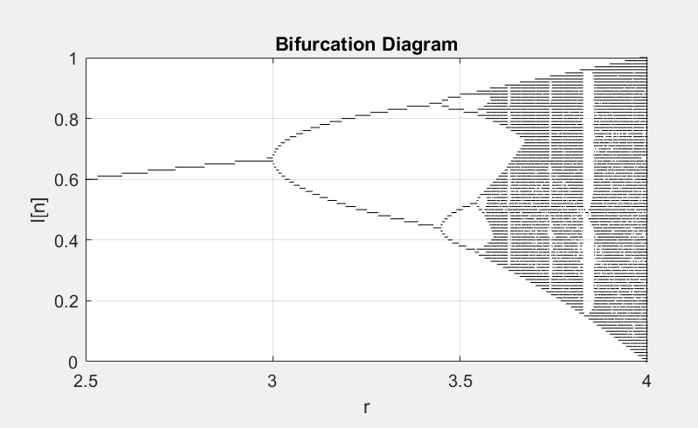
Code Explanation
For the Bifurcation Diagram I used different methods but by using the following method I found the most similarities between the image of bifurcation diagram in project file and my simulation.
Line 56: We need to determine a scale for level of rounding to a certain precision. It makes the chaotic values easier to compare. I choose 700 because it rounds the points and plot the figure clearly enough.
Comparing scale = 700 and scale = 100:

Slide 9
Code Explanation
Line 57 to 59: We set the plot to display the last 200 iterations because we are interested in the system's behavior after it has "settled down," ignoring the initial values. Additionally, we will run 500 iterations for each bifurcation value, with the initial value set to 0.35.
Line 61 to 70: First we create a list as data[], this will store the results of the logistic map for each bifurcation value. Then, we have an outer “for” loop over different bifurcation values, and an inner loop that run the logistic map over each bifurcation values.
Line 72 to 74: In these lines we will store the last 200 points, the reason for this is the system might stabilize after some time. By looking only at the last 200 points, we focus on what the system is doing after it has settled down. So, we will take these last 200 points and rounding them using scale and remove any duplicates because the same values might repeat. At the end we store them.
Line 75 to 85: These lines are for plotting; I won't go through it because it’s the same procedure as before.
Line 77: This line plots bifurcation values against the corresponding l(n) values. We divide by scale because we had scaled up the values earlier.

Slide 10
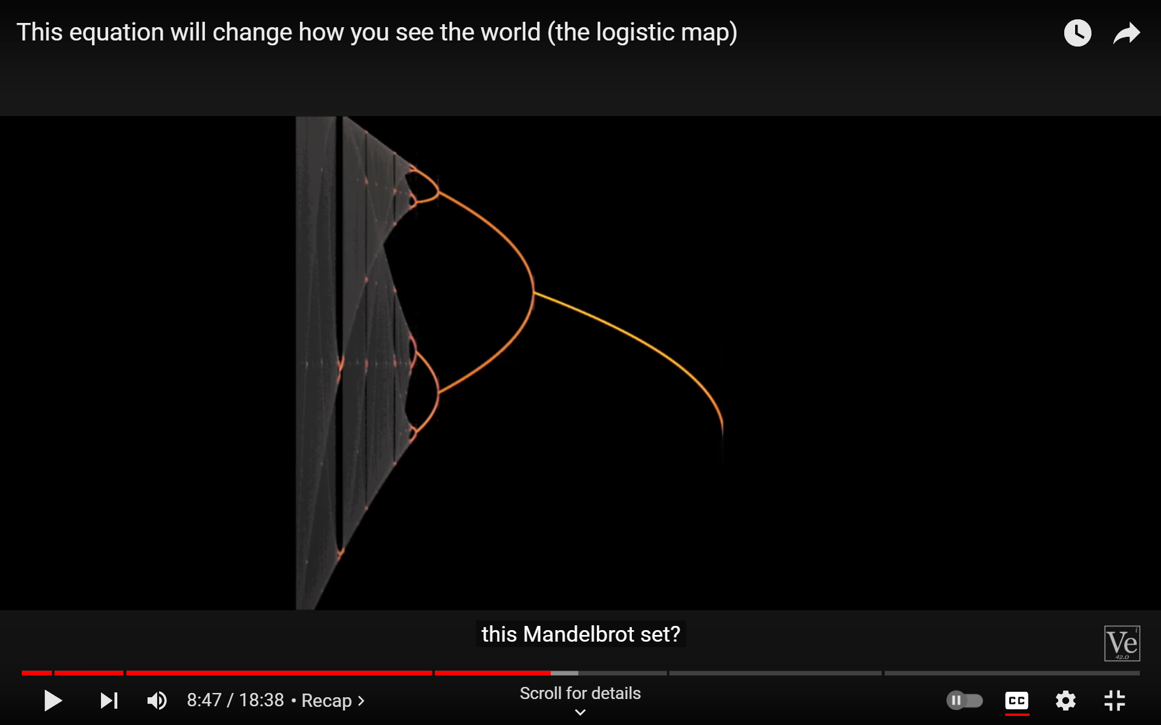
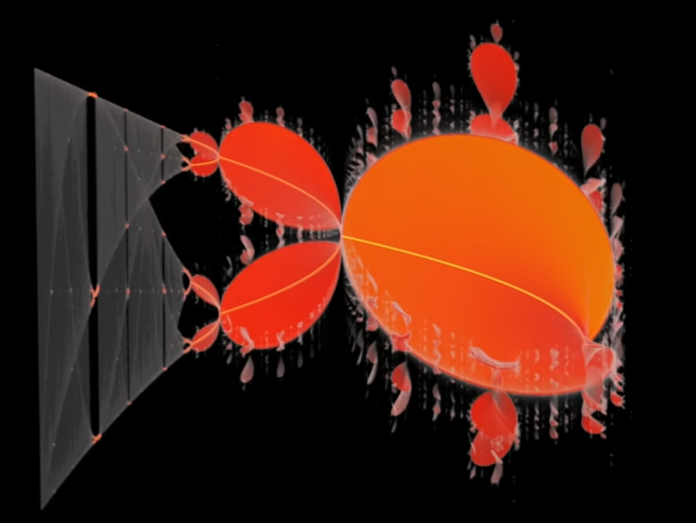
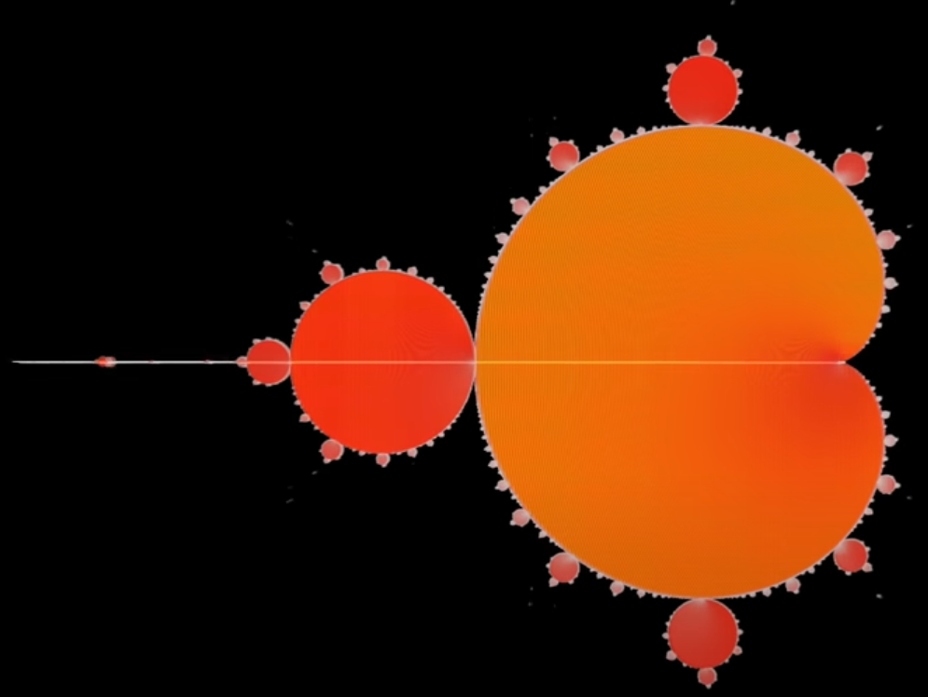
Special thanks to Dr. Ferens for this project. I really enjoyed working on it, especially because it introduced me to the logistic equation and its ability to explain many real-world phenomena, as well as its connection to the Mandelbrot set! ☺
Photo credit: https://www.youtube.com/watch?v=ovJcsL7vyrk

