Slide 1

Project 3
Course : Applied Computational Intelligence
Instructor name: Dr. Ken Ferens
Student name: Mana Zandvakili
Student ID: 8034630
Department: Electrical and Computer Engineering

Slide 2
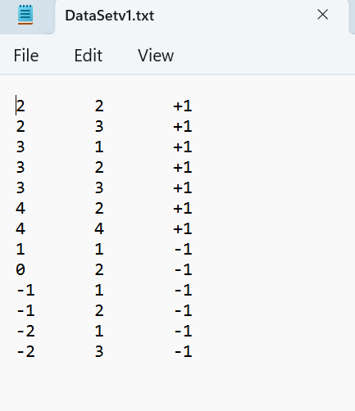
a) Given: training set DataSetv1.txt: Each training example (row) has two features and a class label (+1 or -1)

Slide 3
b) Using Matlab’s SVM library (fitcsvm), train an SVM (with no regularization) using the given (DataSetv1.txt) training data.
MATLAB code explanation:
First, we need to load the dataset into MATLAB.
% Load the dataset
data = load('Desktop/DataSetv1.txt');
Then, we define the features and targets within the dataset.
% Separate features and targets
features = data(:, 1:2);
targets = data(:, 3);
Next, we train an SVM model on the data using fitcsvm. This function offers various options, allowing us to set parameters based on the problem’s requirements.In this part, we first define the features and targets, then set the “BoxConstraint” parameter to Inf. This parameter specifies the regularization strength, and setting it to Inf disables regularization, resulting in a hard-margin SVM that maximizes the margin without allowing for any misclassification.Another parameter in fitcsvm is “KernelFunction,” which defines the kernel function used by the SVM. Setting this to “linear” specifies that a linear kernel is used, meaning the SVM will search for a linear decision boundary. Other available kernel functions include “rbf” for radial basis function kernels and “polynomial” for polynomial kernels.
% Train SVM with no regularization
SVMModel = fitcsvm(features, targets, 'BoxConstraint', Inf, 'KernelFunction', 'linear’);
Displaying the model’s details:
% Display the model details
disp(SVMModel);
MATLAB file name: svm1.m

Slide 4
c) Plot the decision boundary, support vectors, margin, and all training examples.
MATLAB code explanation:
Now, we first need to define the support vectors. In this case, the SVM model is an object, allowing us to access its various attributes. To define the support vectors, we need to access the support vectors attribute from the SVM model object. This is done using dot notation.
% Get support vectors from the model
supportVec = SVMModel.SupportVectors;
However, when I accessed this attribute to identify the support vectors automatically, it only detected two support vectors, as shown in the figure below.
MATLAB file name: svm2.m

Slide 5
However, we know that there should be four support vectors in this SVM model, as there are four vectors closest to the decision boundary. Therefore, in the following lines, I manually added these two missing support vectors.
%Define the specific point (0, 2), (3, 1) as support vectors if it’s not already included
pointToAdd = [0, 2];
if ~ismember(pointToAdd, supportVec, 'rows')
supportVec = [supportVec; pointToAdd];
end
pointToAdd = [3, 1];
if ~ismember(pointToAdd, supportVec, 'rows')
supportVec = [supportVec; pointToAdd];
end
Then, I plotted the dataset points, including the features and targets, and I displayed and plotted the support vectors.
% Plot data points
figure;
gscatter(features(:,1), features(:,2), targets, 'mb', '^+');
hold on;
% Plot support vectors
plot(supportVec(:,1), supportVec(:,2), 'ko', 'MarkerSize', 10);
The code checks if the point (0,2) and (3,1) is already in the supportVectors matrix. If not, it appends this point to the list of support vectors and then plots the entire figure.

Slide 6
After defining the support vectors, we need to define the margin and the decision boundary. For defining the decision boundry, the code defines a grid of points over the feature space to compute and plot the SVM decision boundary and margins. Then it retrieve the current x-axis and y-axis limits of the plot, respectively. “meshgrid” command generates a grid of points over the x and y ranges, which is needed to evaluate the SVM model’s decision function over the entire feature space.
% Define a grid of points to plot the decision boundary
xlim = get(gca, 'XLim');
ylim = get(gca, 'YLim');
[x, y] = meshgrid(linspace(xlim(1), xlim(2), 100), linspace(ylim(1), ylim(2), 100));
This grid of points, xy, allows the SVM model to calculate decision scores across the feature space, which are then used to first plot the decision boundary (where the decision score is 0) and then plot the margins (where the decision score is −1 and +1). Also “predict” evaluates the SVMModel on each point in xy, the grid of points generated earlier and based on the score indicates the distance of each point from the decision boundary. Positive values mean the point is classified as +1. Negative values mean the point is classified as -1 and a score of 0 indicates that the point lies exactly on the decision boundary.
xy = [x(:), y(:)];
% Get the decision scores for each point in the grid
[~, score] = predict(SVMModel, xy);
The command reshape, reshapes this vector back into a 2-dimensional grid, and the “Contour” commends plot the decision boundary and margins based on their scores.
% Reshape the scores to match the grid and plot the decision boundary
scoreGrid = reshape(score(:, 2), size(x));
contour(x, y, scoreGrid, [0 0], 'k', 'LineWidth', 2); % Decision boundary
contour(x, y, scoreGrid, [-1 1], '--', 'LineWidth', 1); % Margins
In the last step, we set the labels and legends for the plot.
% Labels and legend
title('SVM Decision Boundary with Support Vectors and Margins');
xlabel('Feature 1');
ylabel('Feature 2');
legend({'Class +1', 'Class -1', 'Support Vectors'}, 'Location', 'best');
hold off;

Slide 7
Final result:
margin

Slide 8
d) Find the center of gravity (average) of the positive training examples and the center of gravity of the negative training examples. Find the midpoint of the line that joins them. Is this point on the decision boundary line you found in Step c?
MATLAB code explanation:
I completed this step using MATLAB, though it could also be done by hand. For this purpose, I loaded the dataset into MATLAB and separated the features and targets within the dataset. Then, I created the SVM model again using fitcsvm based on the description in part (b).
% Load the dataset
data = load('Downloads/DataSetv1.txt');
% Separate features and labels
features = data(:, 1:2);
targets = data(:, 3);
% Train SVM with no regularization
SVMModel = fitcsvm(features, targets, 'BoxConstraint', Inf, 'KernelFunction', 'linear’);
Next, we need to define the positive and negative training examples: the examples with a target of +1 are defined as positive examples, and those with a target of -1 as negative examples. Then, to find the center of gravity of the positive and negative training examples, I used the “mean” function, which averages the training examples to determine the center of gravity.
% Separate positive and negative examples
positiveExamples = features(targets == 1, :);
negativeExamples = features(targets == -1, :);
% Compute centroids of positive and negative examples
centroidPositive = mean(positiveExamples, 1);
centroidNegative = mean(negativeExamples, 1);
MATLAB file name: svm3.m

Slide 9
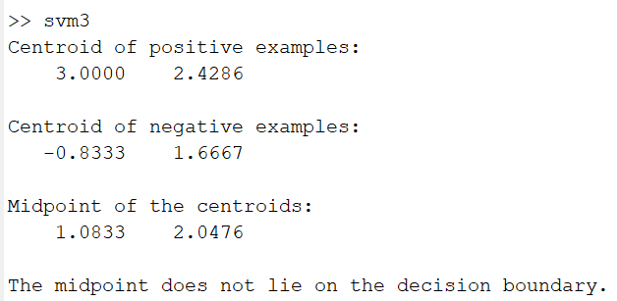
To compute the midpoint of the line joining the centroids, we use the following equation:
% Compute the midpoint of the line joining the centroids
midpoint = (centroidPositive + centroidNegative) / 2;
I display the calculated results for the centroid of the positive examples, the centroid of the negative examples, and the midpoint between the centroids.
% Display centroids and midpoint
disp('Centroid of positive examples:');
disp(centroidPositive);
disp('Centroid of negative examples:');
disp(centroidNegative);
disp('Midpoint of the centroids:');
disp(midpoint);
Results:

Slide 10
Then, I check if the midpoint lies on the decision boundary. I calculate this using the equation of a line, which is the decision boundary equation: 𝑤′∗𝑥+𝑏=0.
% Check if the midpoint is on the decision boundary
% The decision boundary equation: w'*x + b = 0
w = SVMModel.Beta; % Weight vector
b = SVMModel.Bias; % Bias term
decisionValue = dot(w, midpoint) + b;
Finally, in lines, I check and display whether the point is on the decision boundary line found in Step (c).
if abs(decisionValue) < 1e-6 % Close to zero, allowing a small tolerance
disp('The midpoint lies on the decision boundary.');
else
disp('The midpoint does not lie on the decision boundary.');
end
It will be seen that the midpoint does not lie on the decision boundary. We can also see this visually using the code in:

Slide 11
We can also see this results in the figure below:
MATLAB file name: svm9.m

Slide 12

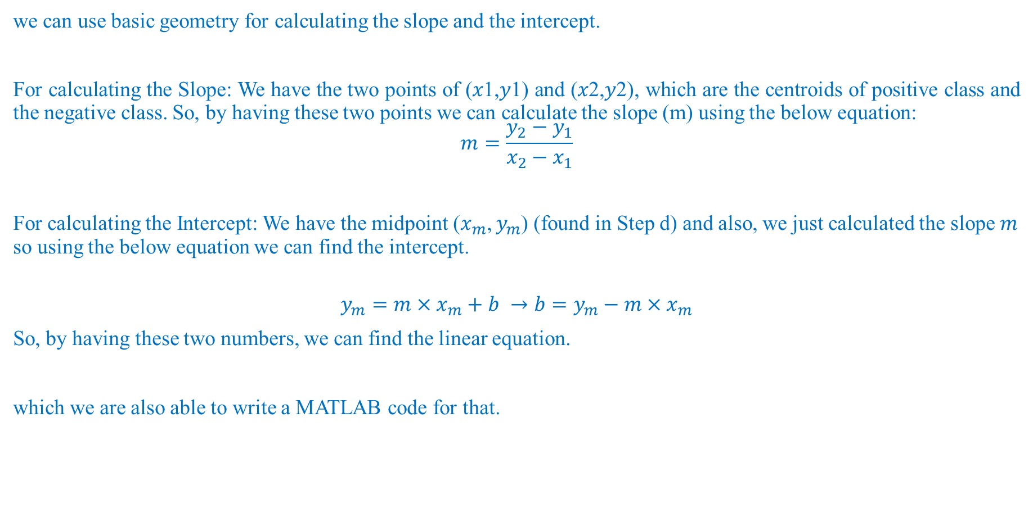
e) Suggest a method for finding the slope and intercept, given the midpoint of the line that joins the centers of gravity, as found in Step d?
we can use basic geometry for calculating the slope and the intercept.
For calculating the Slope: We have the two points of (𝑥1,𝑦1) and (𝑥2,𝑦2), which are the centroids of positive class and the negative class. So, by having these two points we can calculate the slope (m) using the below equation:
$$m=\frac{y_{2}−y_{1}}{x_{2}−x_{1}}$$
For calculating the Intercept: We have the midpoint ($x_{m}$, $y_{m}$) (found in Step d) and also, we just calculated the slope 𝑚 so using the below equation we can find the intercept.
$$y_{m}=m×x_{m}+b →b=y_{m}−m×x_{m}$$
So, by having these two numbers, we can find the linear equation.
which we are also able to write a MATLAB code for that.
MATLAB file name: svm4.m

Slide 13
f) Add 1000 positive training examples as follows: choosing the point clusterCenter = (40.0, 50.0) and generate 1000 neighbors by randomly permuting clusterCenter by +-2.0.
To add this 1000 new positive examples around (40.0, 50.0) we have to first load the original dataset.
% Load the original dataset
originalData = load('Downloads/DataSetv1.txt’);
Then we define the center of the cluster which is (40.0, 50.0) and also define the number of samples as 1000 which is the 1000 neighbors we want to create around the cluster center.
% Define the cluster center and number of new samples
clusterCenter = [40.0, 50.0];
numSamples = 1000;
To generate random variation in the range of [-2, 2] around the cluster center we will use the rand function. However, this function generates random numbers between [0, 1] so it needs an offset. By multiplying it by 4 and subtracting -2 we can get our desired range.
After that our new positive examples will be around the cluster center point and the random offsets.
% Generate random variations in the range [-2, 2] for each coordinate
randomOffsets = (rand(numSamples, 2) * 4) - 2; % Generates values in [-2, 2]
% Create new positive examples by adding the random offsets to the cluster center
newPositiveExamples = clusterCenter + randomOffsets;
Then we need to assign the target +1 to these new positive examples and combine new examples and target (+1).
% Assign label +1 to each of the new examples
newLabels = ones(numSamples, 1);
% Combine the new examples with targets
newData = [newPositiveExamples, newtargets];
At the end all we need to do is to add the new positive examples to the old positive examples and save it to a new text file named NewDataSetv1.txt.
% Append the new data to the original data
addedData = [originalData; newData];
% Save the new dataset to a new file
save('NewDataSetv1.txt', 'addedData', '-ascii');
MATLAB file name: svm5.m

Slide 14
g) Plot your new training set to verify you have created a cluster of positive training examples far away for the original cluster.
MATLAB code explanation:
We can easily plot these new data. We just need to load the new NewDataSetv1.txt file to MATLAB and then again separate the features from targets. Now, we can plot the old data and new data at the same time, and for better visualization, we can highlight the center of the cluster which is (40.0, 50.0).
% Load the augmented dataset
addedData = load('Desktop\NewDataSetv1.txt');
% Separate features and labels
features = addedData(:, 1:2);
labels = addedData(:, 3);
% Plot the original and new data points
figure;
gscatter(features(:,1), features(:,2), labels, 'rb', 'xo');
hold on;
% Highlight the new positive cluster center
plot(40, 50, 'ks', 'MarkerSize', 10, 'MarkerFaceColor', 'k'); % Cluster center
% Add labels and legend
title('Added Training Set');
xlabel('Feature 1');
ylabel('Feature 2');
legend({'Class +1', 'Class -1', 'Cluster Center (40, 50)'}, 'Location', 'best');
hold off;
MATLAB file name: svm6.m

Slide 15
Final result:

Slide 16
Zoomed picture of the cluster with center (40.0, 50.0):

Slide 17
h) Perform SVM (with no regularization) on this new training set, and compare the resulting decision boundary with that obtained by Step c. Are they the same? Explain why they are the same or why they are not the same.
I won’t go through the entire procedure of performing SVM without regularization on the new training set again, as the steps are like those already explained; the only difference here is the training set itself. In this step, we’ll plot the decision boundaries and margins for both the old and new data sets simultaneously. Since the decision boundaries and margins are identical in both cases, they will be shown on top of each other in the plot.
The reason that decision boundaries are the same is that.
Since we performed SVM without regularization, the algorithm only focuses on maximizing the margin between classes, using only the support vectors to define the decision boundary. So here we do not have any trade-off between margin maximization and error minimization on the training data. Also, when we don’t have any regularization we don’t allow any misclassification, and the decision boundary will primarily depend on the points closest to the boundary (support vectors), not on the distribution of points further from it.
In other words, we know that the decision boundary depends on the support vectors, and since by adding new data we don’t change the support vectors, the decision boundary doesn’t change either. As long as the support vectors remain the same, the decision boundary won’t change, even if we add more points far from the boundary.
MATLAB file name: svm7.m

Slide 18
Final result:

Slide 19
i) Do Step h again: this time perform SVM with a significant amount of regularization. Explain.
In this question, we want to perform SVM (with hard regularization) on this new training set and compare the resulting decision boundary with that obtained by Step c.
MATLAB code explanation:
First, we need to load the new dataset into MATLAB and separate the features from the targets in this dataset. Then, to apply regularization, we use the fitcsvm function again, but this time, we set the 'BoxConstraint' parameter to 0.0000001 to ensure a significant amount of regularization. Then, we plot it to see the results.
% Load the added dataset
addedData = load('Desktop/NewDataSetv1.txt');
% Separate features and labels
features = addedData(:, 1:2);
targets = addedData(:, 3);
% Train SVM on the new dataset with regularization
newSVMModel = fitcsvm(features, targets, 'BoxConstraint', 0.0000001, 'KernelFunction', 'linear');
% Plot the added data
figure;
gscatter(features(:,1), features(:,2), targets, 'mb', '^+');
hold on;
Here, we highlight the center of the cluster just to make sure that it is visible and after that, we define the decision boundary and margins, for new data set. (This procedure is the same as the earlier parts).
MATLAB file name: svm8.m

Slide 20
% Highlight the new positive cluster center for reference
plot(40, 50, 'cs', 'MarkerSize', 10, 'MarkerFaceColor', 'c'); % Cluster center
% Plot the new decision boundary and margins
xlim = get(gca, 'XLim');
ylim = get(gca, 'YLim');
[x, y] = meshgrid(linspace(xlim(1), xlim(2), 100), linspace(ylim(1), ylim(2), 100));
xy = [x(:), y(:)];
% Get the decision scores for each point in the grid for the new model
[~, score] = predict(newSVMModel, xy);
scoreGrid = reshape(score(:, 2), size(x));
contour(x, y, scoreGrid, [0 0], 'b', 'LineWidth', 2); % New decision boundary
contour(x, y, scoreGrid, [-1 1], '--b', 'LineWidth', 1); % New margins
Here, we plot the decision boundary for the previous data set based on the calculation we did in step C.
%Plot the original decision boundary (if saved from Step c)
%Here we assume that `SVMModel` from Step c is already available in the workspace
[~, origScore] = predict(SVMModel, xy);
origScoreGrid = reshape(origScore(:, 2), size(x));
contour(x, y, origScoreGrid, [0 0], 'k', 'LineWidth', 2); % Original decision boundary
contour(x, y, origScoreGrid, [-1 1], '--k', 'LineWidth', 1); % Original margins

Slide 21
In the last part we only need to show the title, legends of the result plot.
% Labels and legend
title('Comparing of Decision Boundaries for Original and Added Datasets');
xlabel('Feature 1');
ylabel('Feature 2');
legend({'Class +1', 'Class -1', 'Cluster Center (40, 50)', 'New Decision Boundary', 'Original Decision Boundary'}, 'Location', 'best');
hold off;

Slide 22
Final result:

Slide 23
Explanation:
As you can see in the previous plot the decision boundary of the new data set (Blue line) with regularization is completely different from the decision boundary of the old data set (Black line).
The fact that these two decision boundaries are the same may have several reasons:
First, here we can see that increasing regularization would yield an increasing margin for the support vectors, at the cost of misclassifying the outlier training example. this is a better solution, since the support vectors would be farther away from the decision boundary, and noisy versions of those may still be properly classified, thus leading to improved generalization
Also, the incorrectly classified training example may be an outlier and should be ignored.
Second, if we find the support vectors for the new data set we can see that now these support vectors are different from the support vectors that we found it step c. Therefore, the decision boundary will be different too.

