Slide 1

Project 4
Course: Applied Computational Intelligence
Instructor name: Dr. Ken Ferens
Student name: Mana Zandvakili
Student ID: 8034630
Department: Electrical and Computer Engineering

Slide 2
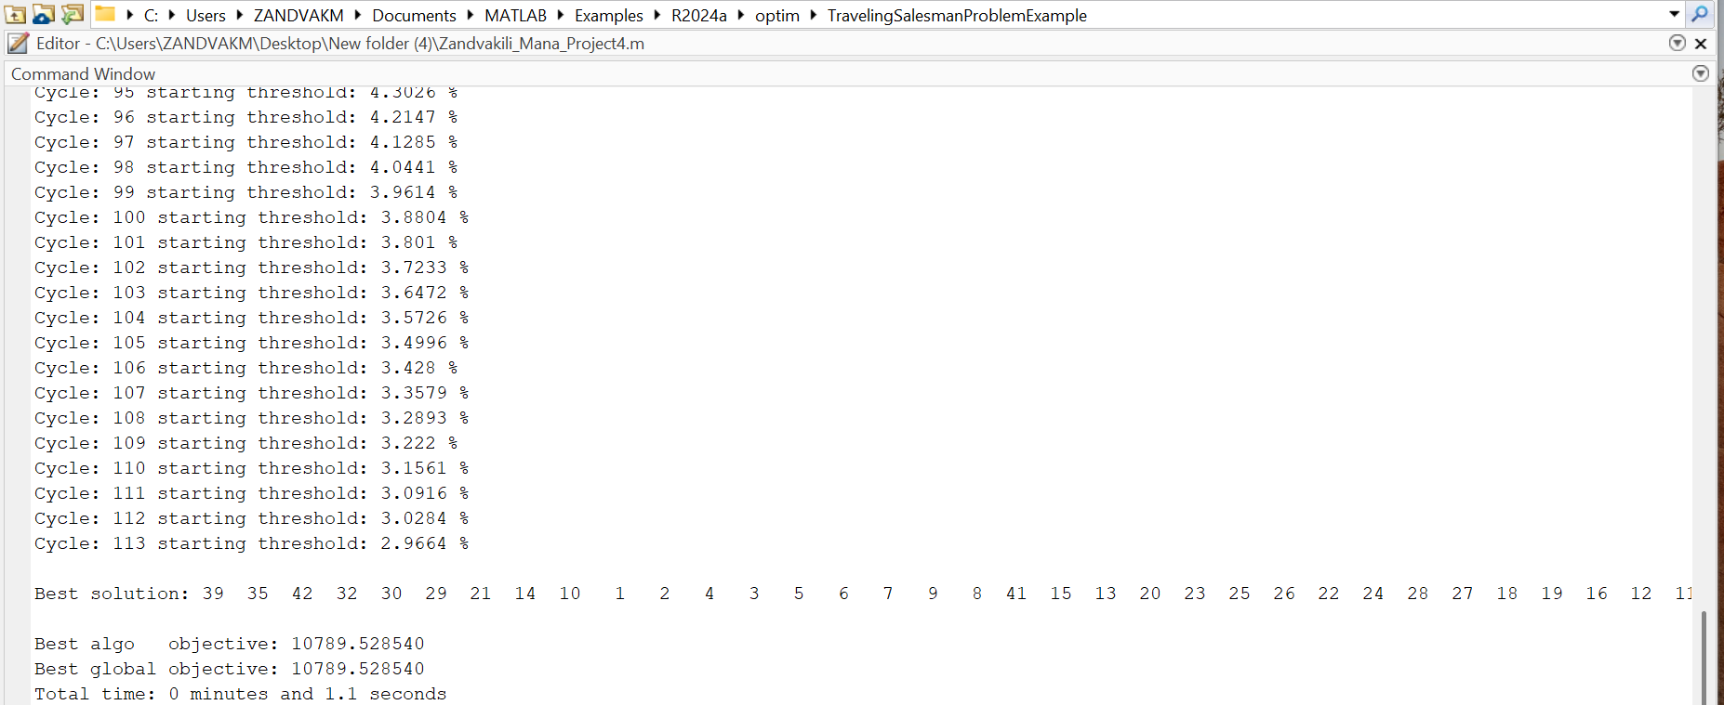
Lowest cost File name:Zandvakili_Mana_Project4.m
The lowest cost with the time taken to compute on my computer is as above:
Lowest Cost: 10789.528540
Total Time: 1.1 Seconds

Slide 3
Lowest cost route File name:Zandvakili_Mana_Project4.m

Slide 4
Explanation File name:Zandvakili_Mana_Project4.m
I made some important changes to the original code, and they had two big effects:
The computation time is now much faster.
The total distance the traveling salesman has to travel is shorter.
We go through each idea one by one:
First Idea: Change the way in which the initial route is created.
One way to make the initial route better is by using a smart strategy, like the Nearest Neighbor Algorithm. This approach helps build a more efficient starting point right from the beginning, setting the stage for better overall performance.
Here’s how I’d approach the initialization:
% Initializations
cityRoute_i = nearestNeighbor(cC, numCities); % Use for initial route
cityRoute_b = cityRoute_i;
cityRoute_o = cityRoute_i;
This idea is based on this paper: “Repetitive Nearest Neighbor Based Simulated Annealing Search Optimization Algorithm for
Traveling Salesman Problem” by Md. Azizur Rahman*, Hasan Parvez

Slide 5
Explanation File name:Zandvakili_Mana_Project4.m
This function is as follows:
function route = nearestNeighbor(cC, numCities)
visited = false(numCities, 1);
route = zeros(1, numCities);
route(1) = 1;
visited(1) = true;
for i = 2:numCities
lastCity = route(i - 1);
distances = pdist2(cC(lastCity, 2:3), cC(:, 2:3));
distances(visited) = inf;
[~, nextCity] = min(distances);
route(i) = nextCity;
visited(nextCity) = true;
end
The nearestNeighbor function is a simple way to plan a route for visiting a list of cities, always picking the closest unvisited city at each step.
We start by creating a list to track which cities we’ve already visited. Initially, no cities are marked as visited. Then, we create a list to store the order in which we’ll visit the cities. The first city is fixed as city 1 (the starting point). Starting from city 1, we calculate the distance to every other city. We ignore cities that we’ve already visited. Among the remaining cities, we pick the closest one and add it to the route. After choosing the next city, we mark it as visited so we won’t visit it again. This process continues until we’ve visited all the cities. Once the loop finishes, we have a complete route that visits each city exactly once, starting from city 1.

Slide 6
Explanation File name:Zandvakili_Mana_Project4.m
Second Idea: Create a different temperature schedule. This can include any change of the schedule.
In this part, I introduce a new temperature schedule. Here, instead of using probabilities to decide whether to keep or discard a solution, I switched to a more straightforward, deterministic approach. Now, in each equilibrium loop, a worse solution is always accepted if it’s only slightly worse than the current one. This "slightly worse" margin is controlled by a new parameter I introduced called threshold. The initial amount and the final amount for this threshold are picked based on trial and error. Early on, when the algorithm is still exploring, it accepts more of these "worse" solutions. Later, in the exploitation phase, it becomes much pickier.
% Parameters
numCoolingLoops = 500;
Threshold = zeros(numCoolingLoops, 1);
th1 = 0.3;
th2 = 0.00001;
thCurrent = th1;
This threshold decreases after each cooling cycle which is similar to the temperature. Here mul1 is the multiplier that reduces the threshold exponentially.
mul1 = nthroot(th2/th1, numCoolingLoops-1);

Slide 7
Explanation File name:Zandvakili_Mana_Project4.m
Also, instead on defining a fixed number of equilibrium loops. I considered that the number of equilibrium loops in each cooling cycle decreases exponentially. For this purpose, I introduced a new multiplier called mul2 based on the number of cooling cycles and user-defined starting and ending loops. This user-defined starting and ending loops numbers are also chosen based on trial and error. This helps us to have more equilibrium loops in the exploration phase and less equilibrium loops in the exploitation phase which is our desire.
loopStart = 10000;
loopEnd = 100;
mul2 = nthroot(loopEnd/loopStart, numCoolingLoops-1);
numEquilbriumLoops = loopStart;
DeltaE_avg = 0.0;
counter = 0;
This idea is based on this paper: "Threshold accepting: A general purpose optimization algorithm appearing superior to simulated annealing." Journal of computational physics 90.1 (1990): 161-175. By Dueck, Gunter, Tobias Scheuer

Slide 8
Explanation File name:Zandvakili_Mana_Project4.m
After that, we enter the Simulated Annealing loop
Third idea: Change the way in which the current route is perturbed in the Thermal Equilibrium Loop.
For this, I used the twoOptSwap function to make changes by swapping two cities in the route.
% Simulated Annealing Loop
for i = 1:numCoolingLoops
disp(['Cycle: ', num2str(i), ' starting threshold: ', num2str(thCurrent*100), ' %']);
numEquilbriumLoops = mul2 * numEquilbriumLoops;
for j = 1:numEquilbriumLoops
cityRoute_j = twoOptSwap(cityRoute_b); % Perturb the current route
This function is as follows:
function newRoute = twoOptSwap(route)
n = length(route);
i = randi(n - 1);
j = randi([i + 1, n]);
newRoute = route;
newRoute(i:j) = route(j:-1:i);
end
The twoOptSwap function is a way to tweak a route by reversing a part of it. This small change can help improve the overall route, especially in optimization problems like the Traveling Salesman Problem (TSP). What the function does is pick two random points in the route. The function picks two points, i and j, randomly along that route. These points define the start and end of a segment of the route. Then, the function takes the cities between i and j and flips their order. And finally, the original route stays the same, and the function gives back a new route with the reversed segment.
This idea is based on this paper: The noisy methods, A generalization of some metaheuristics. By Irene Charon, Oliver Hudry

Slide 9
Explanation File name:Zandvakili_Mana_Project4.m
Fourth idea: Employ the “restart” idea.
% Restart mechanism: Reset every 500 cycles
if mod(i, 500) == 0
cityRoute_b = cityRoute_o;
thCurrent = th1; % Reset the threshold (restart cooling)
end
% Update threshold
thCurrent = mul1 * thCurrent;
% Check for convergence
if abs(D_b - D_o) / D_o < 0.0001
counter = counter + 1;
end
if counter == 100
break;
end
Threshold(i) = thCurrent;
cityRoute_o = cityRoute_b; % Update optimal route
D(i+1) = D_b; % Record the route distance
D_o = D_b; % Update optimal distance
end
The algorithm periodically "restarts" to avoid getting stuck in a bad solution. Every 500 iterations, the line mod(i, 500) == 0 checks if it’s time to restart. If the current iteration i is divisible by 500, the restart is triggered. The current best route (cityRoute_b) is reset to the original route (cityRoute_o). This gives the algorithm a fresh starting point. The "temperature" or threshold (thCurrent) is also reset to its starting value (th1). This helps the algorithm explore new possibilities again, much like reheating a system in Simulated Annealing.
This combination helps the algorithm strike a balance:The restart mechanism allows it to explore new possibilities if it gets stuck.The threshold update ensures it eventually settles down and focuses on finding the best solution.
This idea is based on these paper: 1) Simulated annealing with restart strategy for the blood pickup routing problem. By V F Yu1, T Iswari1,2,3, N M Normasari1,2, A M S Asih2 and H Ting4 2) Simulated Annealing with Restart Strategy for the Path Cover Problem with Time Windows By Vincent F. Yu 1,2 , Winarno 1,3, Achmad Maulidin 1, A. A. N. Perwira Redi 4 , Shih-Wei Lin 5,6,7,*
and Chao-Lung Yang 3) Optimization by simulated annealing: A preliminary computational study for the tsp. By CC Skiscim, BL Golden

Slide 10
Explanation File name:Zandvakili_Mana_Project4.m
Each of these ideas had an impact on the code:
The second idea improved the code's execution speed.
The first, third, and fourth ideas reduced the total distance the traveling salesperson needs to travel.
I will explain each of these in detail.
First Idea: The solution quality depends on the starting city. Starting from different cities can result in significantly different lengths. Also, a common improvement is to run NNA multiple times, starting from each city, and select the best route.
Second Idea: This new method has a big advantage: because the threshold stays constant during each equilibrium phase in a cooling cycle, the algorithm doesn’t have to calculate probabilities using the exponential function for every iteration. This makes the code run a lot faster.
Third Idea: By swapping segments, twoOptSwap removes unnecessary overlaps in the route and this results in a shorter overall distance, making the solution more efficient. Also, it helps the algorithm explore alternative paths and maybe escape local minima. Furthermore, TwoOptSwap makes small improvements to the route rather than huge changes which can be desirable for us.
Fourth Idea: In optimization algorithms like Simulated Annealing the search can get trapped in local minima, but by restarting, the algorithm escapes these traps and explores different parts of the solution space, which increases the possibility of finding a better route. Also, restarts "shake up" the search process, allowing the algorithm to consider entirely new possibilities (THE KICK). Furthermore, it can balance exploration and exploitation. This balance ensures that the algorithm doesn’t spend too much time refining a single suboptimal route.

Slide 11
Explanation File name:TSPwithSAandPSO_ManaZandvakili.m
Fifth idea: Employ the “PSO” idea.
After I reached to the most optimal solution, I applied PSO to my code too to see if it give me a better results or not. However I got the same result as before only in more time.
Here is how I used PSO:
PSO: Handles global exploration, where particles (candidate routes) explore the solution space to find promising regions.
SA: Refines each particle's route by locally optimizing it to escape local minima.
In this approach, each particle represents a potential solution (a route) and keeps track of its own best route (localBest) as well as the best route found by the entire swarm (globalBest). These best routes help guide the search for an optimal solution. At the start, the particles are randomly assigned routes, which are just shuffled lists of city indices. The "fitness" of each route is calculated based on the total distance it covers. As the algorithm runs, each particle undergoes local refinement through Simulated Annealing (SA), where small changes to the route are made (using a method called twoOptSwap). These changes are accepted if they improve the route, but there's a cooling process that makes the algorithm less likely to accept worse solutions over time.The improved routes from SA are then used in the PSO process, where the particles adjust their positions, moving closer to their local best route and the global best route. PSO’s mechanism of inertia (momentum), cognitive (individual experience), and social (shared knowledge) components drive this movement. This combination of PSO’s ability to explore the solution space and SA’s ability to fine-tune solutions locally allows the algorithm to find a balance between finding new solutions and refining existing ones.

Slide 12
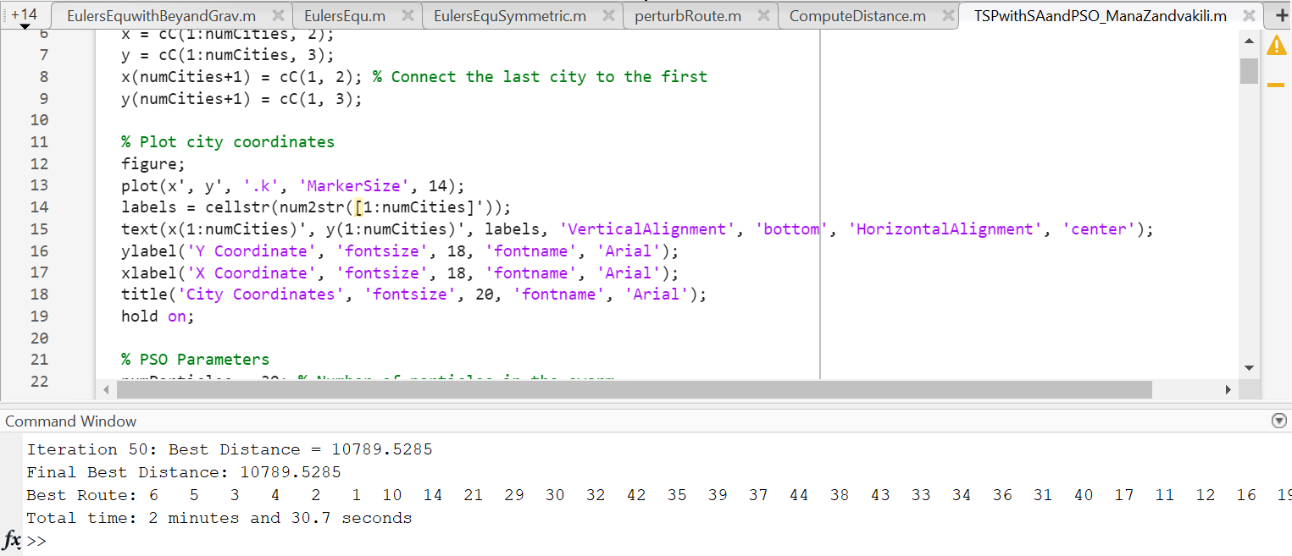
Explanation File name:TSPwithSAandPSO_ManaZandvakili.m
Results:
As you can see we got the same result as the last code but in more computation time.
Iteration 50: Best Distance = 10789.5285
Final Best Distance: 10789.5285
Best Route: 6 5 3 4 2 1 10 14 21 29 30 32 42 35 39 37 44 38 43 33 34 36 31 40 17 11 12 16 19 18 27 28 24 22 26 25 23 20 13 15 41 8 9 7
Total time: 2 minutes and 30.7 seconds

Slide 13
Result:
As you can see, we reached the optimal solution with both the PSO-based approach (File name: TSPwithSAandPSO_ManaZandvakili) and the one without PSO (File name: Zandvakili_Mana_Project4). However, since the version without PSO has significantly better computation time, I consider the first code (without PSO) to be the most optimal. However, PSO-based approach will always find the most optimal solution after 50 iterations but in the first code (without PSO) we don’t know how many times we have to run the code until we get the most optimal solution. So, it is safer to the PSO-based approach.

Slide 14
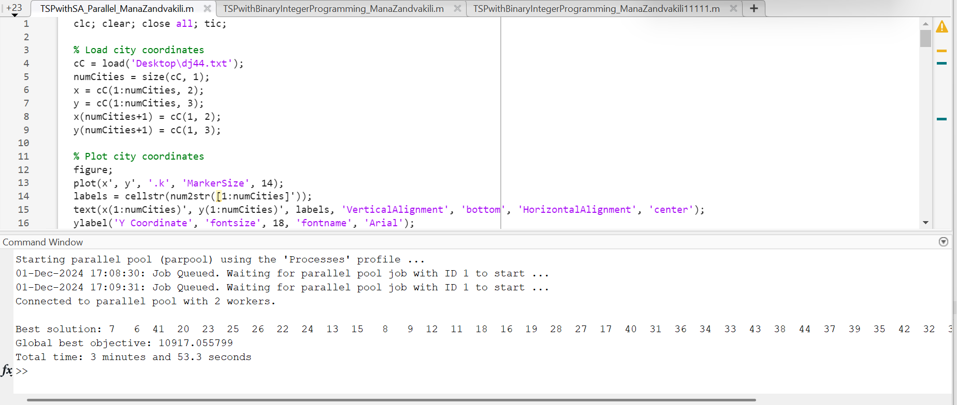
Explanation File name:TSPwithSA_Parallel_ManaZandvakili.m
I explored other approaches, such as "Employing multi-candidate search with (or without) communication between candidates“. However, this method did not provide better solutions or improvements. In fact, it worsened the final result, so I decided not to include them in my report.
For instance, here is the code I wrote for implementing multi-candidate search:

Slide 15
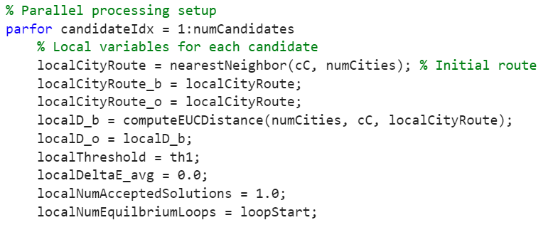
Explanation File name:TSPwithSA_Parallel_ManaZandvakili.m
I wrote this code using parfor function.
The parfor function in MATLAB is a tool I use to run loops in parallel, making the most of multiple processor cores or even a computer cluster. It’s part of MATLAB's Parallel Computing Toolbox and is great for speeding up tasks where each loop iteration can run independently.
Best solution: 7 6 41 20 23 25 26 22 24 13 15 8 9 12 11 18 16 19 28 27 17 40 31 36 34 33 43 38 44 37 39 35 42 32 30 29 21 14 10 1 2 4 3 5
Global best objective: 10917.055799
Total time: 3 minutes and 53.3 seconds
As you can see, it didn’t reduce the distance as effectively as the previous code and significantly increased computation time. Therefore, I decided not to use parallel processing in my code.

Slide 16
Why do I believe my results are the most optimal results
I solved this problem twice: once using the provided Simulated Annealing (SA) solution with some modifications, and once using binary integer programming to solve the classic Traveling Salesman Problem (TSP) (based on this MATLAB example). Both methods produced the same result.
The procedure for this involves the following steps: First, we solve the initial problem, which typically results in a solution containing subtours. Subtours mean the optimal solution doesn’t form a single continuous path through all the points but instead consists of several disconnected loops. To solve this, we use an iterative process where we identify the subtours, add constraints to eliminate them, and rerun the optimization until a valid solution with one continuous tour is achieved.
Problem Formulation
To formulate the Traveling Salesman Problem for integer linear programming, we follow these steps:
Generate all possible trips: This involves creating all distinct pairs of stops.
Calculate the distance: For each pair, we calculate the distance between the two stops.
Define the cost function: The goal is to minimize the total distance of the tour, which is the sum of the distances for each trip included in the final solution.
Define decision variables: These are binary variables associated with each trip. A value of 1 indicates that a trip is part of the tour, while a value of 0 indicates that it is not.
Include linear constraints: To ensure the solution includes every stop exactly once, we add a constraint that each stop must have exactly two trips associated with it—one arrival and one departure.
This iterative approach ensures that we ultimately find the optimal tour without any subtours, achieving a single, continuous path through all the stops.

Slide 17
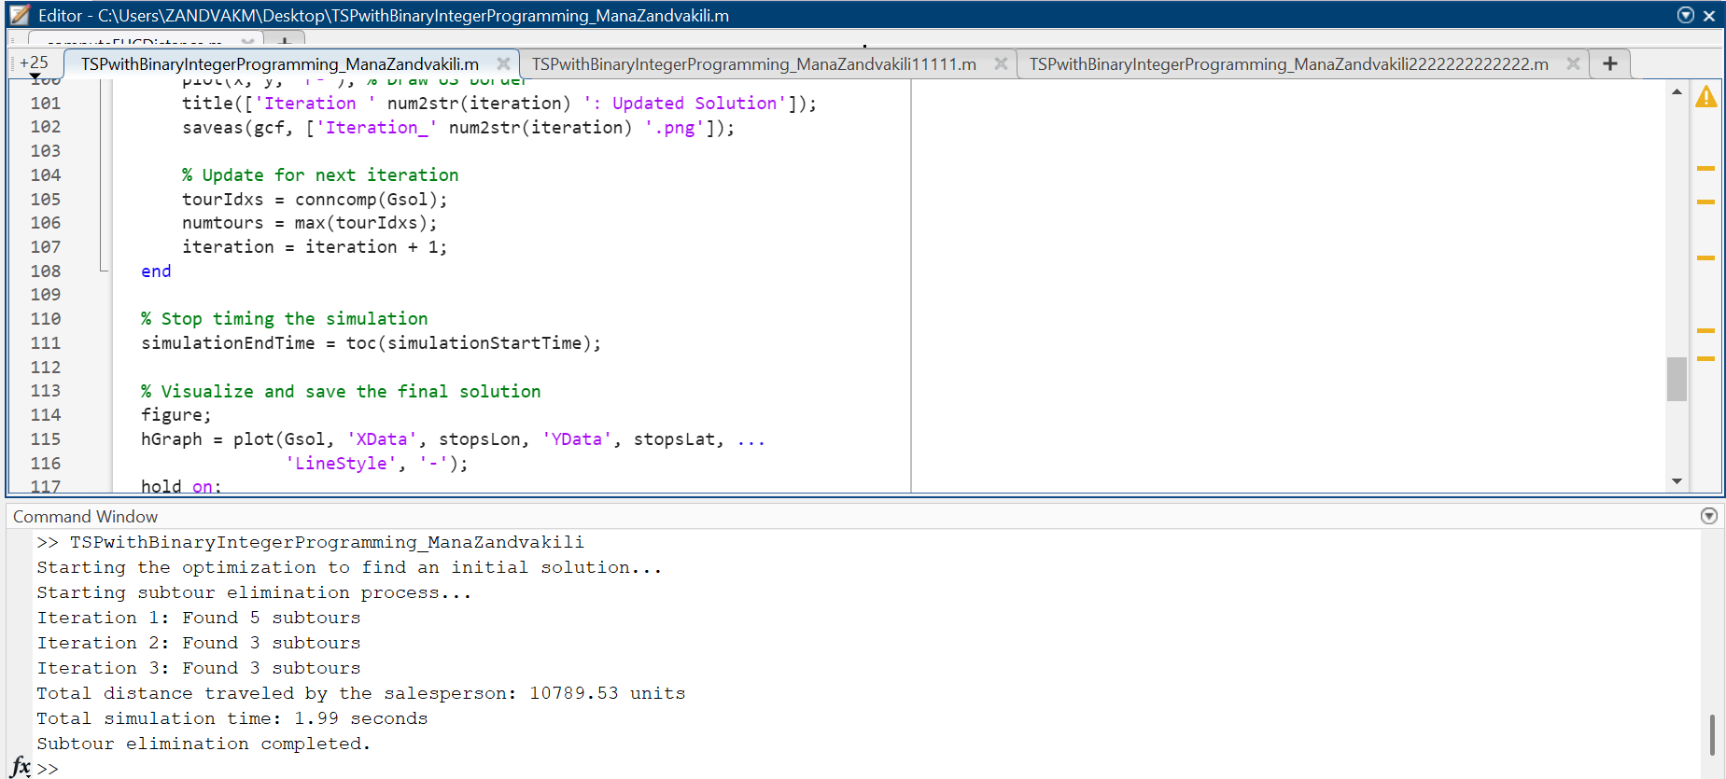
Travel Salesman Problem with Binary Integer Programming File name: TSPwithBinaryIntegerProgramming_ManaZandvakili.m
The lowest cost with the time taken to compute on my computer is as above:
Lowest Cost: 10789.53
Total Time: 1.99 Seconds

Slide 18
Travel Salesman Problem with Binary Integer Programming File name: TSPwithBinaryIntegerProgramming_ManaZandvakili.m

Slide 19
Travel Salesman Problem with Binary Integer Programming File name: TSPwithBinaryIntegerProgramming_ManaZandvakili.m

Slide 20
Travel Salesman Problem with Binary Integer Programming File name: TSPwithBinaryIntegerProgramming_ManaZandvakili.m
As you can see, solving the equation produced the exact same result as the Simulated Annealing (SA) solution. However, it required 0.89 seconds more time and took 3 iterations to converge.

