Slide 1

Chapter 15
Foundations of
Persuasive Speaking

Slide 2

Coercion and Persuasion Are Different
Perception of Choice
Coercion Persuasion
Threats Argument
Physical force Evidence
Blackmail Reasoning
Violence Emotion
Notes:
The difference between coercion and persuasion is a matter of degree regarding audience members’ perceived freedom of choice.

Slide 3
Attitudes and Behavior Are Not Always Consistent
Notes:
Discuss why attitudes and behavior are not always consistent.

Slide 4
Reasons for Attitude and Behavior Inconsistencies
Direct versus indirect experience
Social pressure
Effort required
Notes:
Click to animate each. See next several slides for elaboration.

Slide 5
Reasons for Attitude and Behavior Inconsistencies
Direct versus indirect experience
Notes:
This is a very graphic public service ad from the United Kingdom on texting and driving. It raises some important issues: (1) is this appeal a direct or indirect experience with texting and driving hazards? Remember that direct experience is more likely to produce consistency between attitude and behavior than indirect “second-hand” attitudes. (2) Is it too graphic to be effective?

Slide 6
Reasons for Attitude and Behavior Inconsistencies
2. Social pressure
Notes:
Binge drinking is influenced markedly by social pressure from peer groups.

Slide 7
Reasons for Attitude and Behavior Inconsistencies
Effort required
Notes:
This public service ad about recycling e-waste never provides specific, easy ways to dispose of e-waste. It documents that most people simply throw away used cell phones, etc. Why? Probably because it is easier than finding an e-waste recycling center. Discuss the effort required and ways to recycle.

Slide 8
Goals of Persuasion
Conversion: Radical persuasion
Modification: Do not ask for the moon
Maintenance: Keep them coming back
Notes:
Click to animate each goal. See next several slides for elaboration.

Slide 9
Conversion Is Extremely Difficult
Notes:
People rarely change their attitudes radically, especially when those attitudes are strongly held (e.g., abortion, organic food, nonviolence). Why?

Slide 10
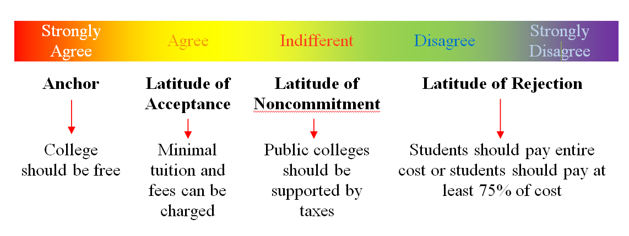
Why Conversion Is Extremely Difficult
Social Judgment Theory
Notes:
The social judgment theory explains why conversion is so challenging as a persuasion goal. The further the speaker’s position is from audience members’ anchor position, the less likely attitude and behavior change are likely to occur. This is especially true when audience members have high ego involvement with the issue presented.

Slide 11
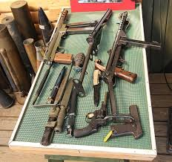
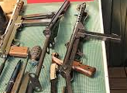
Modification Is Realistic Persuasion
Ban assault rifles
Ban ALL guns
Notes:
Banning all guns is an extreme position. Banning only assault weapons is a modification goal for persuasion.

Slide 12
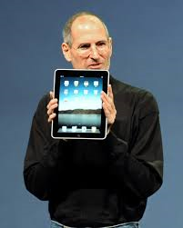
Maintenance Is Persuasion
Notes:
Preaching to the choir is maintenance persuasion. You are attempting to reinforce existing attitudes. Here, Steve Jobs is presenting a product to an audience of Apple “believers.”

Slide 13
Elaboration Likelihood Model
Two primary routes to persuasion:
Central route (skepticism): use of reasoning and evidence
Peripheral route: likeability, credibility, celebrity, physical attractiveness, body language cues

Slide 14
Elaboration Likelihood Model
Peripheral route: likeability, credibility, celebrity, physical attractiveness, body language cues
Notes:
Identify the peripheral cues of both speakers in this photo.

Slide 15
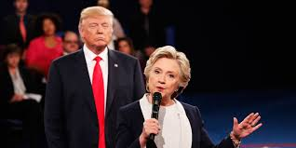
Elaboration Likelihood Model
Peripheral route: likeability, credibility, celebrity, physical attractiveness, body language cues
Notes:
Identify the peripheral cues of both speakers in this photo.

Slide 16
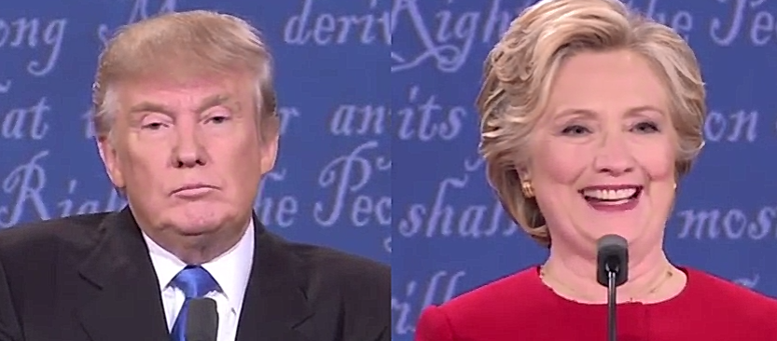
Elaboration Likelihood Model
Peripheral route: likeability, credibility, celebrity, physical attractiveness, body language cues
Notes:
Identify the peripheral cues of both speakers in this photo.

Slide 17
Elaboration Likelihood Model
Parallel processing: using both central and peripheral routes to persuasion
Notes:
This Australian anti-smoking ad uses both central and peripheral routes to persuasion—an award-winning ad and very clever!

Slide 18
Elaboration Likelihood Model
“The Great Debaters”
Notes:
This dramatized final rebuttal in the movie “The Great Debaters” is moving. Does it rely on the central route, peripheral route, or parallel processing? Discuss.

