Slide 1
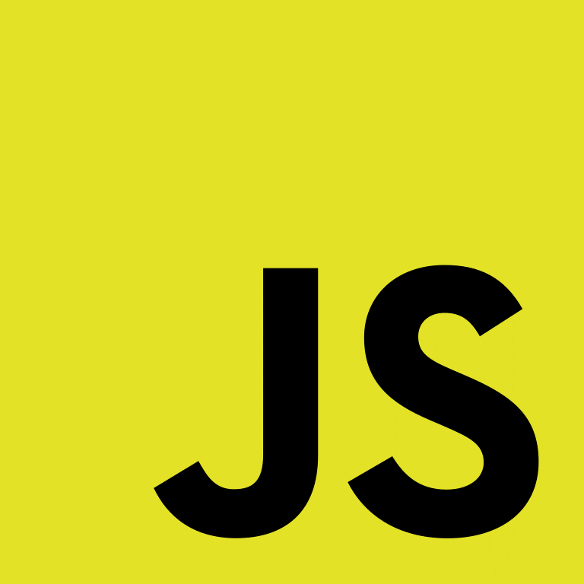
The Principles of Object-Oriented JavaScript
A brief summary prepared by: Manahill Ali

Slide 2
TABLE OF CONTENTS
01
02
03
04
What Are Types?
Primitive Types
Reference Types
Instantiating Built-in Types

Slide 3
TABLE OF CONTENTS
05
06
07
08
Property
Access
Identifying
Reference
Types
Identifying
Arrays
Primitive
Wrapper
Types

Slide 4
01
Primitive & Reference Types
You may simply write code and create data structures as needed with JavaScript.

Slide 5
What Are Types?
Reference Types
Primitive Types
Objects, that refers to locations in memory.
Simple data types.
Notes:
اهنى قبل ما نقول الأنواع بنقول شن معنى تايب أصلا تايب معناها نوع البيانات اللي في المشروع متعي أبسط مثال هي الأنواع intger , double, string…etc.

Slide 6
—Nicholas C. Zakas
“JavaScript tracks variables for a particular scope with a variable
object. Primitive values are stored directly on the variable
object, while reference values are placed as a pointer in the
variable object, which serves as a reference to a location in
memory where the object is stored.”

Slide 7
Primitive Types
True and 25 are examples of primitive types, which represent simple data that is kept as is.
Boolean.
Number.
String.
Null.
Undefined.
True | False
1 , 368 , 77.5
‘A’ , “Manahill”
null
undefined

Slide 8
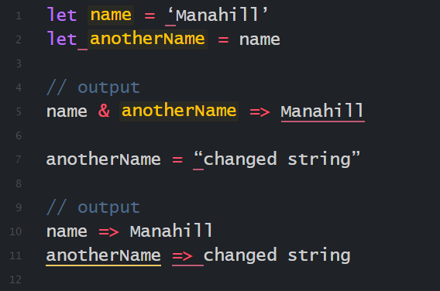
Let me make it more clear for you by an example:

Slide 9
Reference Types
In JavaScript, reference types represent objects. Reference values are similar to objects and are instances of reference types.
Reference types maintain a pointer (or reference) to the address in memory where the object exists, rather than storing the object directly in the variable to which it is allocated.
It's referred to as a method when the value of a property is a function. In JavaScript, functions are just reference values, therefore the only difference between an array and a function is that a function may be performed.
The significant difference between objects and primitive values is that the primitive is directly stored in the variable.

Slide 10
Reference Types
Creating Objects
Adding or Removing Properties
Use the new operator with a constructor.
At any moment, you can add or remove properties.
Dereferencing Objects
set the object variable to null.

Slide 11
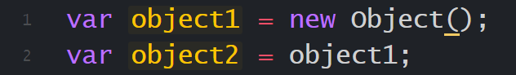
Creating Objects
Memory
Variable Object
• | object1
• | object2
Object

Slide 12
Reference Types
Creating Objects
Adding or Removing Properties
Use the new operator with a constructor.
At any moment, you can add or remove properties.
Dereferencing Objects
set the object variable to null.

Slide 13
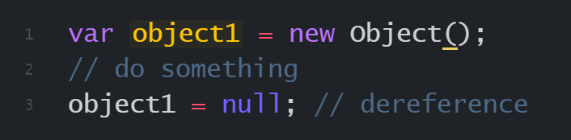
Dereferencing Objects
Dereferencing objects is especially important in very large applications that use millions of objects.

Slide 14
Reference Types
Creating Objects
Adding or Removing Properties
Use the new operator with a constructor.
At any moment, you can add or remove properties.
Dereferencing Objects
set the object variable to null.

Slide 15

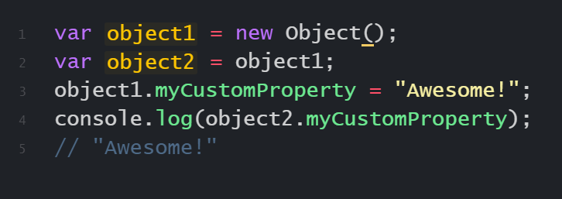
Adding or Removing Properties

Slide 16
Instantiating Built-in Types
Array
Date
Error
An ordered list of numerically indexed values
A date and time
A runtime error
Function
Object
RegExp
A function
A generic object
A regular expression

Slide 17
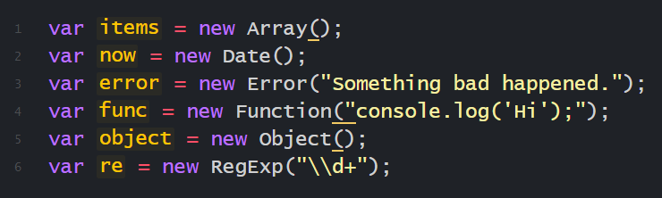
Each built-in reference type may be instantiated using new.

Slide 18
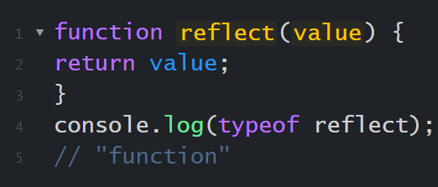

Identifying Reference Types
A function is the simplest reference type to identify since the typeof operator on a function should always return "function":

Slide 19
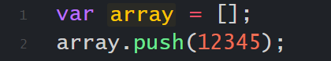
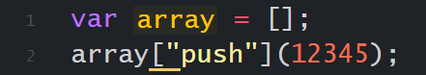
Property Access
access properties using Dot notation:
access properties using bracket notation:

Slide 20

Identifying Arrays
The method Array.isArray() determines whether or not a value is an instance of an Array, independent of its origin. When this function receives a value that is a native array from any context, it should return true.

Slide 21
Primitive Wrapper Types
String
Working with primitive values is as simple as working with objects due to these specific reference types.
Number
JavaScript creates primitive wrapper objects in the background so you may use primitives like regular objects, but the temporary objects are destroyed after the statement that uses them is finished.
Boolean

Slide 22
The End Any Question?

