Slide 1
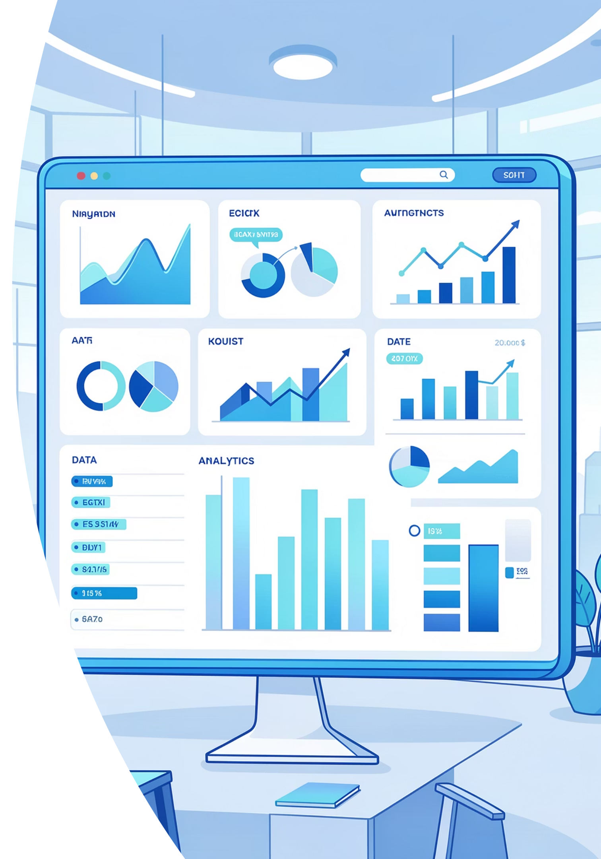
Customer Insights & Engagement Analysis
Examining 3,900 transactions to uncover spending trends, customer segments, and subscription patterns that drive smarter business decisions.

Slide 2
Dataset Overview
3,900
18
37
Total Transactions
Data Columns
Missing Values
Comprehensive purchase records analyzed
Rich feature set for deep analysis
Only in Review Rating column
Key features include customer demographics (Age, Gender, Location, Subscription Status), purchase details (Item, Category, Amount, Season, Size, Color), and shopping behavior (Discounts, Previous Purchases, Frequency, Review Rating, Shipping Type).

Slide 3

Data Preparation & Cleaning
01
Data Loading & Exploration
Imported dataset using pandas, checked structure with df.info() and summary statistics
02
Missing Data Handling
Imputed Review Rating nulls using median rating per product category
03
Feature Engineering
Created age_group bins and purchase_frequency_days from transaction data
04
Database Integration
Connected to PostgreSQL and loaded cleaned data for SQL analysis

Slide 4
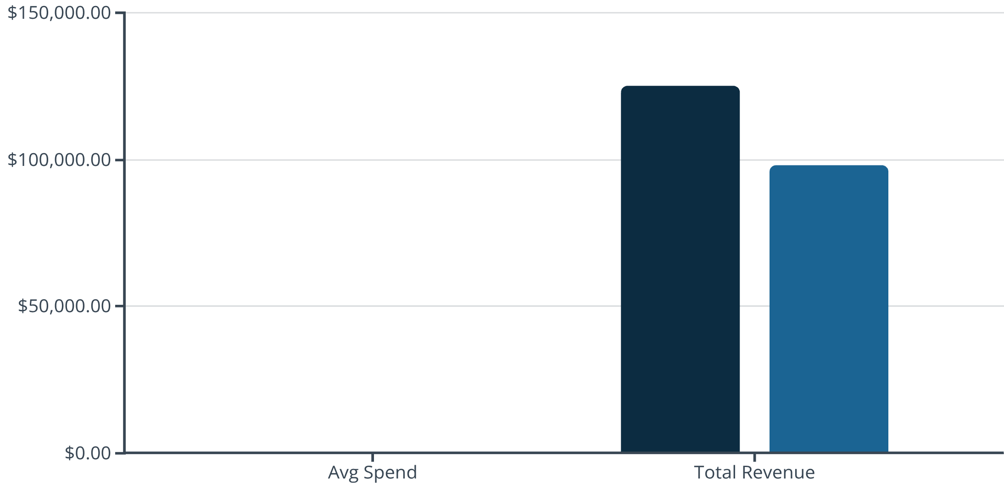
Revenue & Customer Spending Insights
Subscribers Drive Higher Value
Subscribers spend more per transaction and generate significantly higher total revenue. Express shipping users also show elevated purchase amounts compared to standard shipping.
Key Finding: High-spending customers often use discounts but still exceed average purchase amounts, indicating price sensitivity doesn't always mean lower value.
Subscribers
Non-Subscribers

Slide 5





Top-Rated Products
Blouse
Dress
Sweater
Handbag
Highest average rating across all categories
Strong customer satisfaction scores
Consistently positive reviews
Top-rated accessory item
Pants
High marks for fit and quality

Slide 6
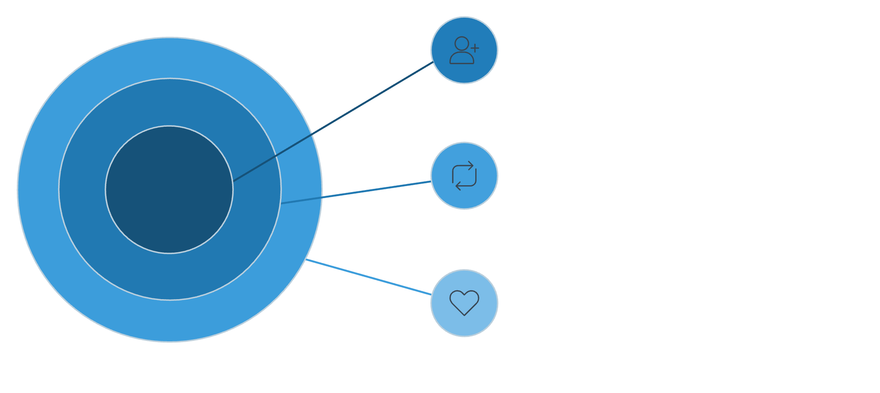



Customer Segmentation Analysis
New Customers
First-time buyers exploring the brand.
Building Customer Loyalty
Returning Customers
Customers with more than 5 purchases show significantly higher subscription rates, indicating strong correlation between repeat buying and subscription adoption.
2–5 purchases, growing trust.
Loyal Customers
5+ purchases, highest lifetime value.
New Customers
Returning Customers
Loyal Customers
First-time buyers exploring the brand
2-5 purchases showing growing trust
5+ purchases, highest lifetime value

Slide 7
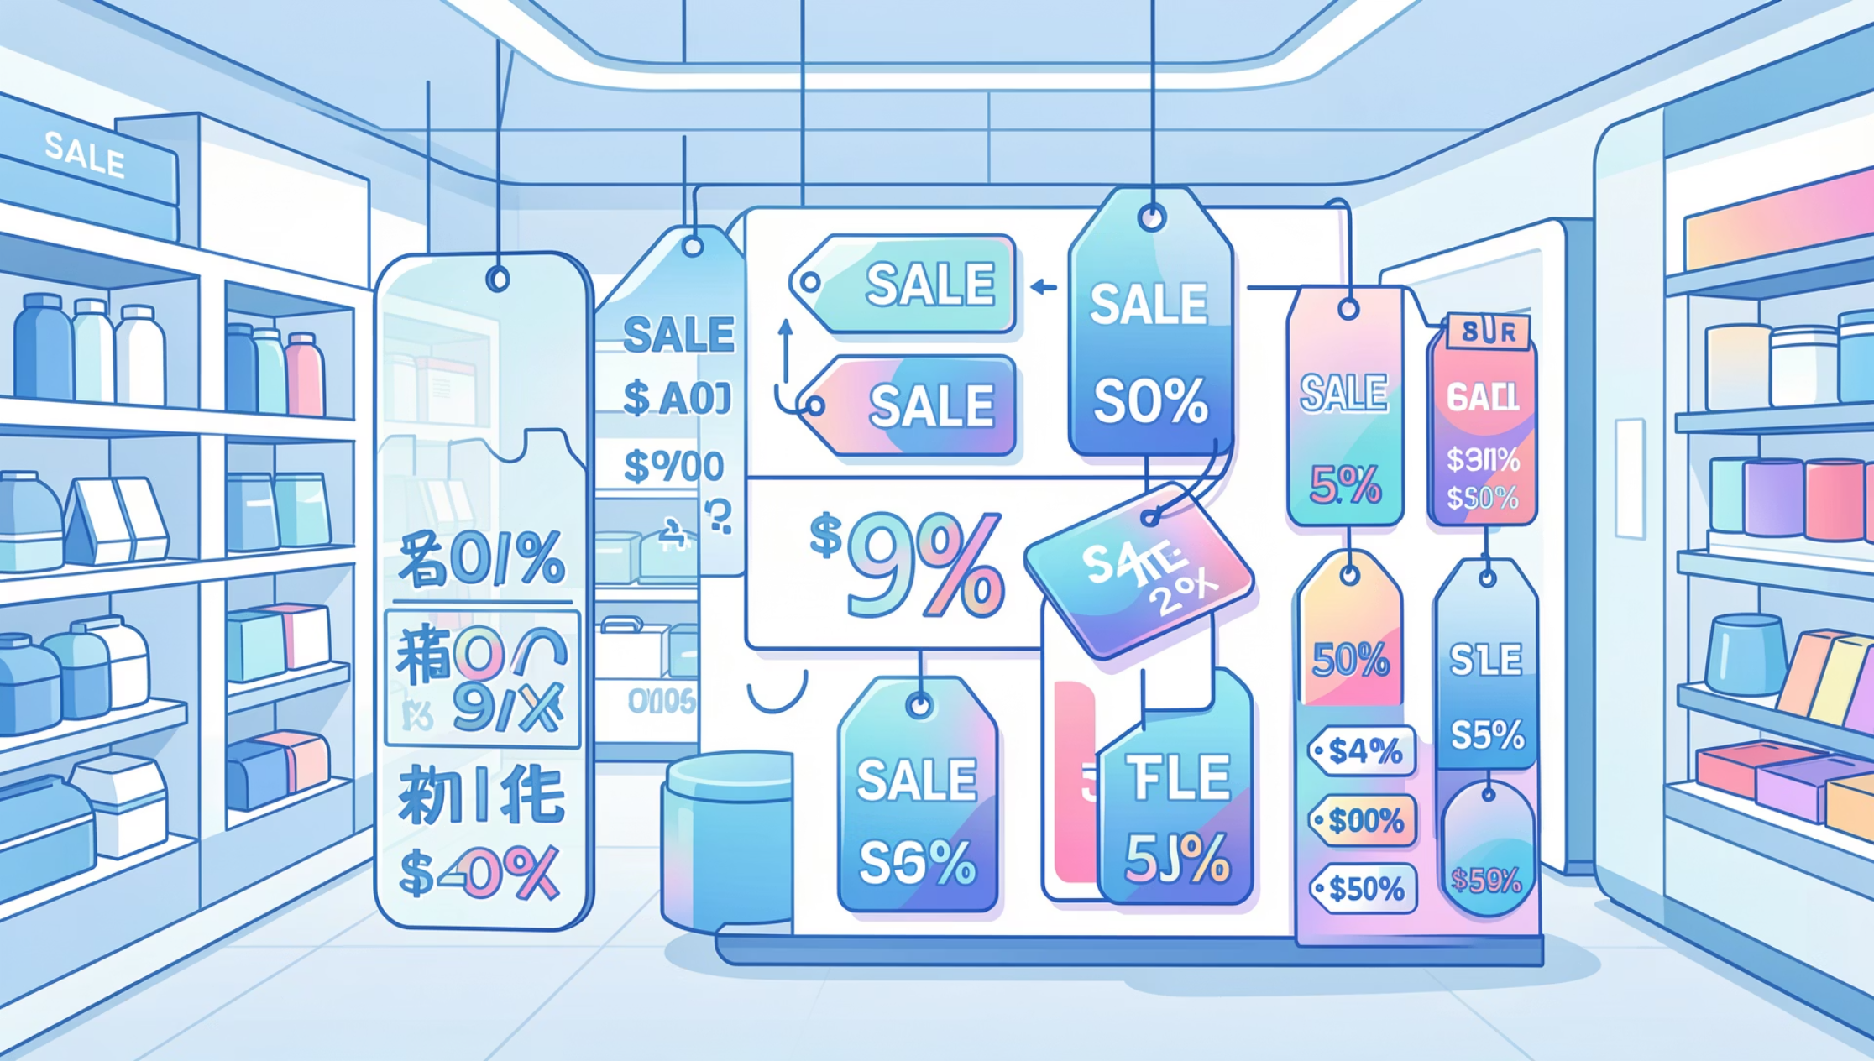

Discount-Dependent Products
Price Sensitivity Leaders
Five products show the highest percentage of discounted purchases, suggesting strong price sensitivity in these categories.
While discounts drive volume, analysis reveals many discount users still spend above average amounts—indicating opportunity to optimize pricing strategy without sacrificing revenue.
Strategic Insight: Balance promotional activity with margin protection by targeting discounts to specific customer segments rather than blanket offers.

Slide 8
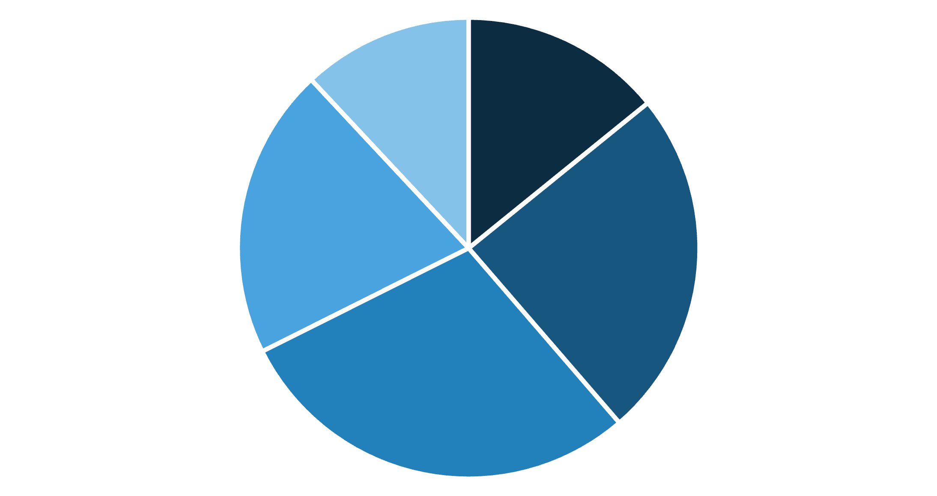
Revenue by Age Group
Age-Based Revenue Patterns
The 36-45 age group generates the highest revenue, followed closely by 26-35 year-olds. These two segments represent the core customer base.
Younger customers (18-25) show strong engagement but lower individual spend, while older segments (56+) contribute less overall volume.
18-25
26-35
36-45
46-55
56+

Slide 9




Power BI Dashboard
Built an interactive dashboard presenting all insights visually, enabling stakeholders to explore data dynamically and make informed decisions in real-time.
Visual Analytics
Dynamic Filtering
KPI Tracking
Interactive charts and graphs for trend analysis
Slice data by category, demographics, and time
Monitor key performance indicators at a glance

Slide 10
Strategic Recommendations
Boost Subscriptions
1
Promote exclusive benefits and perks to convert high-frequency buyers into subscribers
Customer Loyalty Programs
2
Reward repeat buyers to accelerate movement into the "Loyal" segment
Review Discount Policy
3
Balance promotional sales boosts with margin control through targeted offers
Product Positioning
4
Highlight top-rated and best-selling products in marketing campaigns
Targeted Marketing
5
Focus efforts on high-revenue age groups (26-45) and express-shipping users

